Slide 1
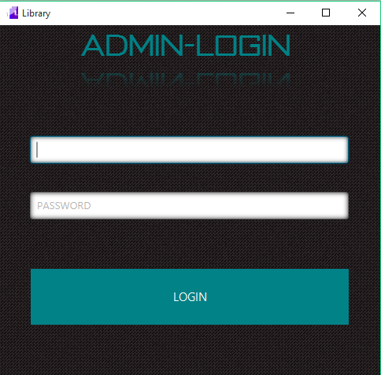
LOG-IN SCREEN

Slide 2
ON APPLICATION START
On Application start the Application Checks if It is the first time the the user is using the application. If it is the first time, it creates a default username and password of user and password respectively, which can be changes later on in the app. It also creates the storage ie database and tables.
-see next slide for codes involved

Slide 3
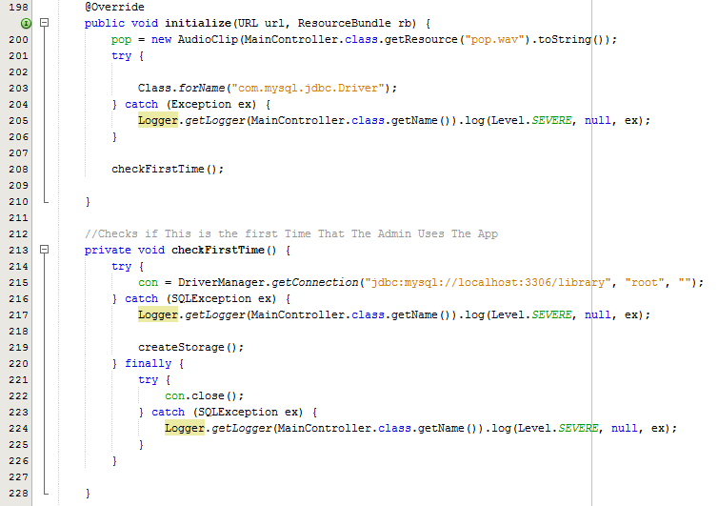

Slide 4
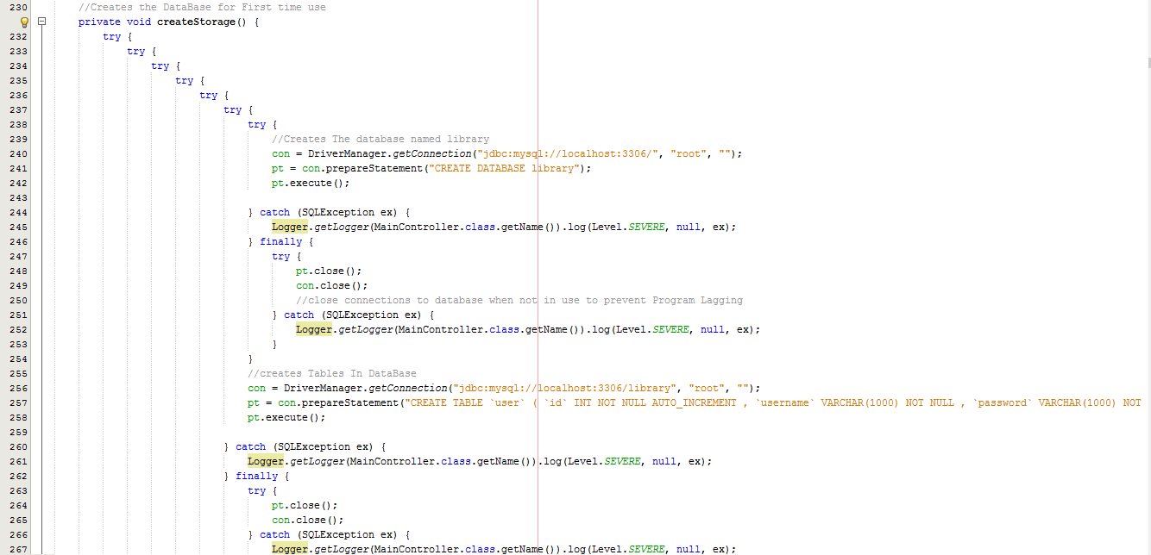

Slide 6
EXPlaINED
con stands for connection, which creates a database connection with the parameters of url(database link), username and password.
Pt stands for preparedStatement which is a mysql database statement or query in the applicable case
Pt.execute(); executed the database statement.
Rs stands for resultset. Result set holds the result from a databse query, ie rows and colums

Slide 7
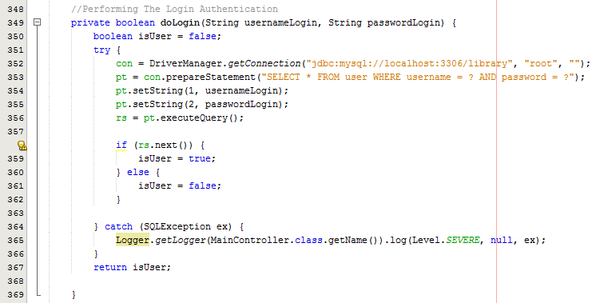
LOGIN-BUTTON

Slide 8
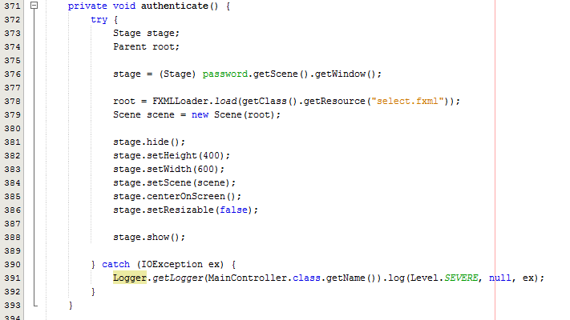
LOGIN-BuTTON
If the username and password is correct the user is taken to the next screen.

Slide 9
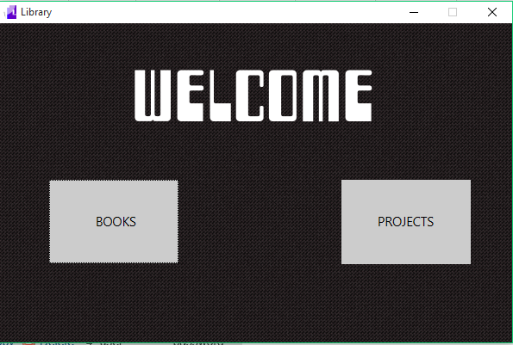
WELCOME SCREEN

Slide 10
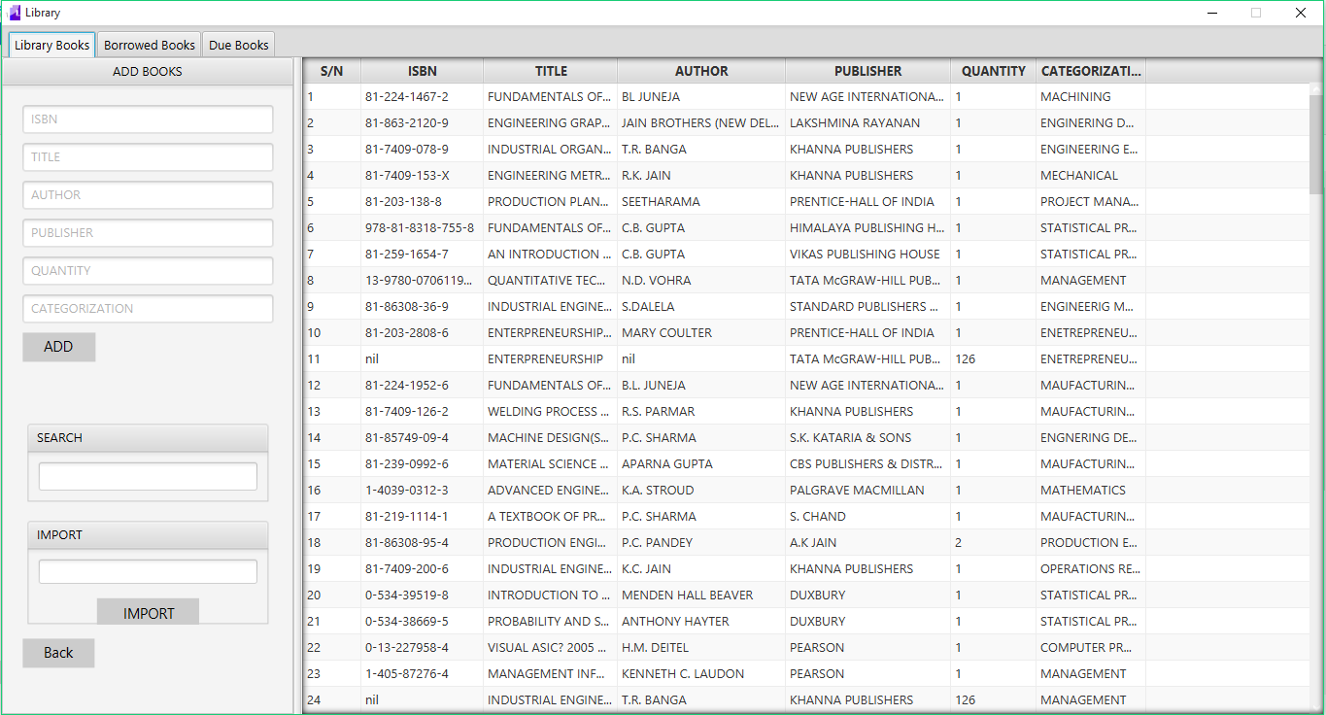

Slide 11
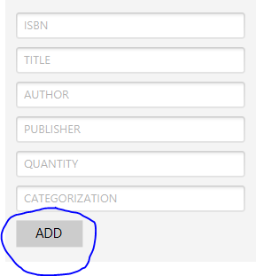
ADD BUTTON

Slide 12
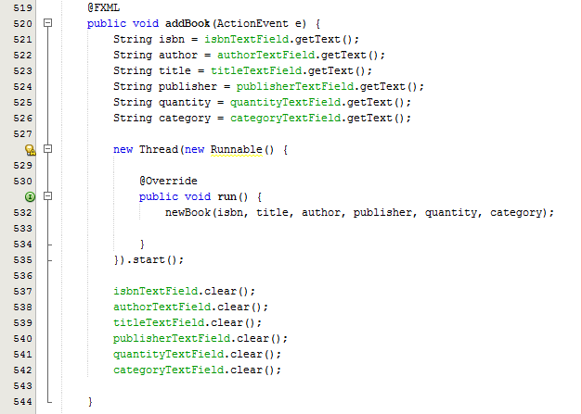

Slide 13
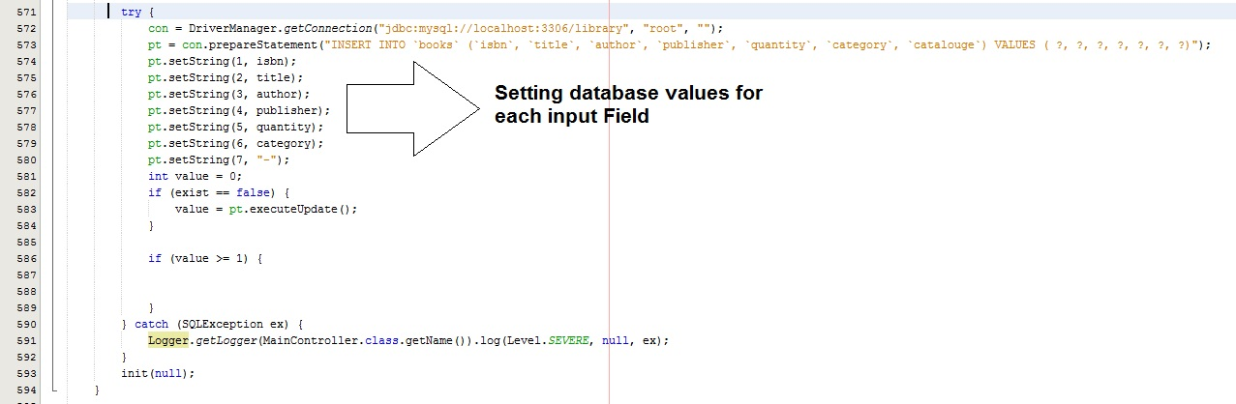

Slide 14
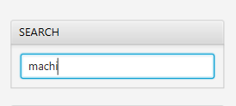
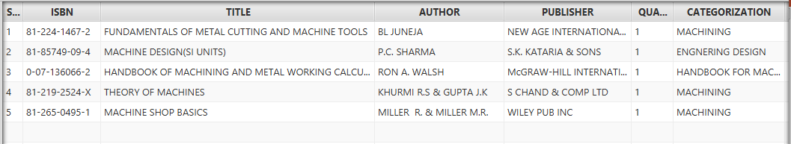
SEARCH TEXTFIELD
Filters the table as the user inputs into the textfield. See next slide for source code.

Slide 15
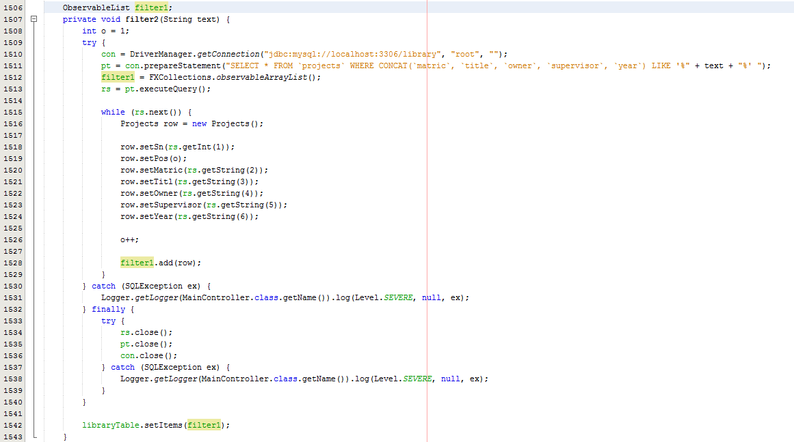

Slide 16
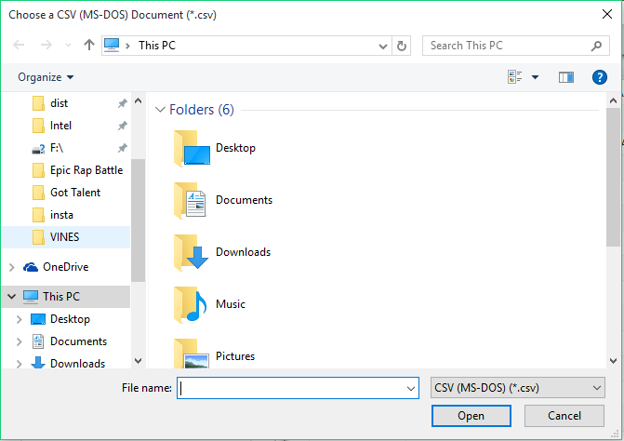
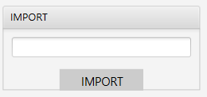
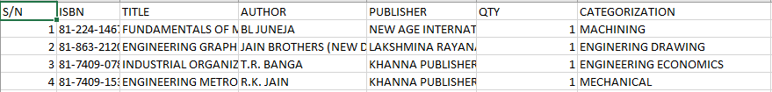
IMPORT-BUTTON

Slide 17
IMPORT FUCTION
A csv (comma delimited ) Excel file must be selected
The file must have the tables shown in the previous slide if not there will be an error in the importing
See source code in next slide

Slide 18
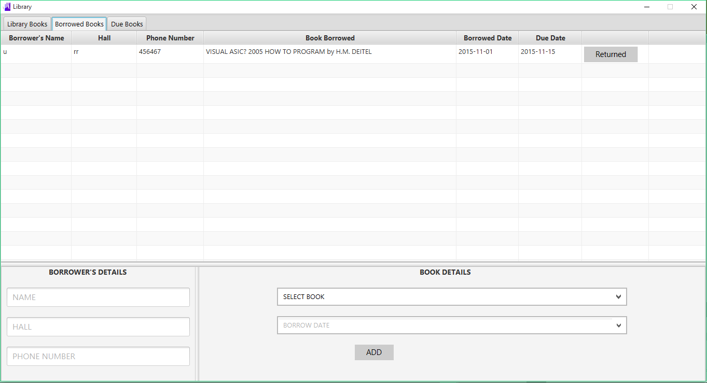
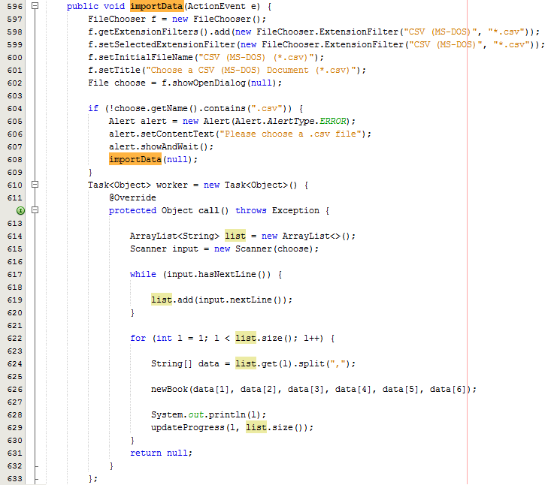

Slide 19
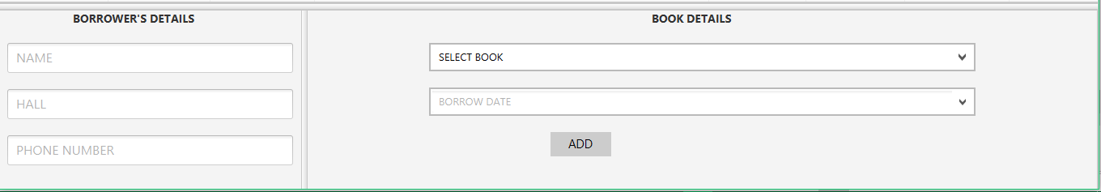
ADD BORROWERS
This section enables the user to keep track of Who Borrowed and what borrowed and the basic borrower details. A book can be borrowed for a maximum of 2 weeks . See source code on next slide.

Slide 20
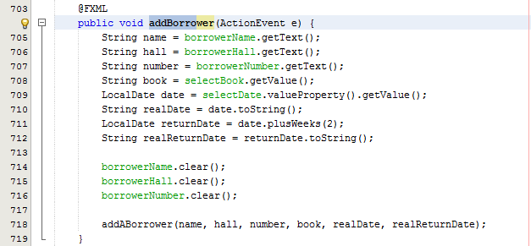

Slide 21
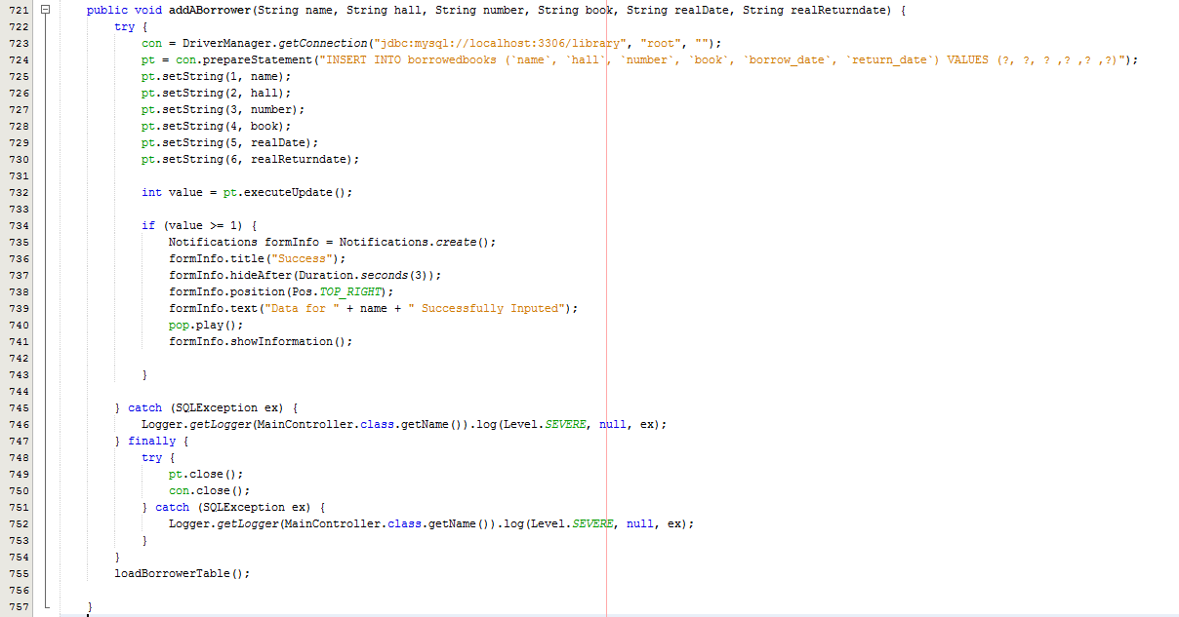

Slide 22
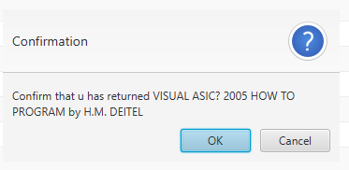
RETURN-BOOK

Slide 23
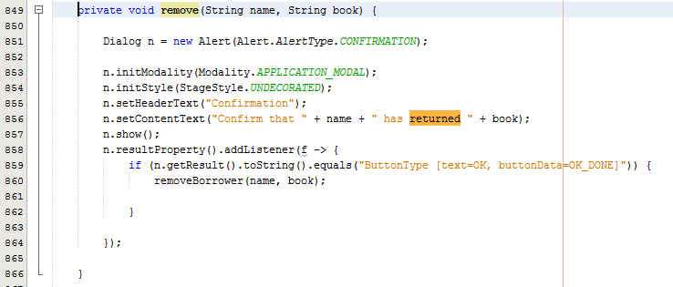

Slide 24
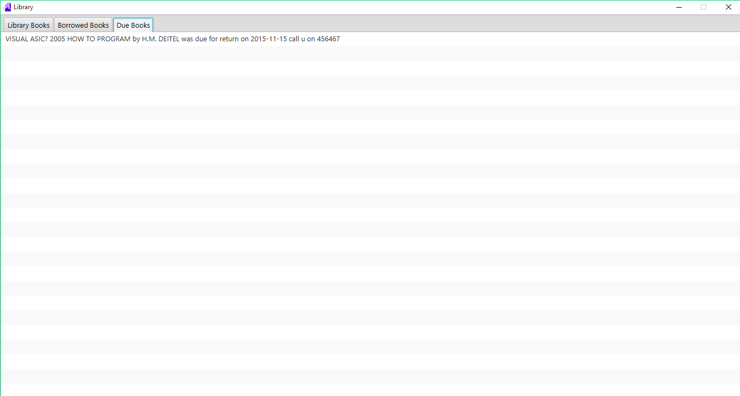
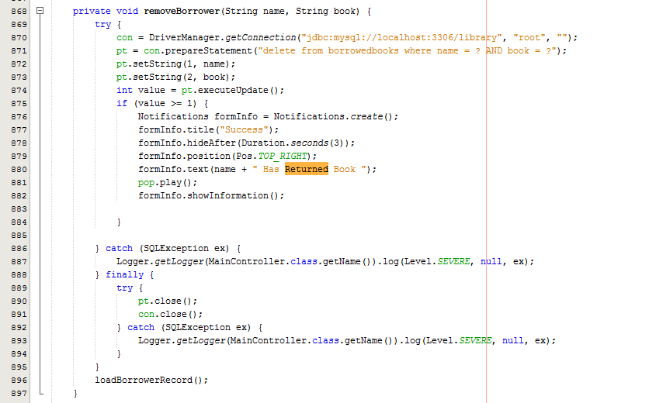

Slide 25
DUE BOOK LIST
If a book is not returned within the specified two weeks , it goes on the due book list
See source code in the next slide

Slide 26
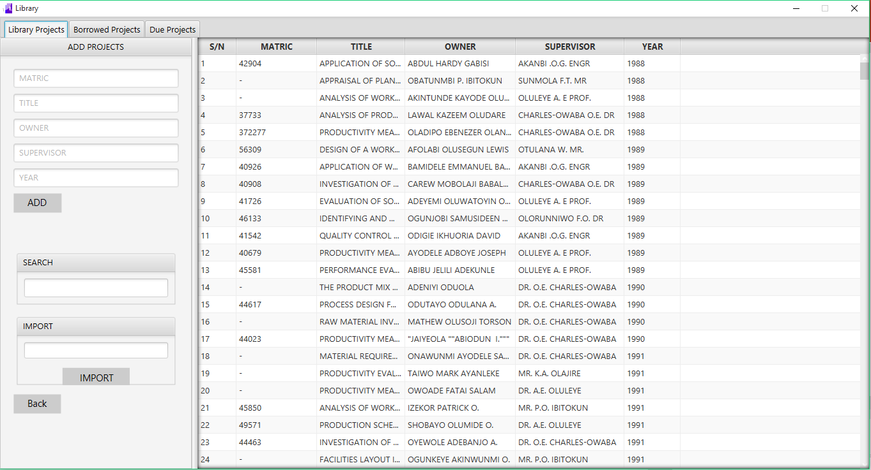
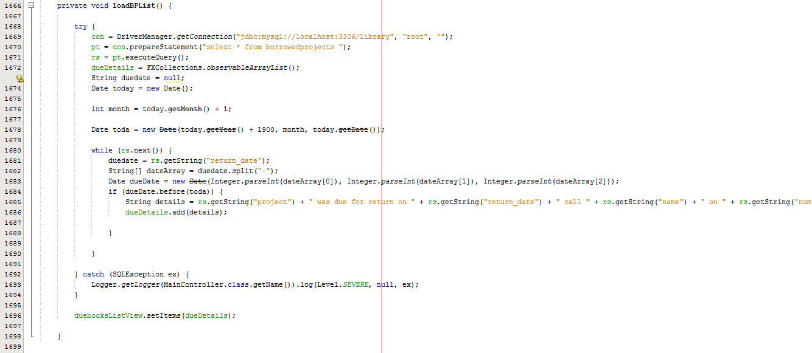

Slide 27
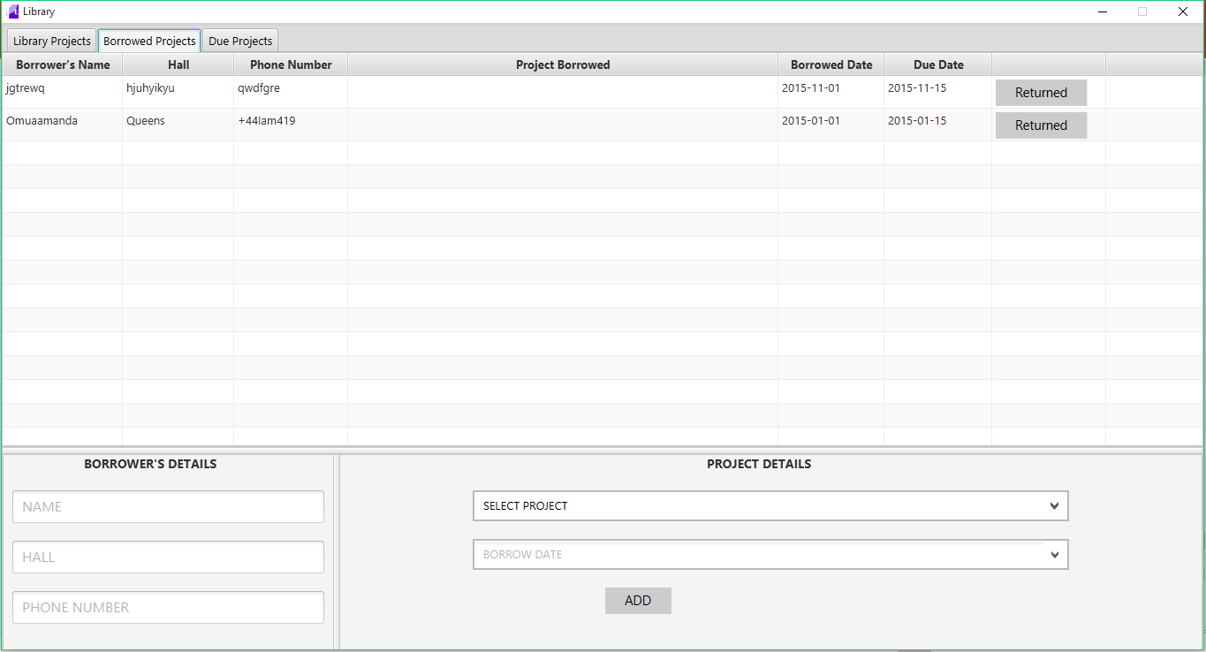

Slide 28
