Slide 1


Statistical Methods for Particle Physics
Lecture 1: introduction & statistical tests
https://indico.fnal.gov/conferenceTimeTable.py?confId=11505
Lectures on Statistics
HCPSS – Fermilab
11,12 August 2016
Glen Cowan
Physics Department
Royal Holloway, University of London
g.cowan@rhul.ac.uk
www.pp.rhul.ac.uk/~cowan
G. Cowan
HCPSS 2016 / Statistics Lecture 1
TexPoint fonts used in EMF.
Read the TexPoint manual before you delete this box.: AAAA

Slide 2
Outline
Lecture 1: Introduction and review of fundamentals
Probability, random variables, pdfs
Parameter estimation, maximum likelihood
Statistical tests for discovery and limits
Lecture 2: Further topics
Brief overview of multivariate methods
Nuisance parameters and systematic uncertainties
Experimental sensitivity
G. Cowan
HCPSS 2016 / Statistics Lecture 1

Slide 3
Some statistics books, papers, etc.
G. Cowan, Statistical Data Analysis, Clarendon, Oxford, 1998
R.J. Barlow, Statistics: A Guide to the Use of Statistical Methods in the Physical Sciences, Wiley, 1989
Ilya Narsky and Frank C. Porter, Statistical Analysis Techniques in Particle Physics, Wiley, 2014.
L. Lyons, Statistics for Nuclear and Particle Physics, CUP, 1986
F. James., Statistical and Computational Methods in Experimental Physics, 2nd ed., World Scientific, 2006
S. Brandt, Statistical and Computational Methods in Data Analysis, Springer, New York, 1998 (with program library on CD)
K.A. Olive et al. (Particle Data Group), Review of Particle Physics, Chin. Phys. C, 38, 090001 (2014); see also pdg.lbl.gov sections on probability, statistics, Monte Carlo
G. Cowan
HCPSS 2016 / Statistics Lecture 1

Slide 4

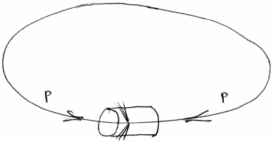
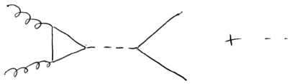


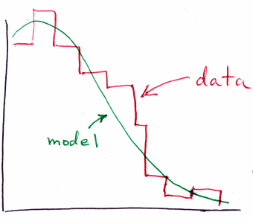
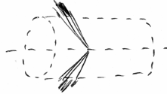

Theory ↔ Statistics ↔ Experiment
Theory (model, hypothesis):
Experiment:
+ data
selection
+ simulation
of detector
and cuts
G. Cowan
HCPSS 2016 / Statistics Lecture 1

Slide 5
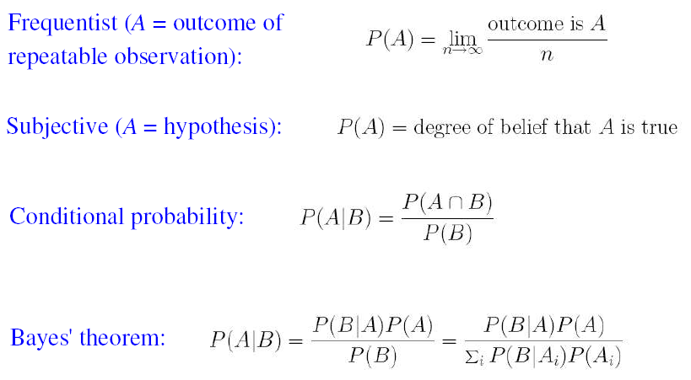
Quick review of probablility
G. Cowan
HCPSS 2016 / Statistics Lecture 1

Slide 6

Frequentist Statistics − general philosophy
In frequentist statistics, probabilities are associated only with
the data, i.e., outcomes of repeatable observations (shorthand: ).
Probability = limiting frequency
Probabilities such as
P (Higgs boson exists),
P (0.117 < α_{s} < 0.121),
etc. are either 0 or 1, but we don’t know which.
The tools of frequentist statistics tell us what to expect, under
the assumption of certain probabilities, about hypothetical
repeated observations.
A hypothesis is is preferred if the data are found in a region of high predicted probability (i.e., where an alternative hypothesis predicts lower probability).
G. Cowan
HCPSS 2016 / Statistics Lecture 1

Slide 7
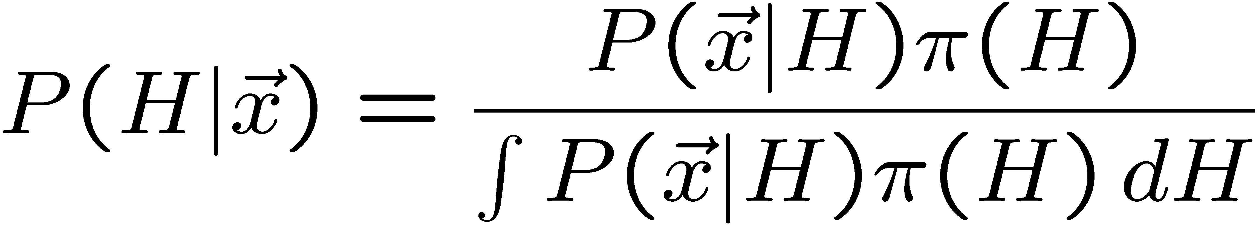
Bayesian Statistics − general philosophy
In Bayesian statistics, use subjective probability for hypotheses:
probability of the data assuming
hypothesis H (the likelihood)
prior probability, i.e.,
before seeing the data
posterior probability, i.e.,
after seeing the data
normalization involves sum
over all possible hypotheses
Bayes’ theorem has an “if-then” character: If your prior
probabilities were π(H), then it says how these probabilities
should change in the light of the data.
No general prescription for priors (subjective!)
G. Cowan
HCPSS 2016 / Statistics Lecture 1

Slide 8
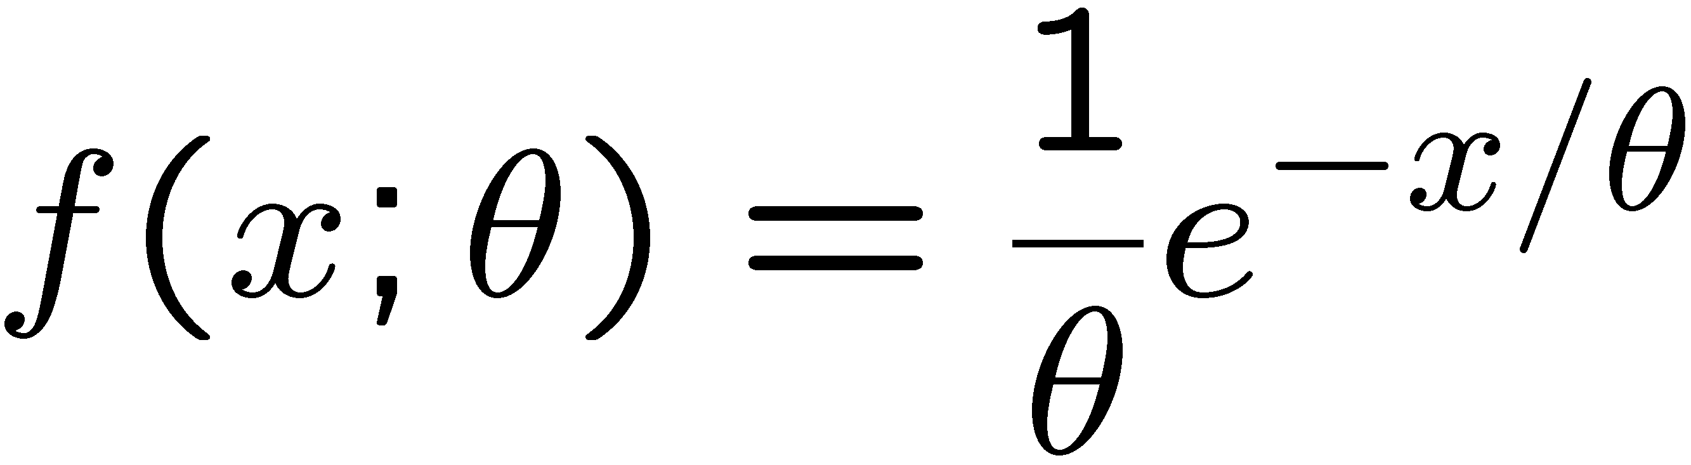
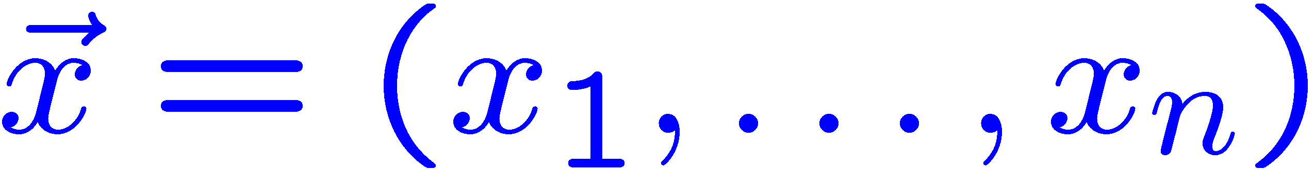
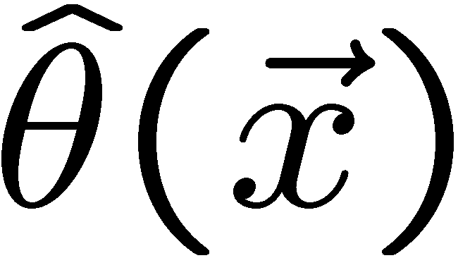
Quick review of frequentist parameter estimation
Suppose we have a pdf characterized by one or more parameters:
random variable
parameter
Suppose we have a sample of observed values:
We want to find some function of the data to estimate the
parameter(s):
← estimator written with a hat
Sometimes we say ‘estimator’ for the function of x₁, ..., x_{n};
‘estimate’ for the value of the estimator with a particular data set.
G. Cowan
HCPSS 2016 / Statistics Lecture 1

Slide 9
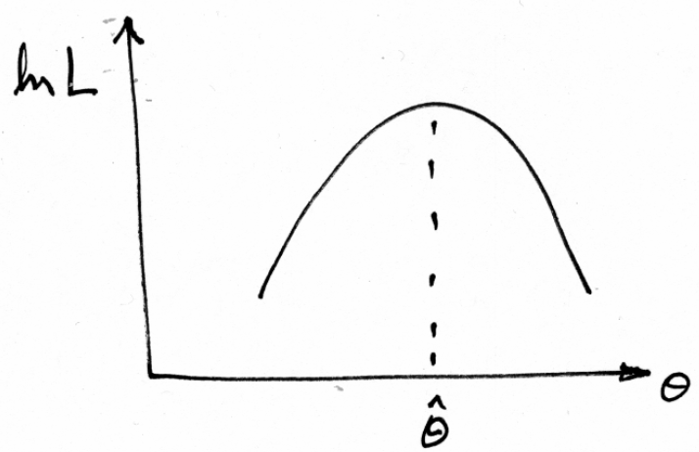

Maximum Likelihood (ML) estimators
The most important frequentist method for constructing estimators is to take the value of the parameter(s) that maximize the likelihood (or equivalently the log-likelihod):
In some cases we can find the ML estimator as a closed-form
function of the data; more often it is found numerically.
G. Cowan
HCPSS 2016 / Statistics Lecture 1

Slide 10
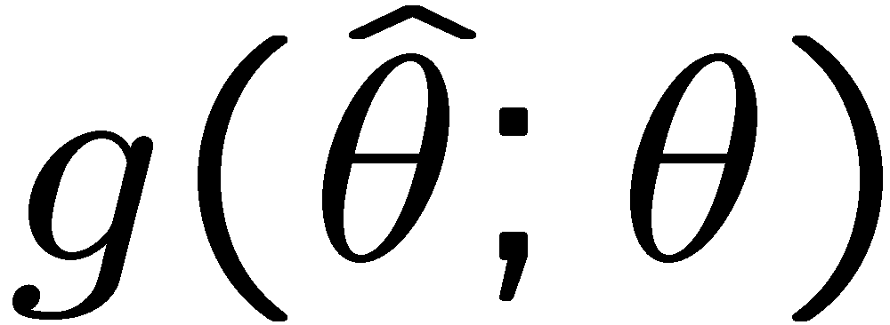
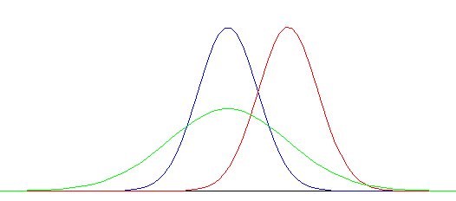



Properties of estimators
Estimators are functions of the data and thus characterized by a sampling distribution with a given (co)variance:
best
large
variance
biased
In general they may have a nonzero bias:
Under conditions usually satisfied in practice, bias of ML estimators
is zero in the large sample limit, and the variance is as small as
possible for unbiased estimators.
G. Cowan
HCPSS 2016 / Statistics Lecture 1

Slide 11
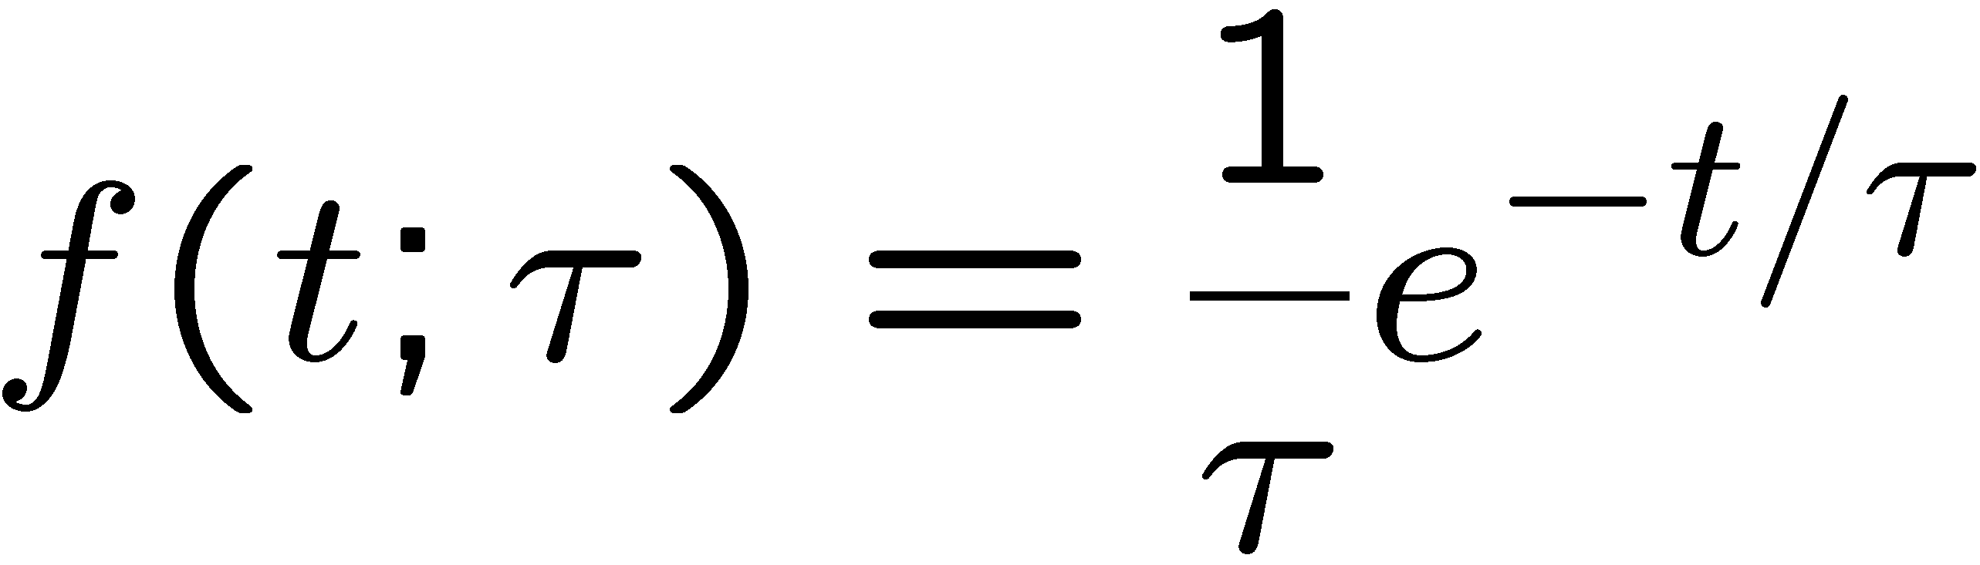

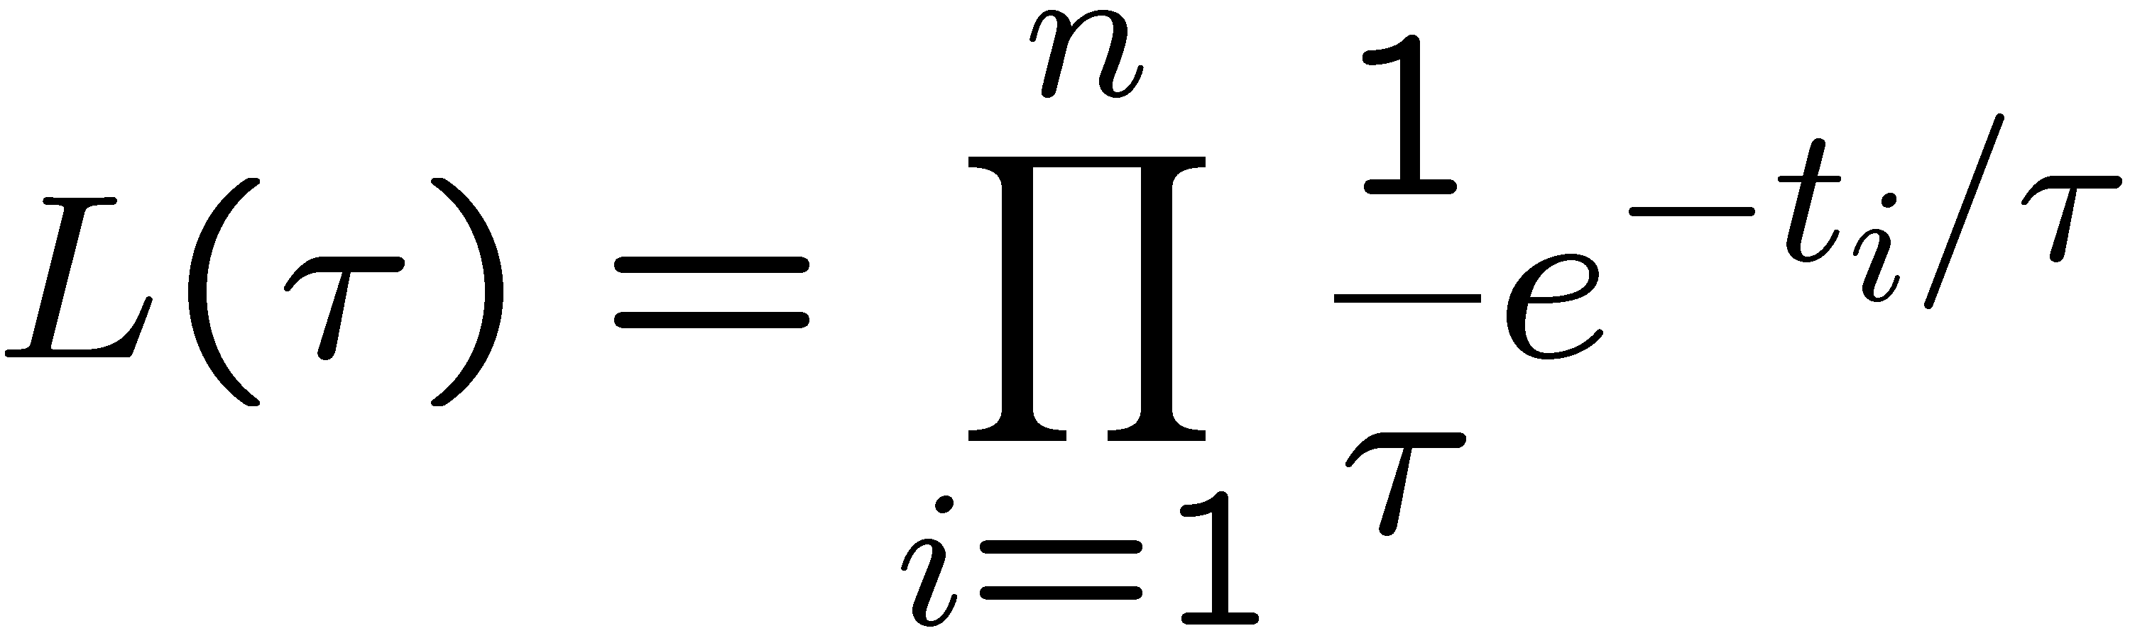
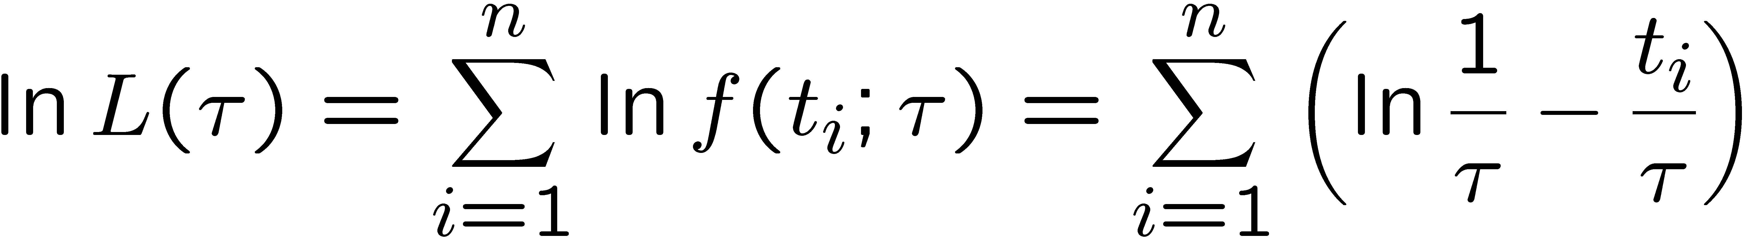
ML example: parameter of exponential pdf
Consider exponential pdf,
and suppose we have i.i.d. data,
The likelihood function is
The value of τ for which L(τ) is maximum also gives the
maximum value of its logarithm (the log-likelihood function):
G. Cowan
HCPSS 2016 / Statistics Lecture 1

Slide 12
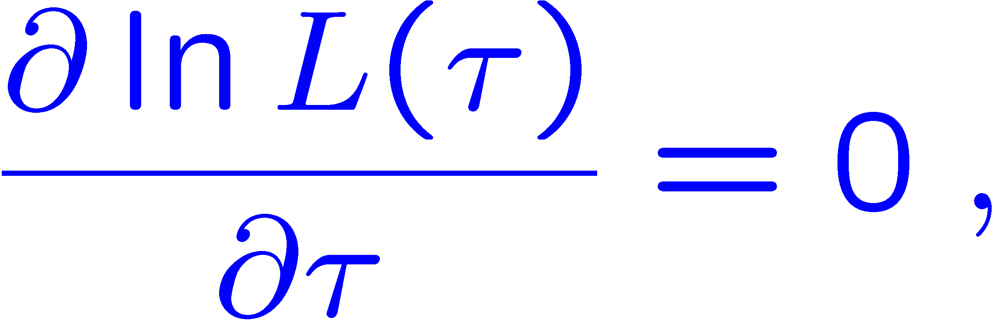
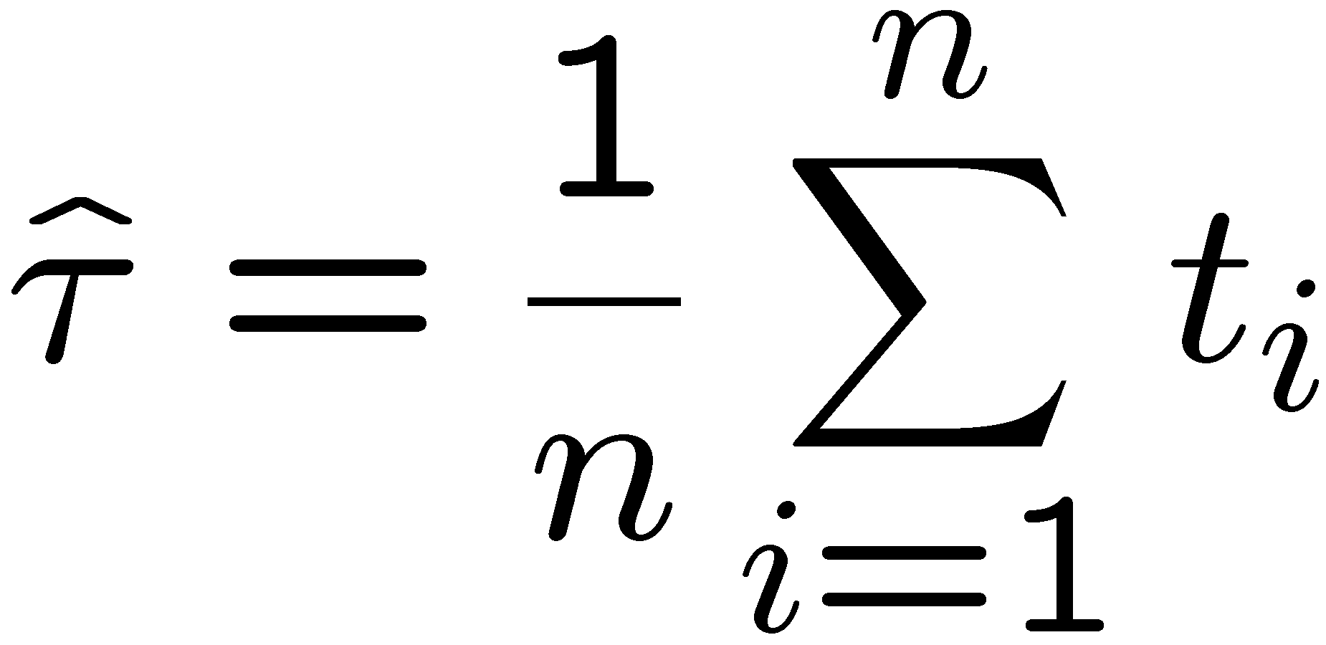
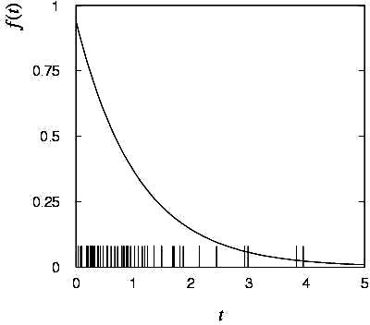

ML example: parameter of exponential pdf (2)
Find its maximum by setting
→
Monte Carlo test:
generate 50 values
using τ = 1:
We find the ML estimate:
G. Cowan
HCPSS 2016 / Statistics Lecture 1

Slide 13






ML example: parameter of exponential pdf (3)
For the exponential distribution one has for mean, variance:
For the ML estimator
we therefore find
→
→
G. Cowan
HCPSS 2016 / Statistics Lecture 1

Slide 14
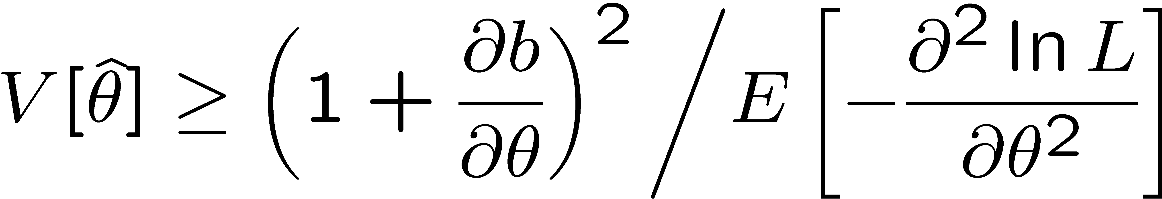
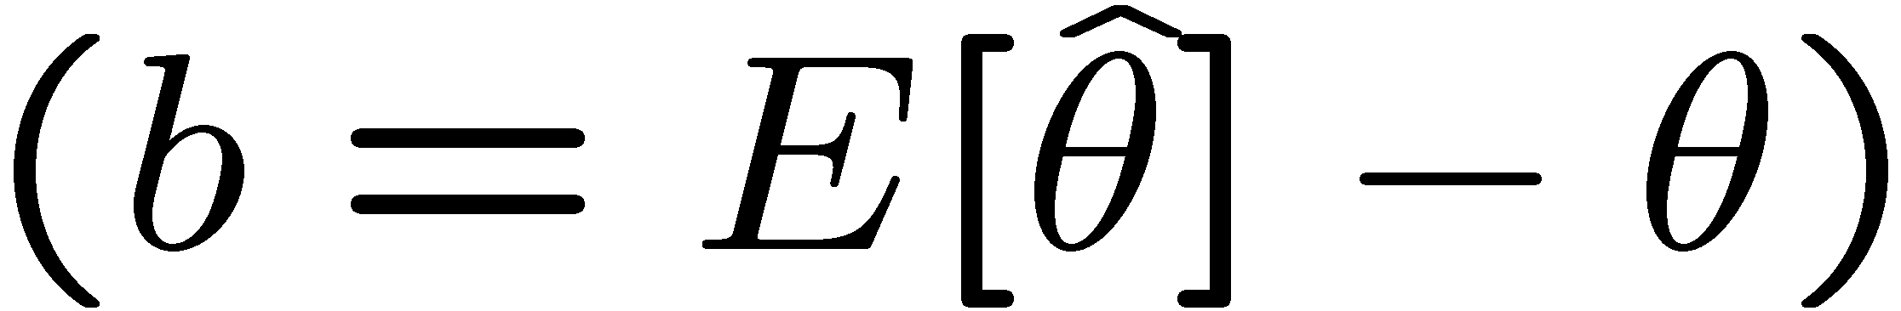
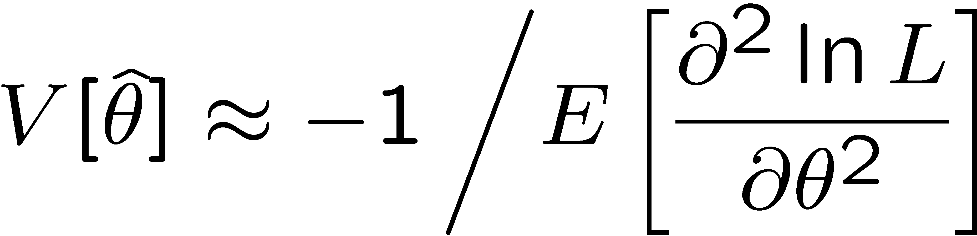
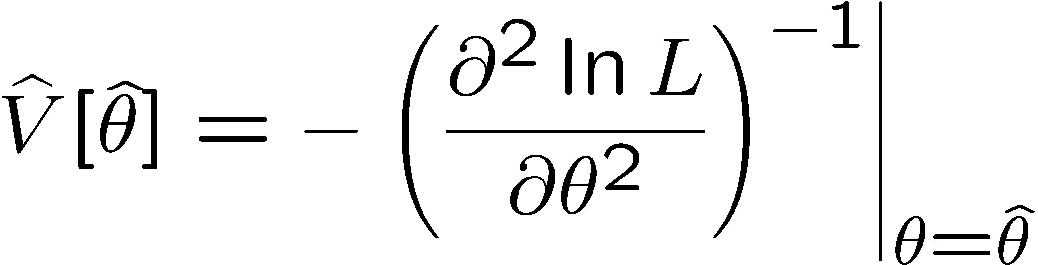
Variance of estimators from information inequality
The information inequality (RCF) sets a lower bound on the
variance of any estimator (not only ML):
Minimum Variance
Bound (MVB)
Often the bias b is small, and equality either holds exactly or
is a good approximation (e.g. large data sample limit). Then,
Estimate this using the 2nd derivative of ln L at its maximum:
G. Cowan
HCPSS 2016 / Statistics Lecture 1

Slide 15
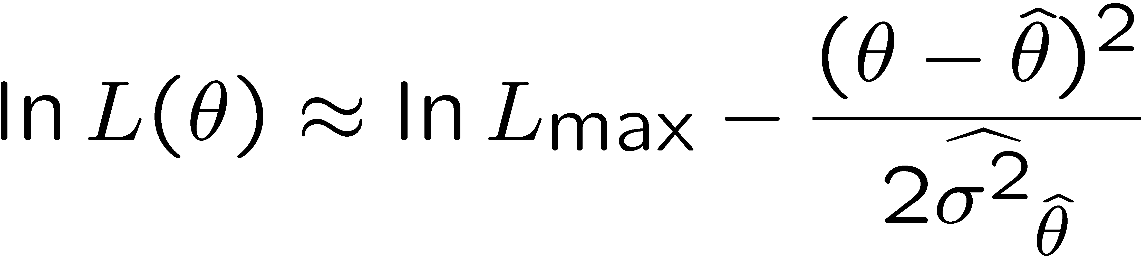
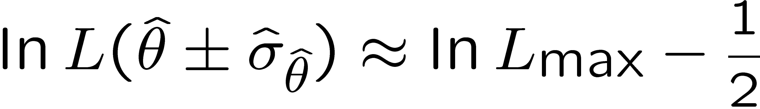


Variance of estimators: graphical method
Expand ln L (θ) about its maximum:
First term is ln L_{max}, second term is zero, for third term use
information inequality (assume equality):
i.e.,
→ to get
, change θ away from
until ln L decreases by 1/2.
G. Cowan
HCPSS 2016 / Statistics Lecture 1

Slide 16
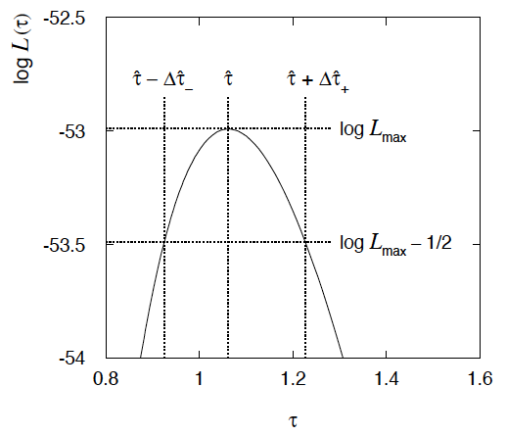
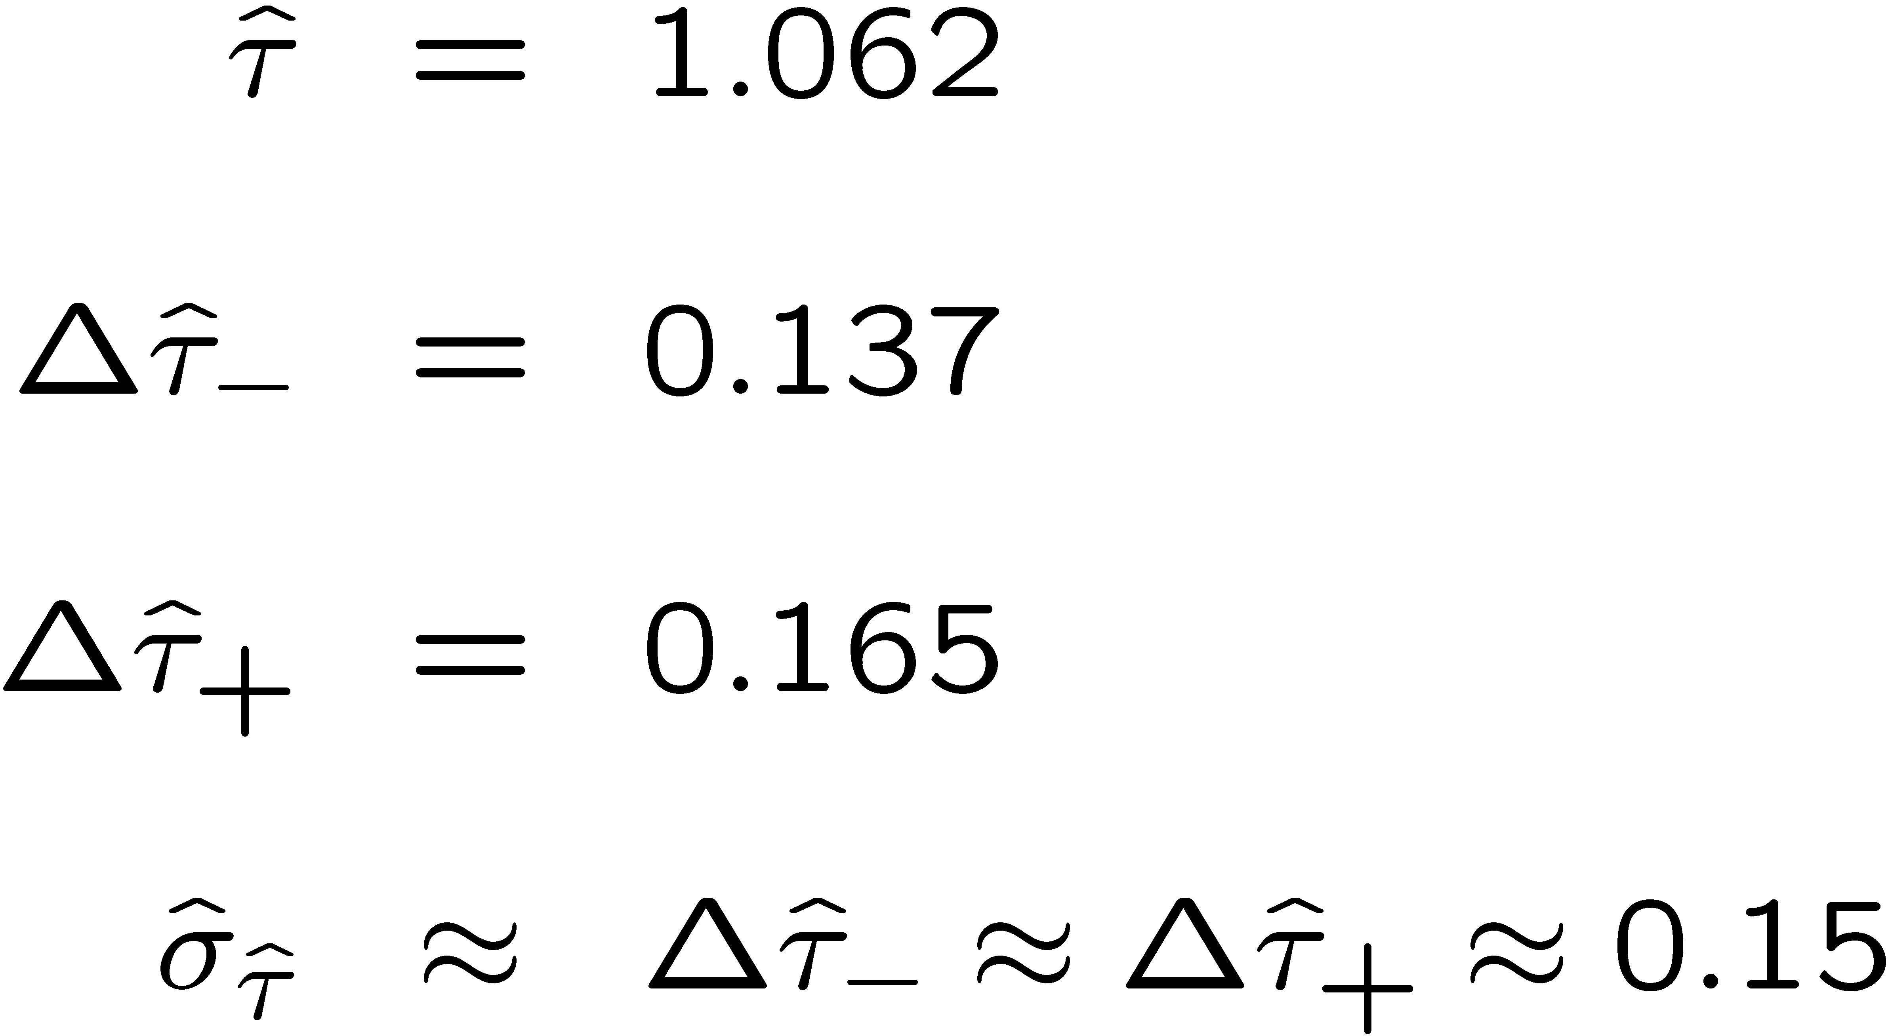
Example of variance by graphical method
ML example with exponential:
Not quite parabolic ln L since finite sample size (n = 50).
G. Cowan
HCPSS 2016 / Statistics Lecture 1

Slide 17
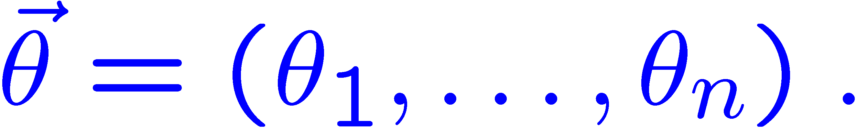
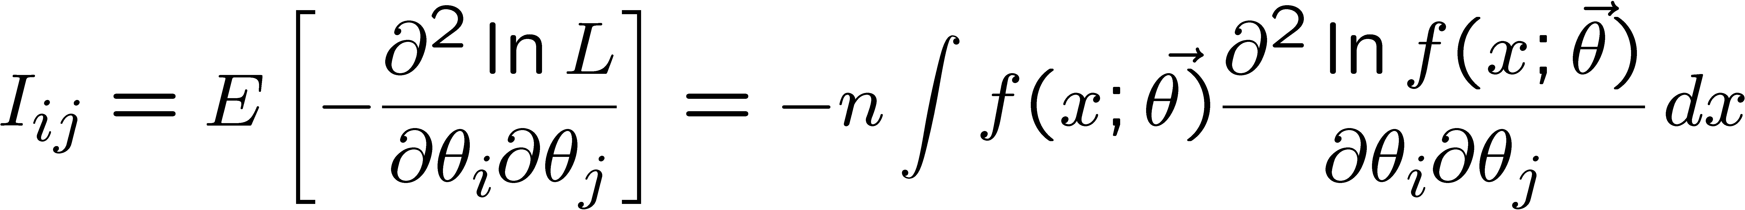

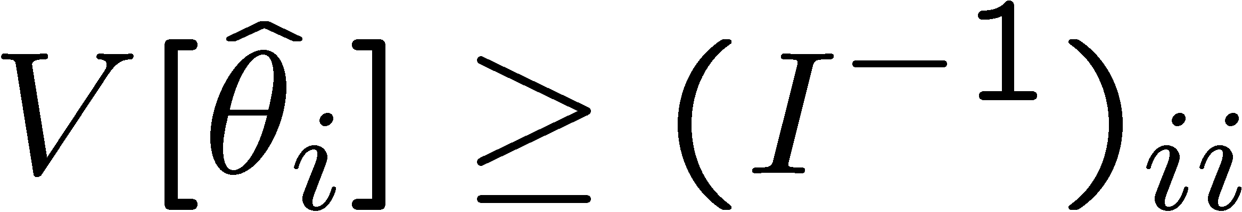
Information inequality for N parameters
Suppose we have estimated N parameters
N
The (inverse) minimum variance bound is given by the
Fisher information matrix:
The information inequality then states that V − I⁻¹ is a positive
semi-definite matrix, where Therefore
Often use I⁻¹ as an approximation for covariance matrix,
estimate using e.g. matrix of 2nd derivatives at maximum of L.
G. Cowan
HCPSS 2016 / Statistics Lecture 1

Slide 18
Frequentist statistical tests
Consider a hypothesis H₀ and alternative H₁.
A test of H₀ is defined by specifying a critical region w of the
data space such that there is no more than some (small) probability
α, assuming H₀ is correct, to observe the data there, i.e.,
P(x ∈ w | H₀ ) ≤ α
Need inequality if data are
discrete.
α is called the size or
significance level of the test.
If x is observed in the
critical region, reject H₀.
data space Ω
critical region w
G. Cowan
HCPSS 2016 / Statistics Lecture 1

Slide 19
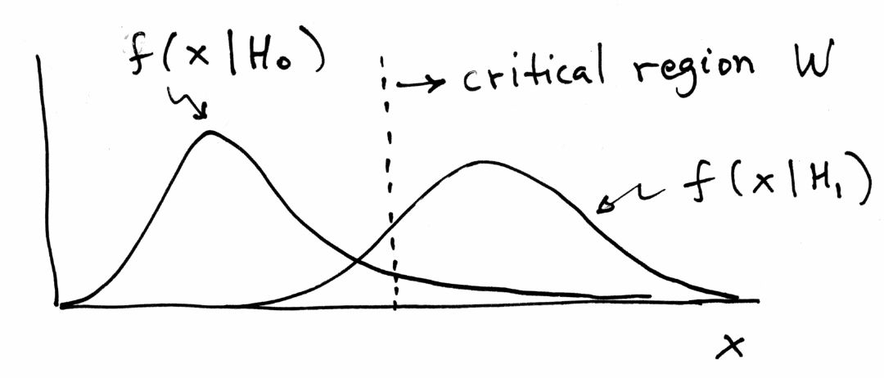
Definition of a test (2)
But in general there are an infinite number of possible critical regions that give the same significance level α.
So the choice of the critical region for a test of H₀ needs to take into account the alternative hypothesis H₁.
Roughly speaking, place the critical region where there is a low
probability to be found if H₀ is true, but high if H₁ is true:
G. Cowan
HCPSS 2016 / Statistics Lecture 1

Slide 20
Type-I, Type-II errors
Rejecting the hypothesis H₀ when it is true is a Type-I error.
The maximum probability for this is the size of the test:
P(x ∈ W | H₀ ) ≤ α
But we might also accept H₀ when it is false, and an alternative
H₁ is true.
This is called a Type-II error, and occurs with probability
P(x ∈ S − W | H₁ ) = β
One minus this is called the power of the test with respect to
the alternative H₁:
Power = 1 − β
G. Cowan
HCPSS 2016 / Statistics Lecture 1

Slide 21

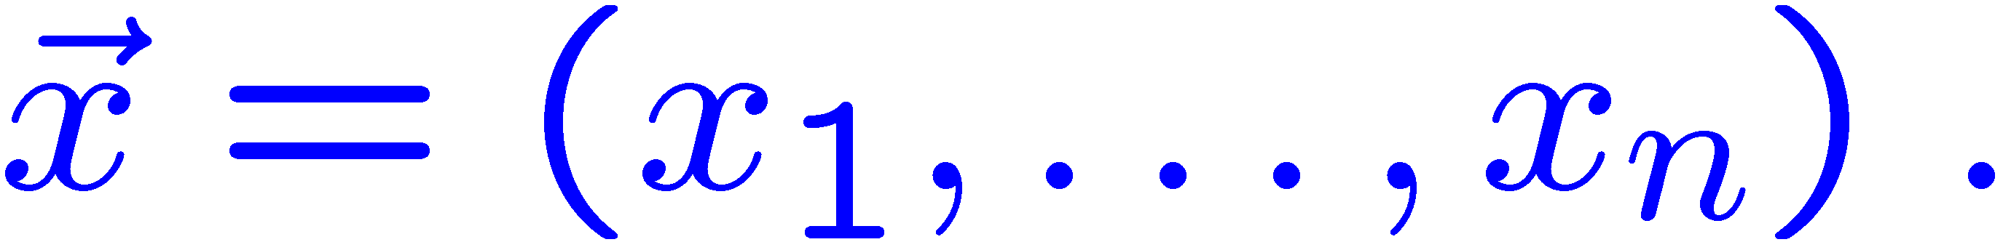



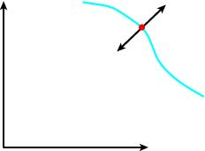


Testing significance / goodness-of-fit
Suppose hypothesis H predicts pdf
for a set of
observations
We observe a single point in this space:
What can we say about the validity of H in light of the data?
Decide what part of the
data space represents less
compatibility with H than
does the point
more
compatible
with H
less
compatible
with H
This region therefore
has greater compatibility
with some alternative Hʹ.
G. Cowan
HCPSS 2016 / Statistics Lecture 1

Slide 22

p-values
Express ‘goodness-of-fit’ by giving the p-value for H:
p = probability, under assumption of H, to observe data with
equal or lesser compatibility with H relative to the data we got.
This is not the probability that H is true!
In frequentist statistics we don’t talk about P(H) (unless H
represents a repeatable observation). In Bayesian statistics we do;
use Bayes’ theorem to obtain
where π(H) is the prior probability for H.
For now stick with the frequentist approach;
result is p-value, regrettably easy to misinterpret as P(H).
G. Cowan
HCPSS 2016 / Statistics Lecture 1

Slide 23
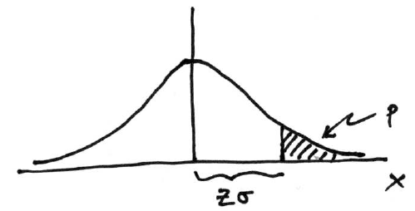
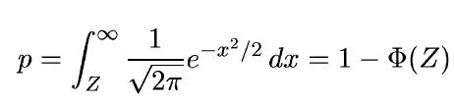

Significance from p-value
Often define significance Z as the number of standard deviations
that a Gaussian variable would fluctuate in one direction
to give the same p-value.
1 - TMath::Freq
TMath::NormQuantile
G. Cowan
HCPSS 2016 / Statistics Lecture 1

Slide 24

Test statistics and p-values
Consider a parameter μ proportional to rate of signal process.
Often define a function of the data (test statistic) q_{μ} that reflects
level of agreement between the data and the hypothesized value μ.
Usually define q_{μ} so that higher values increasingly incompatibility
with the data (more compatible with a relevant alternative).
We can define critical region of test of μ by q_{μ} ≥ const.,
or equivalently define the p-value of μ as:
observed value of q_{μ}
pdf of q_{μ} assuming μ
Equivalent formulation of test: reject μ if p_{μ} < α.
G. Cowan
HCPSS 2016 / Statistics Lecture 1

Slide 25
Confidence interval from inversion of a test
Carry out a test of size α for all values of μ.
The values that are not rejected constitute a confidence interval
for μ at confidence level CL = 1 – α.
The confidence interval will by construction contain the
true value of μ with probability of at least 1 – α.
The interval will cover the true value of μ with probability ≥ 1 − α.
Equivalently, the parameter values in the confidence interval have
p-values of at least α.
To find edge of interval (the “limit”), set p_{μ} = α and solve for μ.
G. Cowan
HCPSS 2016 / Statistics Lecture 1

Slide 26

The Poisson counting experiment
Suppose we do a counting experiment and observe n events.
Events could be from signal process or from background –
we only count the total number.
Poisson model:
s = mean (i.e., expected) # of signal events
b = mean # of background events
Goal is to make inference about s, e.g.,
test s = 0 (rejecting H₀ ≈ “discovery of signal process”)
test all non-zero s (values not rejected = confidence interval)
In both cases need to ask what is relevant alternative hypothesis.
G. Cowan
HCPSS 2016 / Statistics Lecture 1

Slide 27
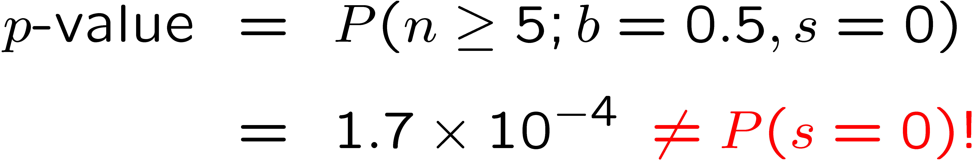
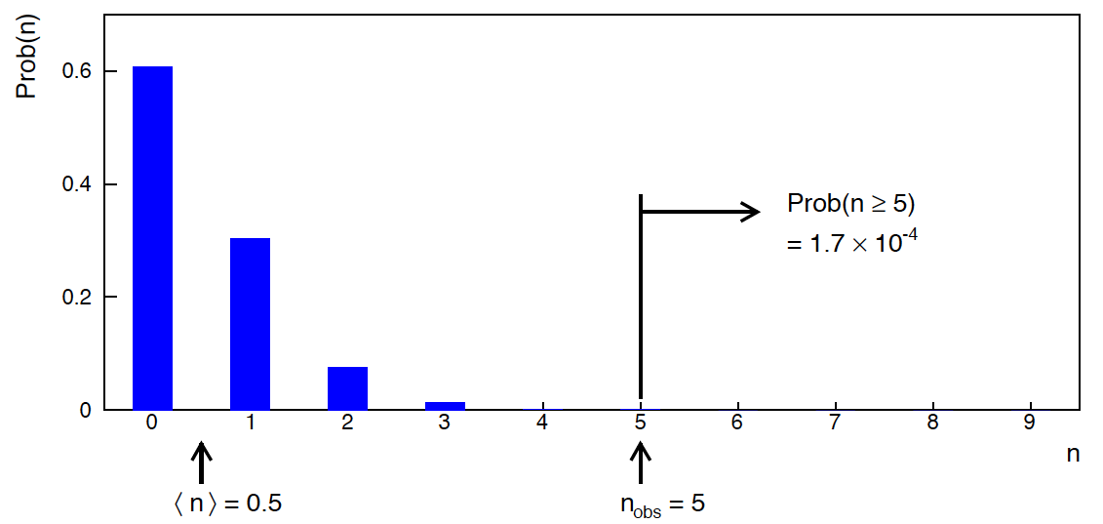
Poisson counting experiment: discovery p-value
Suppose b = 0.5 (known), and we observe n_{obs} = 5.
Should we claim evidence for a new discovery?
Take n itself as the test statistic, p-value for hypothesis s = 0 is
G. Cowan
HCPSS 2016 / Statistics Lecture 1

Slide 28

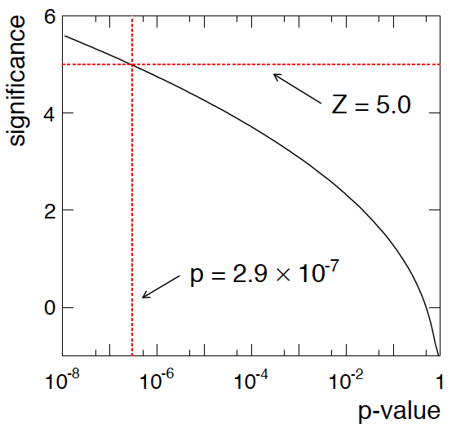
Poisson counting experiment: discovery significance
Equivalent significance for p = 1.7 × 10⁻⁴:
Often claim discovery if Z > 5 (p < 2.9 × 10⁻⁷, i.e., a “5-sigma effect”)
In fact this tradition should be revisited: p-value intended to quantify probability of a signal-like fluctuation assuming background only; not intended to cover, e.g., hidden systematics, plausibility signal model, compatibility of data with signal, “look-elsewhere effect”
(~multiple testing), etc.
G. Cowan
HCPSS 2016 / Statistics Lecture 1

Slide 29



Frequentist upper limit on Poisson parameter
Consider again the case of observing n ~ Poisson(s + b).
Suppose b = 4.5, n_{obs} = 5. Find upper limit on s at 95% CL.
Relevant alternative is s = 0 (critical region at low n)
p-value of hypothesized s is P(n ≤ n_{obs}; s, b)
Upper limit s_{up} at CL = 1 – α found by solving p_{s} = α for s:
G. Cowan
HCPSS 2016 / Statistics Lecture 1

Slide 30
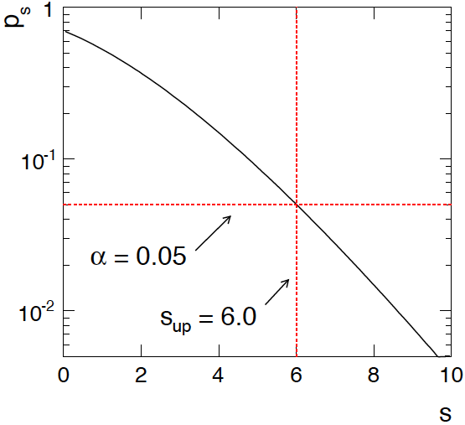
Frequentist upper limit on Poisson parameter
Upper limit s_{up} at CL = 1 – α found from p_{s} = α.
n_{obs} = 5,
b = 4.5
G. Cowan
HCPSS 2016 / Statistics Lecture 1

Slide 31
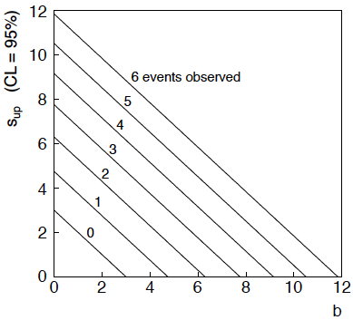
n ~ Poisson(s+b): frequentist upper limit on s
For low fluctuation of n formula can give negative result for s_{up}; i.e. confidence interval is empty.
G. Cowan
HCPSS 2016 / Statistics Lecture 1

Slide 32
Limits near a physical boundary
Suppose e.g. b = 2.5 and we observe n = 0.
If we choose CL = 0.9, we find from the formula for s_{up}
Physicist:
We already knew s ≥ 0 before we started; can’t use negative
upper limit to report result of expensive experiment!
Statistician:
The interval is designed to cover the true value only 90%
of the time — this was clearly not one of those times.
Not uncommon dilemma when testing parameter values for which
one has very little experimental sensitivity, e.g., very small s.
G. Cowan
HCPSS 2016 / Statistics Lecture 1

Slide 33
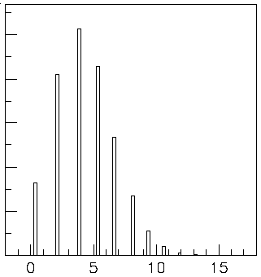

Expected limit for s = 0
Physicist: I should have used CL = 0.95 — then s_{up} = 0.496
Even better: for CL = 0.917923 we get s_{up} = 10⁻⁴ !
Reality check: with b = 2.5, typical Poisson fluctuation in n is
at least √2.5 = 1.6. How can the limit be so low?
Look at the mean limit for the
no-signal hypothesis (s = 0)
(sensitivity).
Distribution of 95% CL limits
with b = 2.5, s = 0.
Mean upper limit = 4.44
G. Cowan
HCPSS 2016 / Statistics Lecture 1

Slide 34
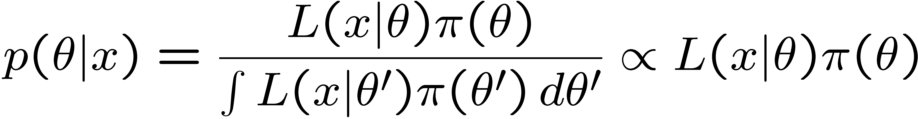
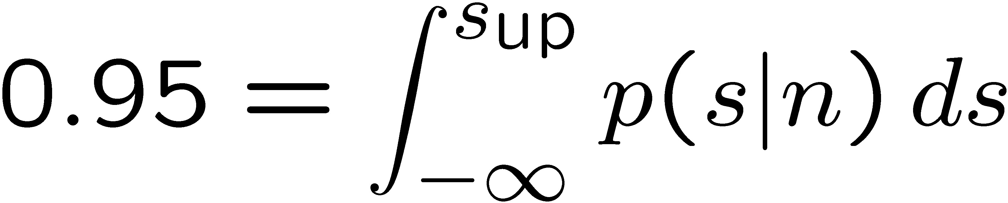
The Bayesian approach to limits
In Bayesian statistics need to start with ‘prior pdf’ π(θ), this
reflects degree of belief about θ before doing the experiment.
Bayes’ theorem tells how our beliefs should be updated in
light of the data x:
Integrate posterior pdf p(θ | x) to give interval with any desired
probability content.
For e.g. n ~ Poisson(s+b), 95% CL upper limit on s from
G. Cowan
HCPSS 2016 / Statistics Lecture 1

Slide 35
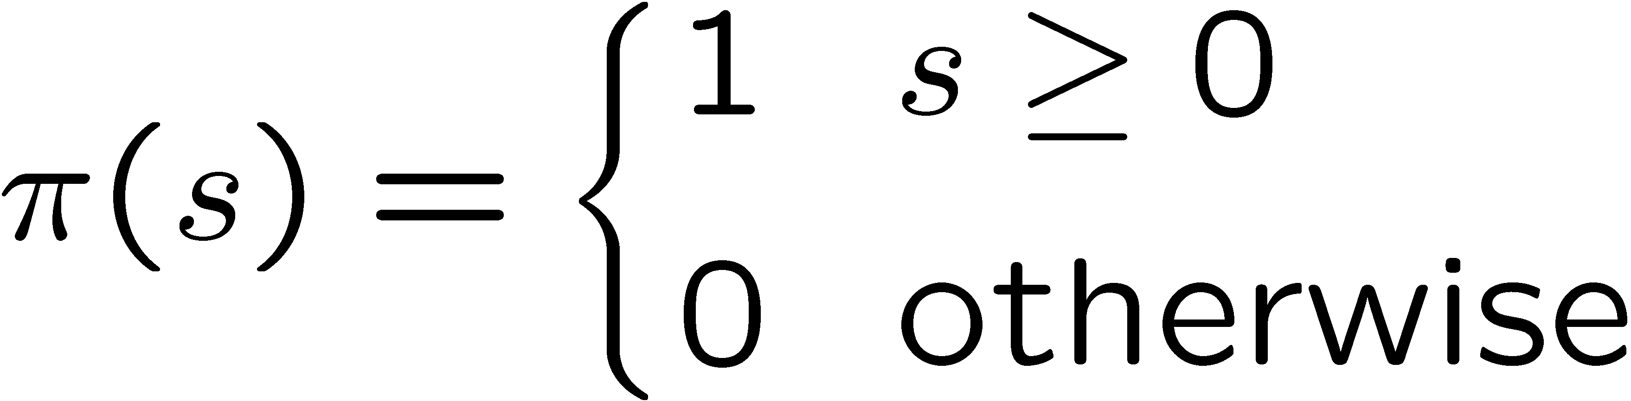
Bayesian prior for Poisson parameter
Include knowledge that s ≥ 0 by setting prior π(s) = 0 for s < 0.
Could try to reflect ‘prior ignorance’ with e.g.
Not normalized but this is OK as long as L(s) dies off for large s.
Not invariant under change of parameter — if we had used instead
a flat prior for, say, the mass of the Higgs boson, this would
imply a non-flat prior for the expected number of Higgs events.
Doesn’t really reflect a reasonable degree of belief, but often used
as a point of reference;
or viewed as a recipe for producing an interval whose frequentist
properties can be studied (coverage will depend on true s).
G. Cowan
HCPSS 2016 / Statistics Lecture 1

Slide 36


Bayesian interval with flat prior for s
Solve to find limit s_{up}:
where
For special case b = 0, Bayesian upper limit with flat prior
numerically same as one-sided frequentist case (‘coincidence’).
G. Cowan
HCPSS 2016 / Statistics Lecture 1

Slide 37
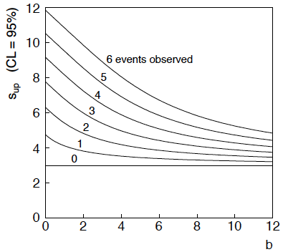
Bayesian interval with flat prior for s
For b > 0 Bayesian limit is everywhere greater than the (one sided) frequentist upper limit.
Never goes negative. Doesn’t depend on b if n = 0.
G. Cowan
HCPSS 2016 / Statistics Lecture 1

Slide 38
Priors from formal rules
Because of difficulties in encoding a vague degree of belief
in a prior, one often attempts to derive the prior from formal rules,
e.g., to satisfy certain invariance principles or to provide maximum
information gain for a certain set of measurements.
Often called “objective priors”
Form basis of Objective Bayesian Statistics
The priors do not reflect a degree of belief (but might represent
possible extreme cases).
In Objective Bayesian analysis, can use the intervals in a
frequentist way, i.e., regard Bayes’ theorem as a recipe to produce
an interval with certain coverage properties.
G. Cowan
HCPSS 2016 / Statistics Lecture 1

Slide 39
Priors from formal rules (cont.)
For a review of priors obtained by formal rules see, e.g.,
Formal priors have not been widely used in HEP, but there is
recent interest in this direction, especially the reference priors
of Bernardo and Berger; see e.g.
L. Demortier, S. Jain and H. Prosper, Reference priors for high
energy physics, Phys. Rev. D 82 (2010) 034002, arXiv:1002.1111.
D. Casadei, Reference analysis of the signal + background model
in counting experiments, JINST 7 (2012) 01012; arXiv:1108.4270.
G. Cowan
HCPSS 2016 / Statistics Lecture 1

Slide 40




Prototype search analysis
Search for signal in a region of phase space; result is histogram
of some variable x giving numbers:
Assume the n_{i} are Poisson distributed with expectation values
strength parameter
where
signal
background
G. Cowan
HCPSS 2016 / Statistics Lecture 1

Slide 41


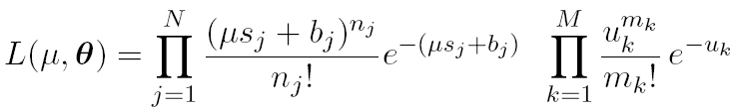
Prototype analysis (II)
Often also have a subsidiary measurement that constrains some
of the background and/or shape parameters:
Assume the m_{i} are Poisson distributed with expectation values
nuisance parameters (θ_{s}, θ_{b},b_{tot})
Likelihood function is
G. Cowan
HCPSS 2016 / Statistics Lecture 1

Slide 42
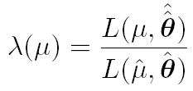
The profile likelihood ratio
Base significance test on the profile likelihood ratio:
maximizes L for
specified μ
maximize L
Define critical region of test of μ by the region of data space
that gives the lowest values of λ(μ).
Important advantage of profile LR is that its distribution becomes independent of nuisance parameters in large sample limit.
G. Cowan
HCPSS 2016 / Statistics Lecture 1

Slide 43

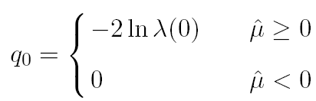
Test statistic for discovery
Suppose relevant alternative to background-only (μ = 0) is μ ≥ 0.
So take critical region for test of μ = 0 corresponding to high q₀
and > 0 (data characteristic for μ ≥ 0).
That is, to test background-only hypothesis define statistic
i.e. here only large (positive) observed signal strength is evidence
against the background-only hypothesis.
Note that even though here physically μ ≥ 0, we allow
to be negative. In large sample limit its distribution becomes
Gaussian, and this will allow us to write down simple
expressions for distributions of our test statistics.
G. Cowan
HCPSS 2016 / Statistics Lecture 1

Slide 44


Cowan, Cranmer, Gross, Vitells, arXiv:1007.1727, EPJC 71 (2011) 1554
Distribution of q₀ in large-sample limit
Assuming approximations valid in the large sample (asymptotic)
limit, we can write down the full distribution of q₀ as
The special case μ′ = 0 is a “half chi-square” distribution:
In large sample limit, f(q₀|0) independent of nuisance parameters;
f(q₀|μ′) depends on nuisance parameters through σ.
G. Cowan
HCPSS 2016 / Statistics Lecture 1

Slide 45
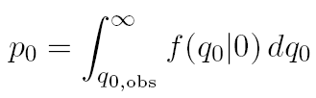
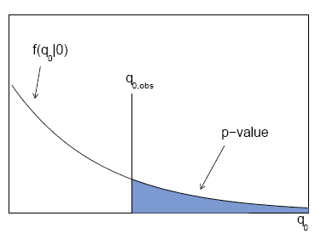

p-value for discovery
Large q₀ means increasing incompatibility between the data
and hypothesis, therefore p-value for an observed q_{0,obs} is
use e.g. asymptotic formula
From p-value get
equivalent significance,
G. Cowan
HCPSS 2016 / Statistics Lecture 1

Slide 46
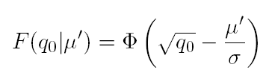



Cowan, Cranmer, Gross, Vitells, arXiv:1007.1727, EPJC 71 (2011) 1554
Cumulative distribution of q₀, significance
From the pdf, the cumulative distribution of q₀ is found to be
The special case μ′ = 0 is
The p-value of the μ = 0 hypothesis is
Therefore the discovery significance Z is simply
G. Cowan
HCPSS 2016 / Statistics Lecture 1

Slide 47


Cowan, Cranmer, Gross, Vitells, arXiv:1007.1727, EPJC 71 (2011) 1554
Monte Carlo test of asymptotic formula
Here take τ = 1.
Asymptotic formula is
good approximation to 5σ
level (q₀ = 25) already for
b ~ 20.
G. Cowan
HCPSS 2016 / Statistics Lecture 1

Slide 48

How to read the p₀ plot
The “local” p₀ means the p-value of the background-only
hypothesis obtained from the test of μ = 0 at each individual m_{H}, without any correct for the Look-Elsewhere Effect.
The “Expected” (dashed) curve gives the median p₀ under assumption of the SM Higgs (μ = 1) at each m_{H}.
ATLAS, Phys. Lett. B 716 (2012) 1-29
The blue band gives the
width of the distribution
(±1σ) of significances
under assumption of the
SM Higgs.
G. Cowan
HCPSS 2016 / Statistics Lecture 1

Slide 49




Cowan, Cranmer, Gross, Vitells, arXiv:1007.1727, EPJC 71 (2011) 1554
Test statistic for upper limits
For purposes of setting an upper limit on μ use
where
I.e. when setting an upper limit, an upwards fluctuation of the data
is not taken to mean incompatibility with the hypothesized μ:
From observed q_{μ} find p-value:
Large sample approximation:
95% CL upper limit on μ is highest value for which p-value is
not less than 0.05.
G. Cowan
HCPSS 2016 / Statistics Lecture 1

Slide 50

Cowan, Cranmer, Gross, Vitells, arXiv:1007.1727, EPJC 71 (2011) 1554
Monte Carlo test of asymptotic formulae
Consider again n ~ Poisson (μs + b), m ~ Poisson(τb)
Use q_{μ} to find p-value of hypothesized μ values.
E.g. f (q₁|1) for p-value of μ =1.
Typically interested in 95% CL, i.e., p-value threshold = 0.05, i.e.,
q₁ = 2.69 or Z₁ = √q₁ = 1.64.
Median[q₁ |0] gives “exclusion sensitivity”.
Here asymptotic formulae good
for s = 6, b = 9.
G. Cowan
HCPSS 2016 / Statistics Lecture 1

Slide 51

How to read the green and yellow limit plots
For every value of m_{H}, find the upper limit on μ.
Also for each m_{H}, determine the distribution of upper limits μ_{up} one would obtain under the hypothesis of μ = 0.
The dashed curve is the median μ_{up}, and the green (yellow) bands give the ± 1σ (2σ) regions of this distribution.
ATLAS, Phys. Lett. B 716 (2012) 1-29
G. Cowan
HCPSS 2016 / Statistics Lecture 1

Slide 52



How to read the “blue band”
On the plot of versus m_{H}, the blue band is defined by
i.e., it approximates the 1-sigma error band (68.3% CL conf. int.)
ATLAS, Phys. Lett. B 716 (2012) 1-29
G. Cowan
HCPSS 2016 / Statistics Lecture 1

Slide 53
Finishing Lecture 1
So far we have introduced the basic ideas of:
Probability (frequentist, subjective)
Parameter estimation (maximum likelihood)
Statistical tests (reject H if data found in critical region)
Confidence intervals (region of parameter space not
rejected by a test of each parameter value)
We saw tests based on the profile likelihood ratio statistic
Sampling distribution independent of nuisance parameters
in large sample limit; simple formulae for p-value.
Formula for upper limit can give empty confidence interval
if e.g. data fluctuate low relative to expected background.
Can be avoided/mitigated using Bayesian, CLs, unified,...
G. Cowan
HCPSS 2016 / Statistics Lecture 1

Slide 54
Extra slides
G. Cowan
HCPSS 2016 / Statistics Lecture 1

Slide 55

Low sensitivity to μ
It can be that the effect of a given hypothesized μ is very small
relative to the background-only (μ = 0) prediction.
This means that the distributions f(q_{μ}|μ) and f(q_{μ}|0) will be
almost the same:
G. Cowan
HCPSS 2016 / Statistics Lecture 1

Slide 56

Having sufficient sensitivity
In contrast, having sensitivity to μ means that the distributions
f(q_{μ}|μ) and f(q_{μ}|0) are more separated:
That is, the power (probability to reject μ if μ = 0) is substantially
higher than α. Use this power as a measure of the sensitivity.
G. Cowan
HCPSS 2016 / Statistics Lecture 1

Slide 57
Spurious exclusion
Consider again the case of low sensitivity. By construction the probability to reject μ if μ is true is α (e.g., 5%).
And the probability to reject μ if μ = 0 (the power) is only slightly greater than α.
This means that with probability of around α = 5% (slightly higher), one excludes hypotheses to which one has essentially no sensitivity (e.g., m_{H} = 1000 TeV).
“Spurious exclusion”
G. Cowan
HCPSS 2016 / Statistics Lecture 1

Slide 58
Ways of addressing spurious exclusion
The problem of excluding parameter values to which one has
no sensitivity known for a long time; see e.g.,
In the 1990s this was re-examined for the LEP Higgs search by
Alex Read and others
and led to the “CL_{s}” procedure for upper limits.
Unified intervals also effectively reduce spurious exclusion by
the particular choice of critical region.
G. Cowan
HCPSS 2016 / Statistics Lecture 1

Slide 59

The CL_{s} procedure
In the usual formulation of CL_{s}, one tests both the μ = 0 (b) and
μ > 0 (μs+b) hypotheses with the same statistic Q = −2ln L_{s+b}/L_{b}:
f (Q|b)
f (Q| s+b)
p_{s+b}
p_{b}
G. Cowan
HCPSS 2016 / Statistics Lecture 1

Slide 60

The CL_{s} procedure (2)
As before, “low sensitivity” means the distributions of Q under
b and s+b are very close:
f (Q|b)
f (Q|s+b)
p_{b}
p_{s+b}
G. Cowan
HCPSS 2016 / Statistics Lecture 1

Slide 61




The CL_{s} procedure (3)
The CL_{s} solution (A. Read et al.) is to base the test not on
the usual p-value (CL_{s+b}), but rather to divide this by CL_{b}
(~ one minus the p-value of the b-only hypothesis), i.e.,
Define:
f (Q|s+b)
f (Q|b)
1−CL_{b}
= p_{b}
CL_{s+b}
= p_{s+b}
Reject s+b
hypothesis if:
Increases “effective” p-value when the two
distributions become close (prevents
exclusion if sensitivity is low).
G. Cowan
HCPSS 2016 / Statistics Lecture 1

Slide 62

Setting upper limits on μ = σ/σ_{SM}
Carry out the CLs procedure for the parameter μ = σ/σ_{SM},
resulting in an upper limit μ_{up}.
In, e.g., a Higgs search, this is done for each value of m_{H}.
At a given value of m_{H}, we have an observed value of μ_{up}, and
we can also find the distribution f(μ_{up}|0):
±1σ (green) and ±2σ (yellow) bands from toy MC;
Vertical lines from asymptotic formulae.
G. Cowan
HCPSS 2016 / Statistics Lecture 1

Slide 63




Approximate confidence intervals/regions from the likelihood function
Suppose we test parameter value(s) θ = (θ₁, ..., θ_{n}) using the ratio
Lower λ(θ) means worse agreement between data and hypothesized θ. Equivalently, usually define
so higher t_{θ} means worse agreement between θ and the data.
p-value of θ therefore
need pdf
G. Cowan
HCPSS 2016 / Statistics Lecture 1

Slide 64




Confidence region from Wilks’ theorem
Wilks’ theorem says (in large-sample limit and providing
certain conditions hold...)
chi-square dist. with # d.o.f. =
# of components in θ = (θ₁, ..., θ_{n}).
Assuming this holds, the p-value is
where
To find boundary of confidence region set p_{θ} = α and solve for t_{θ}:
G. Cowan
HCPSS 2016 / Statistics Lecture 1

Slide 65




Confidence region from Wilks’ theorem (cont.)
i.e., boundary of confidence region in θ space is where
For example, for 1 – α = 68.3% and n = 1 parameter,
and so the 68.3% confidence level interval is determined by
Same as recipe for finding the estimator’s standard deviation, i.e.,
is a 68.3% CL confidence interval.
G. Cowan
HCPSS 2016 / Statistics Lecture 1

Slide 66

Example of interval from ln L
For n = 1 parameter, CL = 0.683, Q_{α} = 1.
Exponential example, now with only 5 events:
Parameter estimate and
approximate 68.3% CL
confidence interval:
G. Cowan
HCPSS 2016 / Statistics Lecture 1

Slide 67



Multiparameter case
For increasing number of parameters, CL = 1 – α decreases for
confidence region determined by a given
G. Cowan
HCPSS 2016 / Statistics Lecture 1

Slide 68

Multiparameter case (cont.)
Equivalently, Q_{α} increases with n for a given CL = 1 – α.
G. Cowan
HCPSS 2016 / Statistics Lecture 1

Slide 69




Large sample distribution of the profile likelihood ratio (Wilks’ theorem, cont.)
Suppose problem has likelihood L(θ, ν), with
← parameters of interest
← nuisance parameters
Want to test point in θ-space. Define profile likelihood ratio:
, where
“profiled” values of ν
and define q_{θ} = −2 ln λ(θ).
Wilks’ theorem says that distribution f (q_{θ}|θ,ν) approaches the
chi-square pdf for N degrees of freedom for large sample (and
regularity conditions), independent of the nuisance parameters ν.
G. Cowan
HCPSS 2016 / Statistics Lecture 1

Slide 70

p-values in cases with nuisance parameters
Suppose we have a statistic q_{θ} that we use to test a hypothesized
value of a parameter θ, such that the p-value of θ is
Fundamentally we want to reject θ only if p_{θ} < α for all ν.
→ “exact” confidence interval
Recall that for statistics based on the profile likelihood ratio, the distribution f (q_{θ}|θ,ν) becomes independent of the nuisance parameters in the large-sample limit.
But in general for finite data samples this is not true; one may be unable to reject some θ values if all values of ν must be considered, even those strongly disfavoured by the data (resulting interval for θ “overcovers”).
G. Cowan
HCPSS 2016 / Statistics Lecture 1

Slide 71


Profile construction (“hybrid resampling”)
Approximate procedure is to reject θ if p_{θ} ≤ α where
the p-value is computed assuming the profiled values of the
nuisance parameters:
“double hat” notation means
value of parameter that maximizes
likelihood for the given θ.
The resulting confidence interval will have the correct coverage
for the points
.
Elsewhere it may under- or overcover, but this is usually as good
as we can do (check with MC if crucial or small sample problem).
G. Cowan
HCPSS 2016 / Statistics Lecture 1

