Slide 1
C
π⁻
π⁺
υ_{μR}
μ⁻
υ_{μR}
μ⁺
CP
P
P
C
π⁻
π⁺
υ_{μL}
μ⁻
υ_{μL}
μ⁺

Slide 2
C
π⁻
π⁺
υ_{μR}
μ⁻
υ_{μR}
μ⁺
CP
P
P
C
π⁻
π⁺
υ_{μL}
μ⁻
υ_{μL}
μ⁺

Slide 3
e⁻
μ⁻
υ_{eR}
e⁻
υ_{eR}
υ_{eL}
υ_{μL}

Slide 4
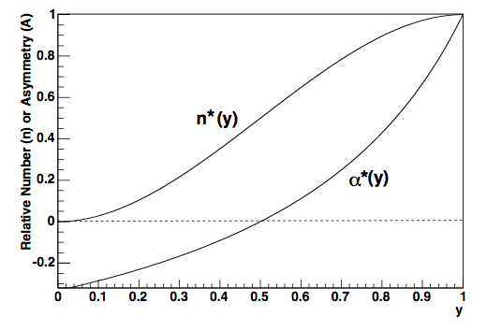
N
(N)
A

Slide 5
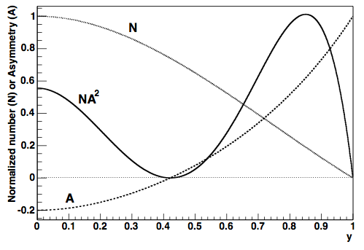

Slide 6
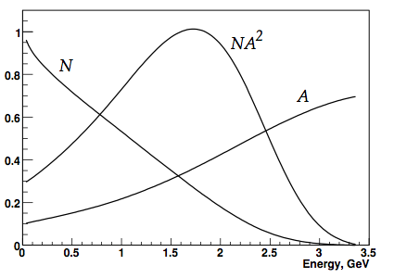

Slide 7
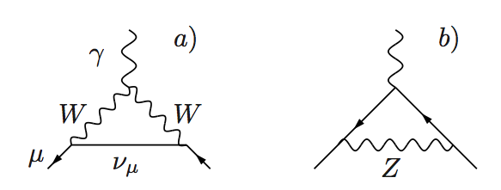
γ
μ
μ
μ
γ
γ

