Slide 1
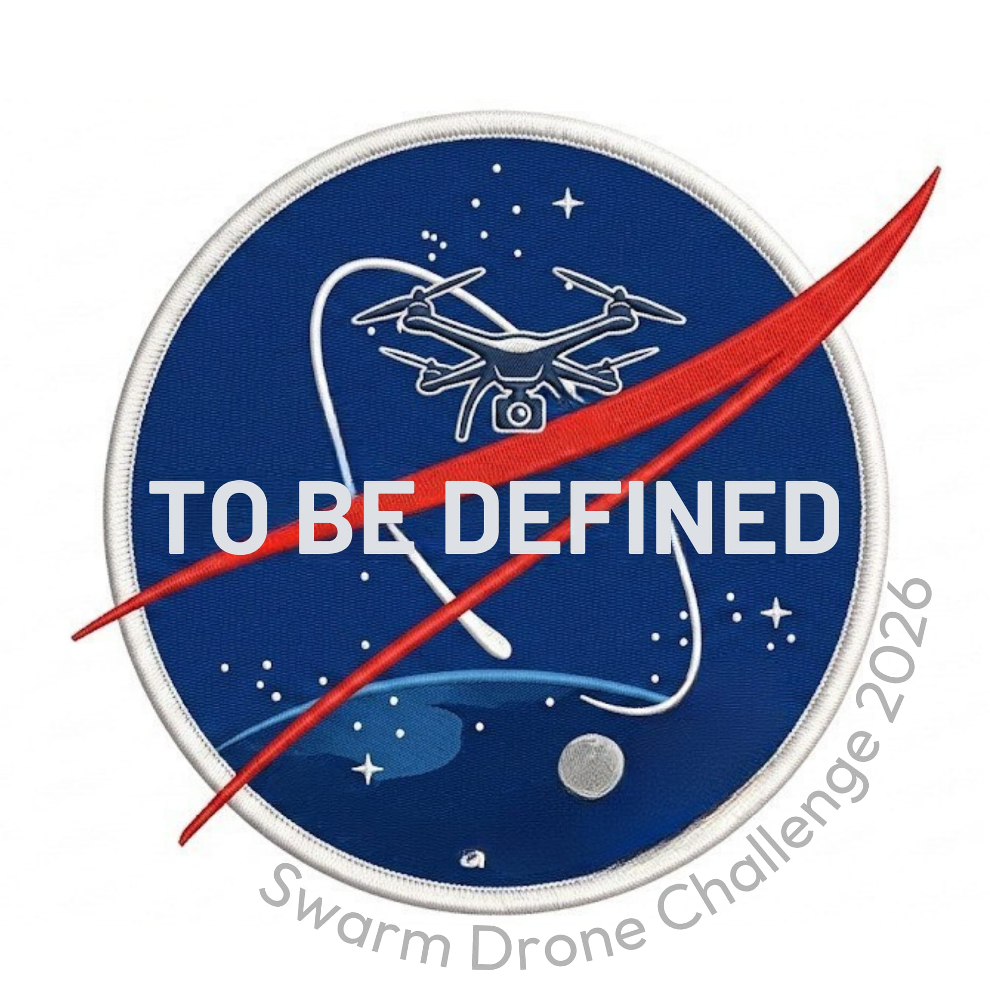
TO BE DEFINED
SWARM DRONE CHALLENGE 2026
Presented to MBDA & BrigkAir

Slide 2
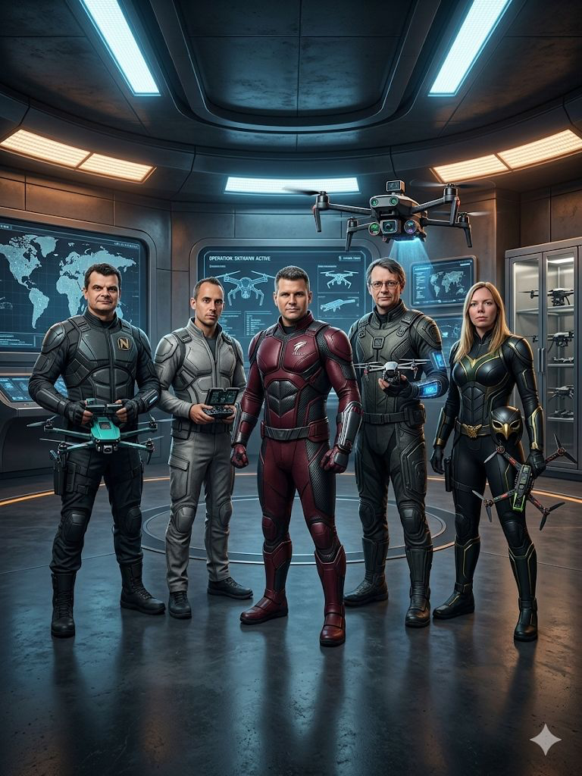
MEET THE TEAM
Supertyp René
Electronics Engineer
Bruchpilot Thomas
Software Developer
Drone Whisperer Sascha
IT Expert
Hive Commander Olli
AI Enthusiast
Drone Queen Vicki
Project Mgmt & Networking
5 experts. 1 swarm. Infinite possibilities.
Team To Be Defined | SDC26 | MBDA & BrigkAir

Slide 3
TECH STACK
Built for autonomy. Designed for scale.
PARROT ANAFI
PYTHON
UNIFIED API
Competition-grade drone platform
Olympiad SDK + MJPEG video stream
Entire stack in Python 3
Flask, OpenCV, NumPy, Ultralytics
Single REST API per drone
Device-agnostic architecture
AI FIRST
AGENTIC AI DEV
FLEET C2
YOLO11n drone detection (15 FPS)
ArUco marker positioning
Claude Code as development partner
3,600+ lines generated & verified
Web-based command & control
Real-time telemetry + mission FSM
Team To Be Defined | SDC26 | MBDA & BrigkAir

Slide 4
SYSTEM ARCHITECTURE
5 x FLIGHT CONTROLLERS
C2 SERVER
Anafi #1
RPi 5 | Unified API | MJPEG
Remote Web Controller
ArUco Positioning
Anafi #2
RPi 5 | Unified API | MJPEG
Fleet management, live telemetry,
manual + autonomous control
DICT_4X4_50 markers, 0.5m
PD controller + IMU damping
→
Anafi #3
RPi 5 | Unified API | MJPEG
Wi-Fi
YOLO Drone Detection
Mission Orchestrator
Anafi #4
RPi 5 | Unified API | MJPEG
YOLO11n on ONNX, 15 FPS
83k image Seraphim dataset
FSM missions, claim-based
collision avoidance
Anafi #5
RPi 5 | Unified API | MJPEG
Flask | OpenCV | Python 3 | Single API per drone
Team To Be Defined | SDC26 | MBDA & BrigkAir

Slide 5
COMMUNICATION ARCHITECTURE
C2 Server
Strategy implementation
Drone coordination
Collision avoidance
Visualization / Dashboard
Killswitch / Start / Stop
HTTP: Target coords (x,y,z)
↓
UDP: Position (x,y,z) + Telemetry
Flight Controller 1
Flight Controller 2
Flight Controller 3
Flight Controller 4
Flight Controller 5
Marker detection (Vision)
Position calculation
Latency-optimized
Flight path control (x,y,z)
Telemetry fusion
Marker detection (Vision)
Position calculation
Latency-optimized
Flight path control (x,y,z)
Telemetry fusion
Marker detection (Vision)
Position calculation
Latency-optimized
Flight path control (x,y,z)
Telemetry fusion
Marker detection (Vision)
Position calculation
Latency-optimized
Flight path control (x,y,z)
Telemetry fusion
Marker detection (Vision)
Position calculation
Latency-optimized
Flight path control (x,y,z)
Telemetry fusion
↓
↓
↓
↓
↓
WiFi
Control
Telemetry
Video stream
WiFi
Control
Telemetry
Video stream
WiFi
Control
Telemetry
Video stream
WiFi
Control
Telemetry
Video stream
WiFi
Control
Telemetry
Video stream
Legend
Core requirement:
HTTP: Commands (target coordinates x,y,z)
UDP: Position (x,y,z) + Telemetry
WiFi: Control + Telemetry + Video stream
LAN connection: FC ↔ C2 (HTTP + UDP)
Exact position detection at minimal latency (marker tracking, telemetry).
Prediction: Where is the drone in X ms?
Team To Be Defined | SDC26 | MBDA & BrigkAir

Slide 6
OUR APPROACH
01
Device-Agnostic Architecture
One unified REST API abstracts all drone hardware. Switch platforms without touching the intelligence layer. Today Parrot Anafi — tomorrow any UAV.
02
AI-First Development with Agentic AI
Claude Code writes, reviews, and iterates our codebase alongside the team. 3,600+ lines of production code generated, tested, and integrated in days, not weeks.
03
Intelligent Swarm Coordination
Centralized C2 with per-drone autonomy. FSM-based missions, shared claim maps for collision avoidance, and real-time ArUco + YOLO perception — the swarm thinks as one.
"We don't just fly drones. We build a thinking swarm."
Team To Be Defined | SDC26 | MBDA & BrigkAir

