Slide 1
ECE322 – LAB EXERCISE 1
PERFORMING DC,AC AND TRANSIENT ANALYSIS ON A STANDARD CIRCUIT

Slide 2
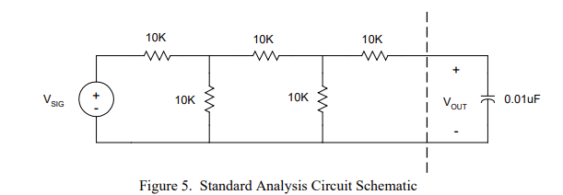
Figure 1. Standard Analysis Circuit Schematic with designated node names
v1
v2
v3
v4

Slide 3
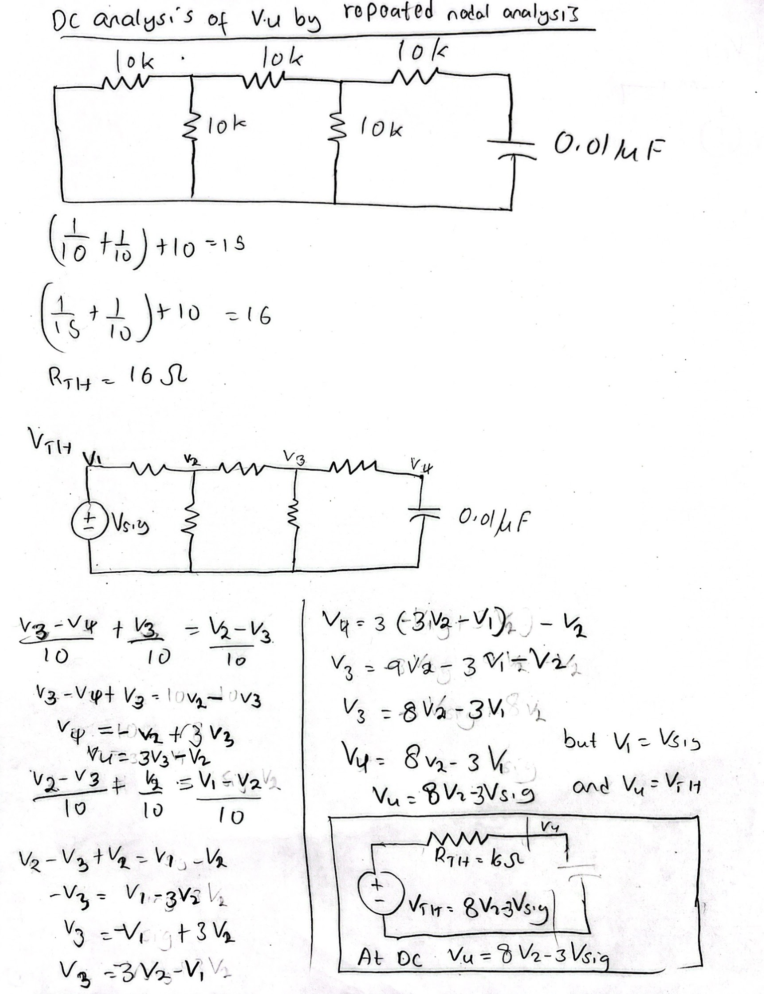

Slide 4
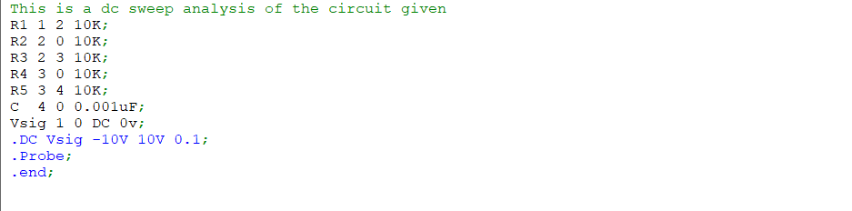

Slide 5
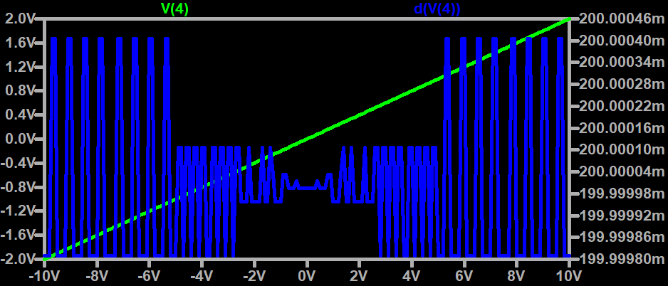
DC SWEEPING ANALYSIS
Figure 2 . DC Sweep Results and slope of V4 vs. V1 at DC

Slide 6
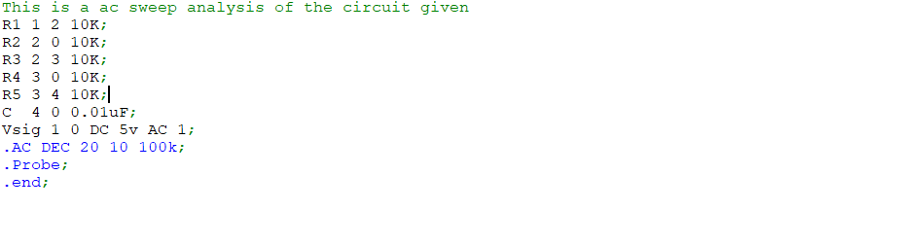

Slide 7
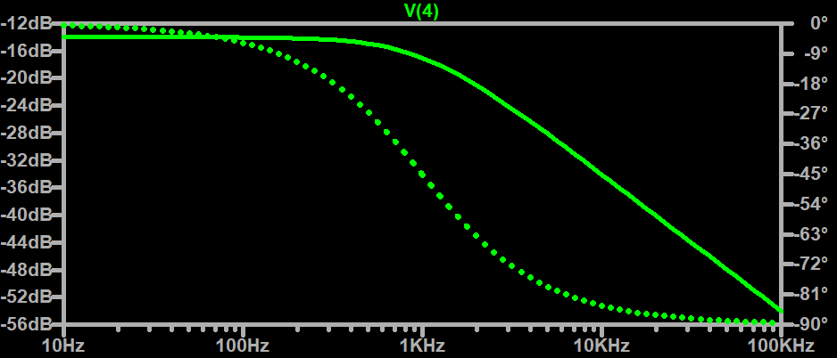
Ac sweeping analysis
Figure 3. AC Sweep Results of Gain magnitude in units of Volt/Volt

Slide 8
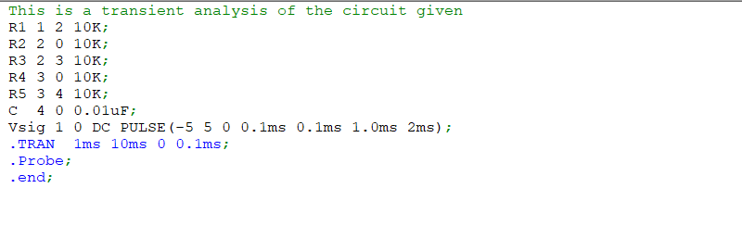

Slide 9
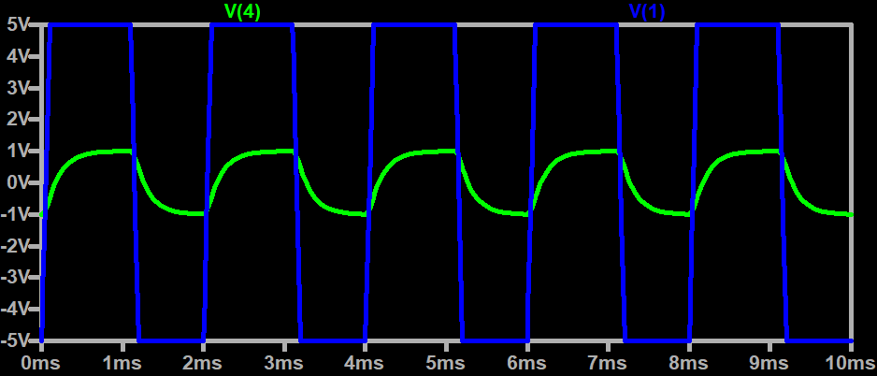
Transient analysis
Figure 4. Transient Simulation Results at V4and v1 with pulsed voltage input

