Slide 2
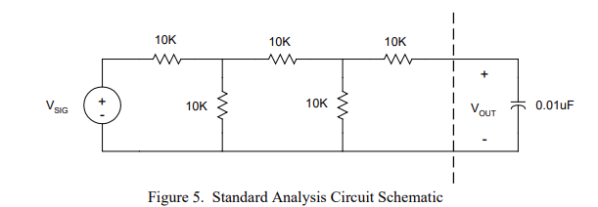

Slide 4
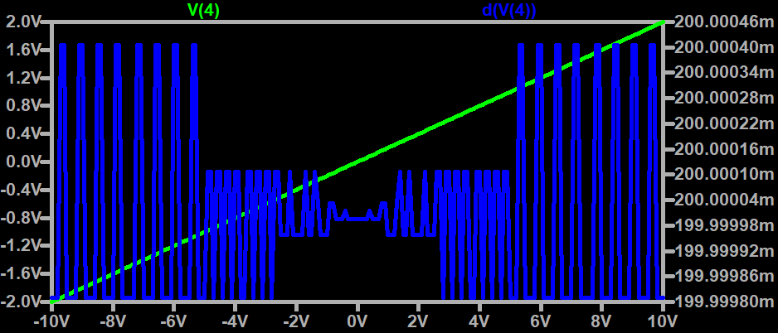
DC SWEEPING ANALYSIS

Slide 5
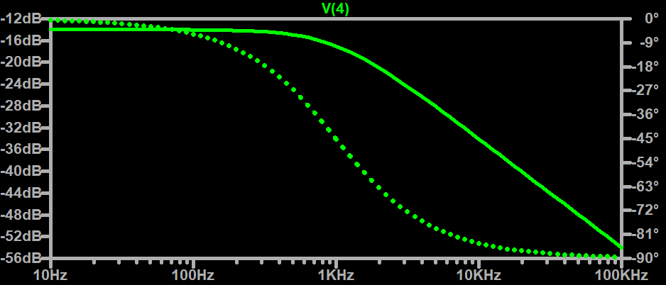
Ac sweeping analysis

Slide 6
