Slide 1
CS 347 Data Management
Bo Li Thesis Project

Slide 2
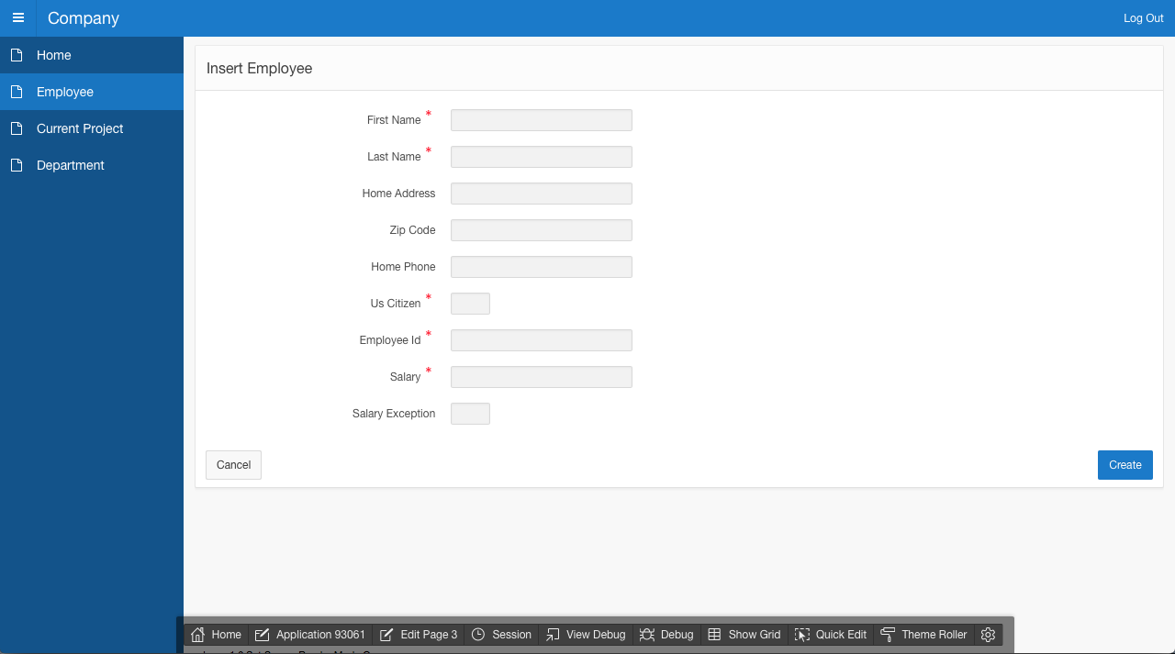
Link to Apex Application

Slide 3
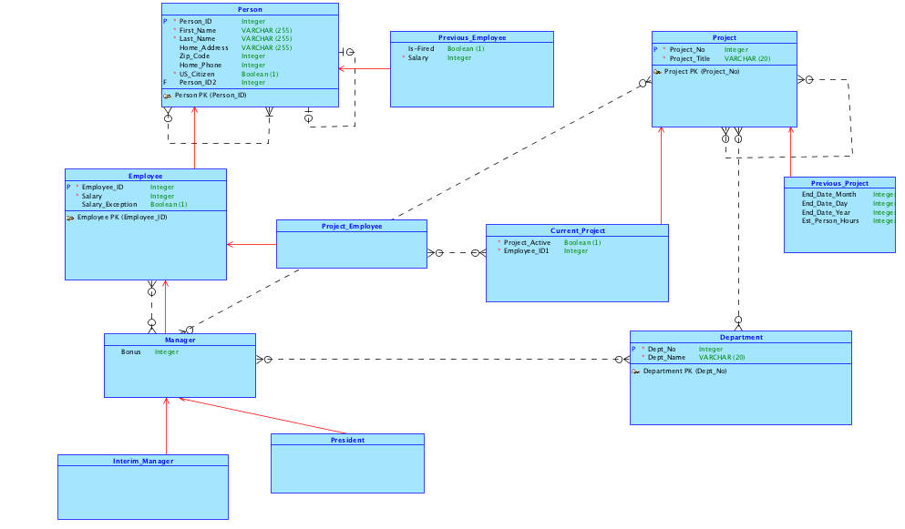
Conceptual Model

Slide 4
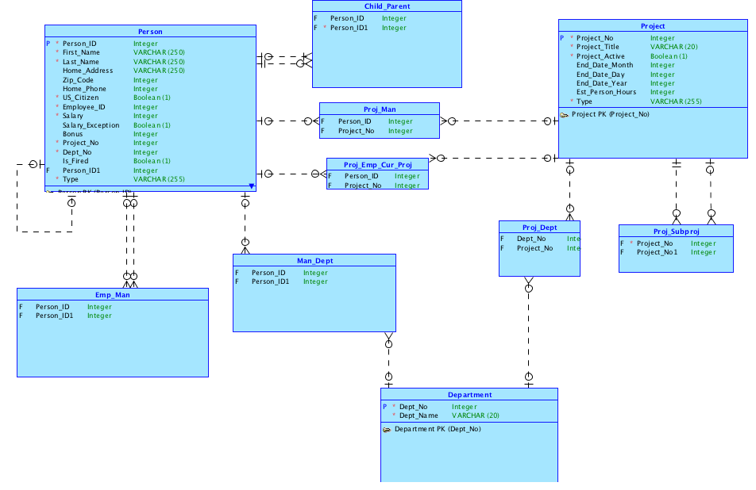
Logical Model

Slide 5
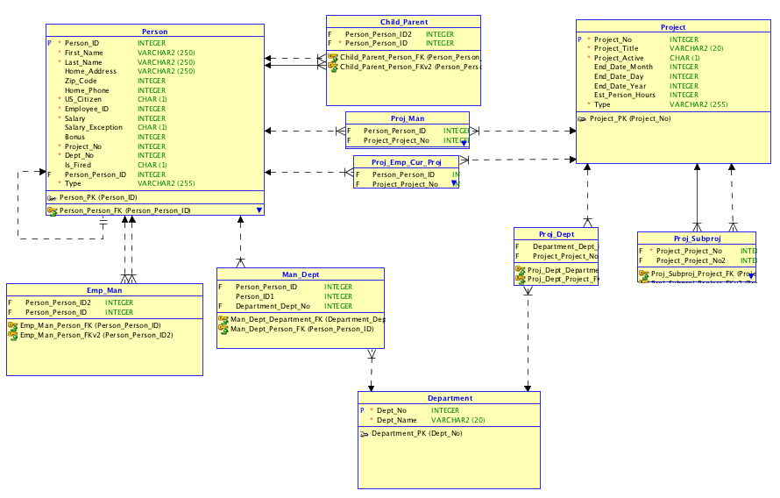
Engineering Model

Slide 6
Project Ideas
Three application sections: Employee, Projects, Department
Each section will have main page to create new instances of each
Sections will have subpage/modal window to edit relationship information. (ex. Employee -> Dept, Employee->Manager)
Employees & projects will have pre-filtered reports
Employees: All Employees, Employee, Manager, President
Projects: All Projects, Current Projects, Previous Projects
Set Manager permissions to edit projects, departments, and employees

Slide 7
Already Answered Questions
Should the relationship between employee and manager be optional, exp. does a manager have to have employees?
Would a project employee be required for current-project?
Can an employee be assigned to multiple projects?
Does Project class and Current Project subclass need assigned managers, or can manager be assigned only to the Project class?
For SIM, how does the inverse children relationship work?

Slide 8
New Questions
Should we allow people to be in the database that are not current or former employees?
Would entering a new employee into the database require the person to be a manager level or above?

