Slide 1
B+ Tree
408410120 鍾博丞 CSIE CCU
2023.05.21

Slide 2
Specs
Language: C++ standard 11
CMake 3.0.0 or newer
Linux OS (optional)

Slide 3
Features
Initialization
Quit
Drop the whole tree handling, also used when exiting the program
Display the entire tree
SIGINT handling
All parts of the entire data structure are implemented in Memory (RAM), including the actual data, which are normally stored on disk.

Slide 4
Advanced Features
Perform Binary Search for all internal nodes and data leaf nodes
All the internal nodes and data leaf nodes have their parent’s pointer and thus can traverse back to the root
Re-distribution in insertion and deletion
Ignoring the same data
Templated class implementation, which can allow another numerical type.

Slide 5
CMake and Makefile
Make a new directory called `build`.
Change to `build` directory.
Type `cmake ..`, or `cmake -S .. -B .` This will create a Makefile inside the `build` directory.
Type `make`. This will create the target executable file called `BTree` inside the `build` directory.

Slide 6
Execution
`./BTree` will enter the shell directly.
`./BTree [ORDER] [VAULE 1] [VALUE 2] ...` will specify the order and insert the following values.

Slide 7
Shell Commands
All floating points will convert to integers by taking float automatically.
All invalid input and all the following commands, e.g. type `abc` in integer area, will be ignored.
Type `h` or `help` can get the full usage.
`c 2` will create a B+ tree with order 2, capacity 4.
Note that `c 2 3 4` will ignore `3 4`.
`dd` will delete the whole B+ tree.
`i 1 2 3 4` will insert the value in order with 1, 2, 3, and 4.
`i 1 2 a 3` will insert the value in order with 1 and 2, ignore a and 3.

Slide 8
Shell Commands (2)
`d 3 1 4 2` will delete the value in order with 3, 1, 4, and 2.
`f 4 1 3 2` will find the value in order with 4, 1, 3, and 2.
`s` will show the B+ tree.
`sd` will show the B+ tree with debug message. Including the amount of data in an internal node, the height of a node, and traversing the leaf node from left to right and then from right to left.
`\! [COMMAND]` will execute the shell command. Just like MySQL.
`q`, `exit`, EOF, or Ctrl+C will exit the program.

Slide 9
Algorithm Contents
Insertion
The first data
The second data
Split the data leaf node when the data leaf overflows
Split the internal node when the root internal node overflows
Split the internal node when the non-root internal node overflows

Slide 10
Algorithm Contents (2)
Deletion and Re-Distribution
Merge
Merge two data leaf nodes
Merge two internal nodes
Move
Merge two data leaf nodes
Merge two internal nodes
Use These Two Rules to do Re-Distribution in Insertion

Slide 11
Algorithm Contents
Insertion
The first data
The second data
Split the data leaf node when the data leaf overflows
Split the internal node when the root internal node overflows
Split the internal node when the non-root internal node overflows
Deletion and Re-Distribution
Merge
Move
Use These Two Rules to do Re-Distribution in Insertion

Slide 12
Insert the First Data
We always have a root pointer to point to the root.
When the root is NULL, then it means that there is no data.
Therefore, when we insert the first data, we need to create a new data leaf node to store the actual data.
We also need to create a new internal node to be the new root.

Slide 13
Insert the First Data
Command:
c 2
i 60
Suppose that we create a new tree with order = 2 (capacity = 4)
We then insert a new value of 60
Create a new data leaf node and put the value into it
Create a new internal node
Make a new key with the new value plus 1
Assign the first index of the data pointer to the data leaf node
Assign the parent of the data leaf node to the internal node

Slide 14
Algorithm Contents
Insertion
The first data
The second data
Split the data leaf node when the data leaf overflows
Split the internal node when the root internal node overflows
Split the internal node when the non-root internal node overflows
Deletion and Re-Distribution
Merge
Move
Use These Two Rules to do Re-Distribution in Insertion

Slide 15
Insert the Second Data
Command:
c 2
i 60
i 58
After inserting the first data, we must have at least one internal node and at least one data leaf node.
If the internal node is at the bottom of the index tree, then its children are data leaf nodes.
If the internal node is NOT at the bottom of the index tree, then its children are internal nodes.
Therefore, we need to find the appropriate bottom internal node from the root given the value.
Next, we need to find the appropriate data leaf node from the bottom internal node given the value.

Slide 16
Insert the Second Data
Command:
c 2
i 60
i 58

Slide 17
Insert the Second Data (2)
Command:
c 2
i 60
i 58
Once we determine the appropriate data leaf node, we then find if there exists the same value. If it is found, then we ignore the insertion.
We will discuss the case of the appropriate data leaf node being NULL later.
Insert the value to the end of the data leaf node.
Sort the value of the data leaf node.
Check if the data leaf node overflows or not.

Slide 18
Algorithm Contents
Insertion
The first data
The second data
Split the data leaf node when the data leaf overflows
Split the internal node when the root internal node overflows
Split the internal node when the non-root internal node overflows
Deletion and Re-Distribution
Merge
Move
Use These Two Rules to do Re-Distribution in Insertion

Slide 19
Data Leaf Overflows
Command:
c 2
i 60 58 56 54
i 52
We allow one extra data, key, and pointer in both data leaf nodes and internal nodes. Thus, a data leaf node can contain (capacity + 1) data and an internal node can contain (capacity + 1) keys, (capacity + 2) data leaf children pointers, and (capacity + 2) internal node children pointers.
We create a new data leaf node when the data leaf overflows.
Assign the parent of this new data leaf node to be the same as the overflow data leaf node.

Slide 20
Copy Up the New Key
Command:
c 2
i 60 58 56 54
i 52
Move (capacity + 1) data from left to right.
Copy up the new key from the first (smallest) data in the new (right) data leaf.

Slide 21
Insertion Sort
Command:
c 2
i 60 58 56 54
i 52
Note that we always create the new data leaf on the right-hand side.
Also note that there is no duplicate data.
After sorting, we need to set up the doubly-linked list of the data leaf nodes.
Since we have added a new key, we need to check if the data leaf node overflows or not.
Here the internal node (56, 61, _, _) doesn’t overflow.

Slide 22
Algorithm Contents
Insertion
The first data
The second data
Split the data leaf node when the data leaf overflows
Split the internal node when the root internal node overflows
Split the internal node when the non-root internal node overflows
Deletion and Re-Distribution
Merge
Move
Use These Two Rules to do Re-Distribution in Insertion

Slide 23
Internal Node Overflows
Command:
c 2
i 60 58 56 54 52 50 48 46 44 42 40 38 36
i 34
When inserting 34 into the data leaf node [36, 38, 40, 42], this data leaf node overflows.
After dealing with data leaf overflow, we will get the following result.

Slide 24
Create New Internal Node
Command:
c 2
i 60 58 56 54 52 50 48 46 44 42 40 38 36
i 34
We then create a new internal node on the right-hand side.
Assign the tree height and the attribute if the internal node is at the bottom of the entire tree (is_bottom) of the new internal node to be the same as the overflow internal node.
Split the keys into 3 parts, the middle value, the left-hand side of the middle value, and the right-hand side of the middle value.
Move the right-hand side of the middle value to the new internal node.
Move the corresponding data leaf pointer / internal node pointer to the new internal node.
Assign the parent of these pointers to be the new internal node.

Slide 25
Create New Internal Node
Command:
c 2
i 60 58 56 54 52 50 48 46 44 42 40 38 36
i 34

Slide 26
Root Case: Make the Middle Value as New Root
Command:
c 2
i 60 58 56 54 52 50 48 46 44 42 40 38 36
i 34
In this case, the overflow internal node is the root.
We create a new internal node to be the new root.
Push up the middle value to the new root.
Assign the is_bottom of the new root to be false.
Set up the new parent of the two internal nodes to be the new root.
Add the total height of the entire tree.
Set up the pointer of the new root.

Slide 27
Algorithm Contents
Insertion
The first data
The second data
Split the data leaf node when the data leaf overflows
Split the internal node when the root internal node overflows
Split the internal node when the non-root internal node overflows
Deletion and Re-Distribution
Merge
Move
Use These Two Rules to do Re-Distribution in Insertion

Slide 28
Non-Root Case: Push Up the Middle Value to the Parent
Command:
c 2
i 60 58 56 54 52 50 48 46 44 42 40 38 36 34 32 30 28 26 24 22 20 18
i 16
When inserting 16 into the data leaf node [18, 20, 22, 24], this data leaf node overflows.
After dealing with data leaf overflow, we will get the following result.
We omit data greater than 50. We are running out of space and these data don’t change during this process.
We then create a new internal node just like the root case.

Slide 29
Non-Root Case: Push Up the Middle Value to the Parent
Command:
c 2
i 60 58 56 54 52 50 48 46 44 42 40 38 36 34 32 30 28 26 24 22 20 18
i 16
In this case, the overflow internal node is not the root. This means that this overflow internal node must have a parent.
Therefore, we don’t need to create a new root.
Instead, we push up the middle value into its parent.
Assign the parent of the new internal node to be the parent of
the overflow internal node.

Slide 30
Non-Root Case: Insertion Sort
Command:
c 2
i 60 58 56 54 52 50 48 46 44 42 40 38 36 34 32 30 28 26 24 22 20 18
i 16
Perform insertion sort like data leaf node overflow.
Assign the parent of the new internal node to be the parent of the overflow internal node.
Since we have added a new key, we need to check if the parent internal node overflows or not.
Here (32, 50, _, _) doesn’t overflow.

Slide 31
Algorithm Contents
Deletion and Re-Distribution
The Concept of Re-Distribution
Merge LEFT
Merge two data leaf nodes
Same parent
Different parent
Merge two internal nodes
Move LEFT
Move data between two leaf nodes
Move keys between two internal nodes
The Root Internal Node
Use These Two Rules to do Re-Distribution in Insertion

Slide 32
The Concept of Re-Distribution
We need to keep the data amount in a single data leaf node and the key amount in a single internal node to be in
order <= x <= capacity.
The first data leaf node and the root internal node are excluded.
We say the underflow occurs when the amount of key or data is less than the order.
There are only two method to deal with underflow.
Merge
Move
We always consider if two nodes can be merged first.
If they can’t be merged, then consider to move key/data between two nodes.

Slide 33
The Meaning of LEFT and RIGHT
We use LEFT and RIGHT to specify the location of the underflow node in the two-node pair.
For example, given two-node pair [1,_,_,_] [4,5,6,_], we want to merge them into [1,4,5,6][_,_,_,_]. In this case, the underflow data leaf node is at the LEFT of the two-node pair and thus we call this process “Merge LEFT”.
For example, given two-node pair [1,4,5,_] [6,_,_,_], we want to merge them into [1,4,5,6][_,_,_,_]. In this case, the underflow data leaf node is at the RIGHT of the two-node pair and thus we call this process “Merge RIGHT”.
We always consider the right sibling first when underflow occurs. That is, we always consider LEFT condition first no matter we are doing merge or move.

Slide 34
Algorithm Contents
Deletion and Re-Distribution
The Concept of Re-Distribution
Merge LEFT
Merge two data leaf nodes
Same parent
Different parent
Merge two internal nodes
Move LEFT
Move data between two leaf nodes
Move keys between two internal nodes
The Root Internal Node
Use These Two Rules to do Re-Distribution in Insertion

Slide 35
Merge LEFT Two Data Leaf Nodes: Same Parent Case
Command:
c 2
i 60 58 56 54 52 50 48 46 44 42 40 38 36 34 32 30 28 26 24 22 20 18 16
d 16
The result of inserting all the values shown above is shown below.
Suppose we want to delete 16, then the data leaf node [18, _, _, _] has only 1 data, which is less than the order 2 and thus underflow occurs.
Consider the right sibling (LEFT) [20, 22, 24, _]. There are 3 data inside.
Since 1 + 3 = 4 <= capacity 4, the leaf node will not cause overflow when merging two leaf nodes together, we perform Merge here.

Slide 36
Move Data From Right to Left
Command:
c 2
i 60 58 56 54 52 50 48 46 44 42 40 38 36 34 32 30 28 26 24 22 20 18 16
d 16
Specify the merge node to the left node and the target node to the right node.
No matter we merge LEFT or RIGHT, we always move data from right to left.
Since we will remove the entire target later, we don’t need to remove the data from target.

Slide 37
Rearrange Key and Data Leaf Pointer
Command:
c 2
i 60 58 56 54 52 50 48 46 44 42 40 38 36 34 32 30 28 26 24 22 20 18 16
d 16
Specify the index of the underflow node in its parent.
Delete the corresponding key and data pointer in the parent internal node.
Move both key and data pointer one index left from the specific index in the parent internal node.
Delete the target.
Rearrange the doubly-linked list.
Since we have deleted a key in the parent internal node, we have to check if the parent internal node underflows or not.
Here (26, _, _, _) is underflow. We have not done yet.

Slide 38
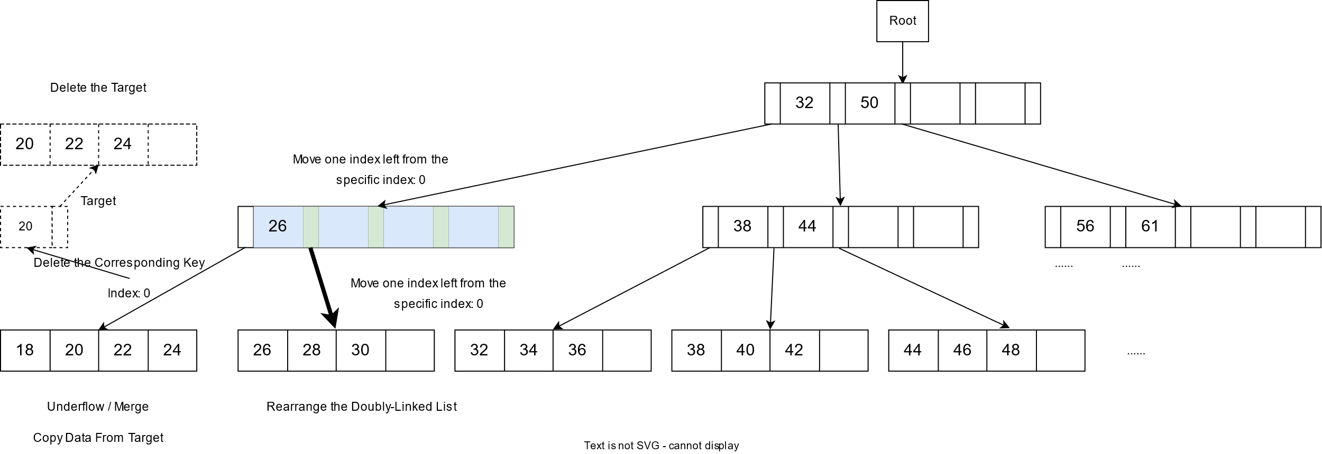
Rearrange Key and Data Leaf Pointer
Command:
c 2
i 60 58 56 54 52 50 48 46 44 42 40 38 36 34 32 30 28 26 24 22 20 18 16
d 16

Slide 39
Algorithm Contents
Deletion and Re-Distribution
The Concept of Re-Distribution
Merge LEFT
Merge two data leaf nodes
Same parent
Different parent
Merge two internal nodes
Move LEFT
Move data between two leaf nodes
Move keys between two internal nodes
The Root Internal Node
Use These Two Rules to do Re-Distribution in Insertion

Slide 40
Merge LEFT Two Internal Nodes
Command:
c 2
i 60 58 56 54 52 50 48 46 44 42 40 38 36 34 32 30 28 26 24 22 20 18 16
d 16
Now, (26, _, _, _) is underflow and it is not root. Therefore, we have to deal with it.
Consider the right sibling (LEFT) (38, 44, _, _). There are 2 data inside.
When merging internal nodes, we will pull down 1 key from their parent.
Since 1 + 2 + 1 (from parent) = 4 <= capacity 4, the internal node will not cause overflow when merging two internal nodes together, we perform Merge here.

Slide 41
Rearrange Keys and Pointers
Command:
c 2
i 60 58 56 54 52 50 48 46 44 42 40 38 36 34 32 30 28 26 24 22 20 18 16
d 16
Specify the merge node to the left node and the target node to the right node.
No matter we merge LEFT or RIGHT, we always move keys from right to left.
Since we will remove the entire target later, we don’t need to remove the keys from target.
Move the data leaf pointer or internal node children pointer from target to merge.
Assign the parents of these pointers to Merge.
Copy the corresponding key in parent first, then copy the keys in target.

Slide 42
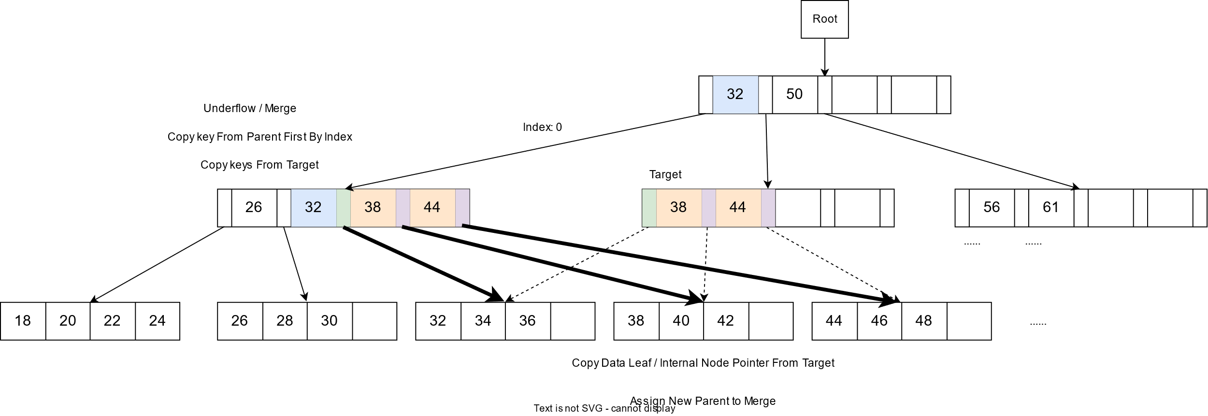
Rearrange Keys and Pointers
Command:
c 2
i 60 58 56 54 52 50 48 46 44 42 40 38 36 34 32 30 28 26 24 22 20 18 16
d 16

Slide 43
Rearrange Keys and Pointers in Parent
Command:
c 2
i 60 58 56 54 52 50 48 46 44 42 40 38 36 34 32 30 28 26 24 22 20 18 16
d 16
Delete the corresponding key in parent.
Move one index left from the specific index.
Delete the target internal node.
Since we have deleted a key in the parent internal node, we have to check if the parent internal node underflows or not.

Slide 44
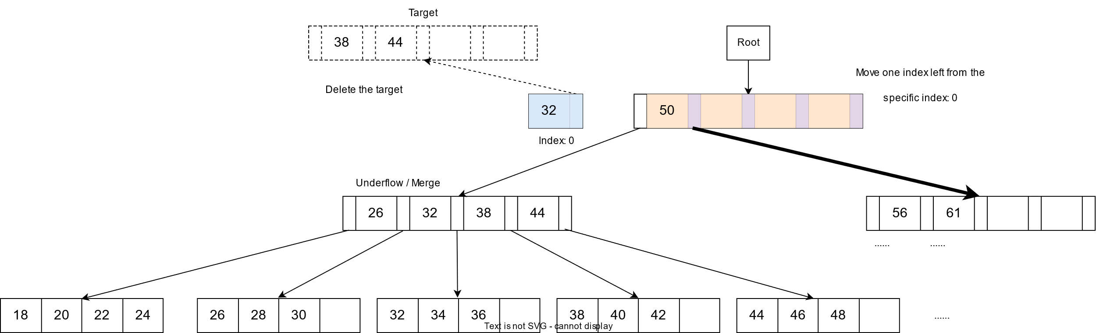
Rearrange Keys and Pointers in Parent
Command:
c 2
i 60 58 56 54 52 50 48 46 44 42 40 38 36 34 32 30 28 26 24 22 20 18 16
d 16

Slide 45
Algorithm Contents
Deletion and Re-Distribution
The Concept of Re-Distribution
Merge LEFT
Merge two data leaf nodes
Same parent
Different parent
Merge two internal nodes
Move LEFT
Move data between two leaf nodes
Move keys between two internal nodes
The Root Internal Node
Use These Two Rules to do Re-Distribution in Insertion

Slide 46
The Rules of Root Internal Node
Command:
c 2
i 60 58 56 54 52 50 48 46 44 42 40 38 36 34 32 30 28 26 24 22 20 18 16
d 16
The only situation we need to consider for root node is when there is no key in root.
After the previous step (delete 16), the root is (50, _, _, _) and thus we have done the deletion.
If there is no key in root, then we need to consider the following two situations:
If the root is NOT at bottom of index tree, then assign the new root to the only child of this empty root, delete the empty root, and assign the parent of the new root to NULL.
Otherwise, the root is at bottom. That is, there is only one internal node left. In this case, we need to assign the largest value in the only data leaf node plus 1 to be the new key in this root.

Slide 47
Algorithm Contents
Deletion and Re-Distribution
The Concept of Re-Distribution
Merge LEFT
Merge two data leaf nodes
Same parent
Different parent
Merge two internal nodes
Move LEFT
Move data between two leaf nodes
Move keys between two internal nodes
The Root Internal Node
Use These Two Rules to do Re-Distribution in Insertion

Slide 48
Algorithm Contents
Deletion and Re-Distribution
The Concept of Re-Distribution
Merge LEFT
Merge two data leaf nodes
Same parent
Different parent
Merge two internal nodes
Move LEFT
Move data between two leaf nodes
Move keys between two internal nodes
The Root Internal Node
Use These Two Rules to do Re-Distribution in Insertion

