Slide 1
數位系統導論實驗 Lab 7 梁郁珮
2022/05/02
2022/05/04

Slide 2

Probability(1/3)
如何寫出具有機率性質的程式?
int x = rand() % 100;
成功
40%
x = 0 ~ 99
if(x < 40)
成功
else
失敗
60%
失敗

Slide 3
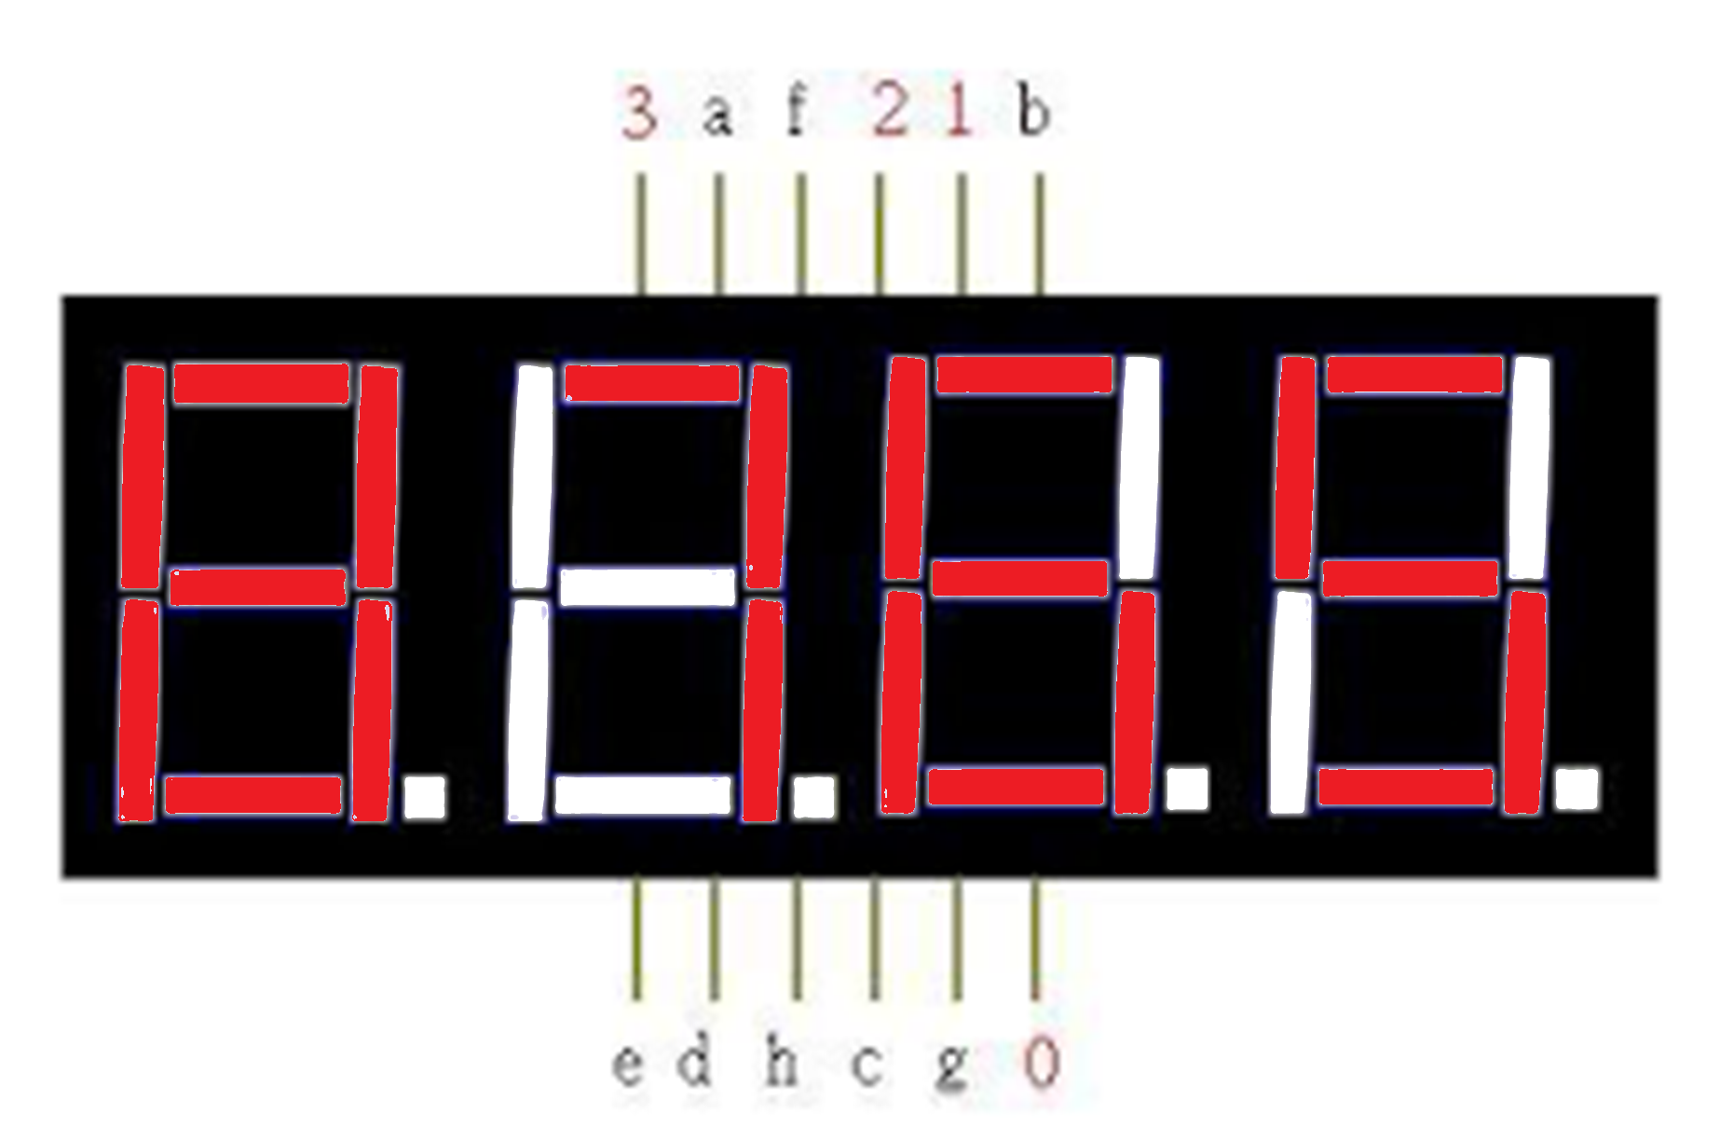
Probability(2/3)
4合1七段顯示器運行方式：
快速的輪流閃爍
t(ns) | 0 | 1 | 2 | 3 | 4 | 5 | 6 | 7 | 8 | 9 | 10 | 11
a~f | 5 | 6 | 7 | 8 | 5 | 6 | 7 | 8 | 5 | 6 | 7 | 8
0 | 1 | 0 | 0 | 0 | 1 | 0 | 0 | 0 | 1 | 0 | 0 | 0
1 | 0 | 1 | 0 | 0 | 0 | 1 | 0 | 0 | 0 | 1 | 0 | 0
2 | 0 | 0 | 1 | 0 | 0 | 0 | 1 | 0 | 0 | 0 | 1 | 0
3 | 0 | 0 | 0 | 1 | 0 | 0 | 0 | 1 | 0 | 0 | 0 | 1

Slide 4
Probability(3/3)
閃爍 = 肉眼可見的消失
亮度 = 肉眼跟不上的閃爍
t(ns) | 0 | 1 | 2 | 3 | 4 | 5 | 6 | 7 | 8 | 9
A | 1 | 1 | 1 | 1 | 1 | 1 | 1 | 1 | 1 | 1
B | 1 | 0 | 1 | 0 | 1 | 0 | 1 | 0 | 1 | 0
C | 1 | 1 | 1 | 1 | 1 | 0 | 0 | 0 | 0 | 0
恆亮
50%
閃爍

Slide 5
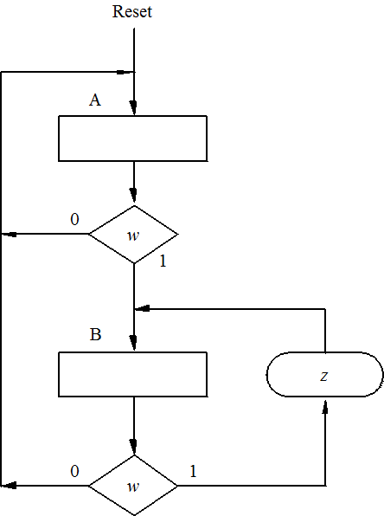
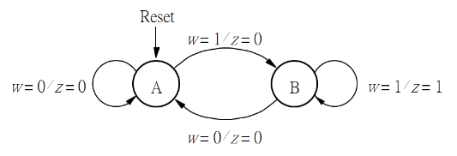
FSM(1/5)
Sequence Recognizer “11” (Mealy)
(a) State diagram
(b) ASM chart

Slide 6
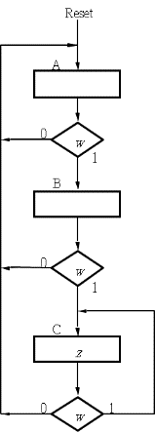
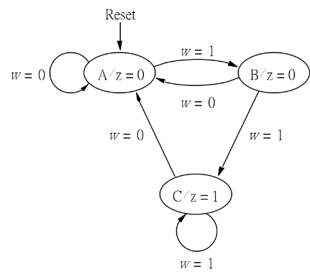
FSM(2/5)
Sequence Recognizer “11” (Moore)
(a) State diagram
(b) ASM chart

Slide 7
FSM(3/5)
reset
密碼為‘101’的數字鎖
以狀態圖表示為：
1
1
0
0/0
1/0
輸入為:001、111、011都會在這個state
到達這裡時一定是輸入除了101以外的XX1
到達這裡時一定是reset或是連續輸入多個0
0
1
0
輸入為:00101、11101、01101、10101都會在這個state
(到達這裡時一定是連續輸入101)
3/1
2/0
0
輸入為:0010、1110、0110、1010都會在這個state
到達這裡時一定是0~n個1和一個0
FSM狀態圖
1

Slide 8
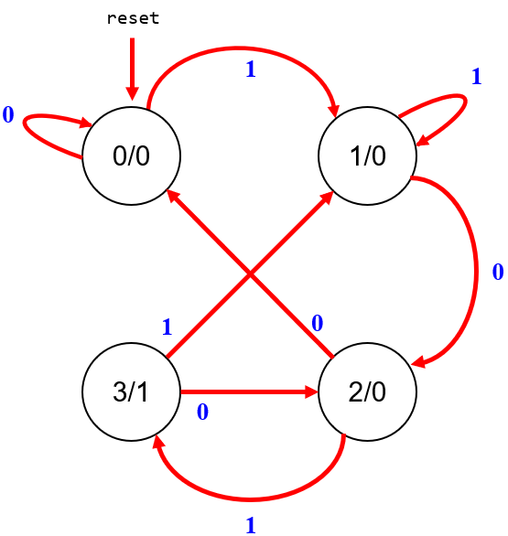
FSM(4/5)
reset
隨機輸入in和相對應的狀態表
t(ns) | 0 | 1 | 2 | 3 | 4 | 5 | 6 | 7 | 8 | 9
Cur state | 0 | 1 | 2 | 3 | 2 | 3 | 1 | 2 | 0 | 0
In | 1 | 0 | 1 | 0 | 1 | 1 | 0 | 0 | 0 | 1
Next state | 1 | 2 | 3 | 2 | 3 | 1 | 2 | 0 | 0 | 1
out | 0 | 0 | 1 | 0 | 1 | 0 | 0 | 0 | 0 | 0
‘101’密碼鎖的真值表
Cur state D1 | Cur State D0 | in | Next State D1 | Next State D0 | Out
0 | 0 | 0 | 0 | 0 | 0
0 | 0 | 1 | 0 | 1 | 0
0 | 1 | 0 | 1 | 0 | 0
0 | 1 | 1 | 0 | 1 | 0
1 | 0 | 0 | 0 | 0 | 0
1 | 0 | 1 | 1 | 1 | 1
1 | 1 | 0 | 1 | 0 | 0
1 | 1 | 1 | 0 | 1 | 0
FSM狀態圖

Slide 9
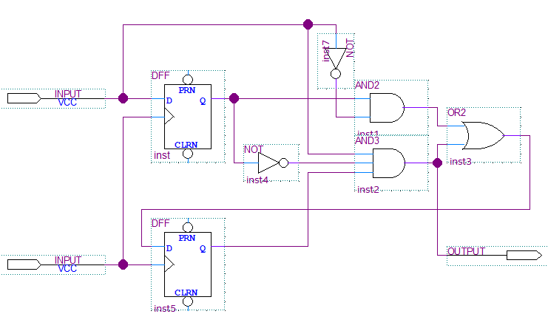
FSM(5/5)
FSM布林代式
Cur state D1 | Cur State D0 | in | Next State D1 | Next State D0 | Out
0 | 0 | 0 | 0 | 0 | 0
0 | 0 | 1 | 0 | 1 | 0
0 | 1 | 0 | 1 | 0 | 0
0 | 1 | 1 | 0 | 1 | 0
1 | 0 | 0 | 0 | 0 | 0
1 | 0 | 1 | 1 | 1 | 1
1 | 1 | 0 | 1 | 0 | 0
1 | 1 | 1 | 0 | 1 | 0
D1(next) = D0·in + D1·D0·in
D0(next) = in
Out = D1·D0·in
in
D0
clock
out
D1
個別畫卡諾圖
FSM真值表
FSM電路圖

Slide 10
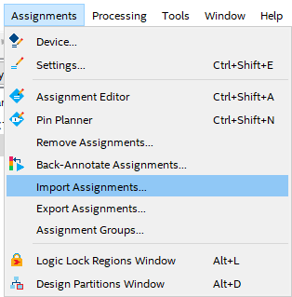
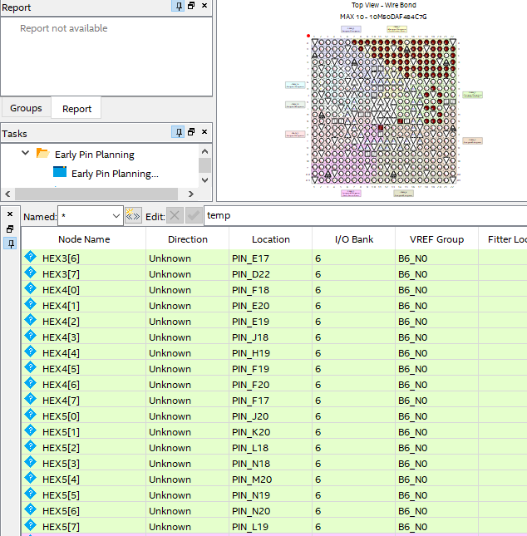
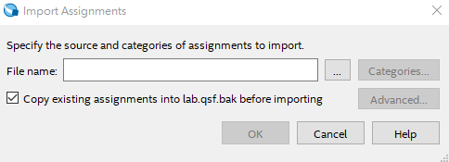
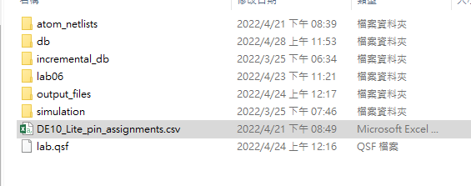
Pin Planner
自動匯入所有Pin腳
(程式輸入輸出名稱需與匯入名稱相同)
1.
2.
3.

Slide 11
Sample
一秒50,000,000的clock中，一半的時間亮state，一半的時間暗掉
(seven_seg中num=10是全暗)
‘101’狀態的程式碼，把即時改變的input存進nstate，等clock來再傳進state中
always@(posedge clk_1hz or negedge rst)
begin
if(!rst) state <= 0;
else state <= nstate;
end
always@(negedge press or negedge rst)
begin
if(!rst) nstate <= 0;
else
begin
case(state)
4'h0: nstate <= (SW[0]) ? 4'h1 : 4'h0;
4'h1: nstate <= (SW[0]) ? 4'h1 : 4'h2;
4'h2: nstate <= (SW[0]) ? 4'h3 : 4'h0;
4'h3: nstate <= (SW[0]) ? 4'h1 : 4'h2;
default: nstate <= nstate;
endcase
end
end
always@(posedge clk or negedge rst)
begin
if(!rst) counter <= 0;
else if(counter == 1)
counter <= 0;
else
counter <= counter + 1;
end
always@(posedge clk or negedge rst)
begin
if(!rst)
begin
num[0] <= 0;
num[1] <= 10;
num[2] <= 10;
num[3] <= 10;
num[4] <= 10;
num[5] <= 10;
end
else if(counter == 1)
num[0] <= state;
else
num[0] <= 10;
end
counter | num[0]
0 | 10
1 | State
0 | 10
1 | State
0 | 10
1 | State
0 | 10
1 | State
全暗
case(seg_number)
.
.
.
4’d9 :seg_data <= 8’b1001_0000;
4’d10:seg_data <= 8’b1111_1111;
.
.
.
endcase

Slide 12
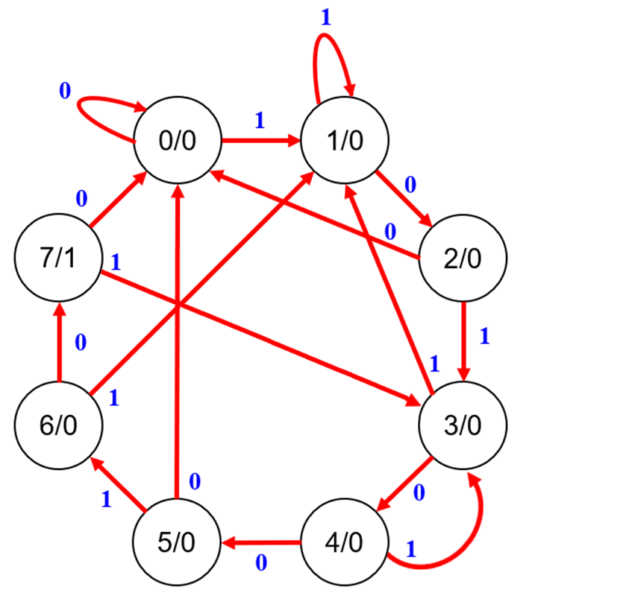
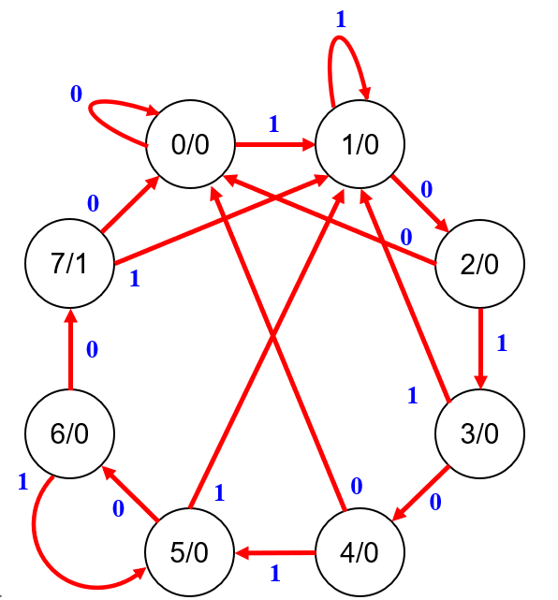
實 驗 項 目
7-1. 請參考範例程式碼並使用內建50MHz時脈，實作出以SW[0]為輸入且密碼為101_0010的數字鎖，解鎖後顯示oPEn
7-2. 請使用SW[9:1]實作出有優先權順序，控制七段顯示器亮度的程式(亮度從10%~90%,全關=100%)
10%亮度
9 8 7 6 5 4 3 2 1 0
30%亮度
9 8 7 6 5 4 3 2 1 0
100%亮度
9 8 7 6 5 4 3 2 1 0

Slide 13
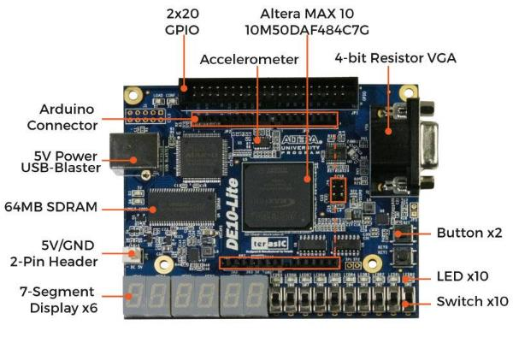
實 驗 項 目
press
rst
“oPEn”
state
bright
in

Slide 14












實 驗 項 目
連續輸入對的密碼時，程式應該運行的狀態

Slide 15
Report of lab 7 (4%)
The report should include …
請畫出實驗FSM的真值表。
請畫出實驗FSM的狀態圖。
請畫出實驗FSM的電路圖。
心得與討論
題目難度: 超難/難/普/易/超易
File type: pdf
File name: Lab7_(Number of team)_report
Deadline: 2022/05/11 23:59

