Slide 1
Before doing anything else:
Fork: https://github.com/lschwetlick/2024-ims-CI-project
Clone!
Make an environment
Pip install brewing pytest
Run pytest to see if everything works!

Slide 2

Sphinx
Lisa Schwetlick
Stuttgart 2024

Slide 3
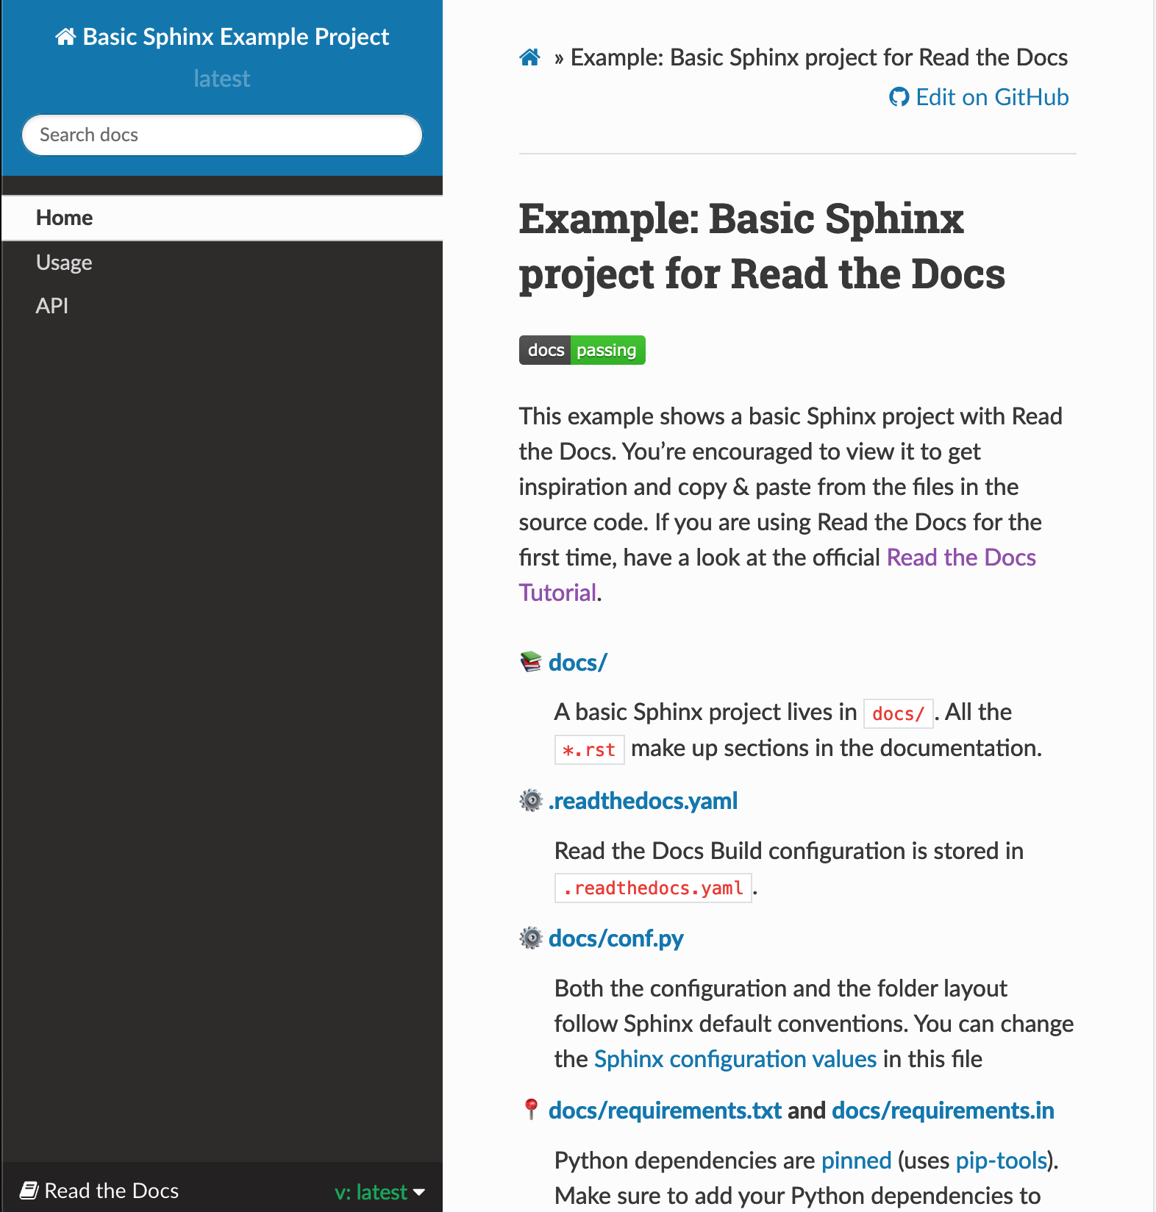
Documentation
Aside from comments and docstrings we want a professional documentation!
Why?
It makes your code much more usable
Nobody likes having to open the code files to find out what the function does
You can add examples and notebooks
It makes for a great portfolio to showcase your work!
Example:
http://lisaschwetlick.de/SceneWalk_Model/
https://github.com/computational-psychology/stimupy

Slide 4
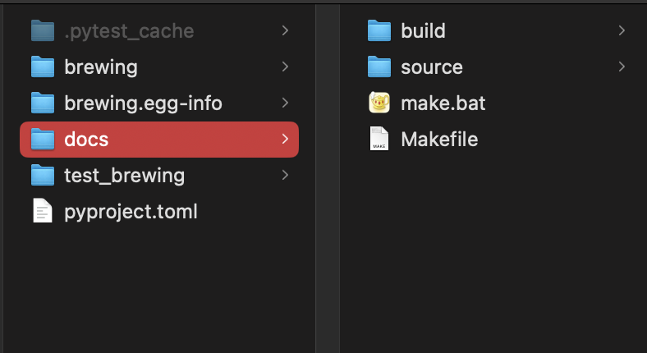
Steps
In your environment
pip install sphinx
Make a folder called docs
Move to that folder
In your [my_project]/docs folder:
sphinx-quickstart
separate folders: yes please!
In your docs folder:
make html
In the docs/build/html folder you will find index.html that contains your current documentation

Slide 5
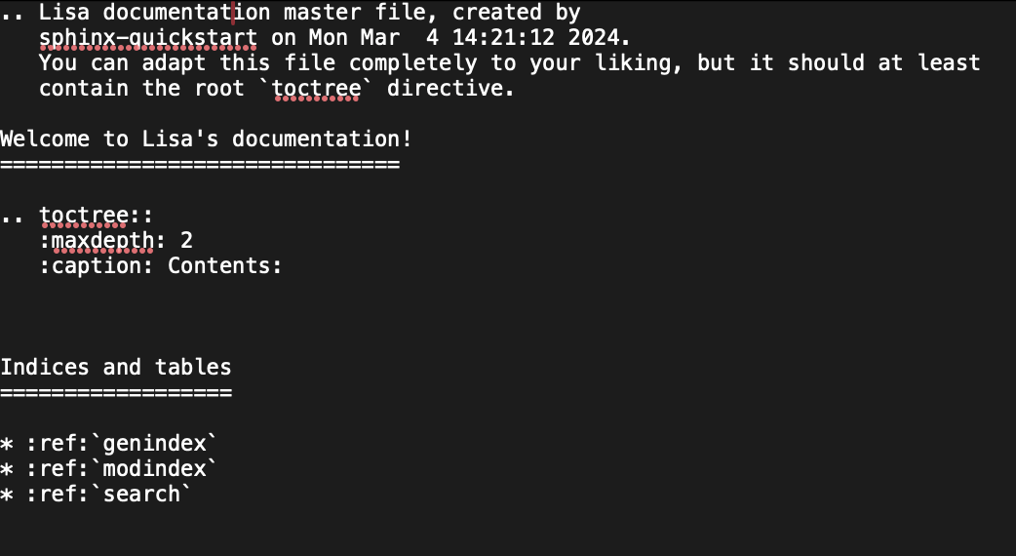
Index.rst
docs/source/index.rst
You can write a kind of markdown, with all the information you like
Make multi-page websites (multiple rst files)

Slide 6
Exercise
Install sphinx
set up the repo for it
Make html
Change something about your index.rst file
Make html again and see the changes

Slide 7
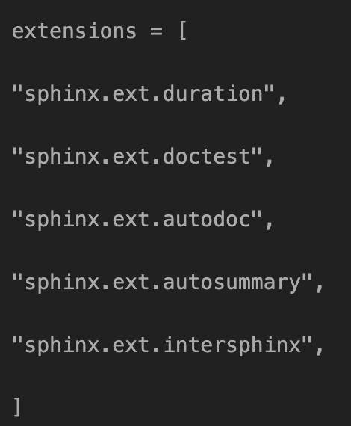
Autodoc
The main advantage of using something like sphinx is the autodocumentation features
Add your docstrings to the documentation page directly
If you change it in the code, it will update in the documentation too
Add the appropriate extensions to the conf.py file
Add the appropriate references to the index.rst

Slide 8
conf.py
Configuration file written in python
You can add a lot of different configurations
Check out the like for examples and ideas
https://www.sphinx-doc.org/en/master/examples.html
extensions = [
"sphinx.ext.duration",
"sphinx.ext.doctest",
"sphinx.ext.autodoc",
"sphinx.ext.autosummary",
"sphinx.ext.intersphinx",
]

Slide 9
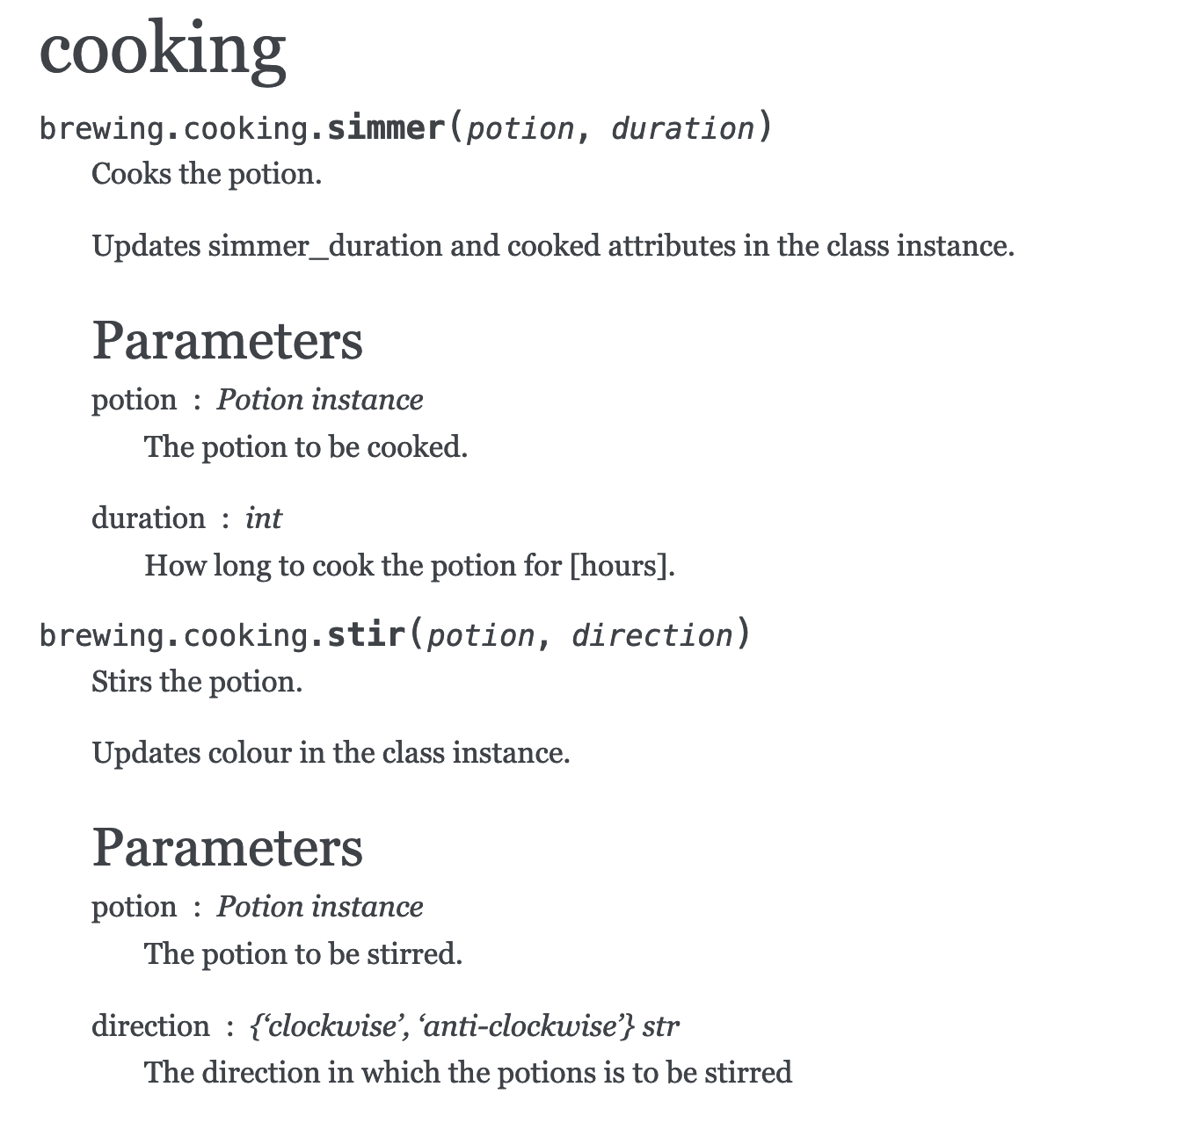
Index.rst
Conf.py has to import your package
They advise to add to PYTHONPATH. I recommend just installing your package with pip!
cooking
===================
.. automodule:: brewing.cooking
:members:
Automatically looks up your docstrings

Slide 10
Exercise
Take the files from the templates/example_docs_files folder
Copy them to docs/source
Look at the index.rst file to understand the structure of how the pages are built
Make html
Open index.html -> navigate to the contributing page
Follow the intructions there!
PR?

Slide 11
readthedocs.io
Hosting site for documentation pages
https://docs.readthedocs.io/en/stable/tutorial/index.html
Sign up
Integrated with Github
import any Github repo
Add readthedocs.yaml file (see template)
Make sure the path to the conf.py file is correct
Your documentation is automatically built and updated!

Slide 12

Thank you!

