Slide 1
Outline
Local importing
→ review and best practices
Packages and editable installations
→ avoid importing errors
Repo structure
→ organize folders and files in a standardized way
Accessibility
→ make code more readable, understandable and usable
Environments
avoid and alleviate package installation problems

Slide 2
repo structure

Slide 3
Motivation
We now know what a package is and how to install it.
But often there are additional files you want in a repo.
.gitignore, LICENSE, tests, examples, data, …
Where should the package code and everything else go?

Slide 4
Where things go
There are no “rules”…
…but there are guidelines.

Slide 5
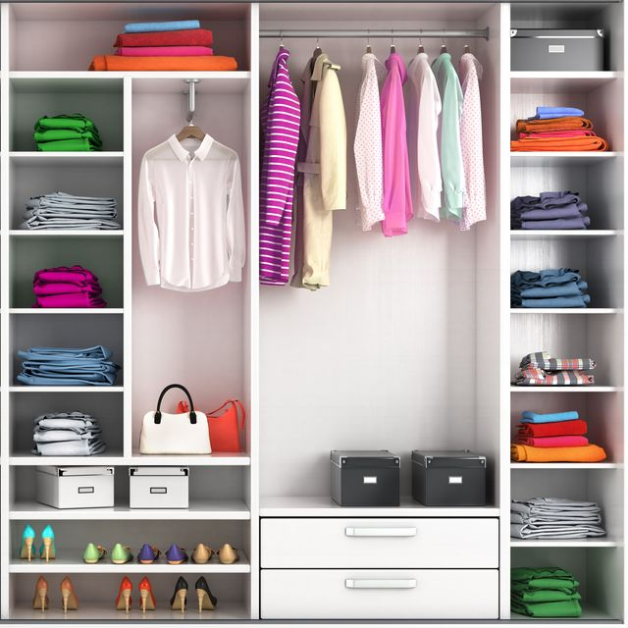

Why you should care
maybe make analogy to kitchen instead of wardrobe?
—> know where to find items in someone else’s code
e.g. wardrobe
suit, shirts
towels
socks
—> science/engineering is
collaborative problem
solving. Facilitate
collaboration.

Slide 6
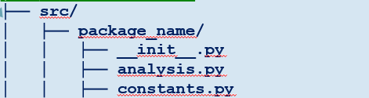
Guidelines
Nest package in src/ folder.
Recommended by Python Packaging Authority [1]. Reduces accidental imports + other benefits.
No need to modify pyproject.toml to include src/, package will be auto-discovered [2].
Only ship reusable code in your package.
User-specific settings, examples, data, etc., should go elsewhere.
Tests may or may not be shipped with your package. Depends on what you want. [3]
Everything else should be…elsewhere.

Slide 7
Other notable files
.gitignore so you don’t add
pycache files ;)
my_project/
├── .gitignore
├── LICENSE
├── notebooks_scripts
│ ├── demo.ipynb
│ ├── recreate_paper_figures.py
├── pyproject.toml
├── README.md
├── requirements.txt
├── src/
│ ├── package_name/
│ │ ├── __init__.py
│ │ ├── analysis.py
│ │ ├── constants.py
│ │ ├── data_preprocessing.py
│ │ ├── data_visualization.py
│ │ ├── file_io.py
│ │ ├── models.py
├── tests/
│ ├── test_analysis.py
│ ├── test_data_processing.py
│ ├── test_models.py
LICENSE makes the package (legally) usable.*
README contains more information e.g. instructions on how to use your package.
requirements.txt in case dependencies
in pyproject.toml is not
sufficient
7
* pick one from choosealicense.com

Slide 8
Organizing files
Like in many other areas in life, code is often organized by purpose or thematically.
Separate folders:
src - package
scripts and notebooks – for demonstrations, teaching, examples, accompanying papers
Note that tests can be in package OR outside [3].
my_project/
├── .gitignore
├── LICENSE
├── notebooks_scripts
│ ├── demo.ipynb
│ ├── recreate_paper_figures.py
├── pyproject.toml
├── README.md
├── requirements.txt
├── src/
│ ├── package_name/
│ │ ├── __init__.py
│ │ ├── analysis.py
│ │ ├── constants.py
│ │ ├── data_preprocessing.py
│ │ ├── data_visualization.py
│ │ ├── file_io.py
│ │ ├── models.py
├── tests/
│ ├── test_analysis.py
│ ├── test_data_processing.py
│ ├── test_models.py
8

Slide 9
Organising file contents
Like in many other areas in life, code is often organized by purpose or thematically
Separate code into files/folders by
purpose / theme – data handling, preprocessing, plotting, …
type – i/o config, parameters, functions
Single responsibility principle
my_project/
├── pyproject.toml
├── src/
│ ├── package_name/
│ │ ├── __init__.py
│ │ ├── analysis.py
│ │ ├── constants.py
│ │ ├── data_preprocessing.py
│ │ ├── data_visualization.py
│ │ ├── file_io.py
│ │ ├── models.py

Slide 10
Organising file contents
Within-module standard order:
1. imports
standard Python library
installed packages
local modules
2. constants
DATA_DIR = "/path/to/data"
3. classes and functions
class ClassName:
def func_name():
4. main execution block
if __name__ == "__main__":

Slide 11
Retrieval practice
my_project/
├── .gitignore
├── LICENSE
├── notebooks_scripts
│ ├── demo.ipynb
│ ├── recreate_paper_figures.py
├── pyproject.toml
├── README.md
├── requirements.txt
├── src/
│ ├── package_name/
│ │ ├── __init__.py
│ │ ├── analysis.py
│ │ ├── constants.py
│ │ ├── data_preprocessing.py
│ │ ├── data_visualization.py
│ │ ├── file_io.py
│ │ ├── models.py
├── tests/
│ ├── test_analysis.py
│ ├── test_data_processing.py
│ ├── test_models.py
Discuss briefly with your partner.
How do you structure your repos/code now?
What, if anything, would you change about your current structure?
What concerns/questions do you have about these guidelines for repo structure?
(5 min)
11

Slide 12
Discussion

Slide 13
defend your code

Slide 14
References
src layout vs flat layout - Python Packaging User Guide
Package Discovery and Namespace Packages
Good Integration Practices - pytest documentation

