Slide 1
Outline
Local importing
→ review and best practices
Packages and editable installations
→ avoid importing errors
Repo structure
→ organize folders and files in a standardized way
Accessibility
→ make code more readable, understandable and usable
Environments
avoid and alleviate package installation problems

Slide 2
accessibility
Notes:
Goal time: 20 minutes (?)

Slide 3
Motivation
Motivation 1. You want to be computationally literate [1].
Three pillars of comp. literacy
Material
Writing a function, using an IDE, etc.
Cognitive
From abstract to computationally tractable.
Social
Community around code.
Motivation 2. You want to make your code easier to understand.
--> Also for future you :)

Slide 4
Accessibility
Two ways to enhance accessibility of your code:
Readability: Adherence to stylistic conventions (PEP8 [2])
Understandability: Comments and docstrings (PEP257 [3])
Spoilers: there are tools to help!

Slide 5

What is PEP
PEP = “Python Enhancement Proposal”
Conventions to standardize python code
Not a standard, not enforced (recommendations/suggestions)
Violating PEP does not break your code (not like div 0)
Aim is to be helpful
Focus for this lecture:
PEP8: Style Guide for Python Code [2]. Code layout, naming conventions, etc.
PEP257: Docstring Conventions [3] - How to document function, classes for user

Slide 6
What is PEP
PEP = “Python Enhancement Proposal”
Conventions to standardize python code
Not a standard, not enforced (recommendations/suggestions)
Violating PEP does not break your code (not like div 0)
Aim is to be helpful
Focus for this lecture:
PEP8: Style Guide for Python Code [2]. Code layout, naming conventions, etc.
PEP257: Docstring Conventions [3] - How to document function, classes for user

Slide 7
PEP8
Style Guide for Python Code [2]
“[I]ntended to improve the readability of code and make it consistent across the wide spectrum of Python code.” [2]
Answers questions like:
Should that variable be capitalized or have underscores?
How many spaces should go around an equals sign?
What is the correct order of imports at the top of a file?
Some projects may intentionally not follow PEP8. “Consistency…is the most important.” [2]

Slide 8
Investigate PEP8
Jenni will assign you a letter: A, B, or C. Follow the instructions in Exercise 6a PEP8.
There is no need to make a Pull Request for this exercise.
(10 minutes)

Slide 9
Anything interesting?
Set A
(add in plenum)
Set B
(add in plenum)
Set C
(add in plenum)

Slide 10
Tools to help
PEP8:
pylint.
Static analysis tool.
Informs you of PEP8 violations + other bad-coding practices.
Enable it in your IDE!
ruff.
Python code formatter.
Automatically formats your code to PEP8.
Can enable in your IDE to auto-format on save.

Slide 11
Typing
As of Python 3.5, you can declare the type of the function argument.
There are pros and cons to using typing.
Be aware that this might be a pain to maintain if you change your functions often and pass complicated objects… tuple[int, dict[str, str]]
See PEP484 [4].
""" This module demonstrates docstrings. """
def add_points(house: str,
house_points: int,
points: int = 0)
-> int:
""" Adds up points for house cup.
If the house is Gryffindor, Dumbledore adds
1000 points no matter what.
Parameters
----------
house_points : Current house cup score.
points : optional; New points to be added
"""
if house == “Gryffindor”:
points += 1000
return house_points + points

Slide 12

Typing
As of Python 3.5, you can declare the type of the function argument.
There are pros and cons to using typing.
Be aware that this might be a pain to maintain if you change your functions often and pass complicated objects… tuple[int, dict[str, str]]
See PEP484 [4].

Slide 13

Accessibility
Two ways to enhance accessibility of your code:
Readability: Adherence to stylistic conventions (PEP8 [2])
Understandability: Comments and docstrings (PEP257 [3])
Spoilers: there are tools to help!

Slide 14
Documentation
I could walk you through comments, function docstrings, method docstrings etc. However, you need to consider…
1. Only up-to-date documentation is useful documentation.
2. Once you have finished writing your documentation, it is basically out-of-date if you are not SUPER diligent about updating it.
→ Try to make your code self-explanatory!

Slide 15
Documentation
Skip
Documenting your code provides a way of making you code usable for future you and others
Comments (#): describe what a line (or multiple lines of code do); notes to self
Function/method docstring (''' '''): purpose of function + params / return
Module docstring (''' '''): what’s in this file
Accessible via mouse-overs in IDE or help(OBJECT).
""" Module docstring """
def add_points(points, extra_points):
""" Function docstring."""
# comment
points += extra_points
return points

Slide 16
PEP257
Skip
Docstring conventions [3]
You guessed it…guidelines for docstrings.
Answers questions like:
What verb tense should I use for one-liner docstrings?
What indentation should I use within a docstring?
Etc.
I will not drag you through PEP257.

Slide 17
Overloaded
Skip
Skip
We have three new PEPs…
PEP8, PEP257 and PEP484.
Remembering all these rules is too much.
→ Static analysis tools!
[6]

Slide 18


Tools to help
Skip
PEP8:
pylint.
Static analysis tool.
Informs you of PEP8 violations + other bad-coding practices.
Enable it in your IDE!
ruff.
Python code formatter.
Automatically formats your code to PEP8.
Can enable in your IDE to auto-format on save.
PEP257:
pydocstyle.
Static analysis tool.
Checks compliance with PEP257.
autoDocstring.
VS code plug-in to auto-generate docstring based on inputs, outputs.
PEP484:
mypy.
Static type checker for Python.
Checks compliance with PEP484 (and more).

Slide 19
Accessibility
Skip
Two ways to enhance accessibility of your code:
Readability: Adherence to stylistic conventions (PEP8 [2])
Understandability: Comments and docstrings (PEP257 [3])
Spoilers: there are tools to help!

Slide 20
make your code self-explanatory

Slide 21
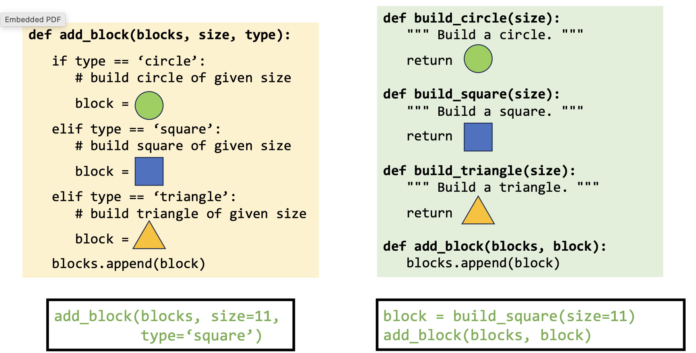
Towards self-explanatory code
Examples of making functions less spaghetti and more modular and readable
avoid writing spaghetti code
get rid of code repetitions
get rid of code you do not need
make things modular
name your variables to that you can read what they do
single responsibility principle
break out things that vary independently
put loading and saving stuff in extra functions, also plotting
magic numbers
nested if and for loops – naming of stuff

Slide 22
Towards self-explanatory code
Examples of making functions less spaghetti and more modular and readable
avoid writing spaghetti code
Moving away from Jupyter
Debugging
Magic numbers,
Demontrate side effects in functions by modifying an array / data frame that comes in and getting a new list out, but original has also been altered
Encourage to pair on code
Talk to the duck
Pair programming - remember that everyone has written shitty code in their life

Slide 23
Variable names
added_points = [10, 5, 1]
# —> variable names use underscores
def add_points(house, house_points, points=0):
if house == “Gryffindor”:
points += 1000
return house_points + points
# —> function names also use underscores
class ScoreKeeper():
def __init__(self):
self.house_points = 0
self._secret_bonus = 5
def add_points(self, house, points):
if house == “Gryffindor”:
points += 1000
return house_points + points
# —> Class names use CamelCase
# —> private variables (intended for use only within the class) prepend “_”
if chatgpt tries to import pandas._testing, that is wrong!

Slide 24
Variable names
def add_points(points, extra_points):
points += extra_points
return points
name your variables so that you can later go back and *read* what the code does (same principle as with module names)
x = 10
p = 10
poi = 10
points = 10
points_add = 10
points_to_be_added = 10
x = 10 —> terrible
p = 10 —> just as terrible
poi = 10 —> still terrible
points = 10 —> better, but potentially unspecific
points_add = 10 —> possibly better, possible worse that the one before
points_to_be_added = 10 # clear, but maybe a bit long

Slide 25
Extra material

Slide 26
Keeping track of docstrings
Most commonly used hosting websites: facilitate building, versioning, and hosting
github.io
readthedocs.org
Automate documentation
Sphinx: a package to collect docstrings and create a nicely formatted documentation website

Slide 27
References
DiSessa, Andrea A. Changing minds: Computers, learning, and literacy. Mit Press, 2000.
PEP 8 – Style Guide for Python Code | peps.python.org
PEP 257 – Docstring Conventions | peps.python.org
PEP 484 – Type Hints | peps.python.org
Example NumPy Style Python Docstrings
Dizzy 2 (Animation GIF) by QToons on DeviantArt

Slide 28
Contents
usability features:
1) separate, individually usable projects
virtual environments
2) clean folder and file structure
standard Python package structure
3) error-free importing of code
editable pip installation
4) readability
documentation, typing, naming

Slide 29
References
https://journals.plos.org/plosbiology/article?id=10.1371/journal.pbio.1001745
https://journals.plos.org/ploscompbiol/article?id=10.1371/journal.pcbi.1005510#pcbi.1005510.ref001
https://goodresearch.dev/

