Slide 1
uRProgramming
Zekai Otles
3/15/2017
Madison R user Group Meeting

Slide 2
1. Introduction
Teaching to myself and others R programming.
Approach R programming to similar to the programming languages used in software engineering.
Benefits utilizing other auxiliary tools.
Disadvantages of not using modular programming and software development tools.

Slide 3
What is R
Programming language mainly used for statistical programming
Free to download and use
Strong Contribution from user Community
Relative to the other statistical programming
Deficits, except CRAN there is no authority to verify the packages

Slide 4
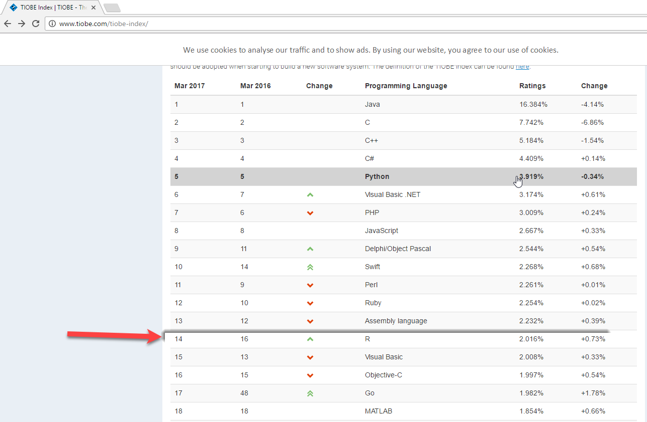

Slide 5
R Distribution
Linux
  Debian
  Ubuntu
Windows
Mac OS
CRAN packages (over 10,000 packages)
https://cran.r-project.org/web/packages/

Slide 6
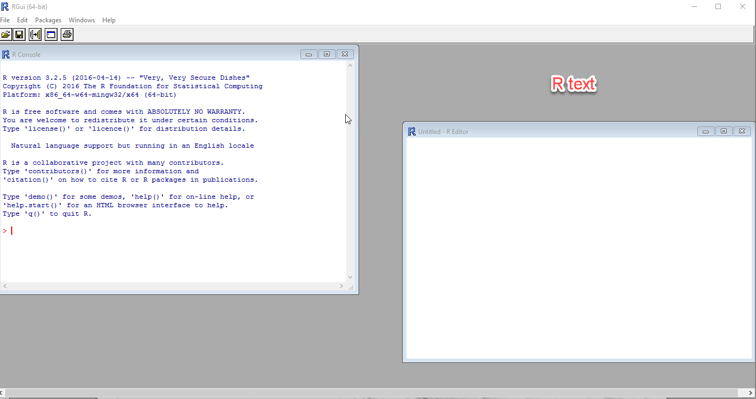
2 Environment Setup for R scripts
Windows (once you installed R)
  RGUI or R shell is avaliable
Or use IDE like Rstudio or Microsoft R open

Slide 7
How do you maintain the scripts
Manually create different versions
Or use version control common practice
  Version control such as git, svn or commercial products
  One way is to use graphical or command line interface
Chapter II uRProgramming

Slide 8
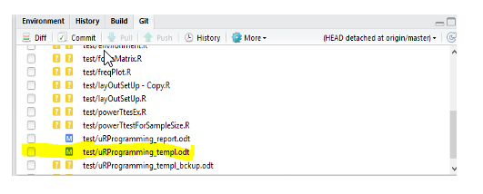
Git plugin Rstudio (live demo from R studio)

Slide 9
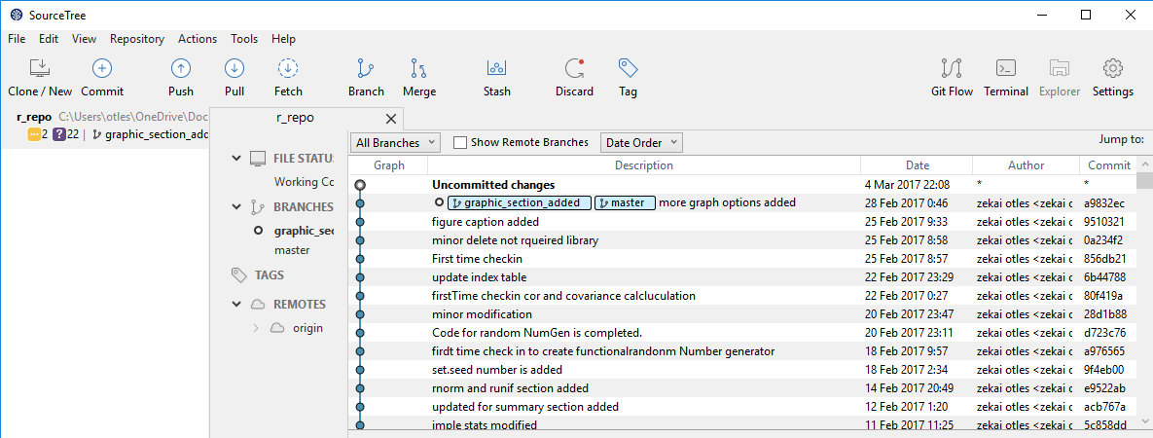
Source tree (live demo)

Slide 10
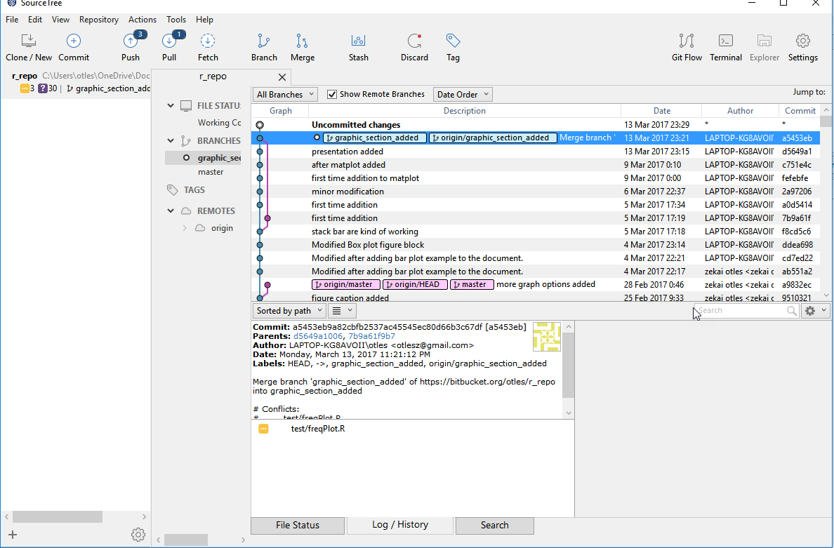
Source tree (live demo)

Slide 11
Demo version control
Use git with Rstudio
Checkin
Modify
Pull
Push

Slide 12
Build R package
Command line
Build package from Rstudio

Slide 13
Modular Programming
In general, long scripts are pretty common
Modularize the scripts using function
Generalize the functions, so it can be used for multiple times
Ex. Functions

Slide 14
3. Data types in R
Logical
Character
Integer
Double
Complex
Ex:

Slide 15
4. Conditional Statements
If block
If {} else {}
Switch (modular if block)
switch("iki", bir = "bir", iki = "Two", uc = "uc")
[1] "Two"

Slide 16
5. Loop structures
Reaching elements by sequence
for (values in sequence) {
statement
}
Access of certain elements by controlling
while(expression){
statement
}

Slide 17
6. Data Structures
Where the data stored
  Database file (MySQL)
  Flat data files (csv, excel files)

Slide 18
Data Structures
Data Frame
Vector for atomic data types, such as integer
Matrix (special two dimensional array storage)
Array one to multi dimesional data storage
List heteregenous data storage

Slide 19
7. Simple Statistical Functions
Simple Stats
Normal Distrubution
Random Number Generation (seed)

Slide 20
8. Graphical Outputs
Histogram
Barplot
Stack barplot
Multiline xy plots

Slide 21
Table Output
Table
as.table

