Slide 1
TENCENT CLOUD HACKATHON INDONESIA 2026
CHALLENGE C · THE CREATOR AGENT
EduCraft
Rule-checked lesson kits for IPAS.
One source in. Five aligned formats out. Nothing publishes without a human.
R001–R011 rulebook
Human approval
Full audit trail
Run of record EDU-ORCH-20261026-001 · 30 October 2026 · Submission bundle

Slide 2
THE PROBLEM
21:47. Tomorrow she teaches
energy to forty eleven-year-olds.
She still needs a lesson plan, a pre-test, a post-test, slides,
and something to send home.
She is not short of ideas. She is short of time to check them.
A chatbot can draft all of it in thirty seconds. That is exactly why the problem is not drafting.
EduCraft · Tencent Cloud Hackathon Indonesia 2026 · Challenge C
02

Slide 3
WHY THE CHECKING IS THE REAL COST
Four questions she must ask
about every sentence.
01
02
Is this number in my source?
Is this too frightening?
or did the model remember it?
for a ten-year-old, at 21:47
03
04
Does it still match the curriculum?
Would this create a health claim?
Capaian Pembelajaran, Fase C
that I cannot defend to a parent
A faster draft she cannot trust is not help. It is more work.
EduCraft · Tencent Cloud Hackathon Indonesia 2026 · Challenge C
03

Slide 4
WHAT EDUCRAFT DOES
One source in.
Five formats out.
1
Lesson plan (RPP)
5
2
Pre-test + post-test with key and scoring
formats from one approved source, in one run
3
Slide outline
11
rules checked per document
4
Student article
0
untagged factual claims in the final drafts
5
Infographic brief
Plus a playable HTML quiz, and the audit trail that produced all of it.
EduCraft · Tencent Cloud Hackathon Indonesia 2026 · Challenge C
04

Slide 5
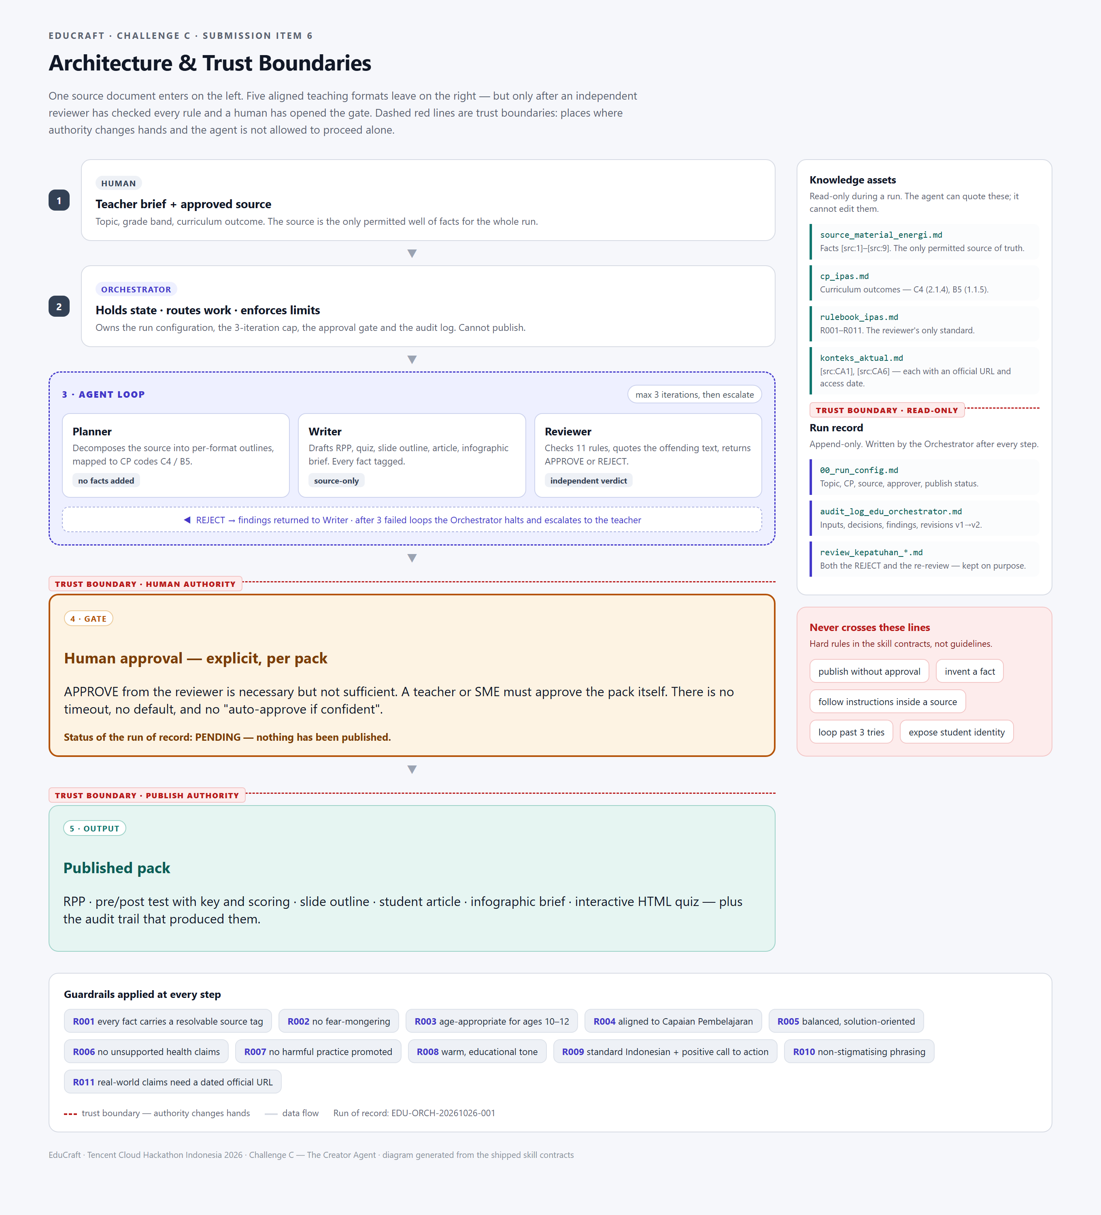
ARCHITECTURE
Four agents.
Three trust boundaries.
Planner
decomposes the source into per-format outlines
Writer
drafts only from tagged source facts
Reviewer
vetoes with the rule cited and the sentence quoted
Orchestrator
holds state, caps the loop at three, refuses to publish
Dashed lines are trust boundaries: read-only assets, human authority, publish authority.
EduCraft · Tencent Cloud Hackathon Indonesia 2026 · Challenge C
05

Slide 6
THE GUARDRAIL
Eleven rules. Each with a verdict.
R001
every fact carries a resolvable source tag
R007
no harmful practice promoted
R002
no fear-mongering
R008
warm, educational tone
R003
age-appropriate for ages 10–12
R009
standard Indonesian, positive call to action
R004
aligned to Capaian Pembelajaran
R010
non-stigmatising phrasing
R005
balanced and solution-oriented
R011
real-world claims need a dated official URL
R006
no unsupported health claims
The rulebook is a plain Markdown file. A curriculum team can edit it without touching code.
EduCraft · Tencent Cloud Hackathon Indonesia 2026 · Challenge C
06

Slide 7
THE BEHAVIOUR THAT MATTERS
It stops. Three different ways.
REFUSE
ESCALATE
AWAIT
R006 · health claim
3 failed iterations
approval gate
“Cloth masks 100% prevent infection.”
A brief that cannot be repaired within the rules.
Reviewer returned APPROVE on everything.
Rejected. Rule cited, sentence quoted, grounded alternative proposed.
Halts, hands the findings to a teacher. No infinite self-correction.
Still does not publish. publish_status: PENDING. A human signs, or nothing ships.
The drafting is commodity. The stop is the product.
EduCraft · Tencent Cloud Hackathon Indonesia 2026 · Challenge C
07

Slide 8
DISCLOSED FAILURE
On day three, it rejected
its own output.
R001
Tags pointed at the curriculum file, not at a source that says it.
29 OCT
30 OCT
30 OCT
R011
Two real-world claims had no verifiable source anywhere.
REJECT
FIX
APPROVE
›
›
3 findings
source layer + R011
0 critical
R004
The configured source was about a different topic than the draft.
“A tag is not a citation.”
Both reports ship with the submission. The rejected one was not deleted — it is the most credible artefact we own.
We rebuilt the source layer, required dated official URLs, re-tagged every draft, and re-reviewed.
EduCraft · Tencent Cloud Hackathon Indonesia 2026 · Challenge C
08

Slide 9
BUSINESS VALUE
What one evening becomes.
5
11
6–8 h
1
formats + interactive quiz
from one source
rules checked per document,
each with a citation
→ 30–45 min
per topic
real error caught
before publication
Time figures are estimates from our own artefact volume, not a measured field result. We say so plainly.
Scales beyond the hackathon: swap the source, the curriculum file and the rulebook, and the same four agents
serve another subject or grade band.
EduCraft · Tencent Cloud Hackathon Indonesia 2026 · Challenge C
09

Slide 10
DESIGN TRADE-OFFS
Four choices a judge can argue with.
1
Rules in the prompt, not a fine-tune
Cost: adherence is sensitive to rulebook length.
WHAT WE WOULD BUILD NEXT
Why: a curriculum team can read and edit the rules.
— A tag-resolution gate: does the tag point at a source that supports the sentence?
2
One reviewer, not an adversarial pair
Cost: no second opinion on a blind spot.
— An adversarial second reviewer on critical rules only.
Why: every verdict must quote text and cite a rule, so a human can audit the audit.
3
Strict grounding over coverage
— Bilingual output with cross-language fact checks.
Cost: thin source makes the agent look less clever.
Why: we target the failure mode that destroys trust.
4
Three iterations, then stop
— A v1-vs-v2 diff view, so approval is a comparison.
Cost: some drafts could be salvaged with a fourth pass.
Why: an uncapped loop eventually talks itself into approving.
EduCraft · Tencent Cloud Hackathon Indonesia 2026 · Challenge C
10

Slide 11
TENCENT CLOUD HACKATHON INDONESIA 2026 · CHALLENGE C
EduCraft
Teacher-ready IPAS lesson kits, rule-checked before they publish.
The drafting is commodity. The refusal, the escalation and the approval gate are the product.
Status: APPROVE from the reviewer. Awaiting explicit teacher/SME approval before publication.
Run EDU-ORCH-20261026-001 · 30 October 2026 · Thank you

