Slide 1
Bet4U: New sports betting platform
Oscar Torreno Tirado
Lead software engineer
EPAM Systems, Inc.
09/05/2022
CONFIDENTIAL | © 2019 EPAM Systems, Inc.

Slide 2
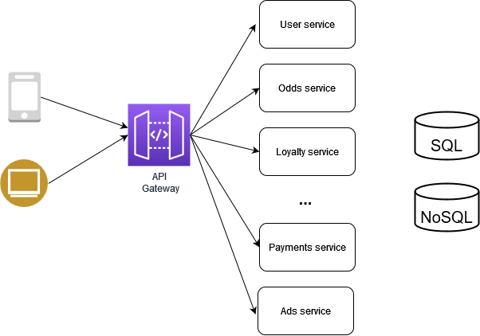
High level design: microservices architecture

Slide 3
Microservices
User service: provide user information
Odds service: real-time odds aggregated from the different feeders (using WebSockets)
Data import service: Lambda or ECS service that will be reading data from standardized topics (for user info, previous bets, etc.)
Admin service: allows changing the odds received from the odds provider (changing the values internally in the DynamoDB table)
Fraud detection service: integrating with a 3rd party or building an in-house ML model
Ads service: which based on user information and what the 3rdparty ads provider sends, it will send a concrete set of ads to the frontend
Loyalty program service: which will consume data produced by the analytics pipeline, and which can potentially query a ML model given the betting history
Betting service: which will be placing a bet and making sure it is paid accordingly. Event sourcing and CQRS will be used to ensure consistency and auditability
Currency exchange service: allows exchanging between different currencies. BitCoin should be one of them. This service should follow a similar architectural pattern to the previous one, to have evidences for future lawsuits.
Notifications service: will consult user settings and will act accordingly for a given notification

Slide 4
Other services
Streaming and batched analytics
Prevention of DDoS
Blocking bots, scrapers, crawlers

Slide 5
Considerations
For the migration, we believe a migration by decomposition would be less disruptive than migrating a small set of users only when the whole system is implemented. Main thing to keep in mind with this is that we should plan what functionality migrates when as the latency between on-premises and the cloud might be big
Latency and availability: as we are talking about a global company, to have similar latency regardless where users are located, the plan is to have the main architecture replicated in multiple regions. The previous is for our services, for databases we recommend to use single Aurora/DynamoDB global databases. Route53 will be routing users to the healthy region with the smallest latency
Scalability: the idea here is to set concrete auto-scaling policies to our different services, making sure the most critical ones will be scaled when needed.

Slide 6
Cloud provider: why?
The chosen cloud provider is AWS. There has been different reasons, some examples.
Technical:
EBS volumes speed compared to standard storage on Azure
No long-term storage on Azure (opposed to Amazon Glacier on AWS)
Diverse set of options to provide the necessary compute on AWS, way more diverse than in Azure
Non-technical
More options to migrate data in the TB range on AWS compared to Azure (Snowball)
EPAM team has an extensive knowledge on AWS, what would reduce the risks to deliver the project in time

Slide 7
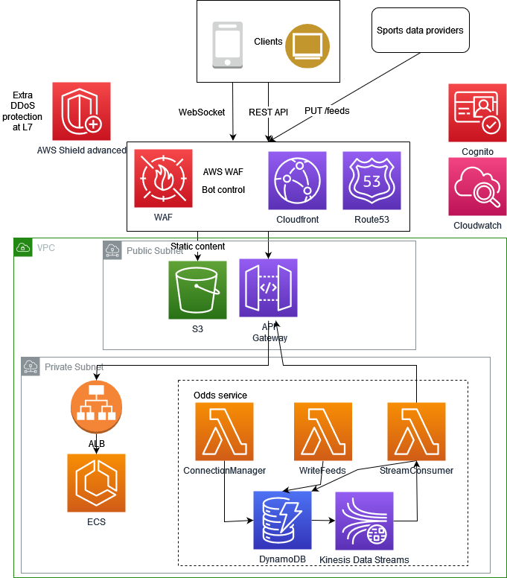
Main architecture

Slide 8
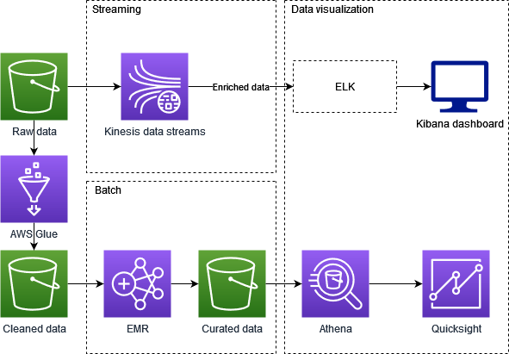
Analytics (real-time, batch)

Slide 9
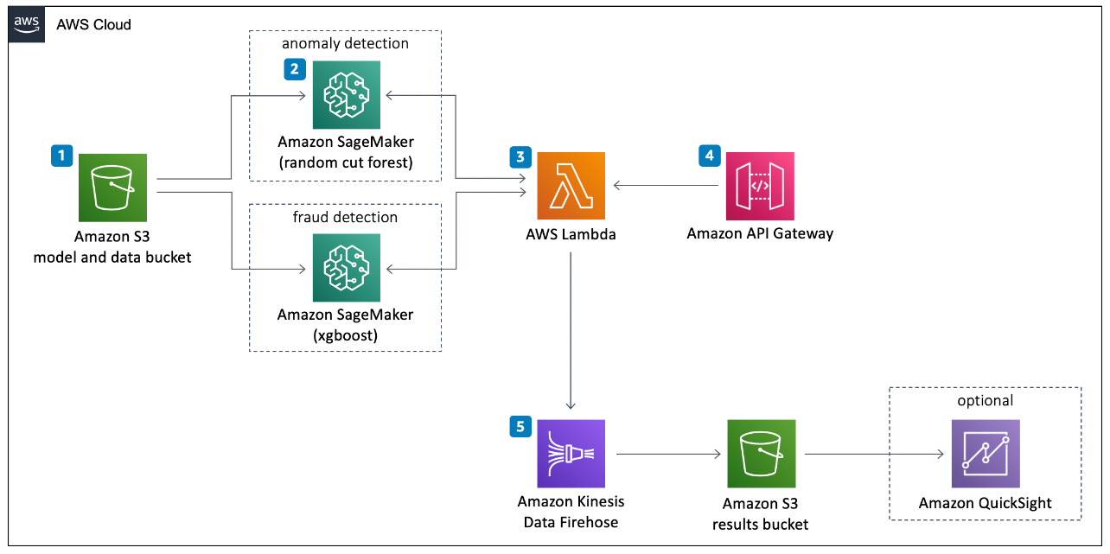
Fraud detection system
The idea here, as previously stated is to encapsulate the logic in a microservice. But there are 2 possible implementations here (from simplest to hardest):
Rely on a third-party service like sportsradar.com to determine whether there is fraud intent in a concrete user transaction
Implement an in-house solution like the following:
https://aws.amazon.com/solutions/implementations/fraud-detection-using-machine-learning/

Slide 10
Architecture to automate bringing in bought competitors
The idea here is to split the automation in 2 parts:
Preparing a streams system with topics/queues for the different data to be imported (users, previous bets, etc.). The idea is to have a common model to which the small companies just bought would have to stick to. Then depending on the data to be migrated we can either have Lambdas to import the data, or other solutions such as ECS containers.
For data feeds that the absorbed company was using, it would be a matter of repointing those to feed data now to Bet4U. The architecture is already prepared to provide the best one for the user.
Using Database Migration Service has been considered and ruled-out because it does not provide enough automation

Slide 11
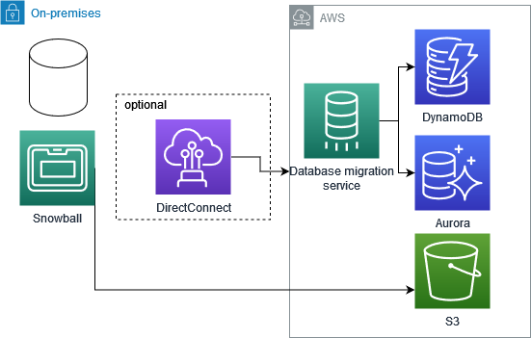
Data migration strategy

Slide 12
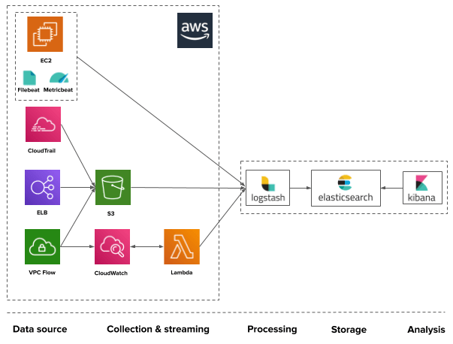
Observability: logs
https://logz.io/learn/definitive-guide-aws-log-analytics-elk/

Slide 13
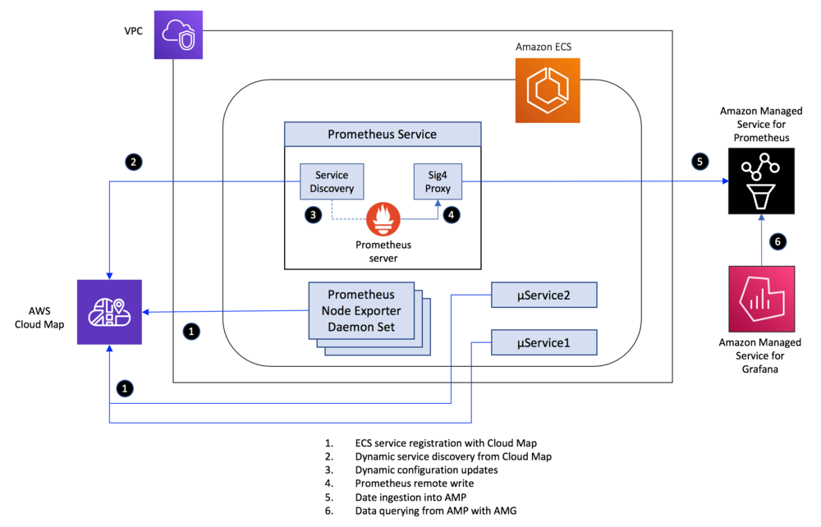
Observability: metrics & dashboards
https://aws.amazon.com/blogs/opensource/metrics-collection-from-amazon-ecs-using-amazon-managed-service-for-prometheus/

Slide 14
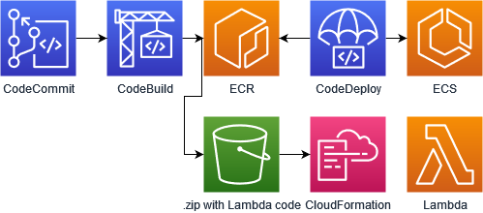
Envs. & CI/CD pipeline
Environments (dev, UAT/staging, PROD)
CI/CD pipeline
What should be part of the pipeline (building, testing –at the different levels-, static code analysis, security checks/scans, publishing artifacts, etc.)
How does it look like at high level:

Slide 15
Thank you!

