Slide 1
Where’s the Money at?
A look at salary trends in Colorado and Texas based on degree subjects and levels.
Omar Trejo, Grace Ortiz, Kabrina Ramnath

Slide 2
Summary
Within the State borders of Texas and Colorado, in which subject should you attain a degree to fall within the highest average salary range?
How does earnings for different subjects vary by educational level?
Maximizing earning potential while considering personal initial educational costs
Does your institution of choice play a role in earnings? To what extent?
Choosing a typically lower paid program at a different institution to potentially earn a higher average salary
How has salary trends per subject changed over time?
Potential contributing factors

Slide 3
The data
Using the US Census Bureau, we found data specifically looking at salary percentiles based on institution attended, degree program and year of graduation.
For subject/earnings data that was not available for a certain institution, that row was removed.
Sort data into degree type- remove certificate and associate level degrees
Final conclusions to be drawn off of data regarding Bachelor, Master and Doctorate degree
Review data for salary percentiles based on locations
Top 6 degree programs within Colorado, Texas and both states.
Use the average earnings for all cohort classes included in the data set.

Slide 4
Data analysis and clean up
Data exploration:
Using pandas to clean up data and place into data frames
Removing null values
Using the average of percentile earnings to simplify data
Grouping by state
Grouping by average earnings
Grouping by years after graduation (1, 5, 10)
Grouping by educational level

Slide 5
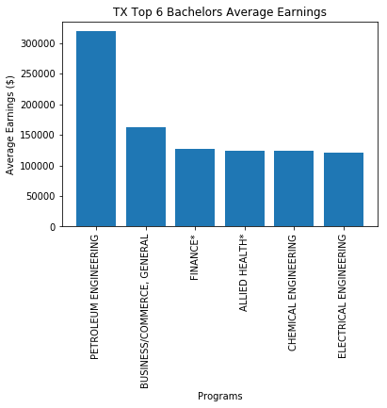
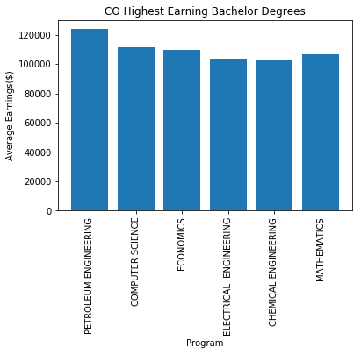
Earnings by bachelors

Slide 6
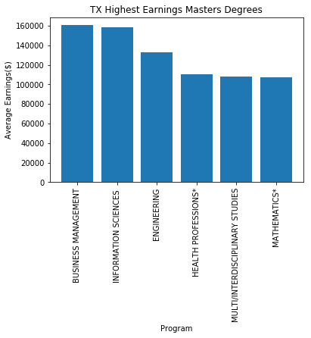
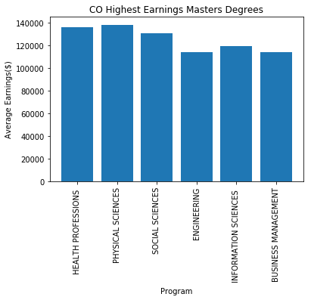
Earnings by Masters

Slide 7
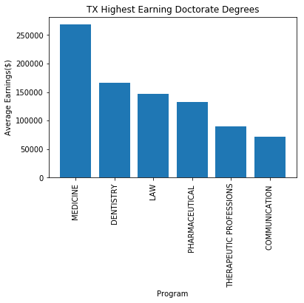
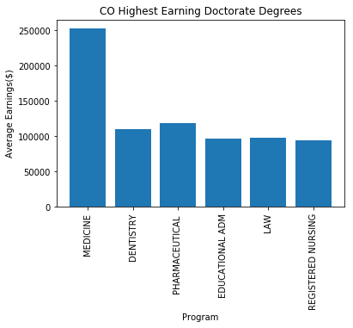
Earnings by Doctorate

Slide 8
Conclusion

Slide 9
Implications

