Slide 1
Where’s the Money at?
A look at salary trends in Colorado and Texas based on degree subjects and levels.
Omar Trejo, Grace Ortiz, Kabrina Ramnath

Slide 2
Summary
Within the State borders of Texas and Colorado, in which subject should you attain a degree to fall within the highest average salary range?
How does earnings for different subjects vary by educational level?
Maximizing earning potential while considering personal initial educational costs
Does your institution of choice play a role in earnings?
Choosing a typically lower paid program at a different institution to potentially earn a higher average salary
How has salary trends per subject changed over time?
Potential contributing factors

Slide 3
The data
Using the US Census Bureau, we found data specifically looking at salary percentiles based on institution attended, degree program and year of graduation.
For subject/earnings data that was not available for a certain institution, that row was removed.
Sort data into degree type- remove certificate and associate level degrees
Final conclusions to be drawn off of data regarding Bachelor, Master and Doctorate degree
Review data for salary percentiles based on locations
Top 6 degree programs within Colorado, Texas and both states.
Use the average earnings for all cohort classes included in the data set.

Slide 4
Data analysis and clean up
Data exploration:
Using pandas to clean up data and place into data frames
Removing null values
Using the average of percentile earnings to simplify data
Grouping by state
Grouping by average earnings
Grouping by years after graduation (1, 5, 10)
Grouping by educational level

Slide 5
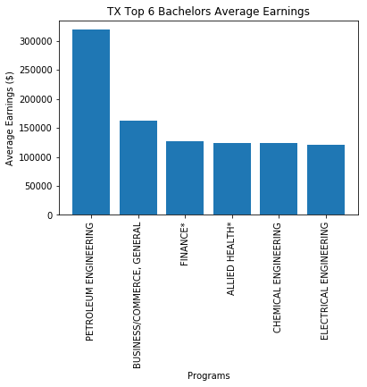
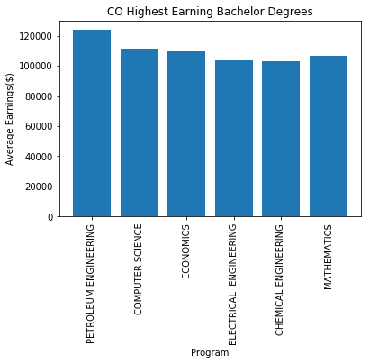
Earnings by bachelors

Slide 6
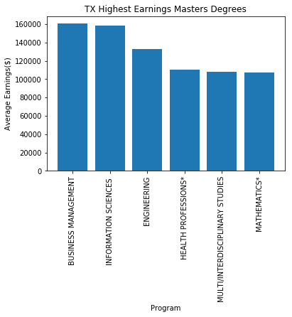
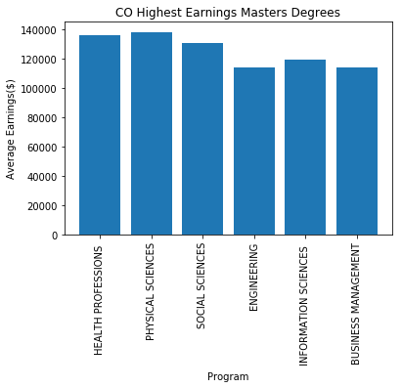
Earnings by Masters

Slide 7
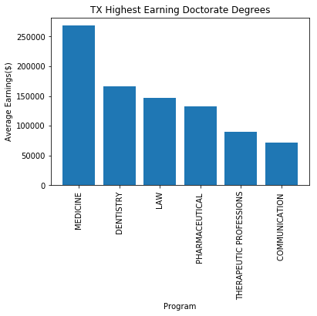
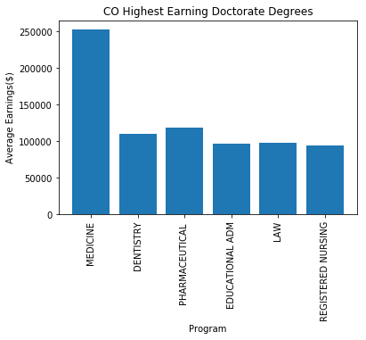
Earnings by Doctorate

Slide 8
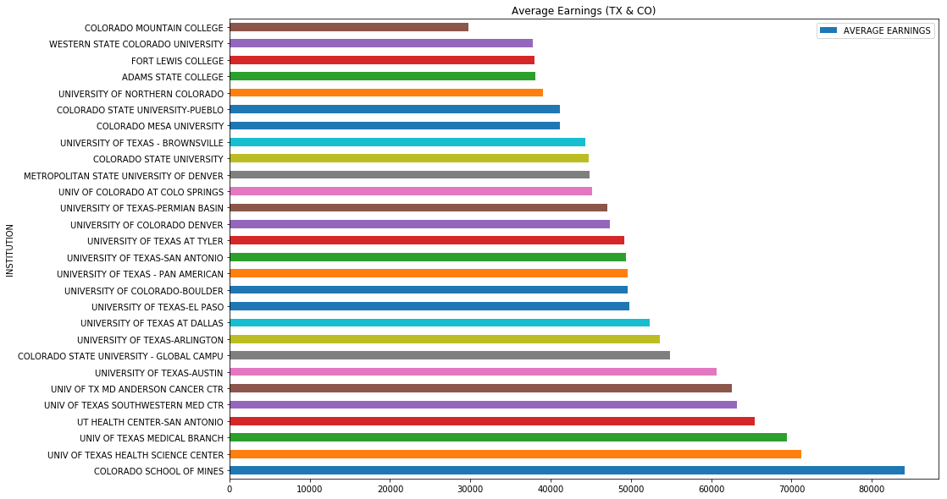
DOES YOUR INSTITUTION AFFECT EARNINGS? (bs)

Slide 9
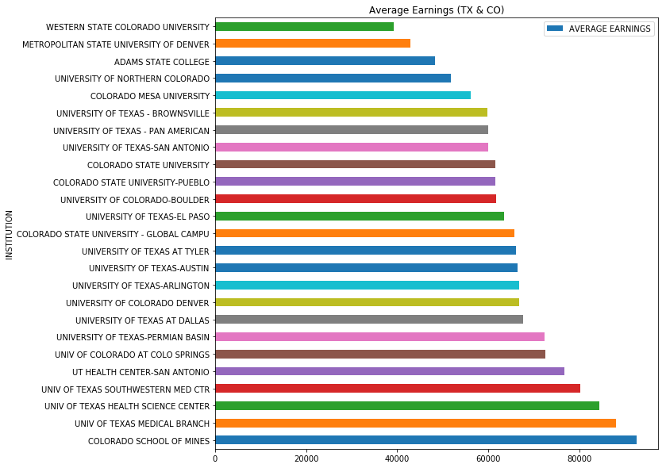
DOES YOUR INSTITUTION AFFECT EARNINGS? (MS)

Slide 10
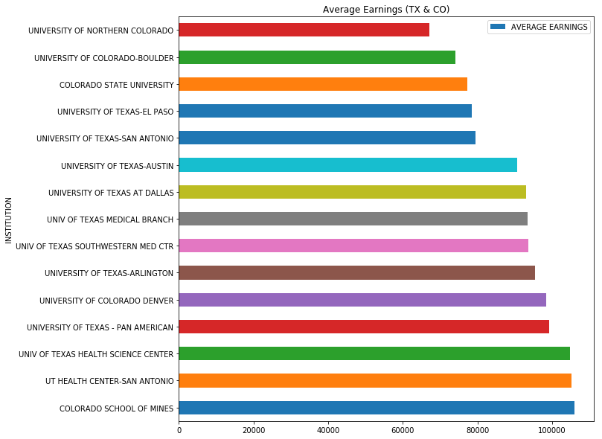
DOES YOUR INSTITUTION AFFECT EARNINGS? (DR)

Slide 11
VALUE CHANGES IN SALARIES: TEXAS

Slide 12
VALUE CHANGES IN SALARIES: TEXAS

Slide 13
VALUE CHANGES IN SALARY: TEXAS

Slide 14
VALUE CHANGES IN SALARY: COLORADO

Slide 15
VALUE CHANGES IN SALARY: COLORADO

Slide 16
VALUE CHANGES IN SALARY: COLORADO

Slide 17
CONCLUSIONS
The 6 subjects with the highest average salary earning potential for an individual with a Bachelor’s degree are:
Texas: Petroleum Engineering, Business, Finance, Allied Health Professionals, Chemical Engineering and Electrical Engineering.
Colorado: Petroleum Engineering, Computer Science, Economics, Electrical Engineering, Chemical Engineering and Mathematics.
Key points:
Across both states, Petroleum Engineering had the highest earning potential. Electrical Engineering and Chemical Engineering are the only other two fields that are in the top 6 in both markets.

Slide 18
Conclusions
The 6 subjects with the highest average salary earning potential for an individual with a Master’s degree are:
Texas: Business Management, Information Sciences, Engineering, Health Professions, Interdisciplinary Studies and Mathematics.
Colorado: Health Professions, Physical Sciences, Social Sciences, Engineering, Information Sciences and Business Management.
Key points:
Across both states, Business Management is the only masters degree to be in the top 6 earning potential category.

Slide 19
Conclusions
The 6 subjects with the highest average salary earning potential for an individual with a Doctoral degree are:
Texas: Medicine, Dentistry, Law, Pharmaceutical, Therapeutic Professions and Communications.
Colorado: Medicine, Dentistry, Pharmaceutical, Education Administration, Law and Registered Nursing.
Key points:
Across both states, Medicine, Dentistry, Law and Pharmaceutical are within the top 6 earning potential salary range.

Slide 20
Conclusions
Reviewing the average earnings for all subjects, the following institutions are within the top 6 salary earnings potential range:
Bachelors: Colorado School of Mines, University of Texas HSC, University of Texas MB, University of Texas Health Centre SA, University of Texas Southwestern and University of Texas Anderson Centre.
Masters: Colorado School of Mines, University of Texas MB, University of Texas HSC, University of Texas Health Centre SA, University of Texas Southwestern and University of Colorado Colorado Springs.
Doctoral: Colorado School of Mines, University of Texas HSC San Antonio, University of Texas HSC, University of Pan American, University of Colorado Denver and University of Texas at Arlington.

