Slide 1
Google Plus project for MMC
Cedric Reichenbach
Oskar Truffer

Slide 2

Hypothesis
Based on +1
Part of the Conversation
You reap what you sow

Slide 3
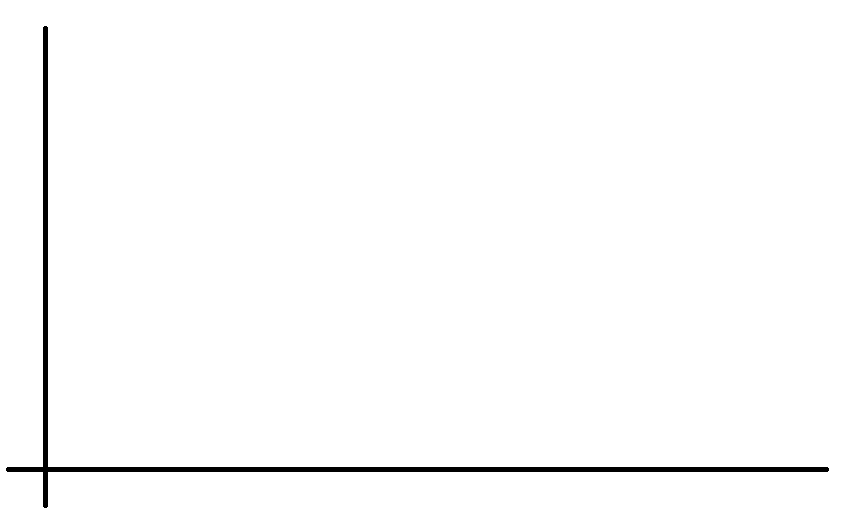

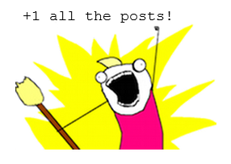

What types of +1'ers are there?
+1 Ratio

Slide 4
Some Maths
X – #+1 given to activities
Y – #+1 received to activities
P(0.8 < X/Y < 1.2) > .9
In words: „Over 90% of Google+ users receive roughly (in a 20% range) the same amount of +1 as they give.“

Slide 5
(Presentation)

Slide 6
Future Work

Slide 7
GUI Showing +1 Statistics
Important numbers
Diagrams
HTML or Java

Slide 8
Evolution Over Time
For one specified person
Did my +1 ratio increase/decrease?

Slide 9
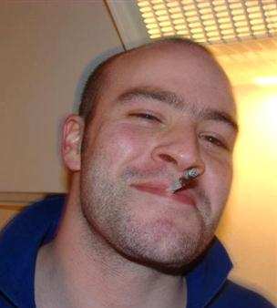

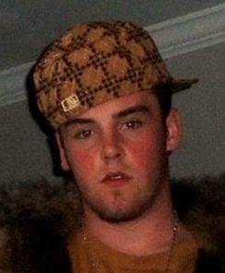
Good/bad friends
Show receive/give +1 ratio for specified friend
Good friends:
Reliable friends:
Bad friends:

