Slide 1
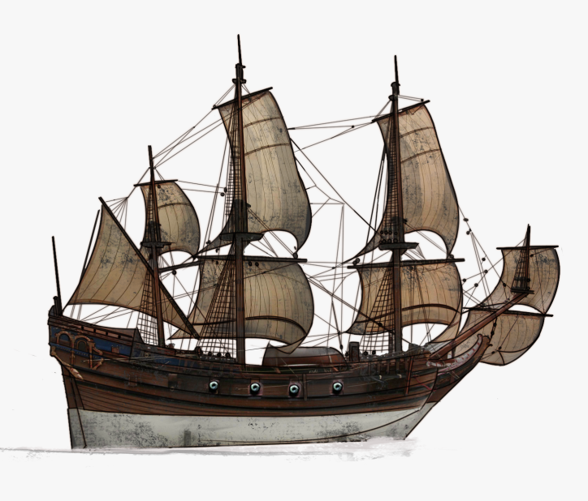
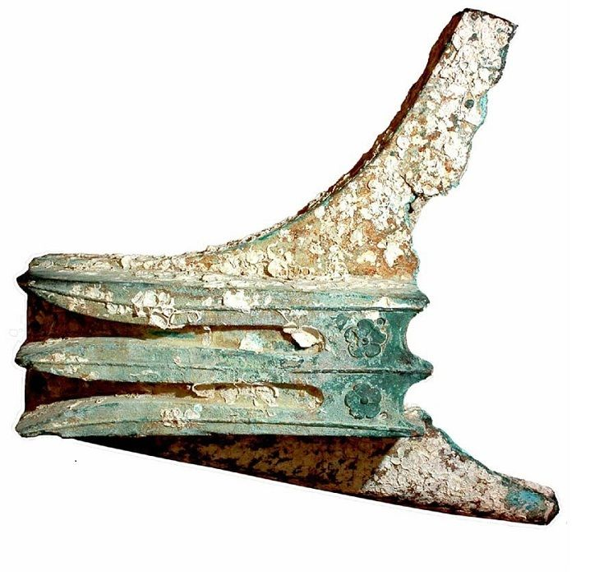
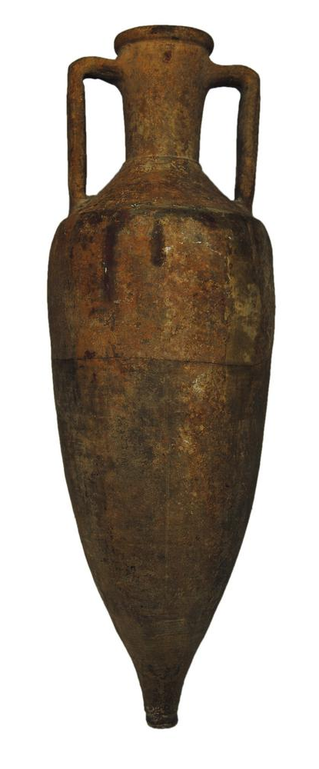
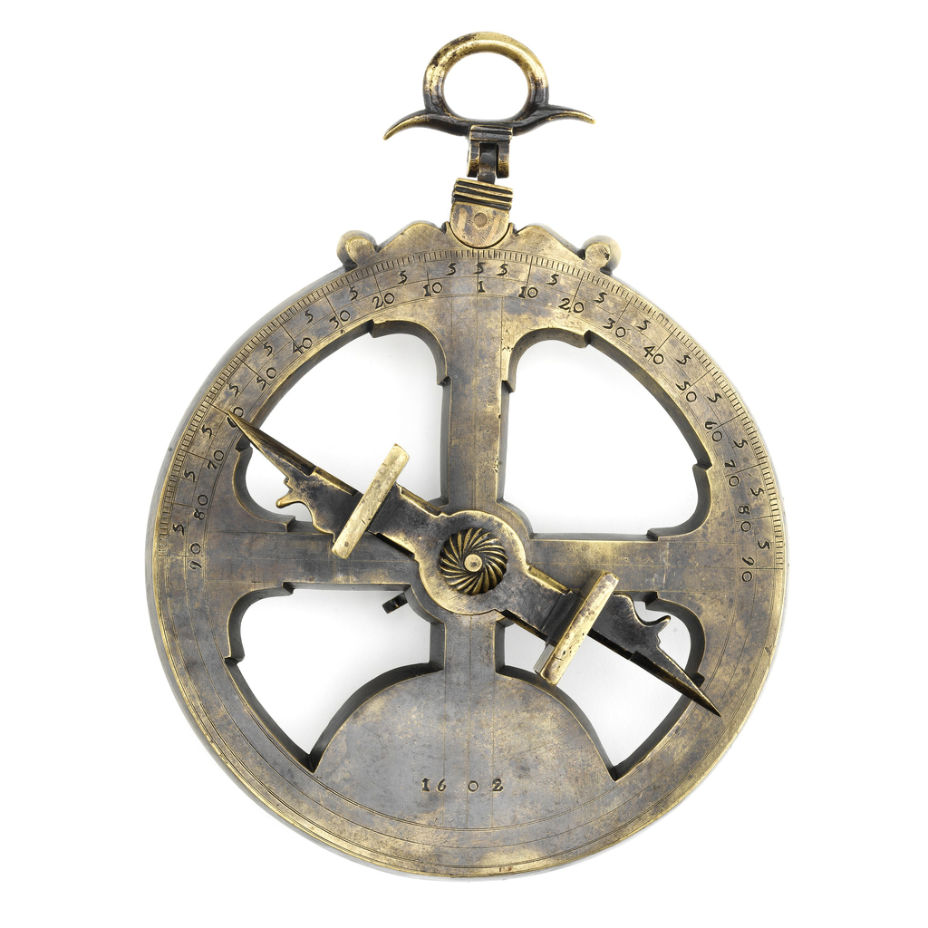
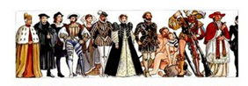
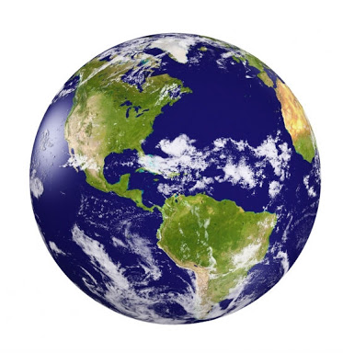
Imagine the connections…
Archaeological Sites
Artifact typologies
Time
Collections – Artifacts
Cultural Heritage
Artifact Marks
Shipwrecks
Artifact Makers
People
Collections - Iconography
Stories
Paintings
Publications
Models
Case Studies
Collections - Texts
Treatises
Places – Landscapes
Region
Countries
Contracts
Islands
Oceans
Seas
Cities
Harbors
Fortresses
Lighthouses
Shipbuilding
Trade Routes
Ship Types
Projects
Ship Parts - Glossaries
N. S. Mártires
Xlendi

