Slide 1
The Queue Inference Engine
Richard C. Larson
1.203J, 15.073J, IDS.700
November 15, 2017

Slide 2

The Queue Inference Engine
QIE
http://m2.aol.com/vlcondon/index.htm

Slide 3
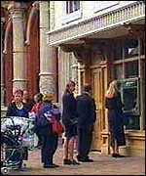
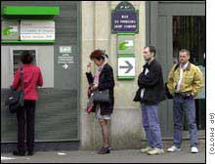
Queue Inference Engine (QIE)
Boston area ATMs: reams of data
Standard approach first
Then the notion that there may be more information in the transactional data
http://news.bbc.co.uk/olmedia/210000/images/_214989_bank_atm_queue150.jpg
http://europe.cnn.com/SPECIALS/2001/euro/stories/security.fears/story.france.atm.jpg

Slide 4
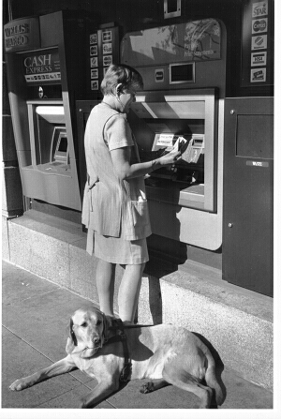
http://www.edrobertscampus.org/press_room/atm.jpg

Slide 5
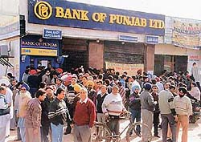
Sometimes the queue is not so orderly!
But the QIE does not care! FCFS is not a requirement
for the basic QIE performance measures.

Slide 6
QIE: Assumptions
(1) A priori, arriving customers are generated by a homogeneous (or slowly time varying) Poisson process;
(2) The signature of a queue from the transactional data is a service stop time followed very shortly by a service start time;
(3) Any balking that occurs is dependent only on whether a positive queue delay will be experienced by the prospective customer, not on the line length.

Slide 7
QIE: Assumptions - continued
Can have single or multiple servers
Service times need not be i.i.d.
Unless otherwise specified, queue discipline need not be FCFS
There is no parameter estimation! The rate parameter λ for the Poisson process does not appear in the analysis.

Slide 8
The Data-set
Time
I
C
I
C
I
C
I
The QIE works on one congestion period at a time. C=Congestion period; I=Idle period
A congestion period commences the instant that all servers become busy, thereby requiring subsequent arrivals to be delayed in queue, and terminates the first moment that one of the servers becomes idle after a service completion because the queue is empty.

Slide 9
The Performance Measures
. For each congestion period the QIE computes, conditioned on the transactional data set, the following quantities:
1. The time-dependent mean number of customers in queue;
2. The mean queue delay experienced by a random customer;
3. The time average number of customers in queue over the duration of the congestion period;
4. The probability that a randomly arriving customer during the congestion period experiences i customers ahead of her in line.

Slide 10
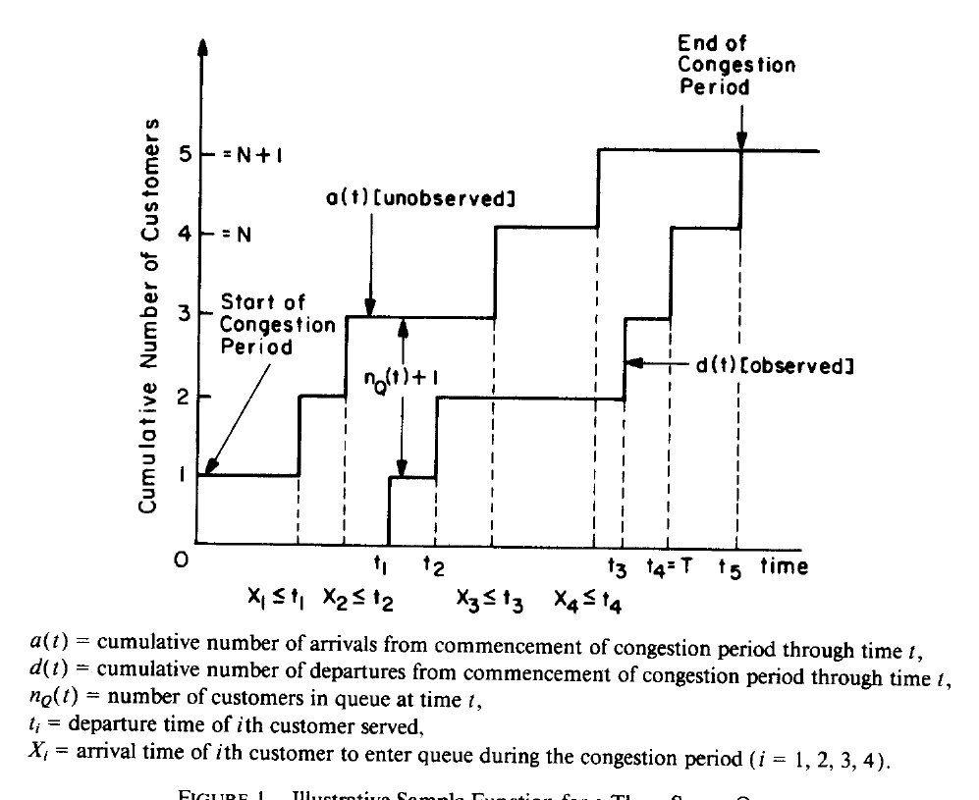

Slide 11
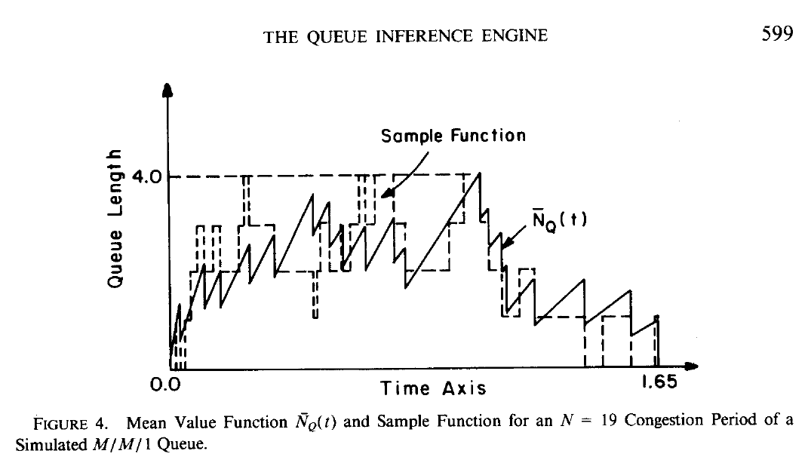

Slide 12
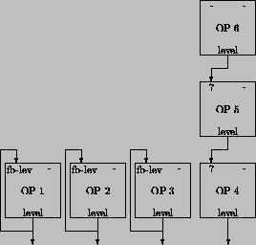
The QIE Algorithms
Order statistics (Larson, 1989; Larson & Jones, 1994)
Integration (Bertsimas and Servi, 1990)
Markov processes with taboo states (Daley and Servi, 1991+)
All O(N³) in computational complexity
http://www.neuroinformatik.ruhr-uni-bochum.de/ini/PEOPLE/heja/sy-prog/node33.html

Slide 13


The Applications
Servi: Air Phone
Larson: Human server queues @ Logan Airport, Post Offices and Banks
http://www.aa.com/American?BV_Operation=Dyn_AAPage&referer=index.html
http://www.usps.gov/
http://www.citibank.com/corporate_affairs/y2000.htm

Slide 14

Order Statistics:
The N Unordered Arrivals in [0,T] of a Poisson Process are Mutually Independent and
Uniformly Distributed (Urban OR Text, Sec. 2.12.3)

Slide 15
Example: M/D/1 Queue
Service time = 1.0 minute
Congestion period contains three customers
Implies N = 2 queued customers
Busy period = 3 minutes, starting say @ t=0
We know that zero customers arrived during [2,3]. Why?
So our 2 queued customers arrived during [0,2], with at least one in [0,1]

Slide 16
X₂
2
1
0
1
2
X₁
X₁ and X₂ are our two unordered arrival times

Slide 17
X₂
2
Not allowed
since at least one
arrival must be
in [0,1].
1
0
1
2
X₁
A priori probability of this event = 3/4 = master probability

Slide 18
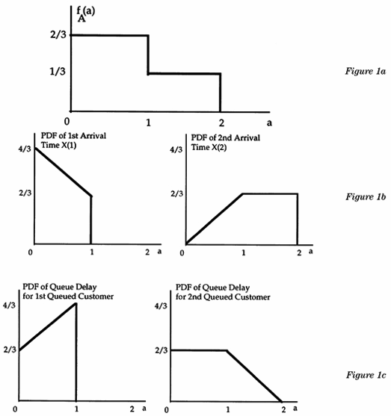
Arrival time pdf of a
randomly queued customer
PDF's for the first and
second arrival times
of the queued customers
PDF's for the queue waits
for the first and second
queued customers (FIFO)
Figure 1
Probability density functions of arrival times and queueing delays of queued customers.

Slide 19
A bank having the QIE for its ATMs could mail you your personal queue delay pdf each month!

Slide 20
We assume a congestion period scaled to [0,1]. We assume that
there are N customers queued (and N customers who depart
during the congestion period). Here t_{i} is the departure time for
the i^{th} served customer, and it is also the time of initiation of service
for the i^{th} customer to leave the queue.
The set of r.v.'s {X₁, X₂, ..., X_{N}} are the i.i.d. uniformly distributed
unordered arrival times.
The set of r.v.'s {X₍₁₎, X₍₂₎, ..., X_{(N)}} are the corresponding
order statistics, e.g., X₍₂₎ is the arrival time of the second
customer to enter the queue; X₍₂₎ is the second smallest
from the set {X₁, X₂, ..., X_{N}}.

Slide 21
We have the vector t of departure times (and of service
initiation times): t = (t₁, t₂, ..., t_{N}), where t_{(i+1)}>t_{i}.
Also consider a vector s = (s₁, s₂, ..., s_{N}), where s_{(i+1)}>s_{i}, and
where s_{i}<t_{i}.
We have determined how to efficiently and recursively
compute the following important probability:
This is the probability that the order statistics fall within
a prescribed N-rectangle (in N-dimensional space).
If s = 0, then Γ(0, t) = 'master probability.' Formal recursion
derived in the web-posted handout.

Slide 22
Illustrative Performance Measures
1. Maximum Experienced queue Delay (FCFS).
Interested in the cdf for the max of N non-independent r.v.s,
the N queue delays.
Define D(τ|t) = conditional probability that none of the N queued
customers waited in queue τ or more time units, given the observed
departure time data.
Set s_{i} = s_{i}*= max{t_{i} - τ, 0}.
Then
D(τ|t) = Γ(s*,t)/Γ(0,t)

Slide 23

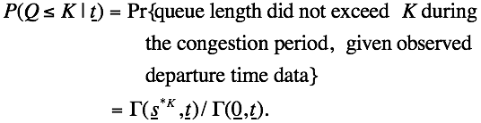
2. Maximum Queue Length
Set s = s^{*K} such that
These values for s imply that each arriving customer i must arrive
after the departure time of departing customer i-K during the
congestion period. Now we can write

Slide 24
There are many more quantities we could compute within the QIE framework
Mean queue delay
Mean value function of queue length
CDF of queue delay
PDF of queue delay for each customer served (FCFS)
PMF of queue length experienced by a random customer
And more.....

Slide 25
For additional reading see
Inferring Queue Performance from Transactional Data, and
Larson, R.C., "The Queue Inference Engine: Deducing Queue Statistics From Transactional Data." Management Science 36(5): 586-601, May 1990.
Jones, Lee K. and Richard C. Larson, "Efficient Computation of Probabilities of Events Described by Order Statistics and Applications to Queue Inference." ORSA Journal on Computation., vol. 7, no. 1, Winter 1995, pp. 89-100.
See the following for an overview of the QIE including a summary of published research by Servi, Bertsimas, Daley and others on queue inferencing: Larson, Richard C., QUEUE INFERENCE ENGINE, chapter in Encyclopedia of Operations Research and Management Science, Centennial Edition, Saul I. Gass and Carl M. Harris (eds.), Kluwer, Boston, 2001, pp.674-679.

