Slide 1
Spatially Distributed Queues II
M/G/1
2 Servers
N servers: Hypercube Queueing Model
Approximations
Richard C. Larson
1.203J, 15.073J, IDS.700
Monday, October 30, 2017

Slide 2
Setup: Hypercube Queueing Model
Region comprised of geographical atoms or nodes
Each node j is an independent Poisson generator, with rate λ_{j}
Travel times: τ_{il} = travel time from node i to node j
N servers
Server locations are random: l_{nj}

Slide 3
Setup: Hypercube Queueing Model - con't.
Server assignment: one assigned
State dependent dispatching
Service times: mean = 1/μ_{n ;} negative exponential density
Service time dependence on travel time
We allow a queue (FCFS, infinite capacity)

Slide 4
Fixed Preference Dispatch Policies for the Model
Idea: for each atom, say Atom 12, there exists a vector of length N that is the preference-ordered list of servers to assign to a customer from that atom
Example: {3,1,7,5,6,4,2}, for N=7.
Dispatcher always will assign the most preferred available server to the customer
Usually order this list in terms of some travel time criterion.

Slide 5
Example Dispatch Policies
SCM: Strict Center of Mass
  Place server at its center of mass
  Place customer at its center of mass
  Estimate travel times: center of mass to center of mass
MCM: Modified Center of Mass
  Place server at its center of mass
  Keep customer at centroid of atom
  Estimate travel times: center of mass to centroid of atom

Slide 6
Example Dispatch Policies
EMCM: Expected Modified Center of Mass
  Do the conditional expected travel time calculation correctly, conditioned on the centroid of the atom containing the customer

Slide 7
Are fixed preference policies optimal?
AVL: Automatic Vehicle Location: dispatch the real time nearest server
  This can be incorporated into the Hypercube framework, but very carefully!
  Consider two servers:
Customer
X
RA2
RA1

Slide 8
Customer in square
marked X. Place an
asterisk in each square
that could have the
closest server.
Assume each server is available
and is located 'somewhere' in
his/her square "police beat."
X

Slide 9
*
*
*
*
X*
*
*
*
*

Slide 10
*
*
*
*
*
*
*
*
*
*
X*
*
*
*
*
*
*
*
*
*
*

Slide 11
What to know about the Hypercube Queueing Model
Know the 2-server setup
Be able to work with a 3-server model
  Read in the text the formulas to apply
Forget the cases for N>3 servers.
Know Hypercube Approximation Procedure (still to come -- fasten your seat belts!)

Slide 12
1,0
1,1
0,0
0,1

Slide 13
1,0
1,1
0,0
0,1

Slide 14

1,1,0
1,1,1
0,1,0
0,1,1
1,0,0
1,0,1
0,0,0
0,0,1
http://www.scsc.k12.ar.us/2001Outwest/PacificEcology/Itinerary/Day3/SEASCAPES.JPG

Slide 15
Hypercube Approximation Procedure: A General Technique
Want to reduce dramatically the number of simultaneous equations to solve
The procedure reduces the number of equations from 2^{N} simultaneous linear equations to N simultaneous nonlinear equations.
We look at only those performance measures we need, not at micro-structure of the binary state space

Slide 16
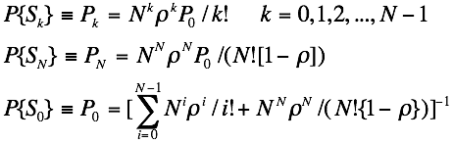
Hypercube Approximation Procedure
A General Technique
Theory: Sampling Servers Without
Replacement from M/M/N Queue
From we know the aggregate
state probabilities:

Slide 17
The Hypercube Model, when the state space is compressed from its cube in N dimensions to a 'line' birth and death process, always reduces to an M/M/N queue (assuming service times are not server-specific)

Slide 18



Key expression:
For our applications, we do not need to know the fine grained
binary state probabilities. Rather we need dispatch probabilities and
server workloads.
What about 'B-' probability reasoning?
"Flips coins" until first Heads is obtained:
Incompatible with known state probability P_{N}
Doesn't include biases.
Let's "Divide and conquer":

Slide 19
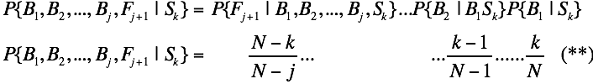
Working carefully and slowly to find the state-conditioned
dispatch probabilities: (recursively apply P{AB}=P{A|B}P{B})
Can plug (**) back into (*) and obtain an exact expression.
Manipulate it to obtain a convenient form as "B-" probability
reasoning with an 'A+" correction term:
"Correction factor"

Slide 20

Explore properties of Correction Factor
The desired dispatch probabilities can be written as a telescoped expression:
Use above in Eq.(***) to obtain:

Slide 21

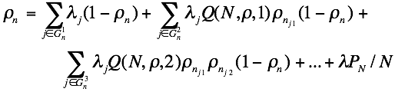

Slide 22


The last equation gives N nonlinear simultaneous equations in
the unknown workloads, ρ_{n}, subject to the constraint that
Typically converges in 3 to 5 iterations, within 1 to 2% of
'exact Hypercube' results
Response patterns:
j-1 more
preferred
units
id # of j^{th} preferred
unit for atom k
j^{th} preferred
unit

Slide 23

Square Root Laws (approximations)
In Chapter 3 we found
Area of service region
Number of mobile servers
depended on distance metric
and location strategy
Assumes all N₀ servers are available or free (not busy)

Slide 24

Now consider N to be a R.V.
Might we expect the following to be true?
What if the locations of servers were determined by a homogenous
spatial Poisson process, with busy servers selected by "random erasers"?

Slide 25

Getting to Expected Travel Distance
From M/M/N₀
queueing model
where P_{k} = Probability of k servers available (M/M/N₀)

Slide 26


Moving to E[D]
Since P₀ 0, we can write
We now apply "B-" probability reasoning, to get
(Jensen's Inequality shows that this Eq. is a lower bound to true E[D].)

Slide 27
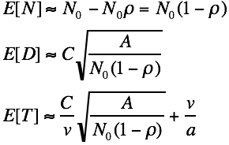
Finishing
Acceleration term
Great results in practice

Slide 28
Jensen's Inequality
If g(X) is a convex function over the region of non-zero probability,
then
(Problem 5.5 explores this further.)

Slide 29
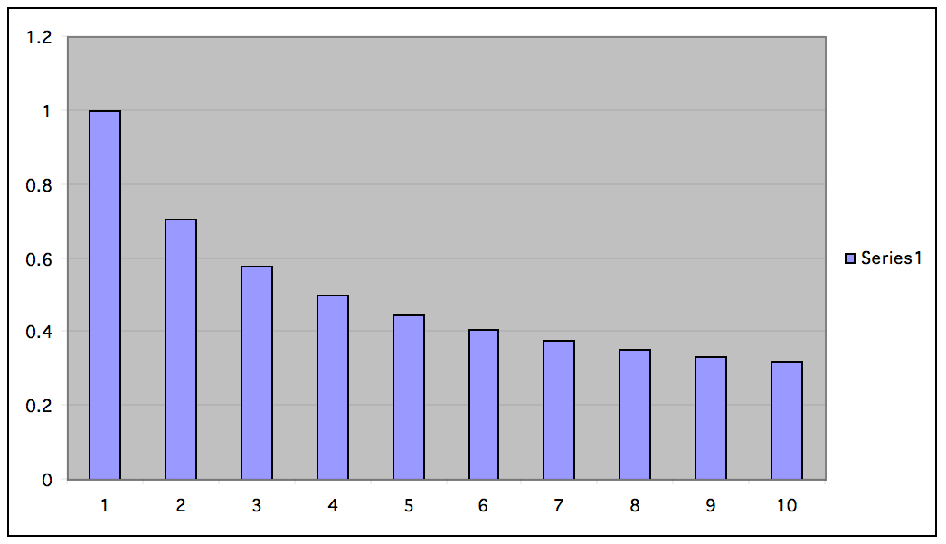
Jensen's Inequality
N

Slide 30
E[ ]=0.5*(1) + 0.5*(10)^{-0.5} = 0.5*(1 + 0.316) = 0.658
1/E[N]^{-0.5} = 1/(1*0.5 + 10*0.5)^{-0.5} =1/(5.5)^{-0.5} = 1/2.345 = 0.426
True mean (0.658)
Suppose 50% of
probability
mass here
And suppose 50%
of probability
mass here
"B-" mean (0.426)

