Slide 1
Computer Networks
CS1652
Jack Lange
University of Pittsburgh
The slides are adapted from the publisher’s material
All material copyright 1996-2009
J.F Kurose and K.W. Ross, All Rights Reserved
1-1

Slide 2
Today’s topic
Network core
How is data transferred in the core?
Basic characteristics of computer networks
Delay, loss and throughput
Protocol layers and service model
Layered architecture: pros and cons
Brief overview of network security
More later in the course
Introduction
1-2

Slide 3

The Network Core
mesh of interconnected routers
How is data transferred through net?
  Circuit switching: dedicated circuit per call: telephone net
  Packet switching: data sent thru net in discrete “chunks”
1-3

Slide 4




Network Core: Circuit Switching
End-end resources reserved for “call”
link bandwidth, switch capacity
dedicated resources: no sharing
circuit-like (guaranteed) performance
call setup required
1-4

Slide 5
Network Core: Circuit Switching
network resources (e.g., bandwidth) divided into “pieces”
pieces allocated to calls
resource piece idle if not used by owning call (no sharing)
dividing link bandwidth into “pieces”
frequency division
time division
1-5

Slide 6
Circuit Switching: FDM and TDM
Example:
FDM
4 users
frequency
time
TDM
frequency
time
1-6
Notes:
Two simple multiple access control techniques.
Each mobile’s share of the bandwidth is divided into portions for the uplink and the downlink. Also, possibly, out of band signaling.
As we will see, used in AMPS, GSM, IS-54/136

Slide 7
Numerical example
How long does it take to send a file of 640,000 bits from host A to host B over a circuit-switched network?
  All links are 1.536 Mbps
  Each link uses TDM with 24 slots/sec
  500 msec to establish end-to-end circuit
Get a calculator!
  (1.536 * 1,000,000) / 24 = 64,000
1-7
Notes:
1.536 Mbps / 24 slots = 64 kbps per connection
640,000 / 64 kbps = 10 secs
Total = 10.5

Slide 8
Network Core: Packet Switching
each end-end data stream divided into packets
user A, B packets share network resources
each packet uses full link bandwidth
resources used as needed
resource contention:
aggregate resource demand can exceed amount available
congestion: packets queue, wait for link use
store and forward: packets move one hop at a time
Node receives complete packet before forwarding
Bandwidth division into “pieces”
Dedicated allocation
Resource reservation
1-8

Slide 9
Packet-switching: store-and-forward
L
R
R
R
takes L/R seconds to transmit (push out) packet of L bits on to link at R bps
store and forward: entire packet must arrive at router before it can be transmitted on next link
delay = 3L/R (assuming zero propagation delay)
Example:
L = 7.5 Mbits
R = 1.5 Mbps
transmission delay = 15 sec
more on delay shortly …
1-10

Slide 10
Packet Switching: Statistical Multiplexing
100 Mb/s
Ethernet
A
C
statistical multiplexing
1.5 Mb/s
B
queue of packets
waiting for output
link
D
E
Sequence of A & B packets does not have fixed pattern, bandwidth shared on demand: statistical multiplexing.
TDM: each host gets same slot in revolving TDM frame.
1-9

Slide 11

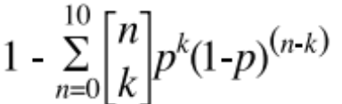
Packet switching versus circuit switching
Packet switching allows more users to use network!
1 Mb/s link
each user:
  100 kb/s when “active”
  active 10% of time
circuit-switching:
  10 users
packet switching:
  with 35 users, probability > 10 active at same time is less than .0004
N users
1 Mbps link
Q: how did we get value 0.0004?
A: Binomial distribution
n = 35, k = 0…10, p = .1
1-11
Notes:
1 – SIGMA(0…10)(combination)

Slide 12
Packet switching versus circuit switching
Is packet switching a “slam dunk winner?”
great for bursty data
  resource sharing
  simpler, no call setup
excessive congestion: packet delay and loss
  protocols needed for reliable data transfer, congestion control
Q: How to provide circuit-like behavior?
  bandwidth guarantees needed for audio/video apps
  still an unsolved problem (chapter 7)
1-12

Slide 13
How do loss and delay occur?
packets queue in router buffers
packet arrival rate to link exceeds output link capacity
packets queue, wait for turn
packet being transmitted (delay)
A
B
packets queueing (delay)
free (available) buffers: arriving packets
dropped (loss) if no free buffers
Introduction
1-18

Slide 14
Four sources of packet delay
1. nodal processing:
  check bit errors
  determine output link
2. queueing
time waiting at output link for transmission
depends on congestion level of router
transmission
A
propagation
B
nodal
processing
queueing
Introduction
1-19

Slide 15
Delay in packet-switched networks
3. Transmission delay:
R=link bandwidth (bps)
L=packet length (bits)
time to send bits into link = L/R
4. Propagation delay:
d = length of physical link
s = propagation speed in medium (~2x10⁸ m/sec)
propagation delay = d/s
Note: s and R are very different quantities!
transmission
A
propagation
B
nodal
processing
queueing
Introduction
1-20

Slide 16
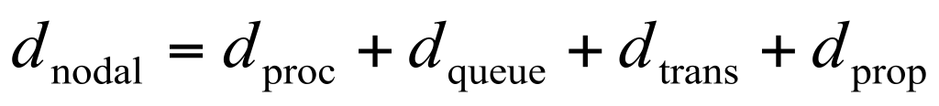
Nodal delay
d_{proc} = processing delay
  typically a few microsecs or less
d_{queue} = queuing delay
  depends on congestion
d_{trans} = transmission delay
  = L/R, significant for low-speed links
d_{prop} = propagation delay
  a few microsecs to hundreds of msecs
Introduction
1-23

Slide 17

Queueing delay (revisited)
R=link bandwidth (bps)
L=packet length (bits)
a=average packet arrival rate
traffic intensity = La/R
La/R ~ 0: average queueing delay small
La/R -> 1: delays become large
La/R > 1: more “work” arriving than can be serviced, average delay infinite!
Introduction
1-24

Slide 18
“Real” Internet delays and routes
What do “real” Internet delay & loss look like?
Traceroute program: provides delay measurement from source to router along end-end Internet path towards destination. For all i:
  sends three packets that will reach router i on path towards destination
  router i will return packets to sender
  sender times interval between transmission and reply.
3 probes
3 probes
3 probes
Introduction
1-25

Slide 19
Packet loss
queues (aka buffers) have finite capacity
packets arriving to full queue dropped (aka lost)
lost packet may be retransmitted by previous node, by source end system, or not at all
buffer
(waiting area)
packet being transmitted
A
B
packet arriving to
full buffer is lost
Introduction
1-27

Slide 20
Throughput
throughput: rate (bits/time unit) at which bits transferred between sender/receiver
  instantaneous: rate at given point in time
  average: rate over longer period of time
server, with
file of F bits
to send to client
link capacity
R_{s} bits/sec
link capacity
R_{c} bits/sec
bottleneck link
link on end-end path that constrains end-end throughput
Introduction
1-28
pipe that can carry
fluid at rate
R_{s} bits/sec)
pipe that can carry
fluid at rate
R_{c} bits/sec)
server sends bits
(fluid) into pipe

Slide 21
Throughput: Internet scenario
per-connection end-end throughput:
  min(R_{c},R_{s},R/10)
in practice: R_{c} or R_{s} is often bottleneck
R_{s}
R_{s}
R_{s}
R
R_{c}
R_{c}
R_{c}
10 connections (fairly) share backbone bottleneck link R bits/sec
Introduction
1-30

Slide 22
Where we are?
Network core
Circuit switching, packet switching, network structure
Delay, loss and throughput
Protocol layers, service models
Networks under attack: security
Introduction
1-31

Slide 23
Protocol “Layers”
Networks are complex!
many “pieces”:
  hosts
  routers
  links of various media
  applications
  protocols
  hardware, software
Question:
Is there any hope of organizing structure of network?
Or at least our discussion of networks?
Introduction
1-32

Slide 24
Internet protocol stack
application: supporting network applications
  FTP, SMTP, HTTP
transport: process-process data transfer
  TCP, UDP
network: routing of datagrams from source to destination
  IP, routing protocols
link: data transfer between neighboring network elements
  PPP, Ethernet
physical: bits “on the wire”
Application
Transport
Network
Link
Physical
Introduction
1-33

Slide 25
ISO/OSI reference model
presentation: allow applications to interpret meaning of data, e.g., encryption, compression, machine-specific conventions
session: synchronization, checkpointing, recovery of data exchange
Internet stack “missing” these layers!
  these services, if needed, must be implemented in application
  needed?
Application
Presentation
Session
Transport
Network
Link
Physical
Introduction
1-35

Slide 26
Encapsulation
source
message
M
application
segment
H_{t}
M
Transport
datagram
H_{n}
H_{t}
M
Network
frame
H_{l}
H_{n}
H_{t}
M
Link
Physical
link
physical
switch
destination
H_{n}
H_{t}
M
network
M
Application
H_{l}
H_{n}
H_{t}
M
Link
H_{t}
M
Transport
Physical
H_{n}
H_{t}
M
Network
H_{l}
H_{n}
H_{t}
Link
router
M
Physical
Introduction
1-36

Slide 27
Chapter1 Summary
Covered a “ton” of material!
Internet overview
what’s a protocol?
network edge, core, access network
  packet-switching versus circuit-switching
  Internet structure
performance: loss, delay, throughput
layering, service models
history
You now have:
context, overview, “feel” of networking
more depth, detail to follow!
Introduction
1-45

Slide 28
Network Security
The field of network security is about:
  how bad guys can attack computer networks
  how we can defend networks against attacks
  how to design architectures that are immune to attacks
Internet not originally designed with (much) security in mind
  original vision: “a group of mutually trusting users attached to a transparent network” ☺
  Internet protocol designers playing “catch-up”
  Security considerations in all layers!
Introduction
1-37

Slide 29
Bad guys can put malware into hosts via Internet
Malware can get in host from a virus, worm, or trojan horse.
Spyware malware can record keystrokes, web sites visited, upload info to collection site.
Infected host can be enrolled in a botnet, used for spam and DDoS attacks.
Malware is often self-replicating: from an infected host, seeks entry into other hosts
Introduction
1-38

Slide 30
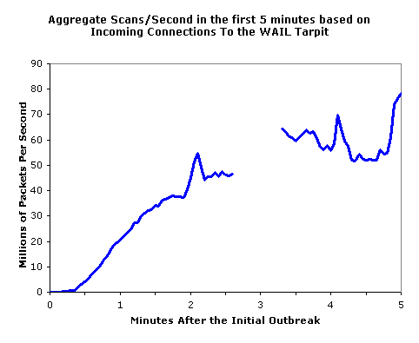
Bad guys can put malware into hosts via Internet
Trojan horse
  Hidden part of some otherwise useful software
  Today often on a Web page (Active-X, plugin)
Virus
  infection by receiving object (e.g., e-mail attachment), actively executing
  self-replicating: propagate itself to other hosts, users
Worm:
infection by passively receiving object that gets itself executed
self- replicating: propagates to other hosts, users
Sapphire Worm: aggregate scans/sec
in first 5 minutes of outbreak (CAIDA, UWisc data)
Introduction
1-39

Slide 31

Bad guys can attack servers and network infrastructure
Denial of service (DoS): attackers make resources (server, bandwidth) unavailable to legitimate traffic by overwhelming resource with bogus traffic
select target
break into hosts around the network (see botnet)
send packets toward target from compromised hosts
target
Introduction
1-40

Slide 32
The bad guys can sniff packets
Packet sniffing:
  broadcast media (shared Ethernet, wireless)
  promiscuous network interface reads/records all packets (e.g., including passwords!) passing by
A
C
src:B dest:A payload
B
Wireshark, tcpdump, ethereal, etc
Introduction
1-41

Slide 33
The bad guys can use false source addresses
IP spoofing: send packet with false source address
A
C
src:B dest:A payload
B
Introduction
1-42

Slide 34
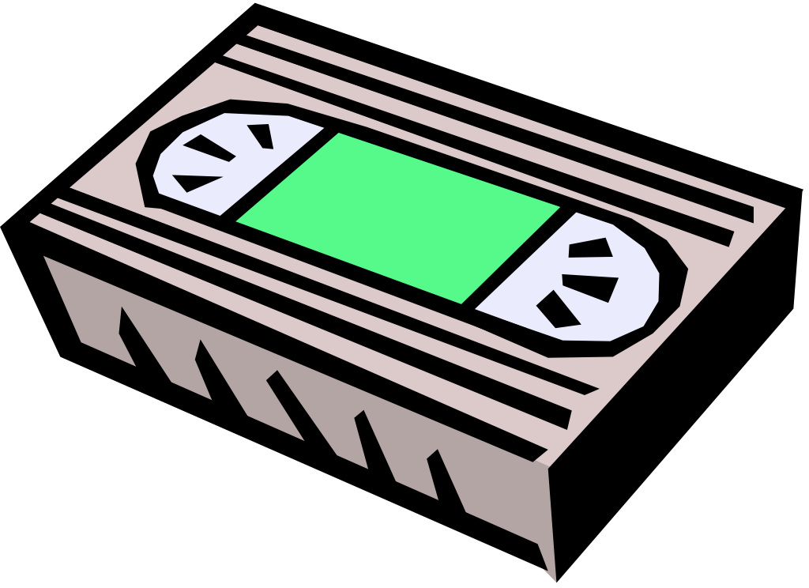
The bad guys can record and playback
record-and-playback: sniff sensitive info (e.g., password), and use later
  password holder is that user from system point of view
C
A
src:B dest:A user: B; password: foo
B
Introduction
1-43

Slide 35
Network Security
more throughout this course
chapter 8: focus on security
crypographic techniques: obvious uses and not so obvious uses
History(1.7) is for self-study
Introduction
1-44

Slide 36
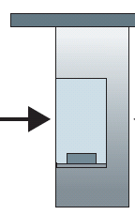

Caravan analogy
100 km
100 km
ten-car
caravan
toll
booth
toll
booth
cars “propagate” at
100 km/hr
toll booth takes 12 sec to service car (transmission time)
car~bit; caravan ~ packet
Q: How long until caravan is lined up before 2nd toll booth?
Time to “push” entire caravan through toll booth onto highway = 12*10 = 120 sec
Time for last car to propagate from 1st to 2nd toll both: 100km/(100km/hr)= 1 hr
A: 62 minutes
Introduction
1-21

Slide 37
Caravan analogy (more)
100 km
100 km
ten-car
caravan
toll
booth
toll
booth
Yes! After 7 min, 1st car at 2nd booth and 3 cars still at 1st booth.
1st bit of packet can arrive at 2nd router before packet is fully transmitted at 1st router!
Cars now “propagate” at
1000 km/hr
Toll booth now takes 1 min to service a car
Q: Will cars arrive to 2nd booth before all cars serviced at 1st booth?
Introduction
1-22

Slide 38
“Real” Internet delays and routes
traceroute: gaia.cs.umass.edu to www.eurecom.fr
Three delay measurements from
gaia.cs.umass.edu to cs-gw.cs.umass.edu
1 cs-gw (128.119.240.254) 1 ms 1 ms 2 ms
2 border1-rt-fa5-1-0.gw.umass.edu (128.119.3.145) 1 ms 1 ms 2 ms
3 cht-vbns.gw.umass.edu (128.119.3.130) 6 ms 5 ms 5 ms
4 jn1-at1-0-0-19.wor.vbns.net (204.147.132.129) 16 ms 11 ms 13 ms
5 jn1-so7-0-0-0.wae.vbns.net (204.147.136.136) 21 ms 18 ms 18 ms
6 abilene-vbns.abilene.ucaid.edu (198.32.11.9) 22 ms 18 ms 22 ms
7 nycm-wash.abilene.ucaid.edu (198.32.8.46) 22 ms 22 ms 22 ms
8 62.40.103.253 (62.40.103.253) 104 ms 109 ms 106 ms
9 de2-1.de1.de.geant.net (62.40.96.129) 109 ms 102 ms 104 ms
10 de.fr1.fr.geant.net (62.40.96.50) 113 ms 121 ms 114 ms
11 renater-gw.fr1.fr.geant.net (62.40.103.54) 112 ms 114 ms 112 ms
12 nio-n2.cssi.renater.fr (193.51.206.13) 111 ms 114 ms 116 ms
13 nice.cssi.renater.fr (195.220.98.102) 123 ms 125 ms 124 ms
14 r3t2-nice.cssi.renater.fr (195.220.98.110) 126 ms 126 ms 124 ms
15 eurecom-valbonne.r3t2.ft.net (193.48.50.54) 135 ms 128 ms 133 ms
16 194.214.211.25 (194.214.211.25) 126 ms 128 ms 126 ms
17 * * *
18 * * *
19 fantasia.eurecom.fr (193.55.113.142) 132 ms 128 ms 136 ms
trans-oceanic
link
* means no response (probe lost, router not replying)
Introduction
1-26

Slide 39
Throughput (more)
R_{s} < R_{c} What is average end-end throughput?
R_{s} bits/sec
R_{c} bits/sec
R_{s} > R_{c} What is average end-end throughput?
R_{s} bits/sec
R_{c} bits/sec
Introduction
1-29

Slide 40
Layered architecture
Dealing with complex systems:
Each layer implements a service
  Via its own internal-layer actions
  Relying on services provided by layer below
Explicit structure allows identification, relationship of complex system’s pieces
  layered reference model for discussion
Modularization eases maintenance, updating of system
  change of implementation of layer’s service transparent to rest of system
  e.g., change in application layer doesn’t affect the transport layer
Layering considered harmful?
Introduction
1-34

