Slide 1


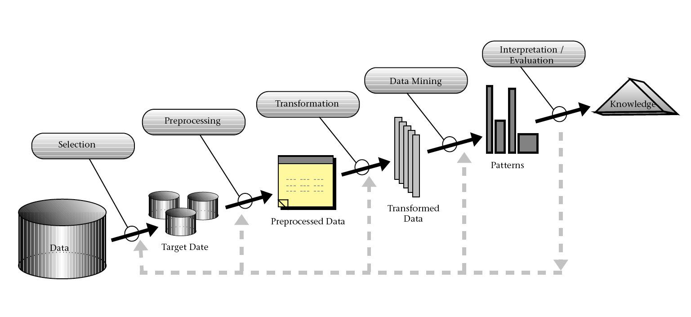

Analyzing Student Retention through Data Mining
Luis Retana and Rommel Rico
Advisor: Dr. Eric Jiang
Department of Mathematics and Computer Science
University of San Diego, 5998 Alcala Park, San Diego, CA 92110
Introduction to Data Mining
With digital information databases increasing in size, more experts in various fields are turning to Data Mining to transform raw data into valuable knowledge
Data Mining is the process that uses ideas and concepts from computer science and statistics to extract patterns from data
Data Mining includes multiple phases before data becomes valuable knowledge
Data Mining phases include Data Acquisition and Integration, Data Preparation (Data Preprocessing), Modeling, Evaluation, and Deployment (Figure 1)
Figure 1: Data Mining process
Data Corpus
USD freshmen from Fall 2002 to Fall 2009
Contains about 80 attributes but no identifiable private info
Data Preprocessing
Our preprocessing involved
Handling categorical fields (e.g., gender) and missing entries (e.g., GPA)
Normalizing numeric attributes (e.g., financial aid)
Transforming and consolidating various fields (e.g., SAT/ACT Comp, localToCA, distToUSD)
Modeling
Built some regression based preliminary analytical models
Helps reveal some important associations between different data attributes and retention
Findings
The attributes were found to unlikely play a role in student retention:
Age, Religion (catholic or not), SAT/ACT Comp scores, Distance to USD, Merit/Athletic Scholarships
The attributes seem to be closely associated with student retention:
Gender, Ethnic groups, HS type (public, private, etc), Pell/Cal Grant, 1st Generation college student, HS GPA, and Financial aid
Some interpretations from the models
Female students were about 1.4 times likely to return than their
Findings (cont.)
male colleagues
African American students were about half as likely as other ethnic groups to return for the succeeding semester
A $8000 increase in aid raises the probability of returning by 1.3 times
Conclusion
Student retention models from this research have indicated that attributes such as age, religion, SAT/ACT scores are not likely to impact student retention, but other attributes such as gender, ethnicity, high school type (public, private, etc), high school GPA and amount of financial aid show a strong correlation with freshman student retention
Although our research has produced some interesting and meaningful results and revealed the student and institutional characteristics that closely connect to student retention, we plan to continue investigating the retention data. As future work, we will build more sophisticated data mining models and find more interesting insights to help USD to achieve a higher retention rate

