Slide 1
Trust in Multiagent Systems
Pınar Yolum
p.yolum@uu.nl
Utrecht University

Slide 2
Ontology-Based Service Representation
Alternative: Replace Ratings with Experiences, which are the semantic descriptions of consumers’ past dealings with the providers (Sensoy and Yolum, TKDE 2007).
An Experience is …
  A combination of what a consumer requests from a service provider and what the consumer receives at the end.
  Expresses the story between the consumer and the provider regarding a specific service demand.
  Used to evaluate service providers according to consumers’ own criteria.

Slide 3
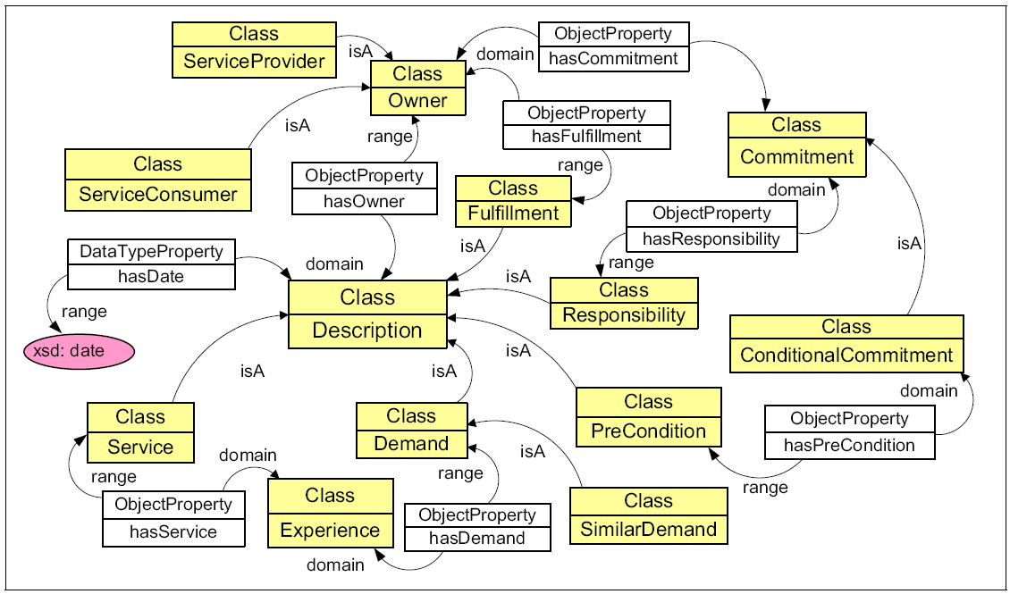
Base-Level Ontology

Slide 4
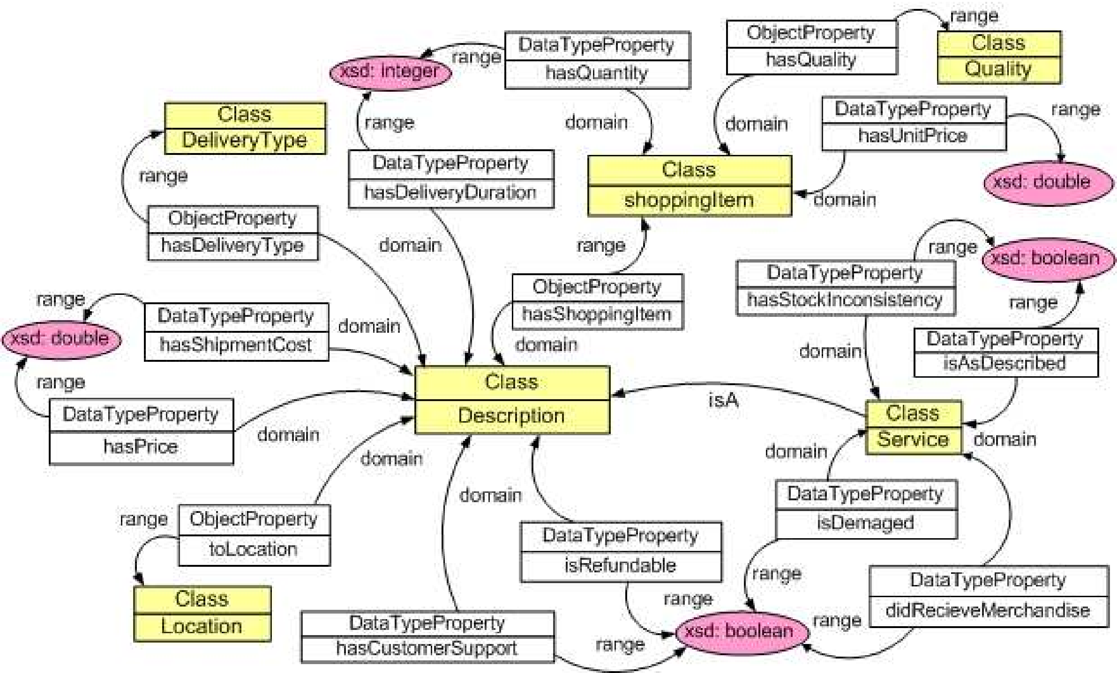
Domain-Level Ontology

Slide 5
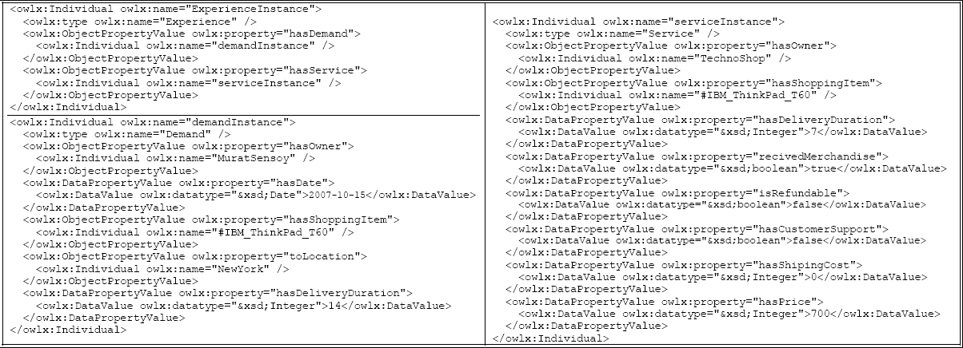


Alice states that she ordered an IBM ThinkPad T60 notebook from a seller named TechnoShop on 15 October 2007. She requested the merchandise to be delivered to New York within 14 days.
Example
For me, customer support is crucial. I would give a negative rating.
I would give a positive rating
The seller received $700 for the product and delivered the merchandise within 7 days without requesting any extra money for shipping. But, the delivered product was not refundable and TechnoShop did not provide any customer support.
Ontologies enable the consumers to evaluate the experience according to their own satisfaction criteria.
Jack
Jennifer

Slide 6
  Exchanging Experiences (1)
Service Consumers need others' experiences to decide.
CHALLENGE:
Many people are on the social network. Whom to trust for that particular service need?
PROPOSED SOLUTION:
Model others' expertise. When looking for a dentist, you might want to get referrals from a doctor (rather than your high school friend).

Slide 7
Exchanging Experiences (2)
Service Consumers collect experiences related to semantically similar service demands. Then, they use these experiences for the service selection.
CHALLENGE:
Similarity is a subjective concept and may differ for each consumer.
PROPOSED SOLUTION:
Model others' familiarity. Allow consumers to express their description of similar demand using SimilarDemand concept and Semantic Web Rule Language (SWRL).

Slide 8
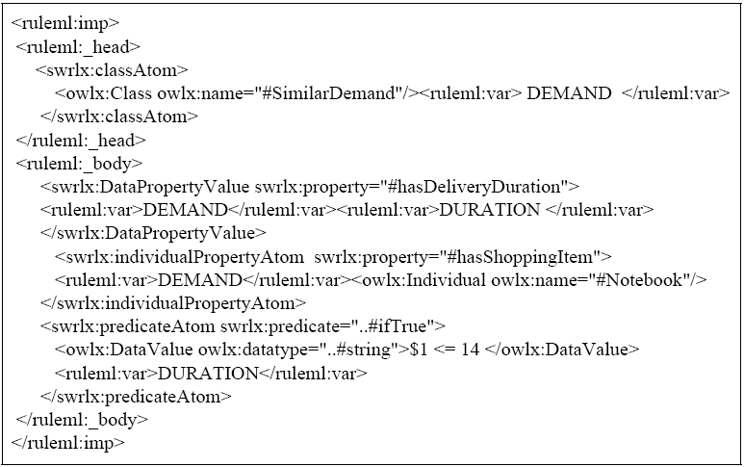
A demand is a Similar Demand only if the demand is related to buying a notebook and
requires a delivery duration less than or equal to 14 days.

Slide 9
Decision Making
Each experience can be interpreted by an agent. Hence, a satisfaction level is assigned to each experience using the agent’s personal satisfaction criteria.
Decision making using:
  Classification Methods (e.g., Parametric classification with Multivariate Gaussian Model)
  Case-Based Reasoning
...

Slide 10
Classification Problem (SPSGM)
Satisfied
Class
If the supplied service within an experience is satisfactory according to my satisfaction criteria, then the experience belongs to Satisfied Class
Set of experiences
similar to my service
demand and
related to
TechnoShop
For each provider, the consumer estimates the probability of satisfaction given its current demand.
Divide this experiences into two sets
Dissatisfied
Class
Train
Classify
Classifier
Current Service Demand
P( Sat | Demand, TechnoShop)
Select the provider with the highest satisfaction probability

Slide 11
Case-Based Reasoning
The assumption behind CBR approaches is that if two problems look similar, the solutions to these problems will probably be similar too.
Each experience is given a score, depending on:
Recency : The newer experiences, higher the recency
Similarity: Context similarity to the current demand
Satisfaction: How satisfied the current consumer would be, had it lived the examined experience.
Score for Experience i
S_{i} = recency_{i} × sim_{i} × sat_{i}
Recency factor
Similarity factor
Satisfaction factor
Then, the consumer picks the experience with the highest score and selects the provider supplying the service within this experience.

Slide 12
Evalutaion
The simulator is implemented in Java and KAON2 is used as OWL-DL reasoner.
10 Service Providers and 200 Service Consumers are simulated.
At least one service provider satisfies a service demand. The providers give services in different contexts with varying properties.
In the simulations, performance is measured in terms of the ratio of service decisions resulted in satisfaction.

Slide 13
Evalutaion
The simulator is implemented in Java and KAON2 is used as OWL-DL reasoner.
10 Service Providers and 200 Service Consumers are simulated.
At least one service provider satisfies a service demand. The providers give services in different contexts with varying properties.
In the simulations, performance is measured in terms of the ratio of service decisions resulted in satisfaction.

Slide 14
Four Approaches Compared
Experiences with Gaussian Model (SPS_{GM})
Experiences with CBR (SPS_{CBR})
Ratings from randomly chosen consumers (SPS_{RR})
Selective ratings (SPS_{SR}): Ratings are taken from those agents who have similar demands with respect to similarity criteria of the agent.

Slide 15
Simulation Factors
Variations in service demand (P_{CD}):
  Probability of each consumer to change the context of its service demand.
  Corresponds to variation in context.
Variations in service satisfaction (R_{subj}):
  The ratio of consumers who have similar service demands but conflicting satisfaction criteria.
  Represents the subjectivity in the environment.

Slide 16
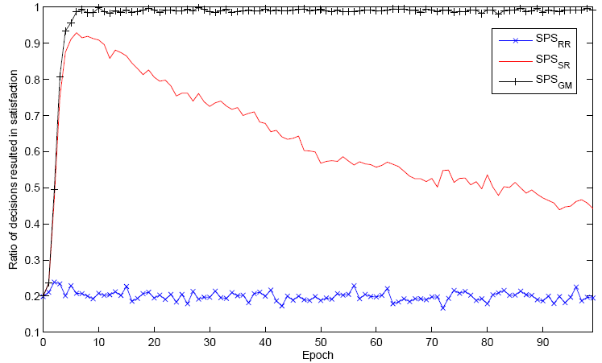
Variation in context
Consumers vary the context of their service demands over time (P_{CD}=0.2), but satisfaction criteria of consumers are the same for similar contexts (R_{subj}=0).
Y-axis:Ratio of satisfaction.
SPS_{GM}
SPS_{SR} is sensitive to variation in context.
SPS_{RR} is not better than random service selection.
X-axis:Discrete time.

Slide 17
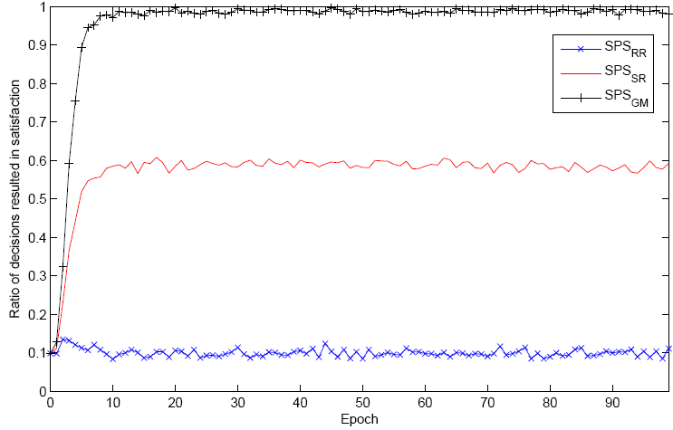
Subjectivity
Consumers do not vary the context of their service demands over time (P_{CD}=0.0), but half of the consumes having similar demands have conflicting satisfaction criteria (R_{subj}=0.5).
SPS_{GM}
SPS_{SR} is sensitive to subjectivity.
SPS_{RR} is not better than random service selection.

Slide 18
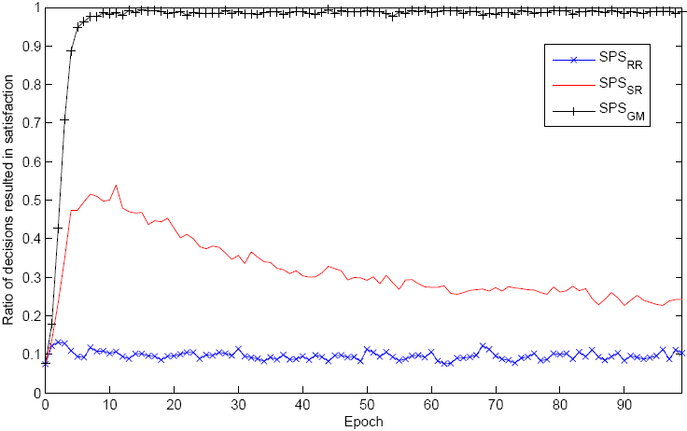
Context and subjectivity
Consumers vary the context of their service demands over time (P_{CD}=0.2), and half of the consumes having similar demands have conflicting satisfaction criteria (R_{subj}=0.5).
SPS_{GM} is robust to subjectivity and variation in context
SPS_{SR}

Slide 19
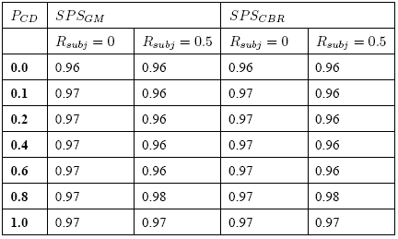
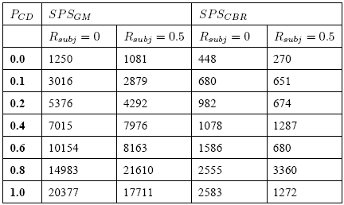
Results
Performances of SPS_{GM} and SPS_{CBR} are the same in terms of the success in service selection.
Service Selection Performance
SPS_{CBR} is around 7 times faster than SPS_{GM} on the average.
SPS_{CBR} can replace SPS_{GM}.
Time Performance (in ms.)
We assume that providers consistently produce similar services in the similar contexts. This assumption supports SPS_{CBR}.

Slide 20
Variations in service quality
Variations in service quality: Enable providers to deviate from their expected behavior in the favor of consumers with a small probability: probability of indeterminism (PI).

Slide 21
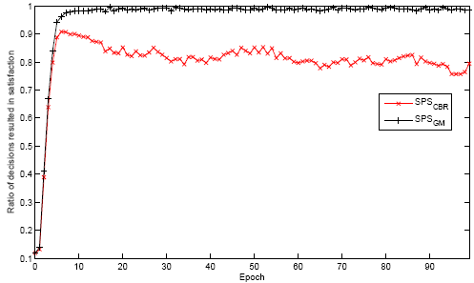
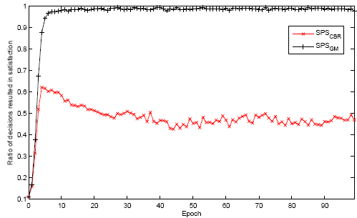
Results
SPS_{GM}
Performance of SPS_{CBR} decreases when PI = 0.001.
SPS_{CBR}
Performance of SPS_{CBR} decreases further, when PI = 0.01.
SPS_{GM}
Performance of SPS_{GM} does not decrease with these values of PI.
SPS_{CBR}

Slide 22
Observations
Rating-based approaches are sensitive to context-change and subjectivity.
Using ontology-based experiences, service selection can be made successfully even in subjective environments where consumers change the context of their service demands.
Unlike rating-based approaches, experience-based approaches are context-aware and can successfully handle subjectivity.

Slide 23
Observations
Most approaches attempt to find the most trustworthy
  Cost and constraints of the SP are not taken into account
General assumption is that there are previous data on service providers
  Some services are needed rarely, thus few interactions with SPs.
  One approach is to formalize stereotype (Burnett et al., 2011)
  Ex: Tall people play basketball better
  Learn rules from visible features
  Classify new service providers using the rules

