Slide 1
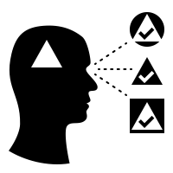
A tool to visualize language biases over time using Reddit comment data.
Filippo M. Libardi & Otto Mättas
Notes:
Hello all. I am Otto and together with Filippo, we are going to make you see the world in a new way.
Well, hopefully a little more clearly at least.
So, we are working on a tool to visualise language biases over time using Reddit comment data.

Slide 2
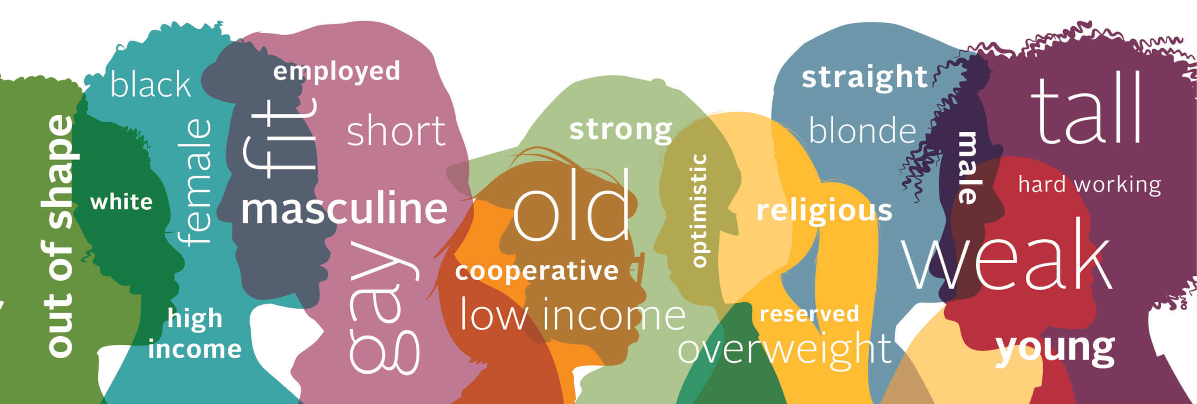
Recap of our research
We identify language bias trough previous research methodology.
We use Reddit comments data to train the model provided.
Display the frequency of biased terms throughout a time period.

Slide 3
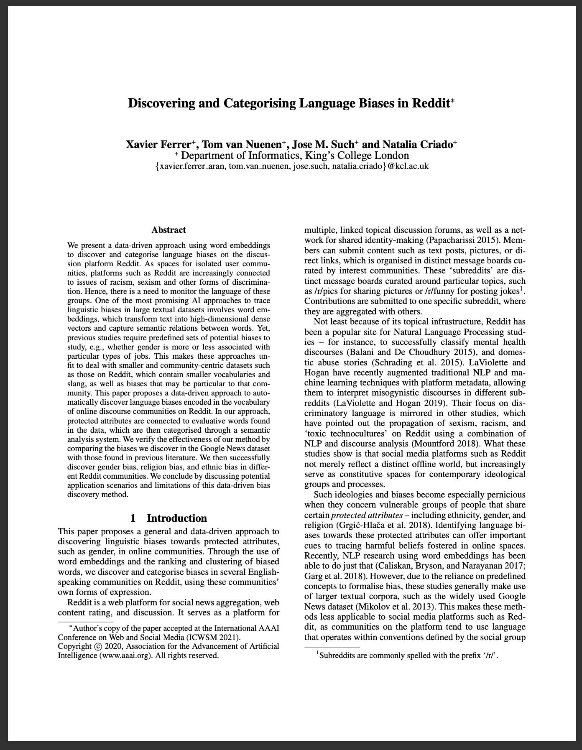
Related work
Very recent 2020 paper.
NLP model to identify biased terms towards a list of concepts given a text corpus.
Method validated on Google News.
The model only returns a list of biased words, the usage of these is not studied at all.
Their method allows to formalize language bias.
We aimed at improving on the method by displaying the usage of each biased word trough time.
Notes:
The method presented is very recent, it uses an Word2Vec model that transforms words in embeddings (vectors) by training on a corpus/
The authors took the plain nlp model and applied it to compute biased words: given word A,B,C. Word B is more biased
towards A if the cosine distance is smaller between embedding A and B rather than B and C.
The method returns a list of most biased words towards a list of concept.

Slide 4






The data
As researchers before us, we also chose for social news aggregation, web content rating, and discussion website Reddit. As the company’s motto says, it is aiming to be "the front page of the internet".
Limitations from previous research
APIs
Formatting
Subreddits
Ingestion
Preprocessing

Slide 5
Our addition to proposed methodology
Take most biased words with negative polarity (sentiment analysis)
Count frequency of each word and accumulate their sentiment score per time bin.
Linking to timestamp.
Normalisation.
Daily controversy of comments (sum up/down votes and their ratio).

Slide 6
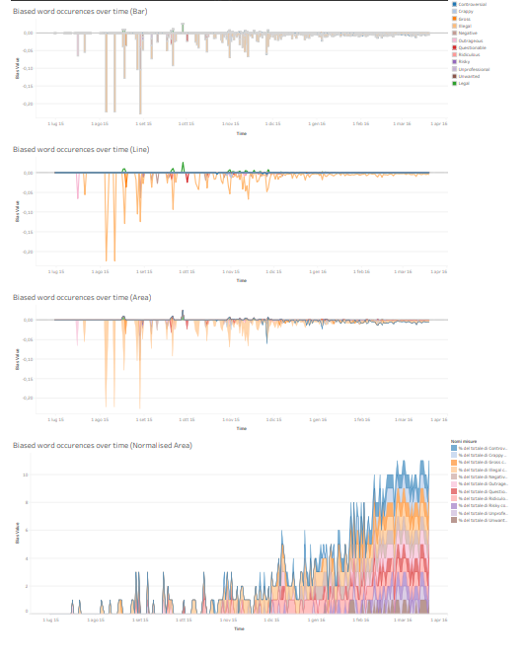
Visualizations
Design:
Run chart
Stacked area chart
Normalized stacked area chart
Implementation:
Using Tableau
Issue with normalized stacked area chart
Ultimately chose stacked area chart

Slide 7
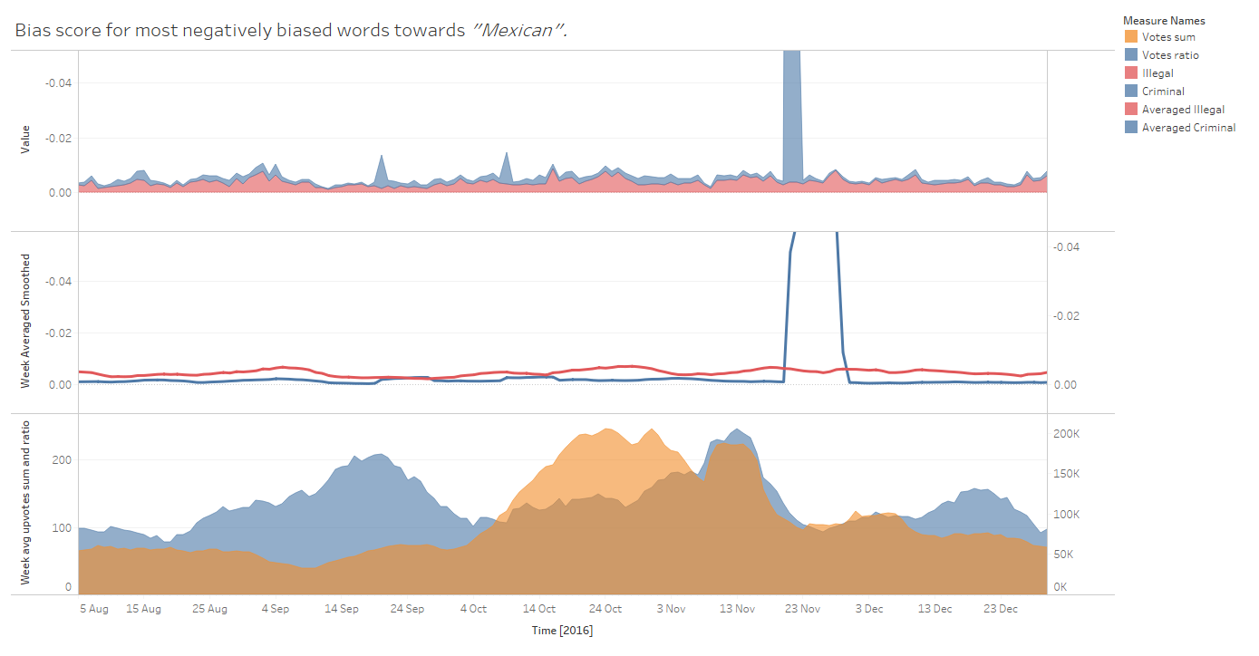
Our findings thus far
“Spike in frequency of biased words results in lower ratio and sum of up/down votes.”
ergo
“People use more biased words when a controversial debate is being discussed.”

Slide 8



Final steps
Validation
Results
Discussion
Empirical observations of new findings.
Correlation of bias spikes with real life events.
We are open to suggestions !
Analysis will entail studying how our method could and has been used.
Study the usability of our tool and if it actually allows to see the unseen.
Future work and possible implementations will be discussed.
Discuss threats to validity and issues in the development.

