Slide 1
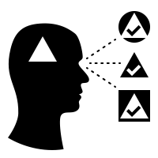
A tool to visualize language biases over time using Reddit comment data.
Filippo M. Libardi & Otto Mättas
Notes:
1 – Start -
Hello all. I am Otto and together with Filippo we are building a tool to visualise language biases over time using Reddit comment data.

Slide 2
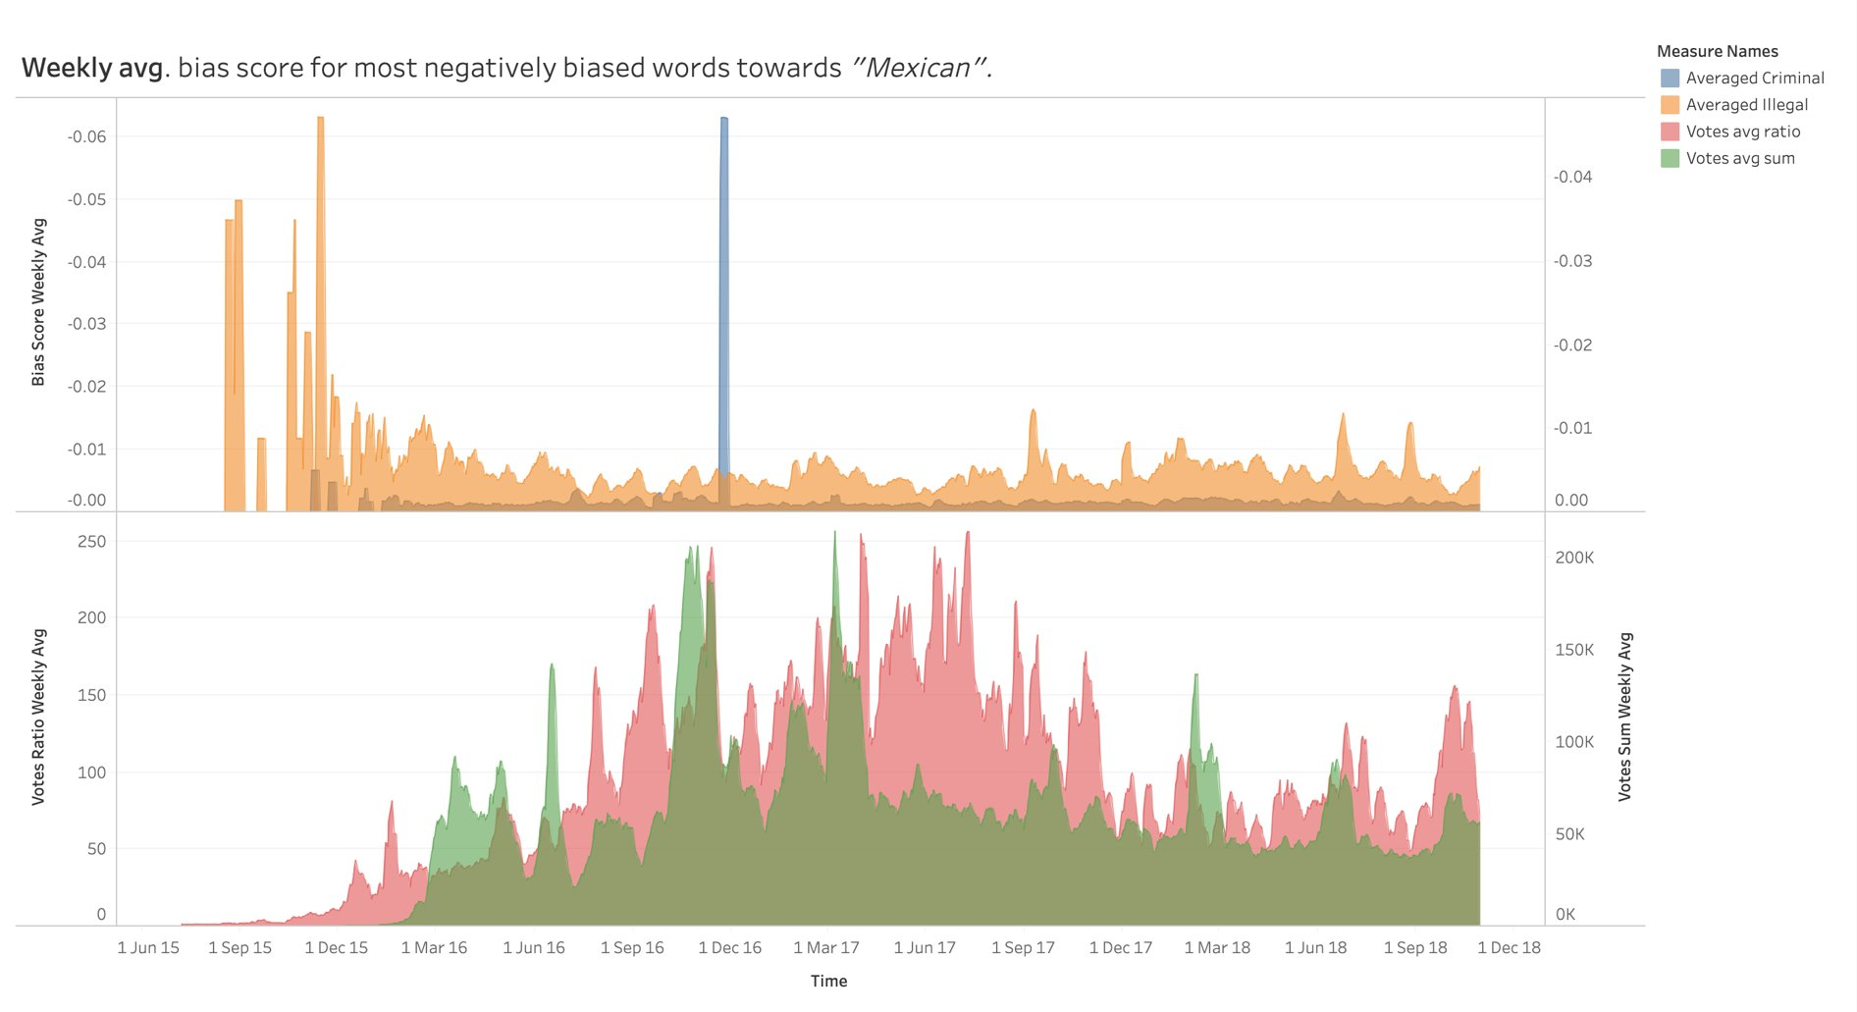
Notes:
2 - Overview and intro -
So, what can you expect from our presentation today?
We are going to share some results on the usefulness of our tool.
We are not doing a study. Rather, we are looking at the graph ourselves, trying to assess whether we can find something relevant ourselves before sending it out into the real world.
Next, a few pointers so you can follow our thoughts here:
First, as you can see, this is the whole of three years from one subreddit/community visualised in one nice overview.
To find a better understanding about certain periods, we can now drill into that period.
To help visualise this for you today, we are going to draw a red box around the period we are interested in.
The box is drawn by hand and is illustrative.
Let’s look at the start of the subreddit and discuss why it looks so wonky with white space present.

Slide 3
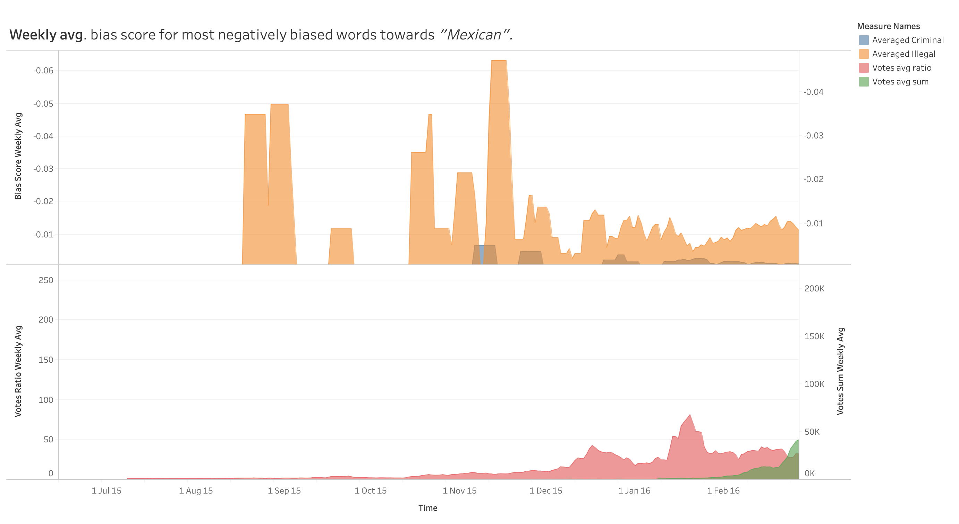
Notes:
3 - Zoom into the beginning of the subreddit -
Filippo explains.

Slide 4
Notes:
4 - Back to overview -
We are now back on the overview again.
Next, we are drawing a red box around and drilling Ito the blue peak in the middle of the graph.
We are narrowing our period and scope a little this time.
Also, on the next slide you will see some labels which would show up when you interact with the graph.
These will give you a better idea of when something might have happened. Also, we can compare bias scores directly on those labels.

Slide 5
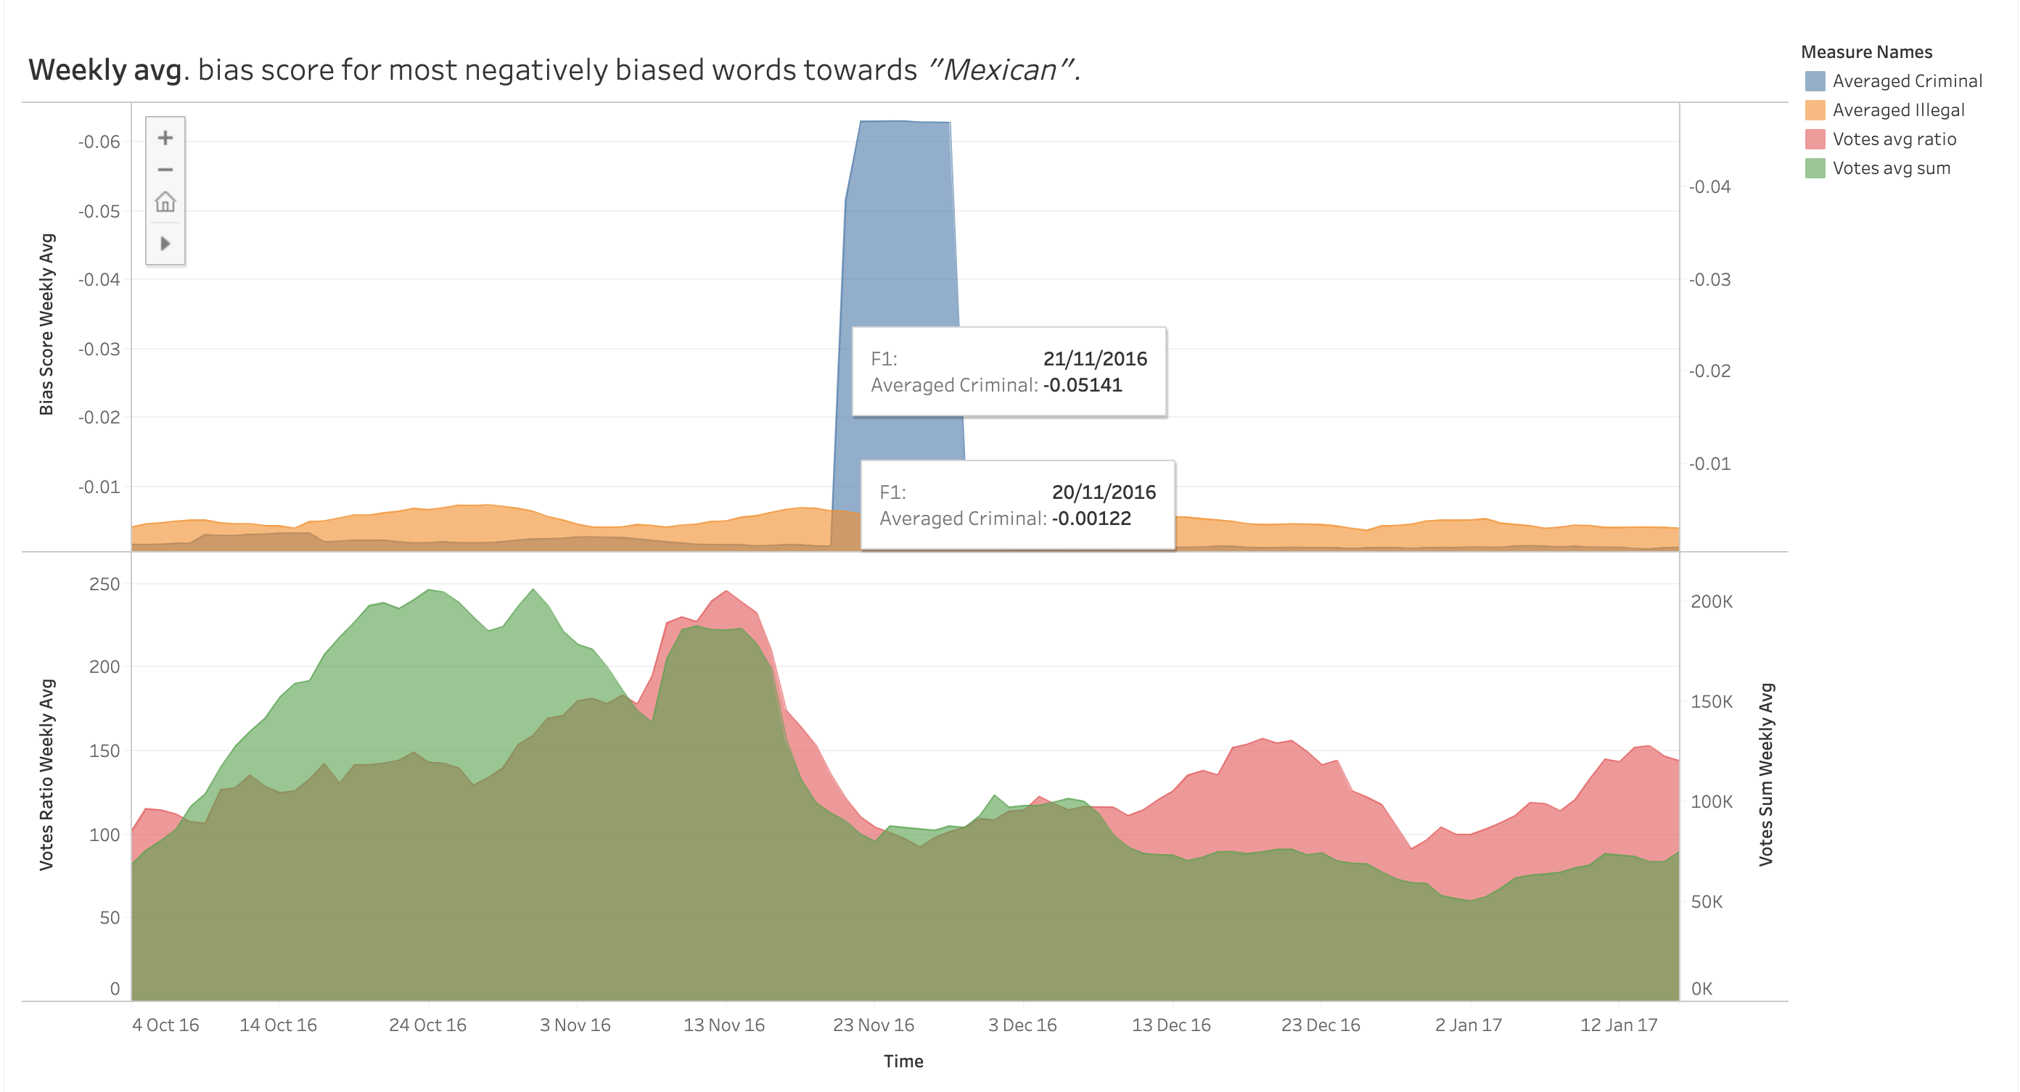
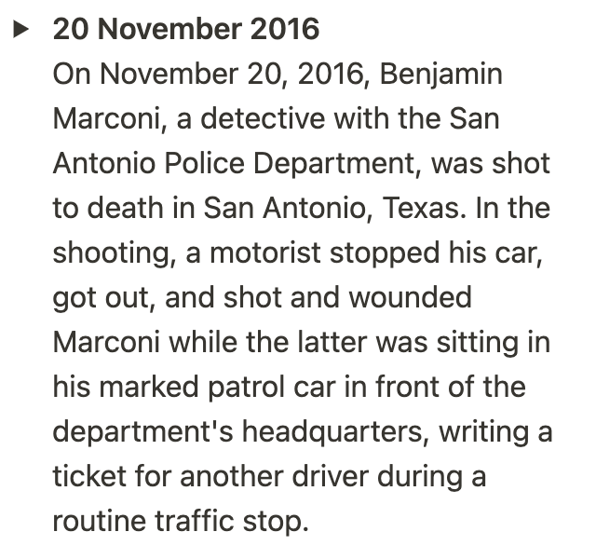
Notes:
5 - Zoom into 20 November 2016 -
Filippo reads the news excerpt and explains further.
On November 20, 2016, Benjamin Marconi, a detective with the San Antonio Police Department, was shot to death in San Antonio, Texas. In the shooting, a motorist stopped his car, got out, and shot and wounded Marconi while the latter was sitting in his marked patrol car in front of the department's headquarters, writing a ticket for another driver during a routine traffic stop.
We can see this from both the high usage of the term Criminal correlated with Mexican or brown as well as the controversy of the day (low vote ratio and score). The murder was in fact debated for a long time even after the judge sentenced the committed murderer.

Slide 6
Notes:
6 - Back to overview -

Slide 7
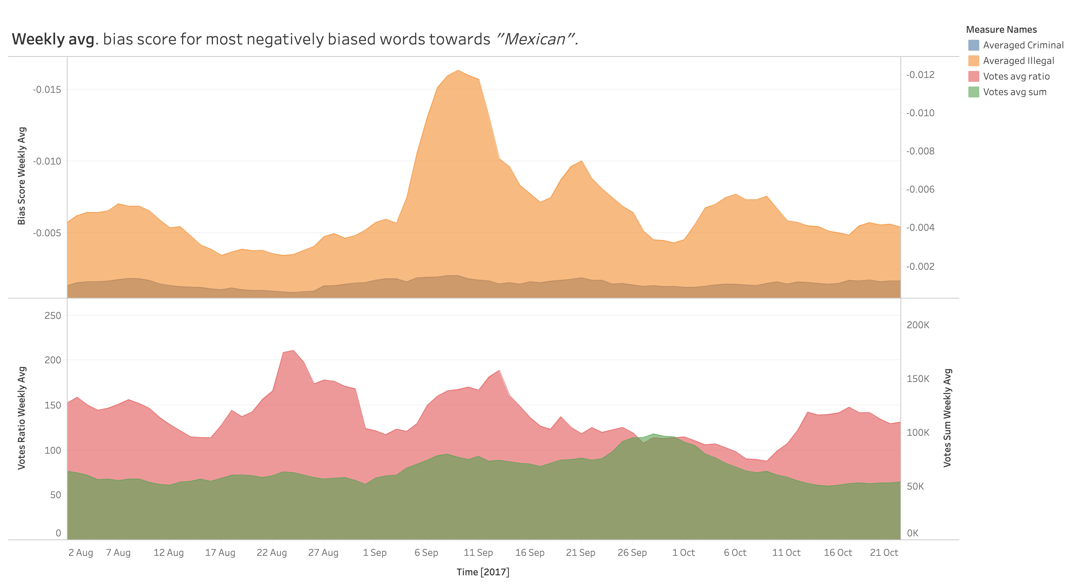
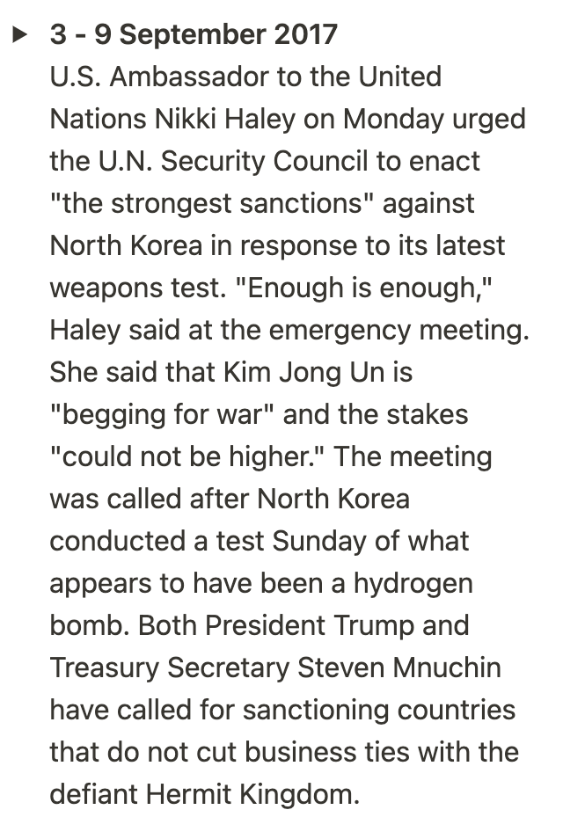
Notes:
7 - Zoom into 3 - 9 September 2017 -
Filippo reads the news excerpt and explains further.
U.S. Ambassador to the United Nations Nikki Haley on Monday urged the U.N. Security Council to enact "the strongest sanctions" against North Korea in response to its latest weapons test. "Enough is enough," Haley said at the emergency meeting. She said that Kim Jong Un is "begging for war" and the stakes "could not be higher." The meeting was called after North Korea conducted a test Sunday of what appears to have been a hydrogen bomb. Both President Trump and Treasury Secretary Steven Mnuchin have called for sanctioning countries that do not cut business ties with the defiant Hermit Kingdom.

Slide 8
Notes:
8 - Back to overview and outro -
So, these are our results so far and we feel confident our tool was worth building.
We can find interesting periods within a certain comment body which would have been otherwise not visible.
With little effort, we were able to find correlations in the real world and get a sense of how the community responds to certain topics.
Now, what do you think after we have taken you through this with us?
What else would you like to look at?

Slide 9
Notes:
9 - That’s all folks -

