Slide 1
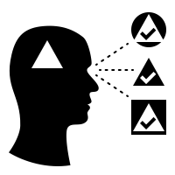
A Tool to Visualize Language Biases Over Time Using Reddit Comment Data
Filippo M. Libardi & Otto Mättas
Notes:
1 – Start -
Hello all. I am Otto and together with Filippo we are building a tool to visualise language biases over time using Reddit comment data.

Slide 2
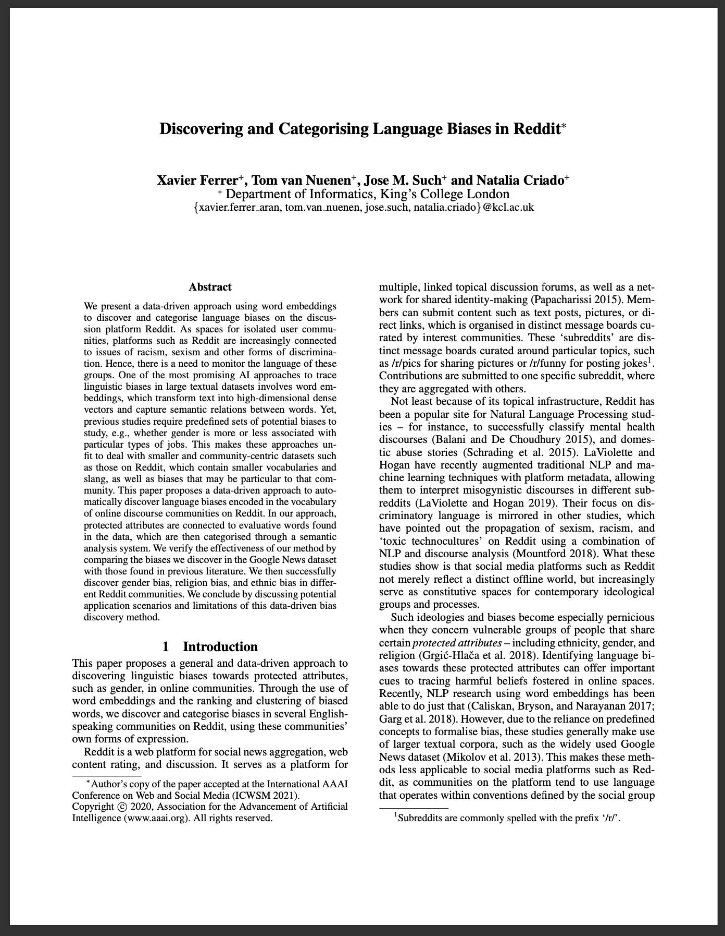
Related Work on Language Bias
Very recent 2020 paper;
NLP model to identify biased terms towards a list of concepts given a text corpus;
Method validated on Google News;
The model only returns a list of biased words, the usage of these is not studied at all;
Their method allows to formalize language bias;
Do associations / correlations rise out of bias and sentiment visualizations after introducing the time dimension?

Slide 3
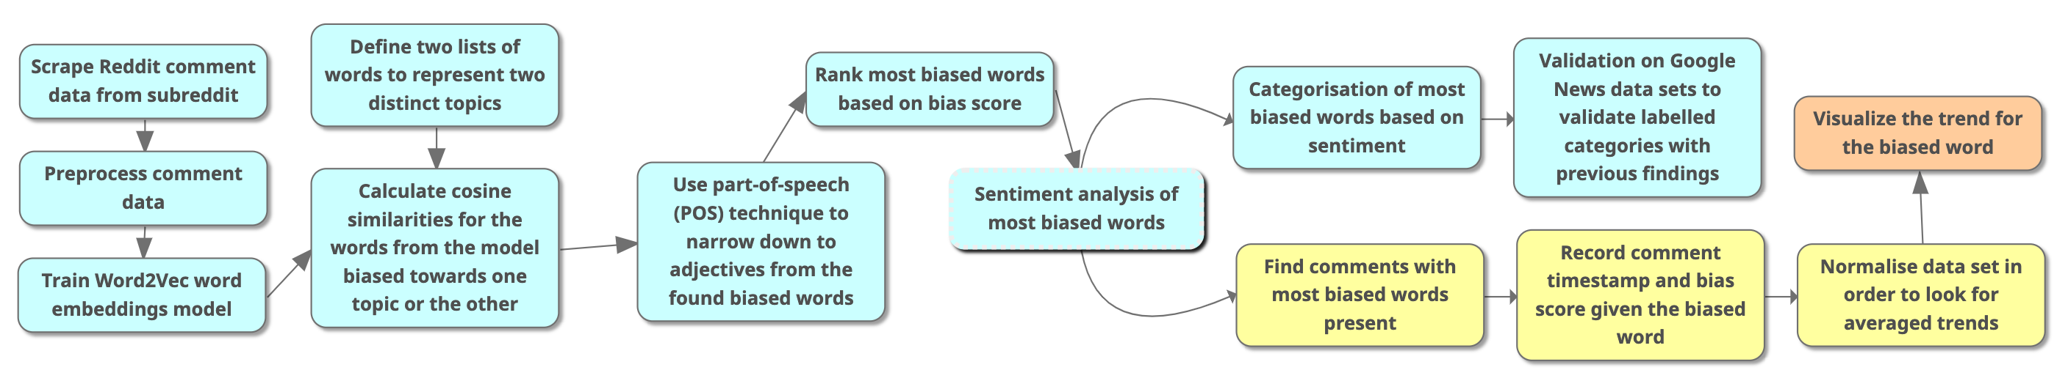
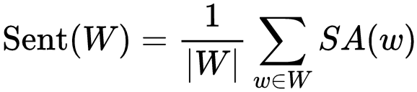
Ferrer et al. (2020)

Slide 4
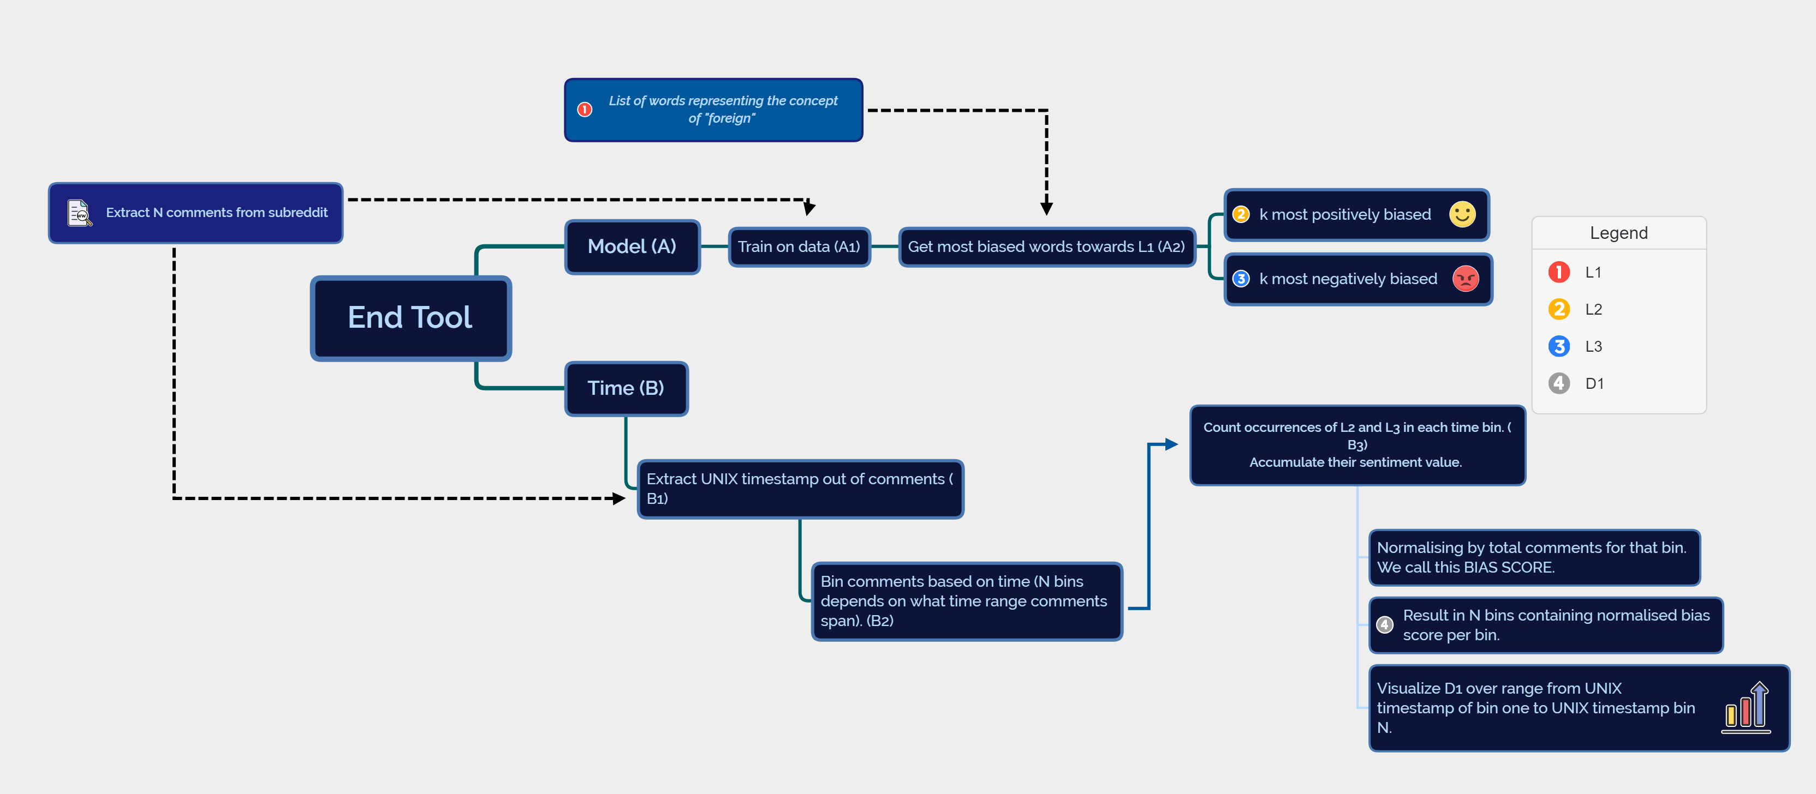
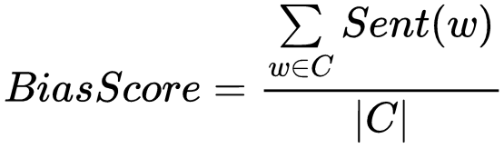
Our Additions

Slide 5
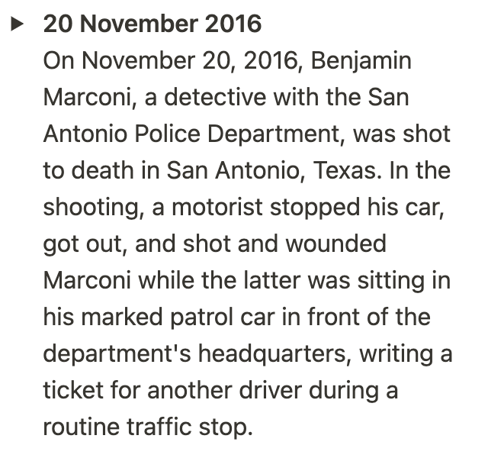
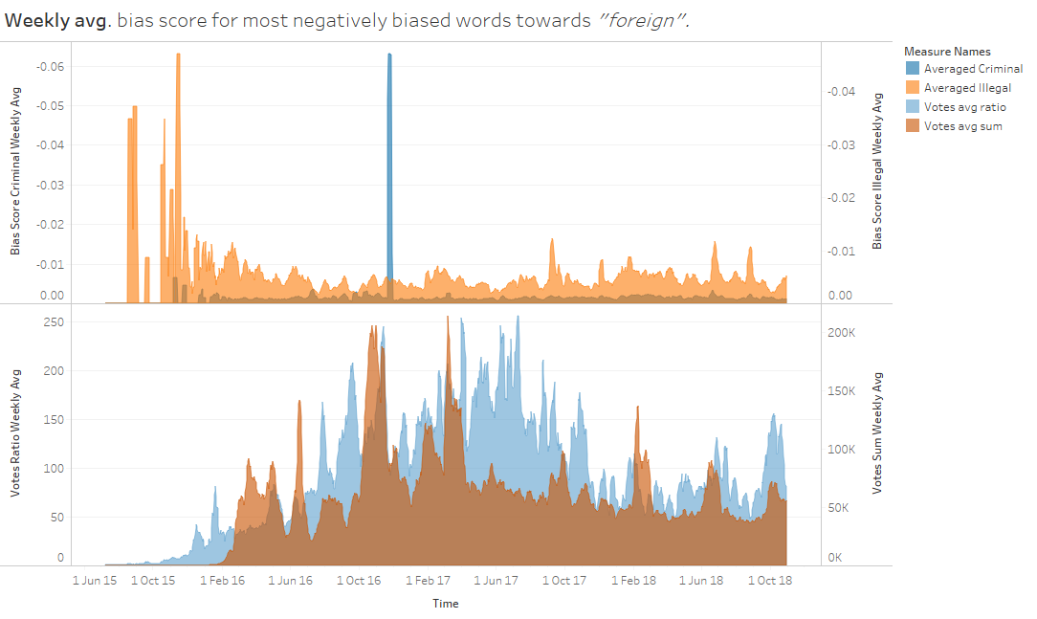
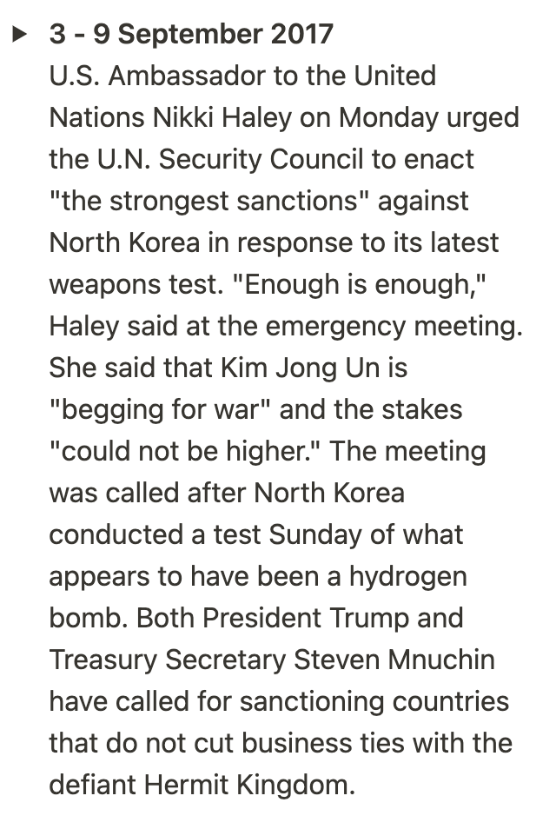
Results and Validation
Source
Source

Slide 6






Issues
Ferrer et al. (2020)
APIs
Formatting
Subreddits
Ingestion
Processing

Slide 7
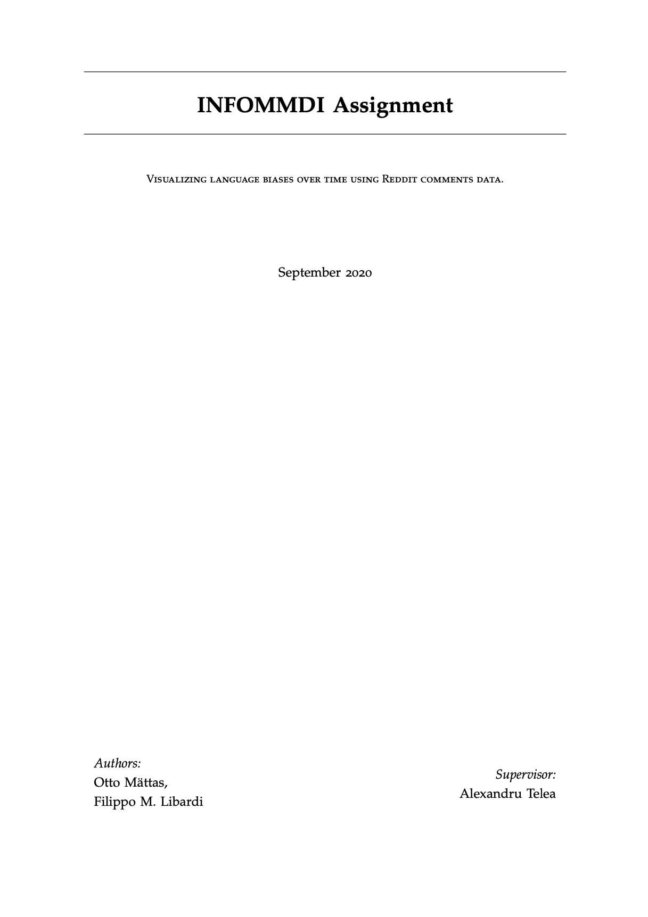
Conclusion
We have further specified and improved the methodology proposed by Ferrer et al. (2020);
We have given a detailed description of the technical implementation;
We have validated the results and the methodology for our purpose;
We invite you to inform our proposal for future research!
And to read our report, of course...

Slide 8
Notes:
9 - That’s all folks -

