Slide 1
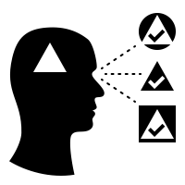
A tool to visualize language biases over time using Reddit comment data.
Filippo M. Libardi & Otto Mättas
Notes:
Hello all. I am Otto and together with Filippo, we are going to make you see the world in a new way.
Well, hopefully a little more clearly at least.
So, we are working on a tool to visualise language biases over time using Reddit comment data.

Slide 2
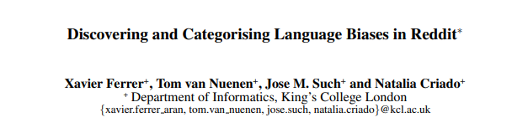
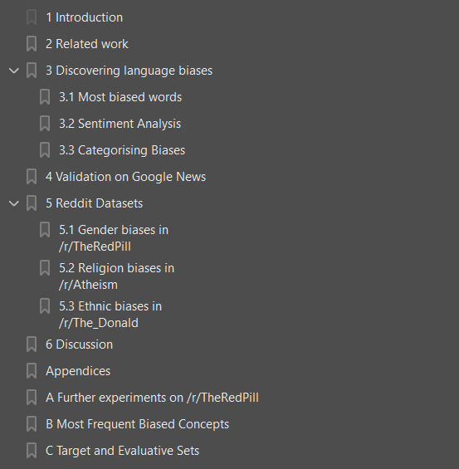
Related work
Very recent paper presented.
Method validated on Google News
Presented in DADD (Discovering and Attesting Digital Discrimination)
Notes:
Our work heavily relies on a model proposed in a very recent paper (https://arxiv.org/pdf/2008.02754v2.pdf) which aims to discover and identify biases in reddit.
They present a statistical model based on word embeddings and give all the details to reproduce their work.
They also provide a visualization tool (https://xfold.github.io/WE-GenderBiasVisualisationWeb/).
After having reproduced the work proposed, we aim to improve this tool by visualizing bias over time.
Adding a time dimension to bias analysis could spark interest in certain periods and raise question on whether there is a causal relationship with events in that same period and the trend of the bias.

Slide 3
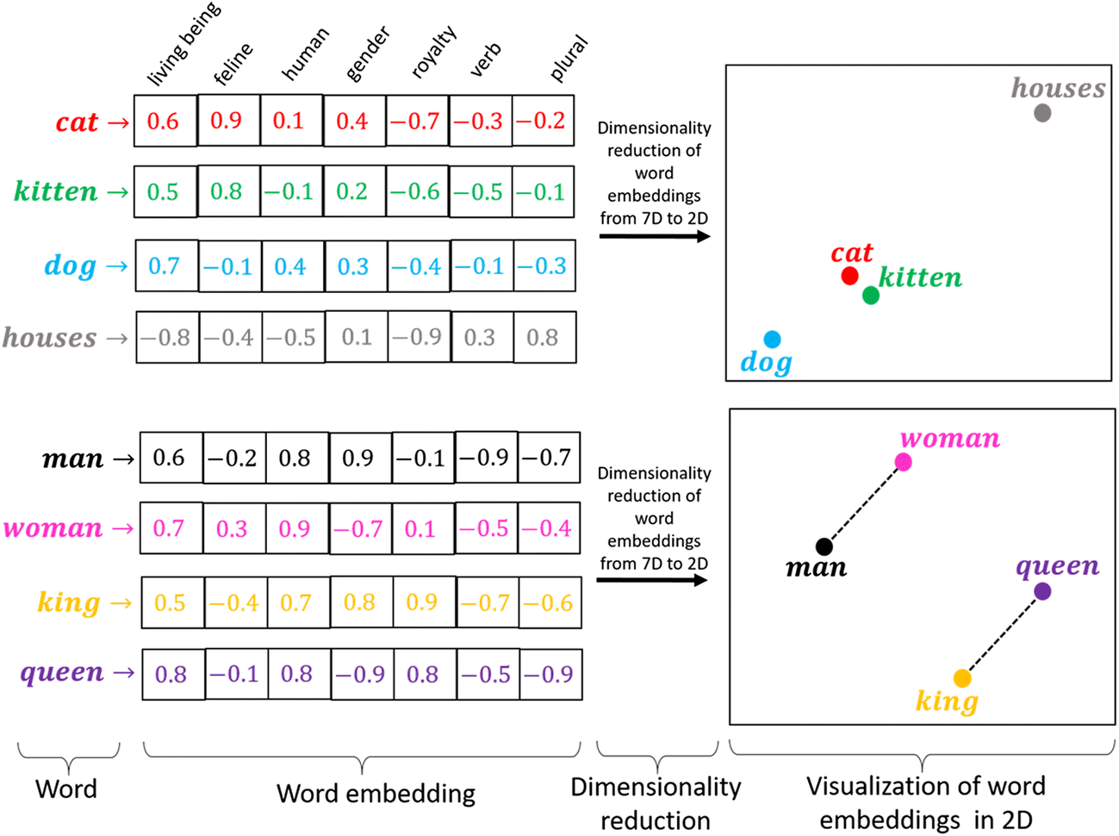
Model
The model considered is a skip-gram word embedding model.
Word embeddings make a dense vector out of a word.
These models have drawbacks.
Notes:
The model considered is a skip-gram word embedding model.
Word embeddings are vector that try to capture the semantic of a word by looking at its occurrences in certain contexts and co-occurrence with other words.
These sort of models are highly dependent on which corpus they are trained on (Reddit in our case).

Slide 4
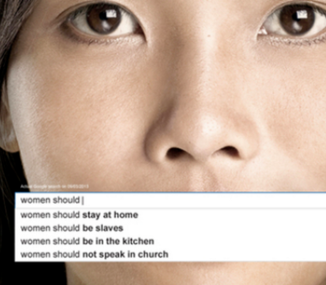
What is biased language?
“A systematic asymmetry in word choice as a function of the social category to which the target belongs.”
Notes:
“A systematic asymmetry in word choice as a function of the social category to which the target belongs.”
Words and phrases that are considered prejudiced, offensive, and hurtful.
Biased language includes expressions that demean or exclude people because of age, sex, race, ethnicity, social class, or physical or mental traits.

Slide 5

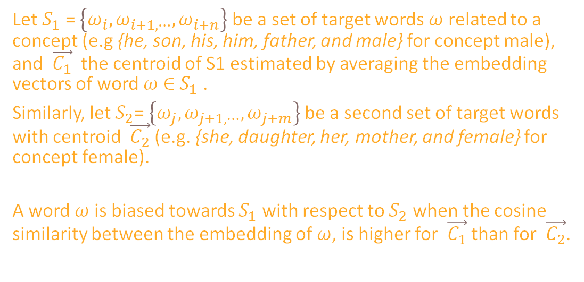
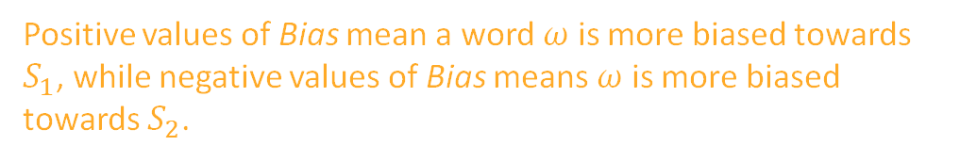
Formalizing bias
Let $S_{1}$ = $\left\{ω_{i},ω_{i+1,⋯},ω_{i+n}\right\}$ be a set of target words $ω$ related to a concept (e.g {he, son, his, him, father, and male} for concept male), and $\vec{C_{1}}$ the centroid of S1 estimated by averaging the embedding vectors of word $ω$ ∈ $S_{1}$ .
Similarly, let $S_{2}$= $\left\{ω_{j},ω_{j+1,⋯},ω_{j+m}\right\}$be a second set of target words with centroid $\vec{C_{2}}$ (e.g. {she, daughter, her, mother, and female} for concept female).
A word $ω$ is biased towards $S_{1}$ with respect to $S_{2}$ when the cosine similarity between the embedding of $ω$, is higher for $\vec{C_{1}}$ than for $\vec{C_{2}}$.
Positive values of Bias mean a word $ω$ is more biased towards $S_{1}$, while negative values of Bias means $ω$ is more biased towards $S_{2}$.
Notes:
A word is represented as a vector.
For example, when we have the nouns "woman / man" and an adjective "irrational", we can measure the distance of each noun to the adjective. Additionally we take the distance between the two distances, if it results closer to one of the two, there is a bias. In our case, man is closer to the word irrational so the data corpus is biased.

Slide 6

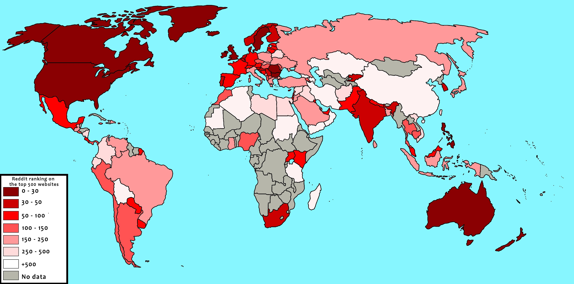
Data
Why reddit?
Is worldwide popular
Is open to data collection
Is discussion based
Being a very popular social media, is a partial reflection of societal phenomena.
Notes:
Similarly as the model proposed we are going to harvest the data from some very popular and context specific subreddits*.
Why reddit?
Is worldwide popular
Is open to data collection
Is discussion based
Being a very popular social media, is a partial reflection of societal phenomena.

Slide 7
Adding time
Our main contribution, after having replicated the work is to identify biases and visualize it over time.
There are several approaches we thought about to go around this task.
Evaluating most biased words and looking at their usage over time.
Training a model with data only from certain periods. E.g. From 2000 to 2005, from 2005 to 2010 etc. and comparing models.
Probably the most feasible solution and our GOTO so far.
Studying the weights matrix at each timestep.
The first models (being trained on fewer and different data) would yield unreliable results.
The order of context words does not influence prediction (bag-of-words assumption).
Notes:
Our main contribution, after having replicated the work is to identify biases and visualize it over time.
There are several approaches we thought about to go around this task.
Evaluating most biased words and looking at their usage over time.
Probably the most feasible solution and our GOTO so far.

Slide 8

Ask us anything!
We are here to answer.
Research question
Users case
Tech stack
Evaluation
Reasons why
What are the tasks our tool supports?
Who will use our tool?
What frameworks will we make us of?
How are we going to evaluate our tool?
Why did we pick this project?
How do perceptions about bias differ and/or change when adding a timeline to bias visualisation?
Subreddit moderators will gain more insights about when bias has developed and if it is currently developing.
Python:
Gensim
nltk
NumPy
Pandas
Scipy
Visualizing:
D3 (?)
Tk (?)
QT (?)
We are contacting mods of some subreddits and we will ask them to use our tool to spot biases violating the community rules.
We believe the end tool has ecological validity and can be used to fight bias creation as well as aiding mods in setting and enforcing community-specific rules, removing posts and comments that violate these rules
Notes:
Thanks for following. For sparking discussion, we have left you here with some questions and an overview of what we’re gonna aim for once more.

Slide 10

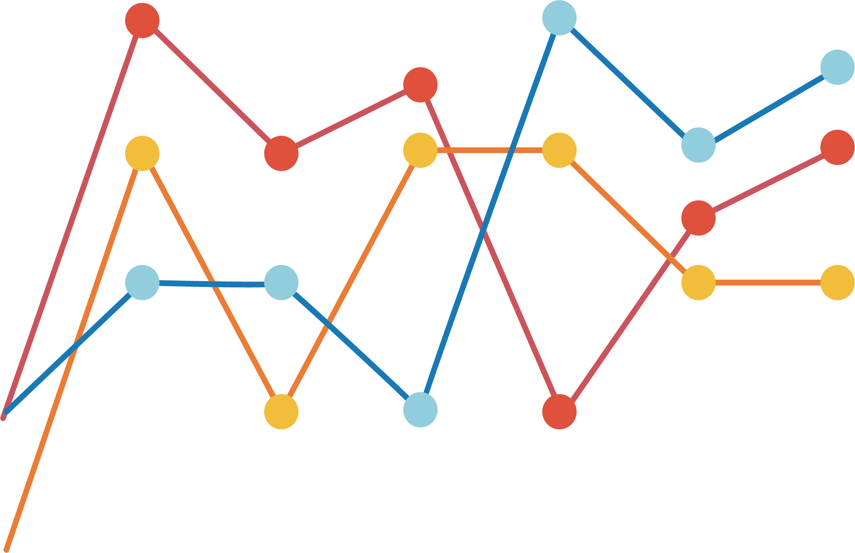
Approach
Replicating
Visualizing
Refining
The code for the model is already available, so replication should not take too long.
Model training and data refinement could be more time consuming.
The data will be gathered trough an API. The latter not only gives real time data but always attach a timestamp to each datapoint.
This will be a fundamental detail for our end application
At first, we will make use of the QT framework and its components to build an application that will display the data highlighting some of its features.
Here we will make great use of Dimensionality Reduction techniques as vector embedding are of high dimensional nature.
DR techniques will be coupled with other visualization tools to better gain insights about the data essence over time.
Finally a better visualization could be implemented by making use of higher-level framework.
Possibly the tool will also be made available online by reducing the python code to the backend of a web application.
Additional work could be investigated to ease the process of “event study” on the application. The latter entails better understanding the statistical significance of a co-occurrence of an event and a change in the data at each point in time.

