Slide 1
Randy Gallistel
on Memory
A presentation by Otto Mättas
Notes:
Welcome to this presentation on Randy Gallistel’s ideas about memory. Gallistel is a cognitive scientist and Professor Emeritus at Rutgers University, known for his unconventional and often controversial ideas in neuroscience.
He has spent much of his career challenging the traditional views of how memory works in the brain, proposing that we may need to fundamentally rethink what memory is and how it’s stored.
Today, we’ll dive into Gallistel’s theories, his critiques of mainstream neuroscience, and why these ideas matter for both cognitive science and artificial intelligence.

Slide 2
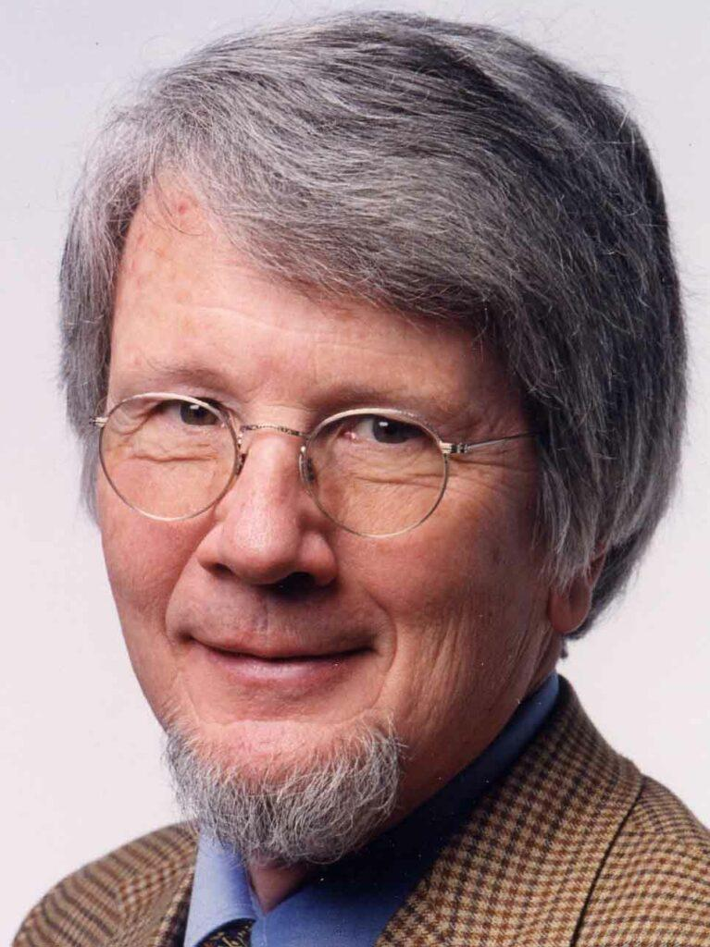
Charles Ransom Gallistel
b. 1941
Professor Emeritus of Psychology at Rutgers.
Known for challenging established neuroscience perspectives on memory.
Notes:
Charles Ransom Gallistel, or Randy Gallistel, was born in 1941 and is a Professor Emeritus of Psychology at Rutgers University.
Or he’s a joyful trickster. Very approachable to listen to, recommend.
He is best known for pushing back against established neuroscience perspectives on memory, advocating for a view of the brain as a computational, symbolic processor rather than just a network of associations.
By questioning assumptions in neuroscience, Gallistel has sparked valuable debate, urging us to examine the fundamentals of memory with a critical eye.

Slide 3
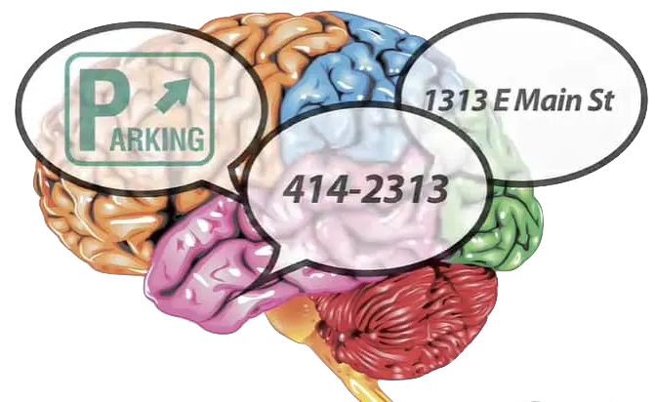
The Nature of Memory
memory is a fact-based system, full of facts.
mainstream neuroscience does not address memory as being filled with explicit, retrievable facts.
Notes:
Gallistel’s work begins with an intriguing premise: memory, in his view, is fundamentally fact-based. Rather than being simply a web of associations, he argues that memory is filled with specific, retrievable facts.
He challenges mainstream neuroscience for not fully addressing this fact-based nature of memory, arguing that existing models don’t explain how we remember particular, detailed information.
To illustrate, consider how we remember precise details like names, numbers, or directions—details that seem too specific to be merely associative connections. Gallistel believes memory involves more precise, symbolic encoding.

Slide 4
Desert Ant Navigation Case Study
The Problem
Desert ants return home in straight lines after complex foraging paths
Navigate accurately in featureless terrain
Store and compute exact distances and angles
Why it matters?
Requires precise numerical storage
Path integration involves ongoing calculations
Can't be explained by simple associative learning
Implications
Demonstrates need for exact number storage
Shows active computational processes
Supports Gallistel's symbolic memory theory
Notes:
This case study perfectly illustrates why Gallistel's theory matters. Desert ants present us with a fascinating puzzle.
These ants travel in complex, winding paths while searching for food, often going hundreds of meters from their nest in featureless desert terrain.
The remarkable part? After finding food, they don't retrace their steps. Instead, they calculate a direct straight-line path back home.
This requires three incredible feats:
1. They must constantly track their exact position relative to home
2. They need to store precise distances and angles
3. They must perform real-time vector calculations
Think about it: How could simple synaptic connections store and process such exact numerical information?
This is why this example is so powerful - it shows us a case where we clearly need exact numerical storage and computation in a tiny brain.

Slide 5
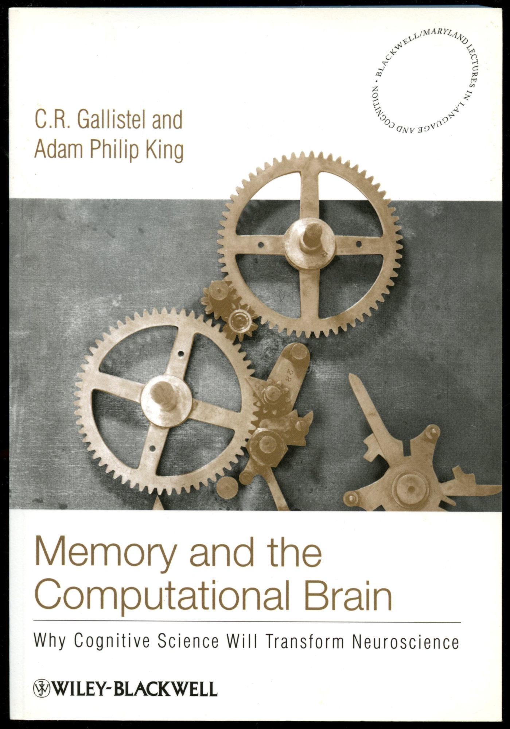
Computational Theory of Mind
the brain must have an addressable, read-write memory mechanism that encodes, stores, and retrieves facts similar to a computer.
memory involves symbolic processing, contrasting with the dominant connectionist model focusing on associative synaptic connections​ (associationism).
Notes:
One of Gallistel’s core arguments is that the brain functions similarly to a computer. He suggests that it must have an addressable, read-write memory system capable of encoding, storing, and retrieving facts as symbols.
In his book Memory and the Computational Brain, Gallistel describes memory as a process of symbol manipulation. This perspective contrasts with models that see memory as a result of synaptic connectivity and associative learning.
Gallistel was also influenced by Noam Chomsky’s ideas on language, particularly Chomsky’s belief in a symbolic foundation for cognitive processes. Gallistel applies a similar approach to memory, proposing that, like language, memory requires symbolic representation.
As a simple analogy, think of how a computer stores and retrieves specific data. Gallistel argues the brain might operate in a similar way, using symbols and precise recall mechanisms.

Slide 6
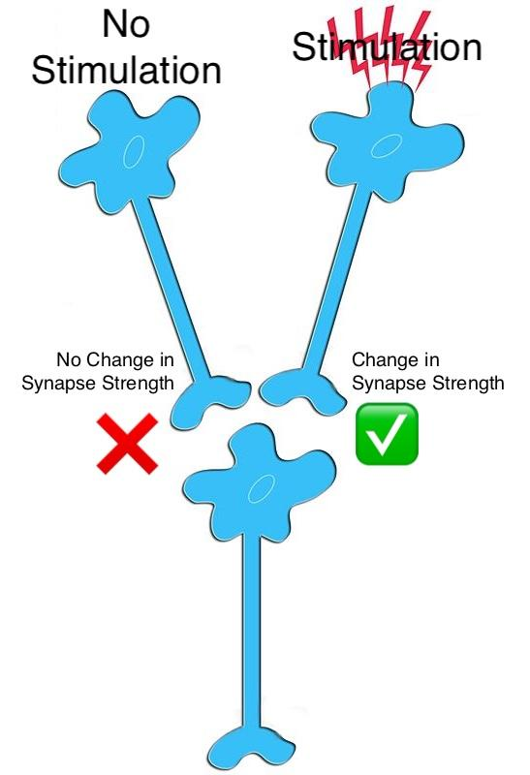
Synaptic Plasticity
can not be the basis / register of memory.
does not explain how specific information, like numerical data, is stored:
distances,
directions,
temporal durations.
How do you store a number in a synapse?
Notes:
Gallistel has been critical of the idea that synaptic plasticity—changes in the strength of synaptic connections—can fully account for memory storage.
He questions how complex and specific data, like exact numerical values or time intervals, could be stored in synaptic weights alone, especially given the variability in synaptic connections.
For instance, he frequently asks, ‘How do you store a number in a synapse?’ This rhetorical question highlights his doubt that synaptic plasticity can explain how facts or symbolic information, such as remembering directions or precise distances, are stored.
If 10 is stored differently from 5, then how exactly are these values encoded? Gallistel finds existing explanations to be insufficient.
What does distance feel like? (qualia)

Slide 7
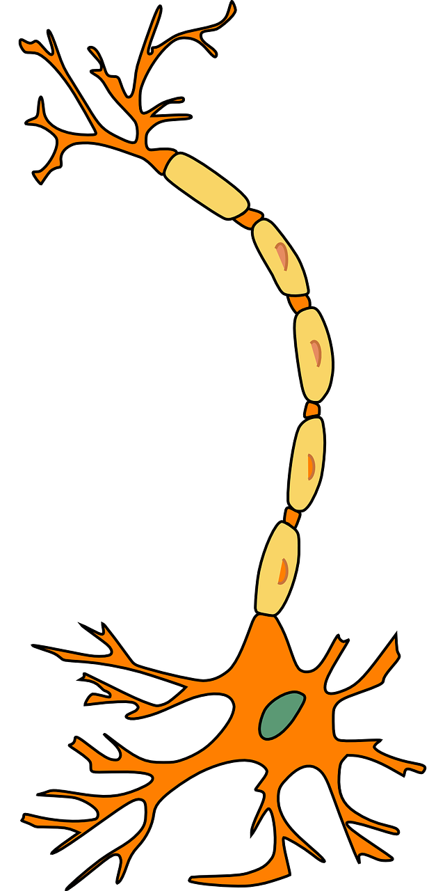
Memory Storage Theory
memory might be stored within individual neurons rather than across synapses.
memories could be encoded in polynucleotides, such as DNA or RNA, which allows for stable, symbol-based storage​.
Notes:
As an alternative to synaptic storage, Gallistel suggests that memory might be stored within individual neurons rather than across synapses.
He proposes that structures like DNA or RNA within neurons could act as storage mechanisms, allowing for stable and reliable encoding of symbols and facts.
This theory points to intracellular storage as a way to enable exact recall of data. DNA, with its stability and precise encoding abilities, might serve as a long-term, symbol-based storage system, whereas RNA could potentially handle read-write operations.
This approach, according to Gallistel, could allow the brain to store specific, retrievable symbols in a way that’s more similar to a computer’s memory register than to distributed synaptic patterns.

Slide 8
Two Views of Memory Storage
Traditional
Gallistel
VS
Synaptic Storage
Intracellular Storage
Stores patterns through connection strengths
Stores precise values like computer memory
Notes:
Here we see the fundamental difference between traditional views and Gallistel's proposal.
On the left, the traditional view sees memory as patterns of synaptic connections between neurons. Think of it like adjusting the strength of connections in a network.
On the right, Gallistel's view proposes that memory is stored within individual neurons, more like computer memory, using molecular mechanisms to store precise values.
The key difference is precision: Traditional models store patterns and associations, while Gallistel's model can store exact numbers and facts.
This distinction becomes crucial when we try to explain phenomena like the ant navigation we just discussed.

Slide 9
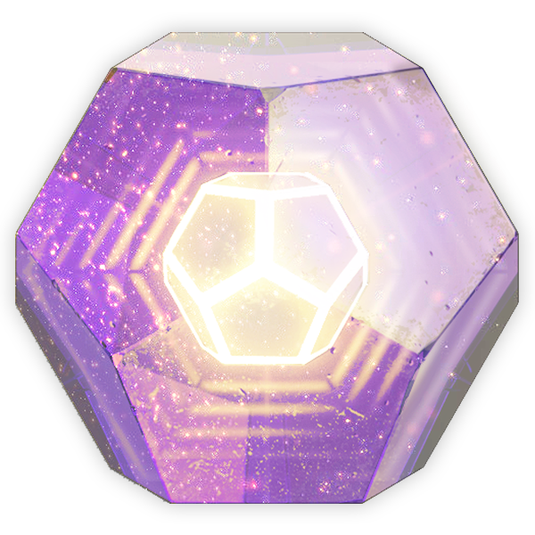
Engrams are hypothetical units of memory stored in the brain or other tissue.
Notes:
Introduce the term engram.

Slide 10
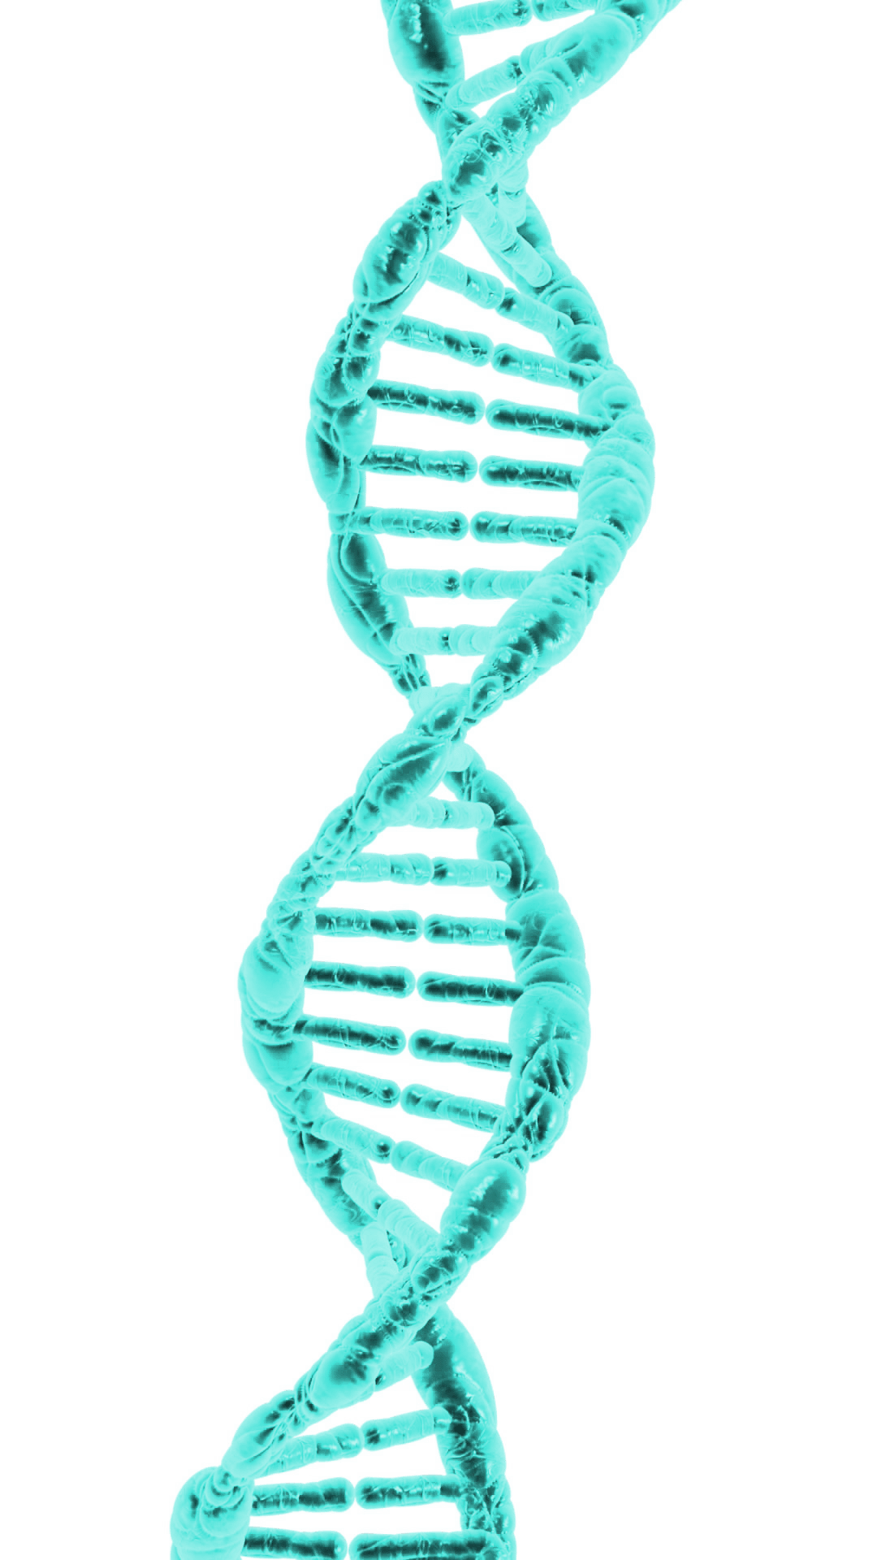
Memory’s Physical Trace
engram is the hypothesised physical trace of memory.
memories are stored intracellularly and not as distributed synaptic patterns.
understanding intracellular mechanisms, like RNA-based storage, might reveal how memories are encoded.
Notes:
The term ‘engram’ refers to the hypothetical physical trace of memory. For years, neuroscientists have debated what exactly this trace might be and where it is located.
Gallistel suggests that if memory is stored as stable, retrievable symbols, then we should be looking within the cell for the engram, rather than across distributed synaptic connections.
His theory proposes that intracellular mechanisms, potentially involving RNA or other molecular substrates, could reveal the engram. Such mechanisms would offer a more reliable and specific storage medium for facts and symbols than a synaptic model.
Finding the engram in this way would provide a concrete answer to one of neuroscience’s biggest questions: Where exactly is memory stored in the brain?

Slide 11
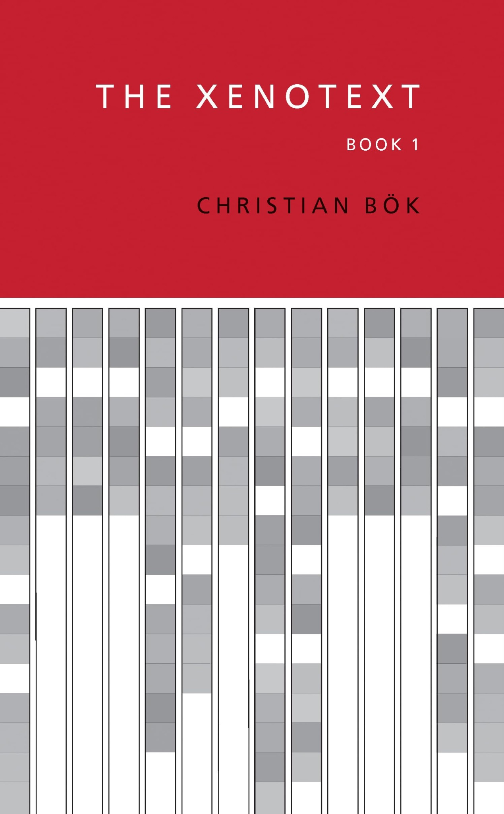
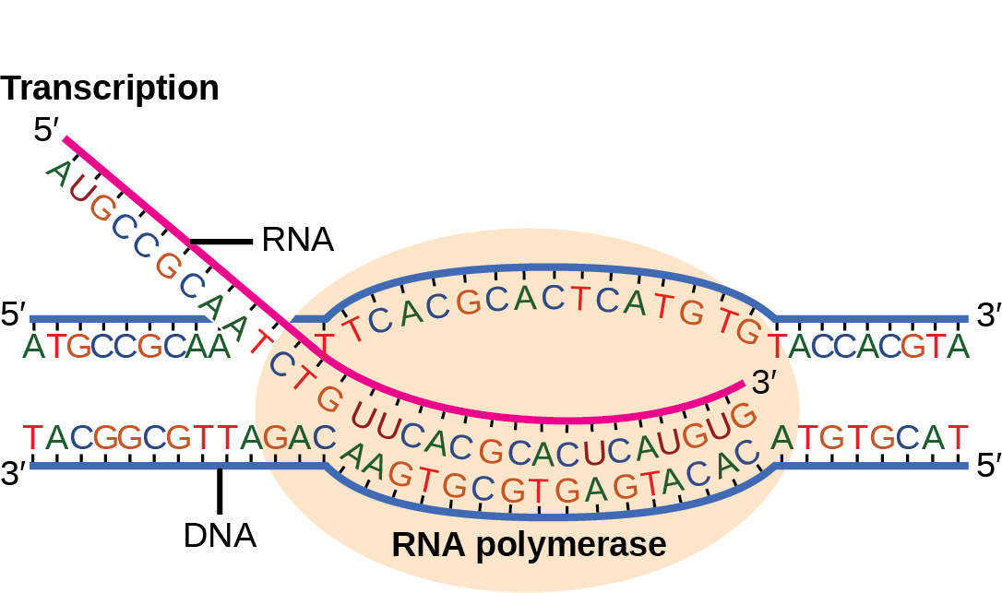
The Xenotext
Notes:
This fascinating art-science project provides a concrete example of how biological material can store precise symbolic information.
Just as The Xenotext shows how DNA can store poetry, Gallistel suggests neural DNA/RNA might store memories.
While this project wasn't designed to test Gallistel's theory, it demonstrates the feasibility of using biological molecules for precise information storage.
It helps us imagine how intracellular mechanisms might serve as nature's hard drive for storing memories.

Slide 12
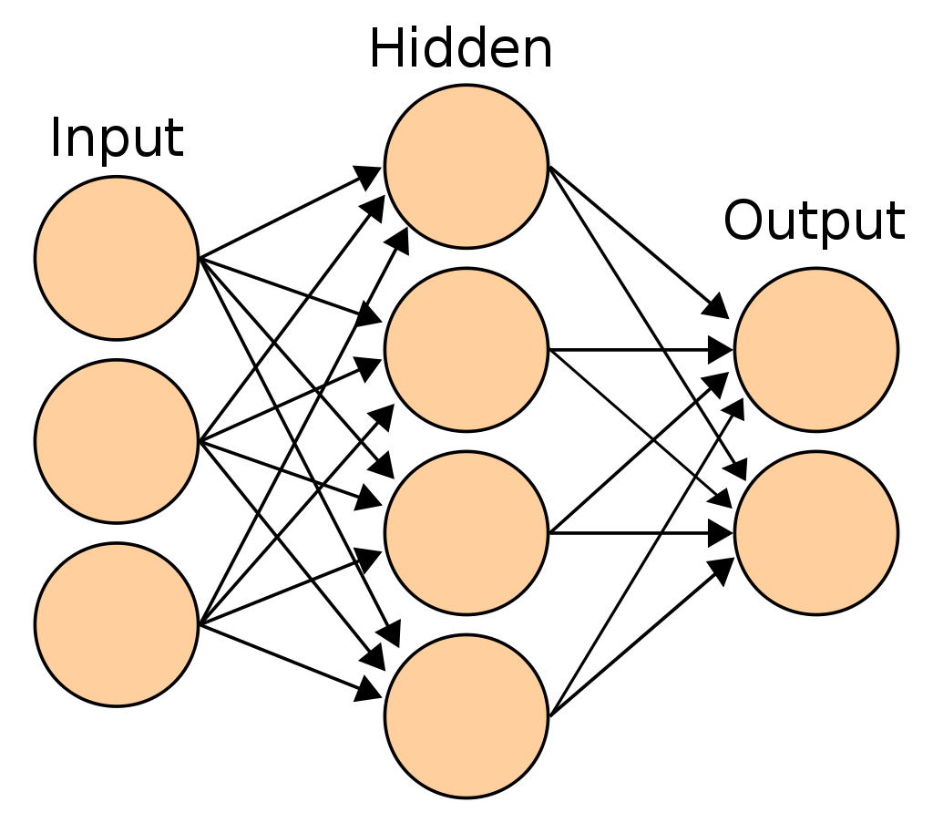
Universal Approximation Theorem
neural networks can approximate functions.
this does not equate to genuine symbol manipulation or memory encoding​.
π
Notes:
This theorem is often cited to defend traditional neural network approaches. It states that neural networks can approximate any continuous function to arbitrary precision.
However, Gallistel points out a crucial distinction: approximating a function is not the same as storing and manipulating precise symbols.
Think about trying to store the exact number π. A neural network might approximate it well, but it's not storing the concept of π itself.
This highlights a fundamental limitation of purely associative systems when it comes to handling symbolic information.

Slide 13

Memory, Facts, and Symbolism
the necessity of symbols in cognitive processing, contrasting with current models of artificial neural networks.
he believes computational theories must address the symbolic nature of memory​.
symbols are fundamental for memory and cognition, beyond associative links.
Notes:
At the core of Gallistel’s theories is his belief that memory—and cognition in general—requires symbols.
He argues that memory should involve symbolic processing rather than associative links, which is a foundational difference from the way artificial neural networks operate.
In contrast to deep learning models that rely on associations, Gallistel insists on the need for models that can handle and manipulate discrete symbols, like numbers or factual data.
This points to a need for future research in AI and neuroscience to develop models that incorporate symbolic representations to handle complex cognitive tasks, aligning more closely with how Gallistel envisions memory working.

Slide 14
Practical Implications
For Medicine
New approach to memory disorders
Target molecular mechanisms inside neurons
Potential for more precise interventions
For AI Development
Rethinking neural network design
Combining symbolic and neural processing
More accurate memory storage systems
For Future Research
Focus on intracellular mechanisms
Develop new tools for memory investigation
Bridge gap between AI and biological memory
Notes:
Let's consider why these ideas matter beyond pure theory.
In medicine, if Gallistel is right, we might be looking in the wrong place for memory disorders. Instead of focusing on synaptic connections, we should be investigating molecular mechanisms inside neurons.
For AI development, this suggests our current neural networks might be fundamentally limited. We might need hybrid systems that combine neural networks with symbolic processing to achieve more human-like memory capabilities.
For future research, this points to exciting new directions. We need new tools to study intracellular mechanisms, and we might need to fundamentally rethink how we approach memory in both biological and artificial systems.
These implications show why Gallistel's seemingly abstract theoretical questions could have very concrete practical impacts.

Slide 15
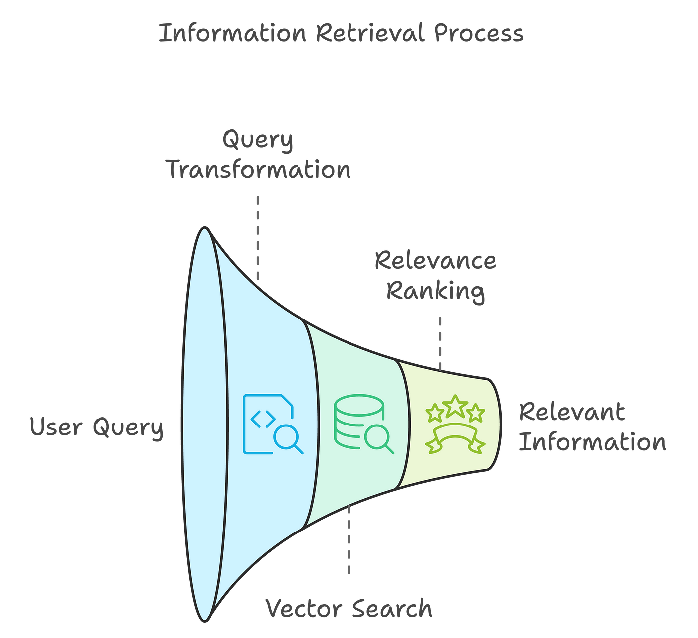
Implications for the Future
potential impacts of Gallistel’s ideas on neuroscience and cognitive science.
reshape memory studies and influence computational models of the brain.
impacts on AI or machine learning if we incorporate symbolic models of memory.
Notes:
If Gallistel’s theories are taken seriously, they could have profound implications for neuroscience, cognitive science, and artificial intelligence.
His arguments suggest a paradigm shift in how we study memory, urging us to view it as a symbolic, computational process.
In practical terms, if we develop models capable of encoding and retrieving facts symbolically, we could see advances in both natural and artificial memory systems.
For example, incorporating symbolic models into AI could allow for a more human-like approach to memory, where systems can store and retrieve specific, factual data with greater accuracy.

Slide 16

Gallistel’s Legacy
questioning the fundamentals.
explore new possibilities for cognitive processes.
ongoing interdisciplinary dialogue.
Notes:
Randy Gallistel’s work has sparked significant debate by questioning the very foundations of how we think about memory.
Whether or not his theories are eventually validated, Gallistel’s critiques push neuroscientists to reconsider assumptions about memory and to explore new possibilities for understanding cognitive processes.
He has inspired an ongoing dialogue about the symbolic nature of memory, the limitations of current models, and the potential for interdisciplinary approaches to uncover the true mechanisms of memory.
Ultimately, his work leaves us with valuable questions about how memory might really work and what that means for future research.
And now again the question that challenges the future of memory science.

Slide 17
How do you store a number in a synapse?
Notes:
"As we conclude, we return to Gallistel’s famous question: How do you store a number in a synapse?
This question challenges the foundation of current memory science by questioning whether associative models can truly explain how precise, fact-based memory storage works.
Gallistel’s question isn’t just about synapses or neurons; it’s about rethinking the very principles of memory, cognition, and symbol processing.
It’s a question that pushes us to consider new approaches and could influence the future of neuroscience and AI research alike.

Slide 18


