Slide 1
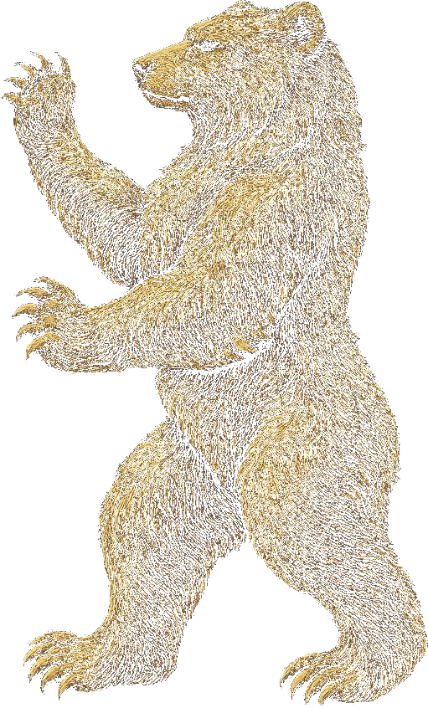
GROWTHHIVE
BRAND CREATION · ULTRA-LUXURY SPIRITS
The coldest
pursuit.
How Growthhive built Russian Bear from nothing — a $95,000 Scottish vodka that enters culture through absence.
PREPARED BY Growthhive CLASSIFICATION Confidential

Slide 2
01 — THE BRIEF
A vodka. Distilled in Scotland. Priced at $95,000. Built from nothing.
No heritage to lean on. No distillery to photograph. No founder's tale already written. Growthhive was engaged to create the entire brand — name, identity, positioning, the vessel, and a launch strategy for a spirit that would never appear on a shelf or in an advertisement.
RUSSIAN BEAR · The Coldest Pursuit
02

Slide 3
02 — THE INSIGHT
Scotland has the purest water, the finest grain, and the most exacting distillers on earth. No one had ever pointed them at vodka.
Vodka belongs, spiritually, to Russia. The provocation of the name is the strategy: take the world's purest spirit to the country that perfected distillation — and make it better than anyone dared. The brand is a paradox held with total confidence.
RUSSIAN BEAR · The Coldest Pursuit
03

Slide 4
03 — THE OBSESSION
The coldest pursuit.
01
02
03
04
WATER
27 DISTILLATIONS
GEMSTONE FILTRATION
THE VESSEL
One glacial Highland source, filtered through quartz across three thousand years.
Twenty-seven passes through copper pot stills — the whisky way — fourteen days per batch.
A final slow pass through raw cairngorm, citrine, and uncut Highland sapphire.
Fewer than eighty bottles per batch. Each blown by hand. No two alike.
RUSSIAN BEAR · The Coldest Pursuit
04

Slide 5
04 — THE VESSEL
The bottle is the reason
they keep it.
Each bottle is individually hand-blown in the Scottish Borders — leaded crystal with a faint blue-smoke tint, stoppered with a single block of polished Scottish granite. Signed on the base. Numbered. Registered. The vodka is the reason they open it.
FACETED CRYSTAL · GRANITE STOPPER · HAND-NUMBERED
RUSSIAN BEAR · The Coldest Pursuit
05

Slide 6
05 — THE IDENTITY
A heraldic bear, drawn the way a master engraver would.
Standing rampant — strength held still, never aggression. Rendered in fine-line engraving and cairngorm gold, the national stone made visible. The mark is debossed into the glass, etched into the granite, watermarked into the certificate. It never shouts. It does not need to.
RUSSIAN BEAR · The Coldest Pursuit
06

Slide 7
06 — THE LAUNCH
Twelve bottles. Twelve people. No advertising.
Russian Bear does not launch with a media buy. It launches by placement — twelve bottles delivered to twelve people chosen because they will never sell, never post for clout, and never need to be asked twice. The brand enters culture through absence. Scarcity is the message; introduction is the only channel.
PLACEMENT, NOT PRESENCE.
RUSSIAN BEAR · The Coldest Pursuit
07

Slide 8
07 — WHY IT HOLDS
The brand that needs you least is the one you want most.
UNCOPIABLE
SELF-EVIDENT
DURABLE
The process — glacial source, 27 distillations, gemstone bed, hand-blown vessel — cannot be faked or rushed by a competitor.
At this tier, the product argues for itself. The marketing's job is restraint, not persuasion.
‘The coldest pursuit’ is a platform Russian Bear can operate within for decades, not a campaign that expires.
RUSSIAN BEAR · The Coldest Pursuit
08

Slide 9
RUSSIAN BEAR · HIGHLAND SINGLE ESTATE VODKA
The coldest
pursuit.
We build brands that don't need us to keep talking.
GROWTHHIVE Work. Play. Grow. 🐝 @thegrowthhive

