Slide 1
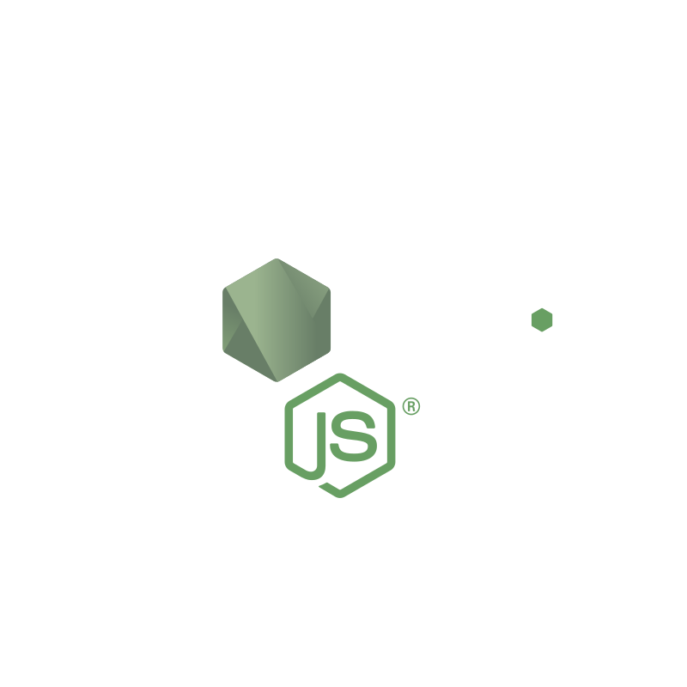
Web Programming
Node.js
200709006 - Affan Selim KAYA
200709011 - Onur Alp AKIN
190709009 - Emre ERZURUM

Slide 2
Overview
In this presentation we will look on Node.js on 3 different parts which are:
Part 1: Introduction to Node.js, V8 JS engine and Node.js benefits
Part 2: Security on Node.js, Async I/O and Node.js examples
Part 3: Applications and firmwares using Node.js and Node.js vs other backends
68

Slide 3
Part 1: Introduction, Installation, Demo
68
5

Slide 4
Introduction to Node.js (1/2)
Node.js is an open-source and cross-platform JavaScript runtime environment.
It is free to use for everyone.
It is quite popular among devolopers and web programmers.
Node.js has many pros but has cons too as every environment.
Node.js is licensed under MIT.
Node.js runs on Windows, Linux, Unix, Mac OS X and other platforms.
68

Slide 5
Introduction to Node.js (2/2)
Node.js uses V8 JS engine.
Node.js uses JavaScript on the servers.
It written in C, C++ and JavaScript.
Node.js is primarily used to build network programs such as Web servers.
Node.js uses ‘.js’ extension on its files.
68

Slide 6
What is V8 JS Engine?
V8 engine firstly released at 2 September 2008.
Firstly developed by Chromium (Open-source Google Chrome) project developers (By leadership on Lars Bak)
It compiles JS to native machine code (IA-32,x86-64,ARM)
V8 is Google Chrome’s open source high-performance and fast JavaScript and WebAssembly engine
It is written in C++
V8 runs on Windows7 or later versions on Microsoft, macOs 10.12 ,and Linux systems that uses x64 base
68

Slide 7
Why V8 Engine Is Preferred?
V8 translates js code to machine code and doesn’t use interpreter thus it’s fast
V8 engine has a very big community
V8 engine is the backbone of Google Chrome and other Chromium-based web browsers therefore it’s reliable
V8 enables any C++ application to expose its own objects and functions to JavaScript code.
68

Slide 8
How V8 Engine Works?
When a developer runs a JS script on V8, the following steps are taken by the engine
The engine compiles and executes the JS code
The engine handles the call stack
The engine manages the memory heap
The engine handles the garbage collection
The engine provides all the data types, objects and functions
The engine also provides the event loop (sometimes implemented by the browser as well)
68

Slide 9
Foundation of Node.js
Originally, Node.js was founded by Ryan Dahl.
It’s initial release is at 27 May 2009
Node.js’s foundation’s goal is to provide an easy way to build scalable network programs
In January 2010, a package manager was introduced for the Node.js environment called npm (will be explained later)
In January 2012, Dahl stepped aside, promoted coworker and npm creator Isaac Schlueter to manage the project.
68

Slide 10
What is NPM?
Npm is package manager of node.js
The package manager does the heavylifting for programmers
Makes it easier for programmers to publish and share Node.js packages
Purpose of it is to simplify installation, updating, and uninstallation of packages
68

Slide 11
Reasons to Use Node.js (1/3)
Node.js can :
create dynamic pages
easily handle file operations on server
collect form data
handle database operations very well
It is cross-platform
Android, iOS, Windows, Linux etc.
Relatively easy to learn (it’s just js)
68

Slide 12
Reasons to Use Node.js (2/3)
Node.js is :
easy to tinker with
effortless to configure
Once written runs everywhere
kinda like java
Node.js is utilized by more than 20 million sites on the internet.
68

Slide 13
Reasons to Use Node.js (3/3)
Node.js has:
large community generating tens of thousands packages
lots of available free content on internet.
consistency with most databases
MySQL, sqlite3, MongoDB, NoSQL
Node.js can make front-end developers full-stack developers
68

Slide 14
Reasons Not to Use Node.js
Node.js doesn't provide scalability
If you’re doing CPU intensive tasks single thread won’t be enough
High speed i/o operations where node.js shines the most.
Big node.js packages can have insufferable amount of dependencies
Dealing with relational databases is relatively hard for node.js
If you’re not careful you can have multiple callback functions for single callback function
68

Slide 15
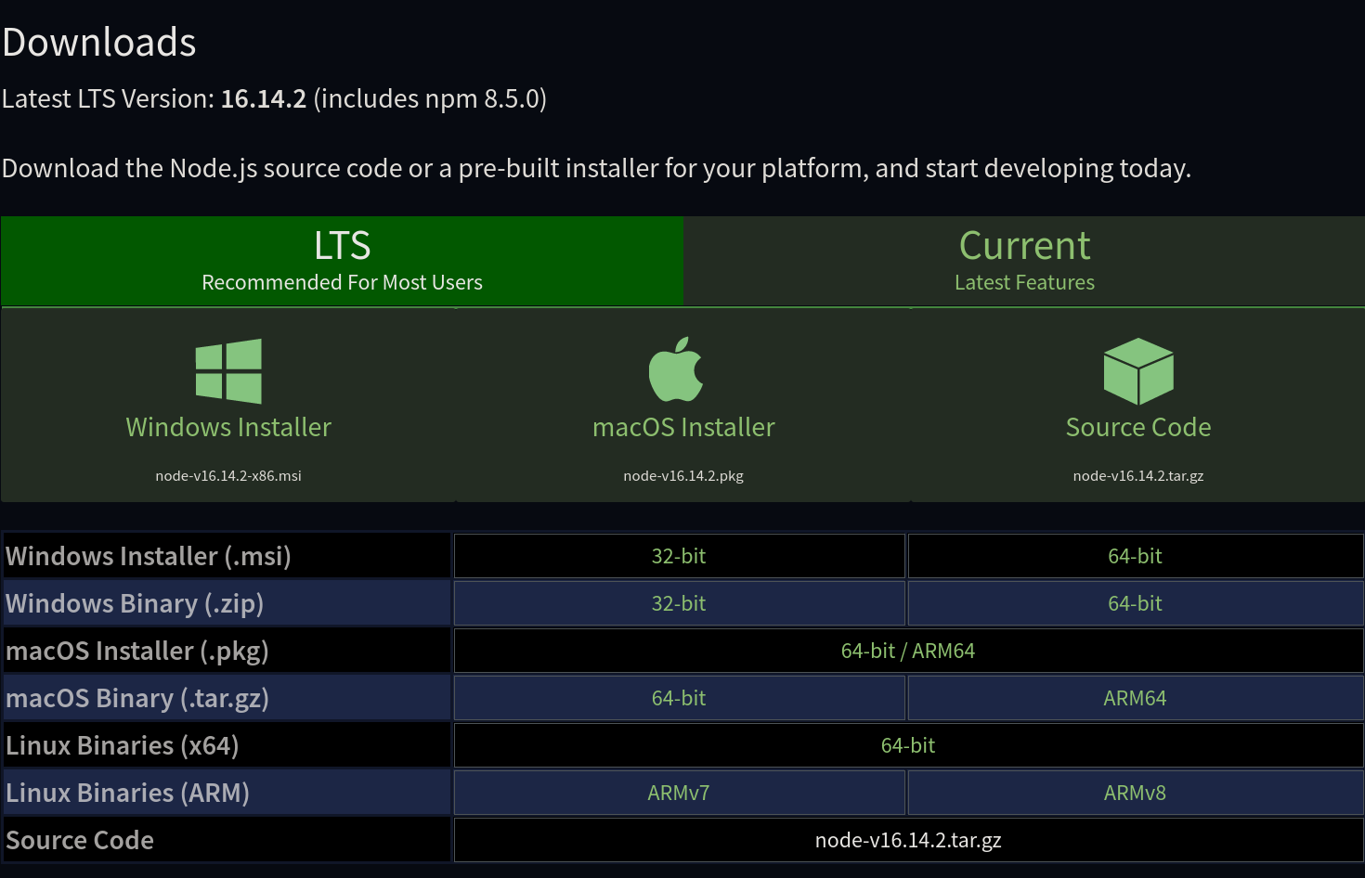
Installation of Node.js (1/5)
Go to Node.js official website
https://nodejs.org
Go to the download section
https://nodejs.org/en/download/
You’ll see LTS and Current versions
Select which operating system you are using
Download of desired verison.
68

Slide 16
Installation of Node.js (2/5)
These instructions will be for Windows
Open the downloaded installer
On the opened screen, click next if you agree to the terms.
Now select the installion folder.
Default is just fine
The wizard will let you select components to install.
Again, unless you have a specific need leave it default
After that, software will setup everything automatically
68

Slide 17
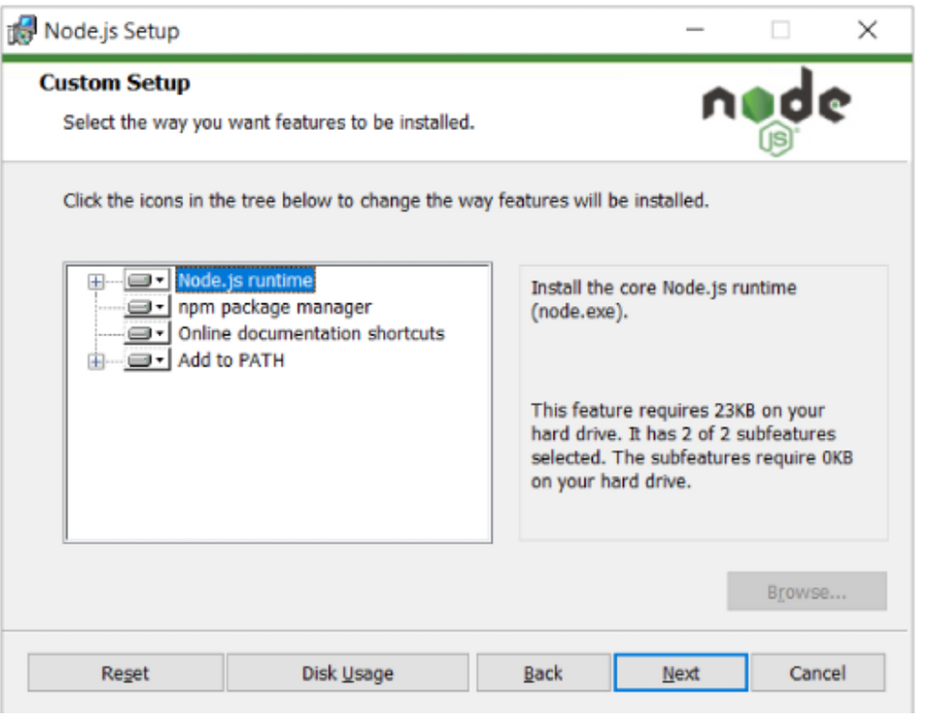
Installation of Node.js (3/5)
68

Slide 18
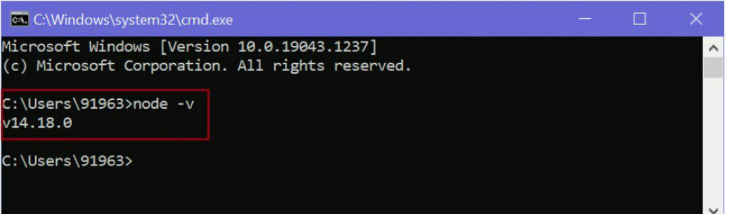
Installation of Node.js (4/5)
To verify installation:
Open a command window or PowerShell and write
node -v
Hit enter
This should display the installed version of node.js
You can do the same thing for npm
npm –v
Now you are good to go
68

Slide 19
Installation of Node.js (5/5)
To upgrade node.js:
The easiest way to would be downloading the latest version again
Download the installer and run it
The setup wizard will overwrite the old version, and replace it with new one.
68

Slide 20
Node.js Command Prompt (1/2)
The screen you see after you write `node` is called command prompt
This is how we use node.js
For example if you wanted to run `Hello World`
You will need to either:
Open interactive prompt and then write the command
Write it in a script file then run it
68

Slide 21
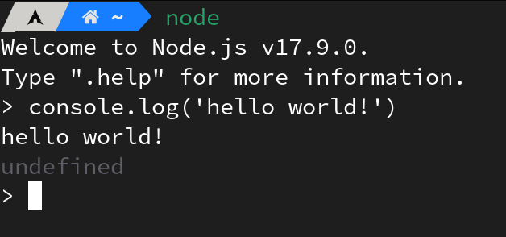
Node.js Command Prompt (2/2)
Below image is the former one (interactive)
68

Slide 22
Creating a Node.js Package (1/2)
To install or manage dependencies you need to create a node package
Even though you can create packages manually it’s not recommended
Instead you should let npm handle it for you
To create package you need to type
npm init
68

Slide 23
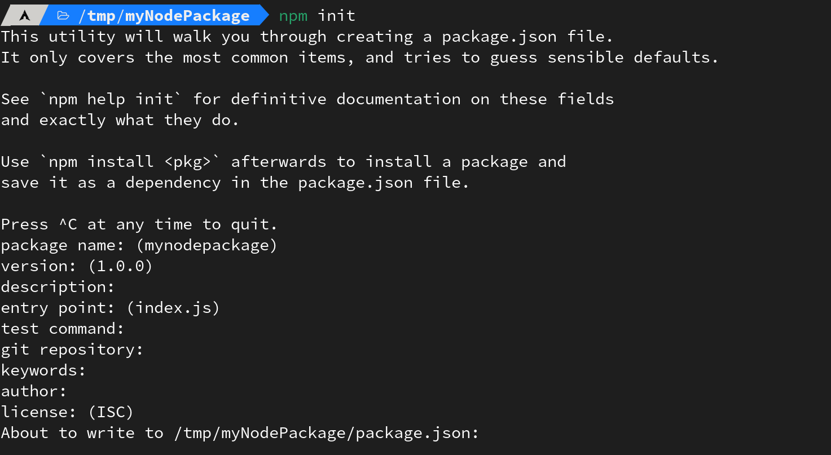
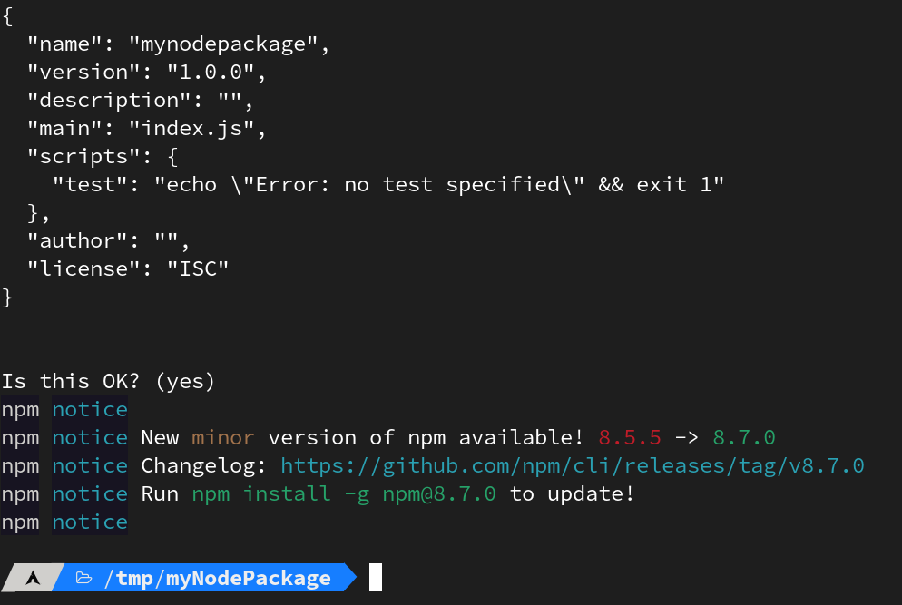
Creating a Node.js Package (2/2)
It will ask you questions then it will create your package.
68

Slide 24
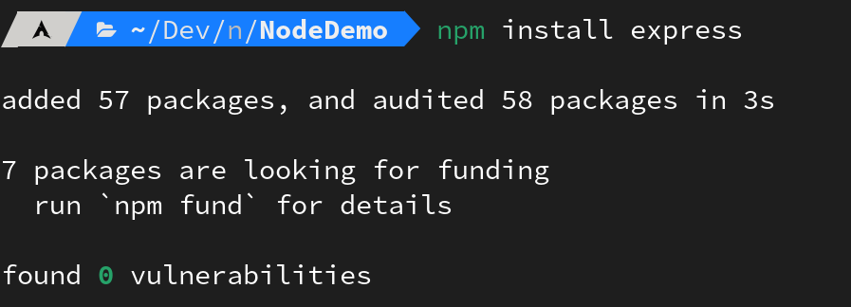
Installation of a Node Package
To install new node packages you need to type
npm install
It will install and check for vulnerabilities
68

Slide 25
Part 2: Async, Event Loop, Node.js Demos, Security
68
5

Slide 26
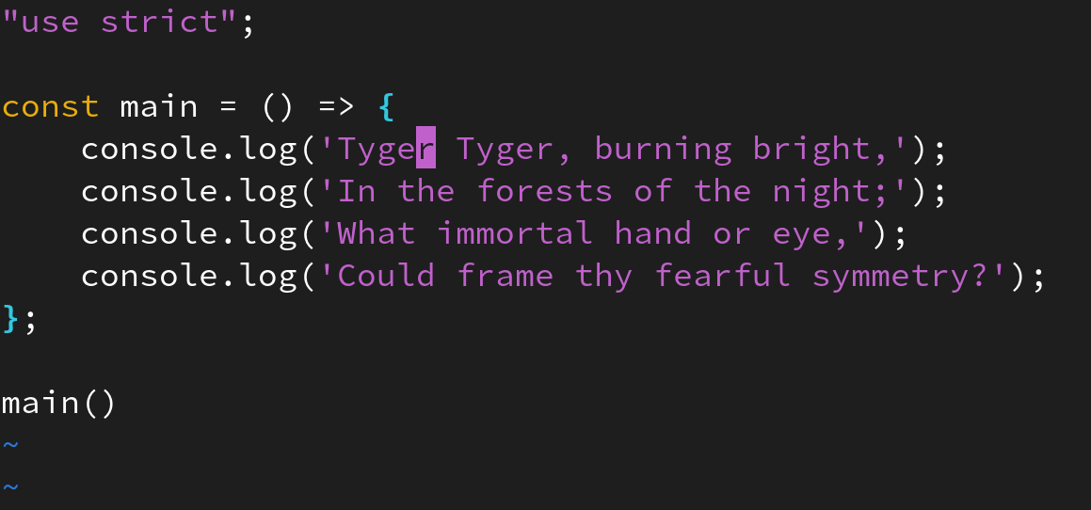
Node.js and Async Operations
Node.js does two concepts very well
Asynchronous code execution
Non-blocking I/O
What is the output​?
68

Slide 27
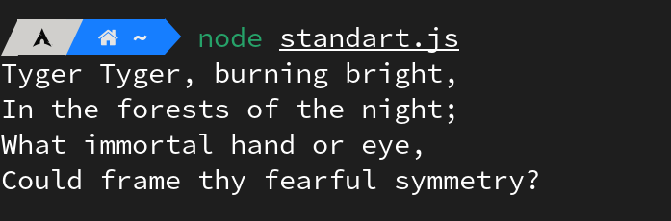
Output
When node.js is not using ‘async function’s it executes codes line by line
68

Slide 28
Asynchronous Code Execution
Asynchronous functions allow you to do execute many instructions in parallel
It’s a trade-off between time and computation power
For example
If you write a server in node.js, your server can create files without making the clients wait
68

Slide 29
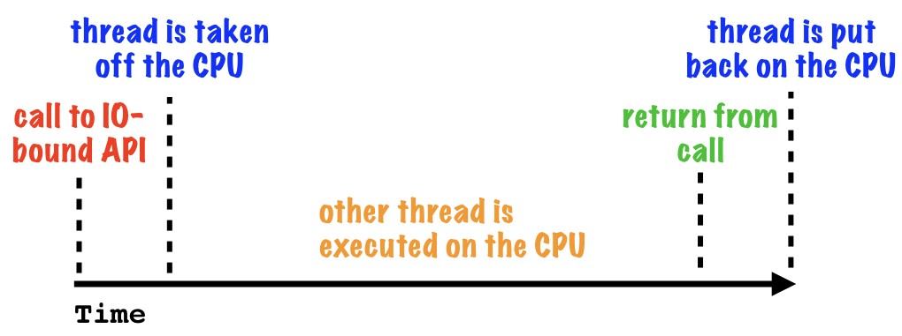
Non-blocking I/O
And the concept of not waiting for output while giving input is what node.js all about
They are not seperate concepts
But rather async functions allow non-blocking i/o
68

Slide 30
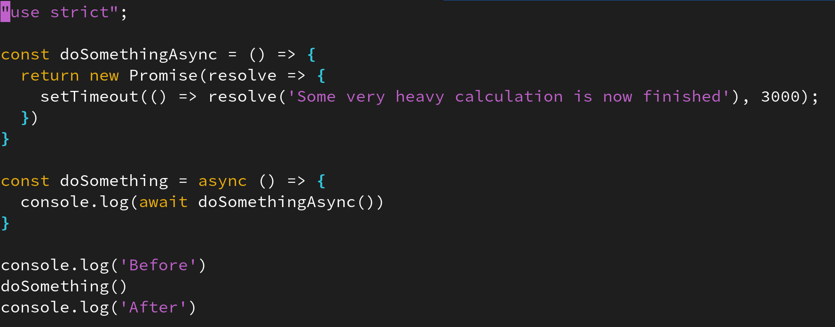
Asynchronous Code Execution Demo
When you use async functions you’ll start to see glimpse of power of node.js
Now what do you think the output is?
68

Slide 31
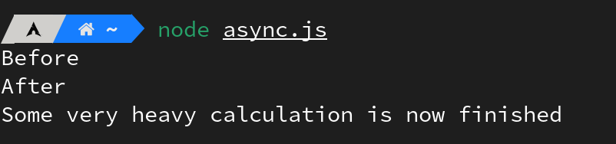
Output
Pretty cool huh?
68

Slide 32
Event Loop (1/2)
But how can node do this?
The answer is: event loop
The event loop is one of the most important aspects to understand about Node.js
The event loop works by reading code line by line than adding each instruction to call stack
The event loop has a single thread
68

Slide 33
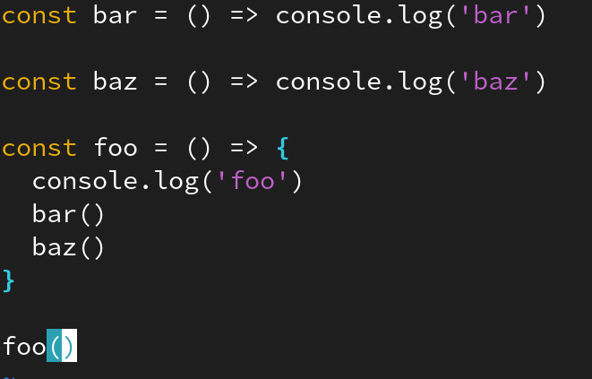
Event Loop (2/2)
Call stack can handle ramifications quite decent
We will visualize call stack as an abstraction of CPU cycles
Let’s pick an example to understand
68

Slide 34
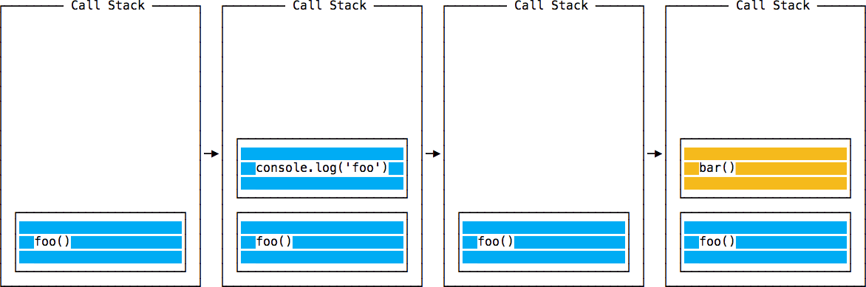
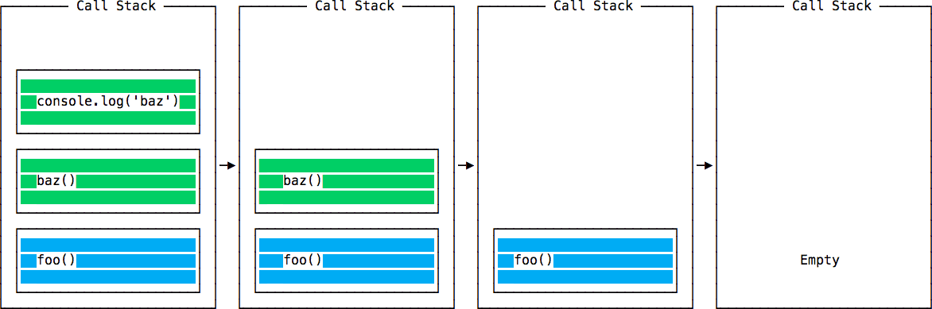
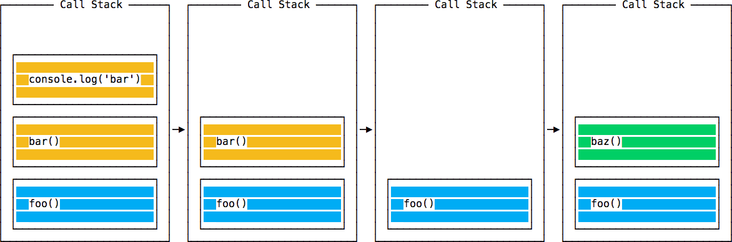
Call Stack of the Example
68

Slide 35
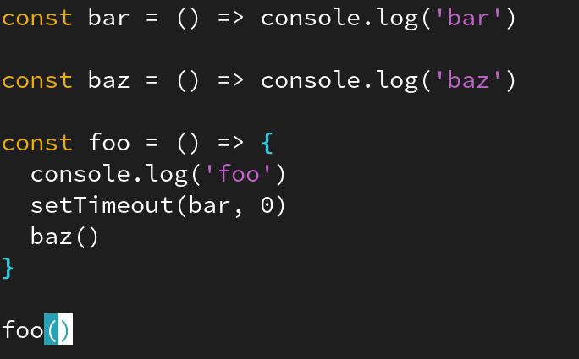
Event Loop of an Async Function
Now we will see how async operation will look
SetTimeout is an async function
This will be our example
68

Slide 36
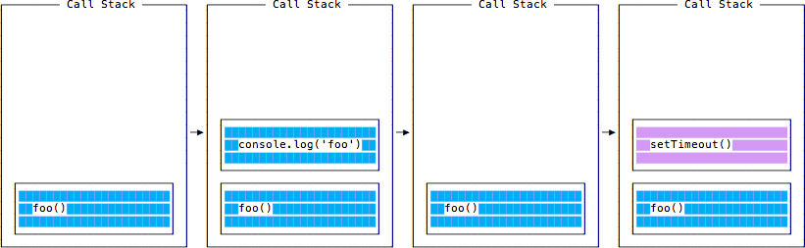
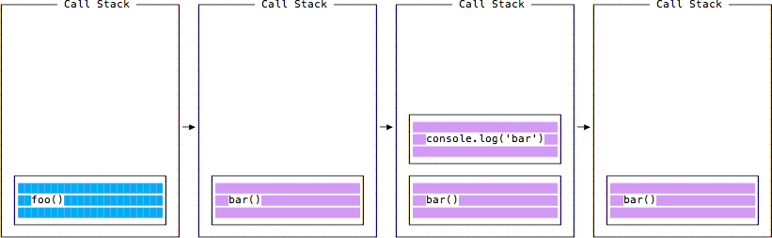
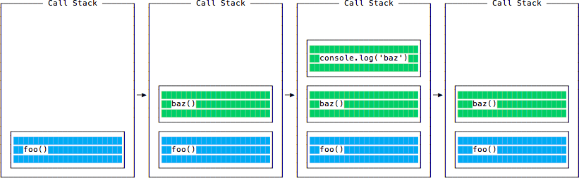
Call Stack of the Async Example
68

Slide 37
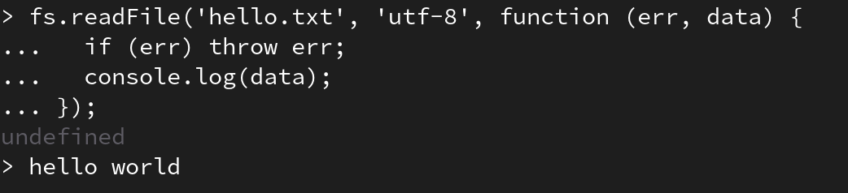
Node.js Filesystem API (Demo)
Node.js can create, delete, list files
And can do many more
68

Slide 38
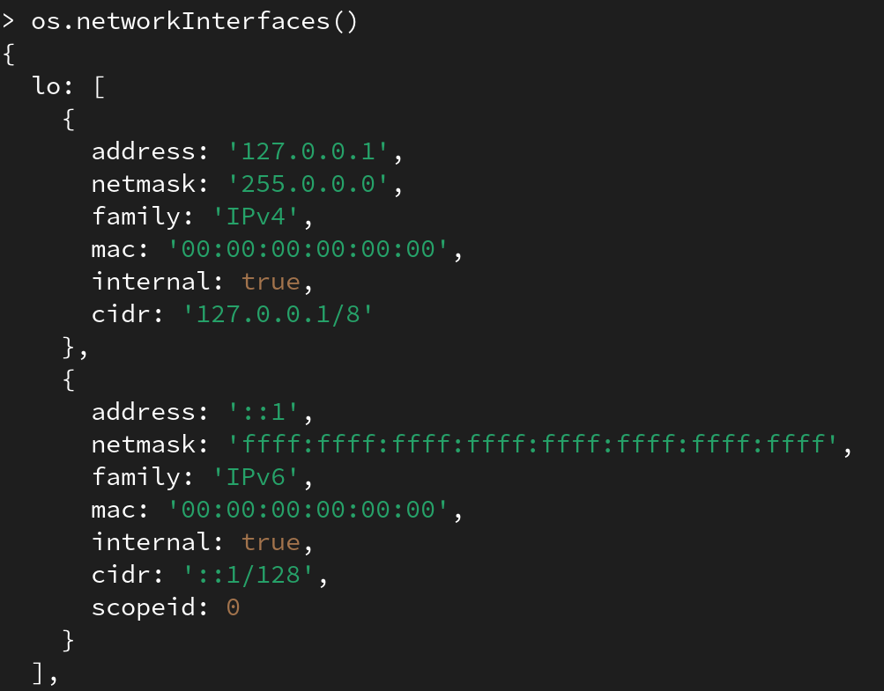
Node.js OS API (Demo)
Node.js can handle information or status about operating system
68

Slide 39
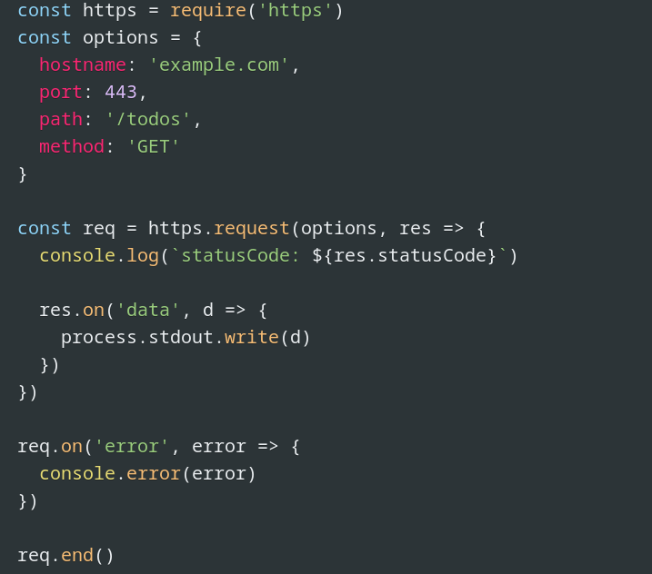
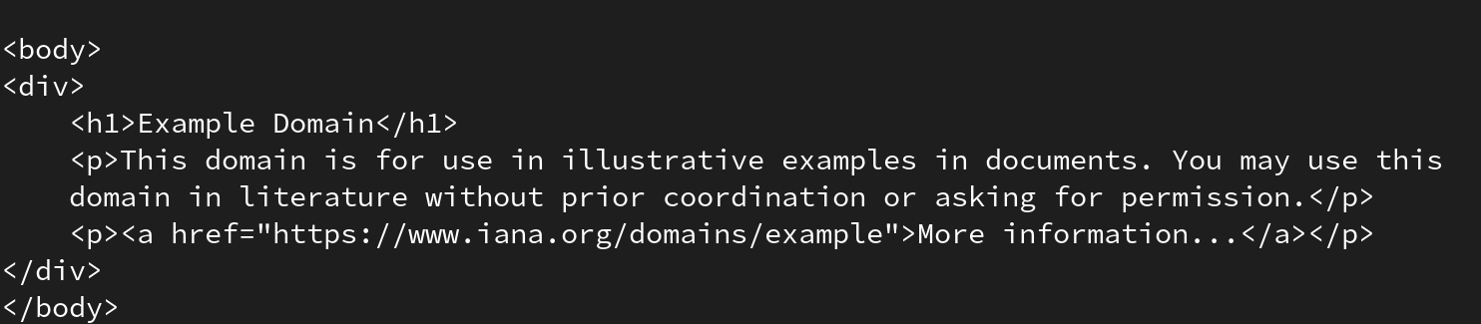
Node.js Web-Request API (Demo)
Node.js can make requests too. You can either use third party library or standart module which is `https`
68

Slide 40
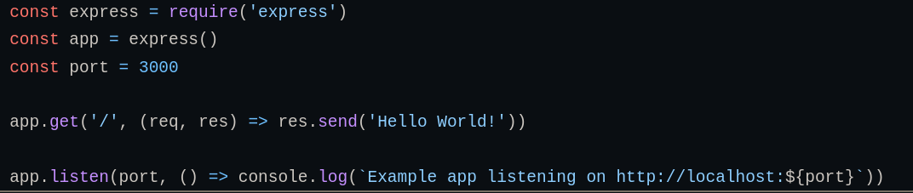
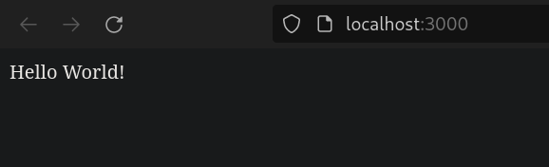
Node.js Web-Server (Demo)
You can create servers pretty fast with express
68

Slide 41
Node.js Dependencies
When you install npm packages your code depends on that package now
And that installed package has dependencies too
This ramification until root is called dependency tree
When a dependent package has a vulnerability, now your package is also vulnerable
68

Slide 42
Insecure Code
And when popular node packages are vulnerable, lots of apps will be exploitable
You can imagine how it’s susceptible to havoc
If a hospital running node.js is vulnerable then people could get hurt
68

Slide 43
Prevention
And to prevent that npm released it’s own security linter `audit` in 2018
You can check your code for vulnerabilities by typing
npm audit
In order to avoid insecure code you should educate yourself in secure code practices
68

Slide 44
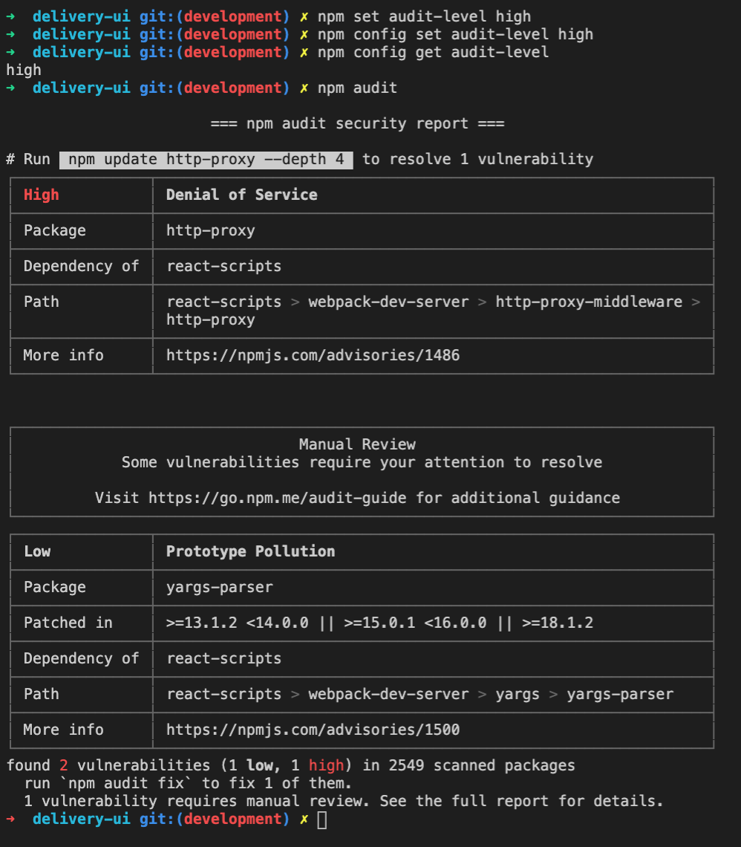
Npm Audit
This is the preview of npm audit command
It will list known vulnerabilities
To fix issues you can type
npm audit fix
68

Slide 45
Dependency Chaos (1/2)
Real world example of harm caused by dependency would be `left-pad`
Left-pad is written by Azer Koçulu
Left-pad is a very simple node-package with 11 lines of code
Left-pad can be used to add characters to the beginning of a string
The author of this package decided to delete it over a dispute with npm
68

Slide 46

Dependency Chaos (2/2)
After the deletion programmers around the world got error message
It meant that the code they were trying to run, required a package called left-pad, but the npm registry didn’t have it.
Some of the largest, most widely used npm packages were suddenly broken. It even affected React.
It’s absence was felt globally
This programmer was able to briefly break the internet just by deleting one package.
68

Slide 47
Part 3: Node.js Apps, Top Node.js Apps, Node.js vs Other Backends
68
5

Slide 48

Node.js Usage Areas
Node.js has many usage areas
Most of them are web-apps
Nearly all of node.js apps are related to web-apps even if they’re not directly web-apps
68

Slide 49
Real-Time Chats
Most people use phone apps or social media apps
Node.js can create chat rooms very easily because because of single-threaded asynchronous model of nodejs.
It is easily scalable and is often used to build chatbots.
68

Slide 50
IoT (Internet of Things) (1/2)
IoT applications often has multiple sensors
They often send small chunks of data
Massive amounts of data can be collected
Inserting large quantities of data into a database usually create a bottleneck
If system has bottleneck it will not function properly
68

Slide 51
IoT (Internet of Things) (2/2)
Node.js is a good choice as it can handle these concurrent requests quickly.
Node.js can receive data, then send it to the backend in a piecewise manner
Piecewise operations ensure that data gets stored without breaking any system
68

Slide 52
Data Streaming
Node.js is light and fast
Thus it’s a great choice for applications that process many short messages
Node.js is a perfect choice for applications require low latency
For that reason companies like Netflix use Node.js for data streaming purposes.
Also, Node.js provides a native streaming API.
68

Slide 53
SPAs (Complex Single-Page Applications)
In SPAs, the entire application is loaded on a single page
This means that there are several requests made in the background
Things like validation code between client machine and server
Node’s ability to process many requests at low response times makes great fit for modern web applications
68

Slide 54
REST API Based Applications
Because of aforementioned reasons (fast, scalable and non-blocking asynchronous structure)
Nodejs is really suitable for rest api development.
Node.js also provides packages like Express.js that make building web applications even easier
You can develop custom APIs in matter of hours
68

Slide 55





Top 5 Apps Using Node.js
PayPal
Netflix
LinkedIn
Uber
eBay
68

Slide 56
Node.js in PayPal
Paypal is a money transaction application so it need’s to be reliable
PayPal was built on Java
But recently it recently migrated to Node.js
As of 2015, the service has over 184 million active users
And it uses Node.js for front-end of the website
68

Slide 57
Node.js in Netflix
As mentioned before Netflix uses Node.js
The whole user interface on Netflix.com is built with Node.js
Node.js delivers a blazing-fast, modular, and lightweight application
With the usage of Node.js Netflix’s web app load time has been reduced by 70%
Now proven effective, the company decided to move the entire data access layer to Node.js recently
68

Slide 58
Node.js in LinkedIn
Node.js powers the server-side of LinkedIn’s mobile app
The new mobile app is with better performance:
Consume lower memory
Has improved resource utilization
is 20 times faster than the previous ruby based version
cut down the number of servers needed
68

Slide 59
Node.js in Uber
Uber was one of the first companies that adopted Node.js
With the usage of Node.js in Uber’s app:
Performance was improved drastically
Information was processed quickly
Speed was boosted up
Any errors could be addressed right away
68

Slide 60
Node.js in eBay
Node.js is part of the eBay’ tech stack
After the switch to Node.js, eBay reported:
Improved speed
Improved simplicity
Improved scalability
Improved transparency and control
68

Slide 61
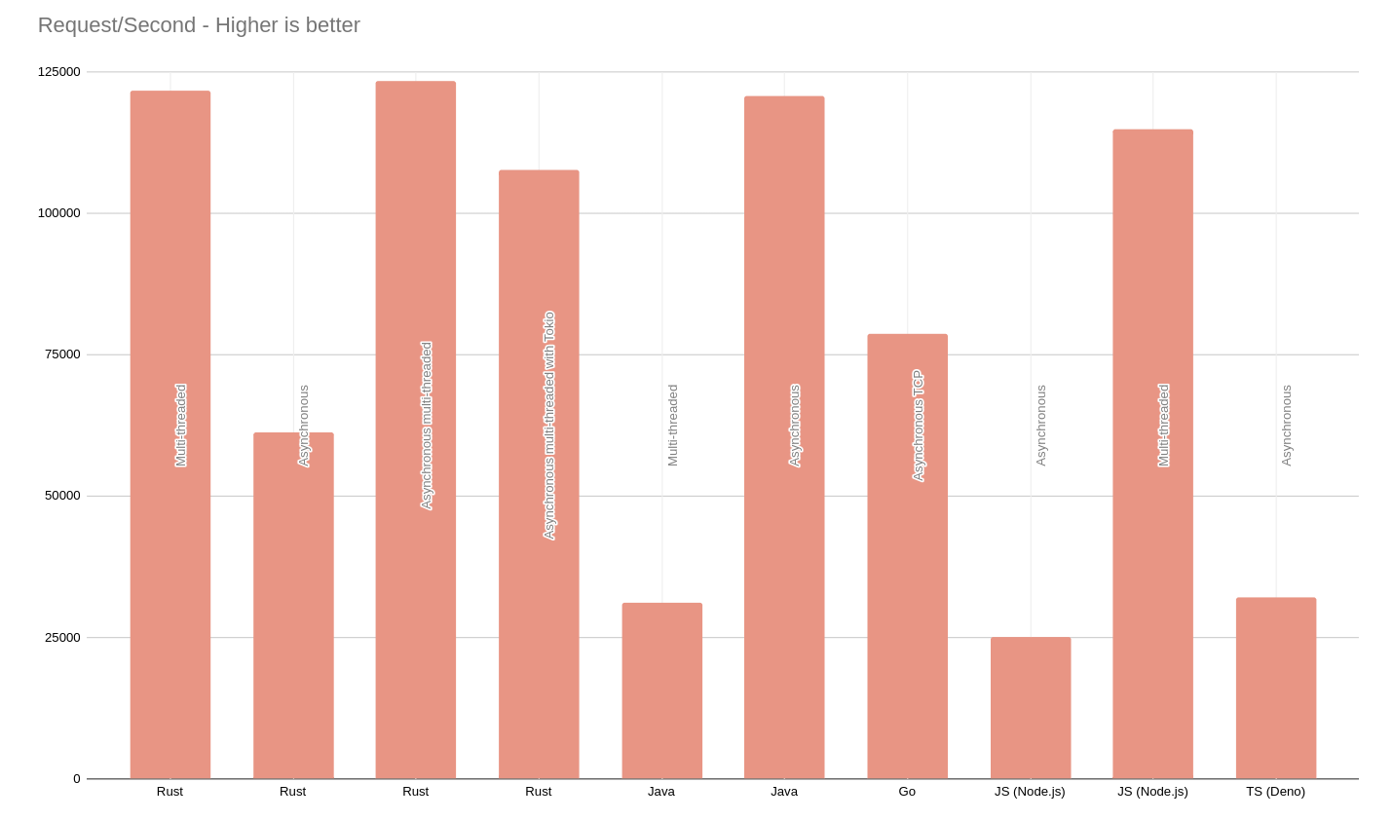
Node.js vs Other Fierce Backends
Even though Node.js is popular, it’s not the only option for speed
68

Slide 62
Node.js vs Go (1/2)
Go is a statically-typed programming language introduced by Google
It is open-source and has syntax similar to C
In terms of raw speed Go is slightly better than Node.js
Go doesn’t need an interpreter, it’s a compiled language
So go has the same level of performance low-level languages like C++
68

Slide 63
Node.js vs Go (2/2)
In terms of IO operations, Go is similar to Node.js.
Both has a garbage collector
Helps preventing memory leaks
Ensure stability
Node.js is only little behind Go in performance.
Single-threaded Node.js boosts efficiency
V8 Javascript engine discards the need of an interpreter
In conclusion very few separates Node.js and Go in real-life performance
Although in real life, the raw performance would not be the only parameter we would compare the two
68

Slide 64
Node.js vs Python
Event-driven architecture allows Node.js servers to process more requests
Performance of Python is not really its strong point
especially with Django
Python require more resources to work at acceptable speeds
Both has many diverse libraries
But Python is ahead by little in terms of libraries
68

Slide 65
Node.js vs PHP
Unlike node PHP is synchronous
PHP was developed much earlier
PHP has slow page-load time
PHP blocks a process till it’s been entirely calculated so has the blocking i/o
One upside of PHP is that it’s an old language meaning it has much more refined content for learning
68

Slide 66
Node.js vs Java
Java is slower than native languages since it uses compilers
It’s garbage collector requires lots of memory space
Node.js never buffer, outputting the data in chunks and making runtime faster.
Just-In-Time compilers may improve Java’s performance a bit
68

Slide 67
Thank You For Listening
https://nodejs.org/en/docs/
https://en.m.wikipedia.org/wiki/Npm_(software)
https://en.m.wikipedia.org/wiki/Node.js
https://en.m.wikipedia.org/wiki/Asynchronous_I/O
https://developer.mozilla.org/en-US/docs/Learn/Server-side/Express_Nodejs/Introduction
https://www.simform.com/bl-frameworks/
https://stackabuse.com/executing-shell-commands-with-node-js/
https://www.geeksforgeeks.org/how-to-open-node-js-command-prompt/amp/
https://github.com/goldbergyoni/nodebestpractices
https://github.com/amkurian/NodeJs-Code-Snippets
https://snyk.io/blog/peacenotwar-malicious-npm-node-ipc-package-vulnerability/
https://jfrog.com/blog/large-scale-npm-attack-targets-azure-developers-with-malicious-packages/
https://www.cisecurity.org/advisory/a-vulnerability-in-an-npm-package-could-allow-for-remote-code-execution_2021-136
https://docs.npmjs.com/cli/v8/commands/npm-audit
https://qz.com/646467/how-one-programmer-broke-the-internet-by-deleting-a-tiny-piece-of-code/amp/
https://www.mindinventory.com/blog/nodejs
68

Slide 68
https://www.dropbox.com/s/5ek1ywkz2sh50xu/3.mp4
https://drive.google.com/file/d/1dD0_iuyCaqZKVGltopjq7XB0Dc8xplPy/view
200709006 - Affan Selim KAYA
200709011 - Onur Alp AKIN
190709009 - Emre ERZURUM

