Slide 1



Open-Source Workflow for Scientific Paper Figures
Inkscape, Python, Matplotlib, and PyVista
Thomas Guillod
Dartmouth College, NH, USA
June 6, 2025 (updated June 27, 2025)
github.com/otvam/inkscape_python_figures

Slide 2
Goal and Disclaimers
Goal: creating publication-quality figures with open-source tools
Special focus on electrical engineering / power electronics
Disclaimers
  This is the workflow I am using for my own research
  Taste is something subjective and personal
  I am neither a designer nor a designer
  Create and/or adapt your own workflow

Slide 3
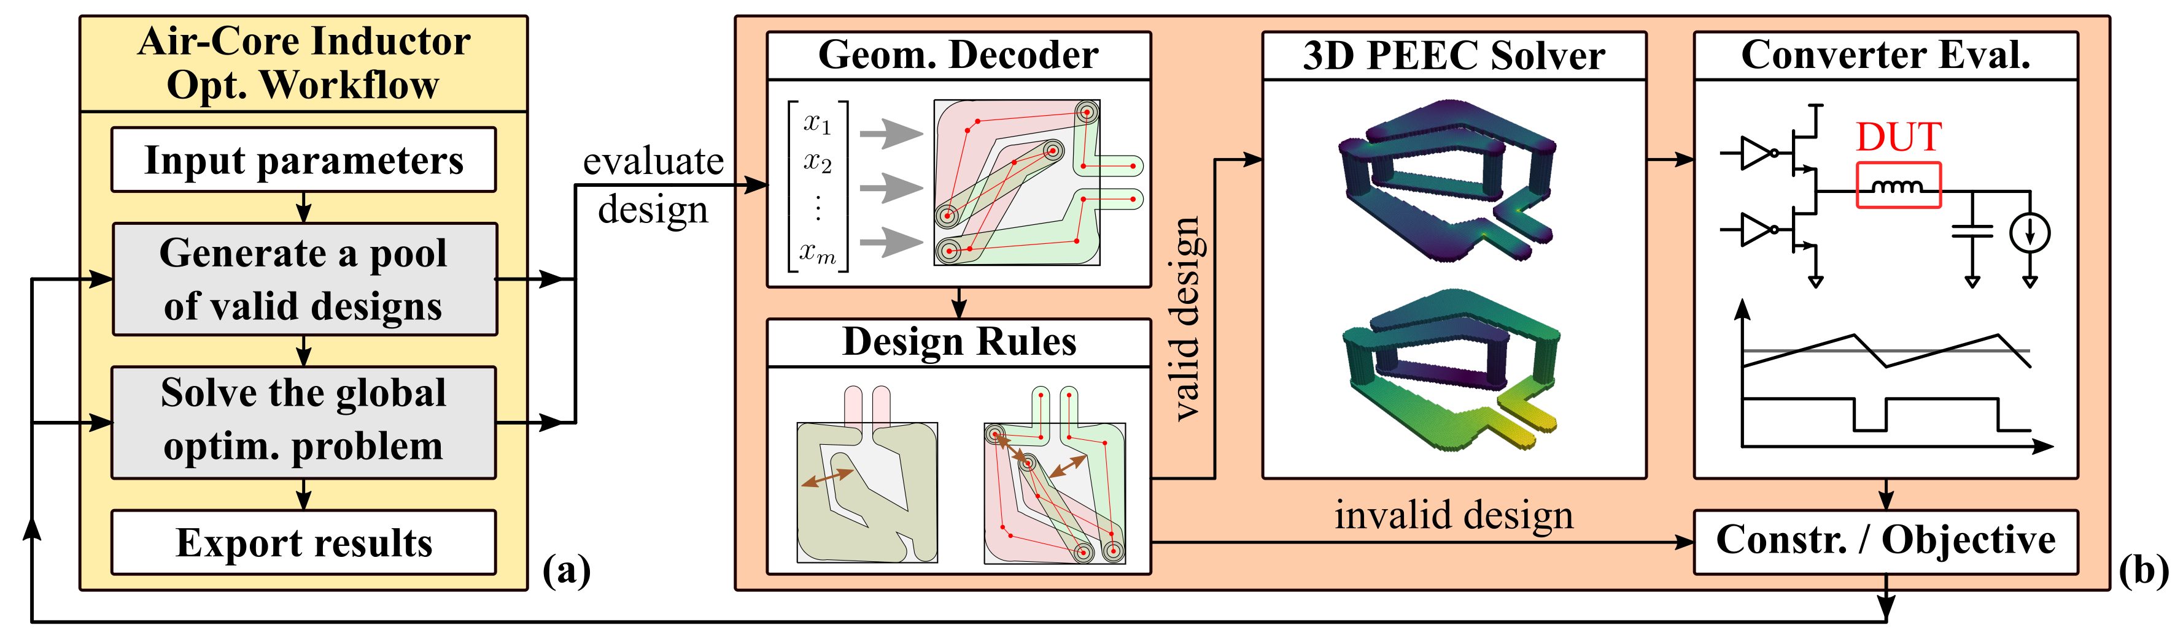
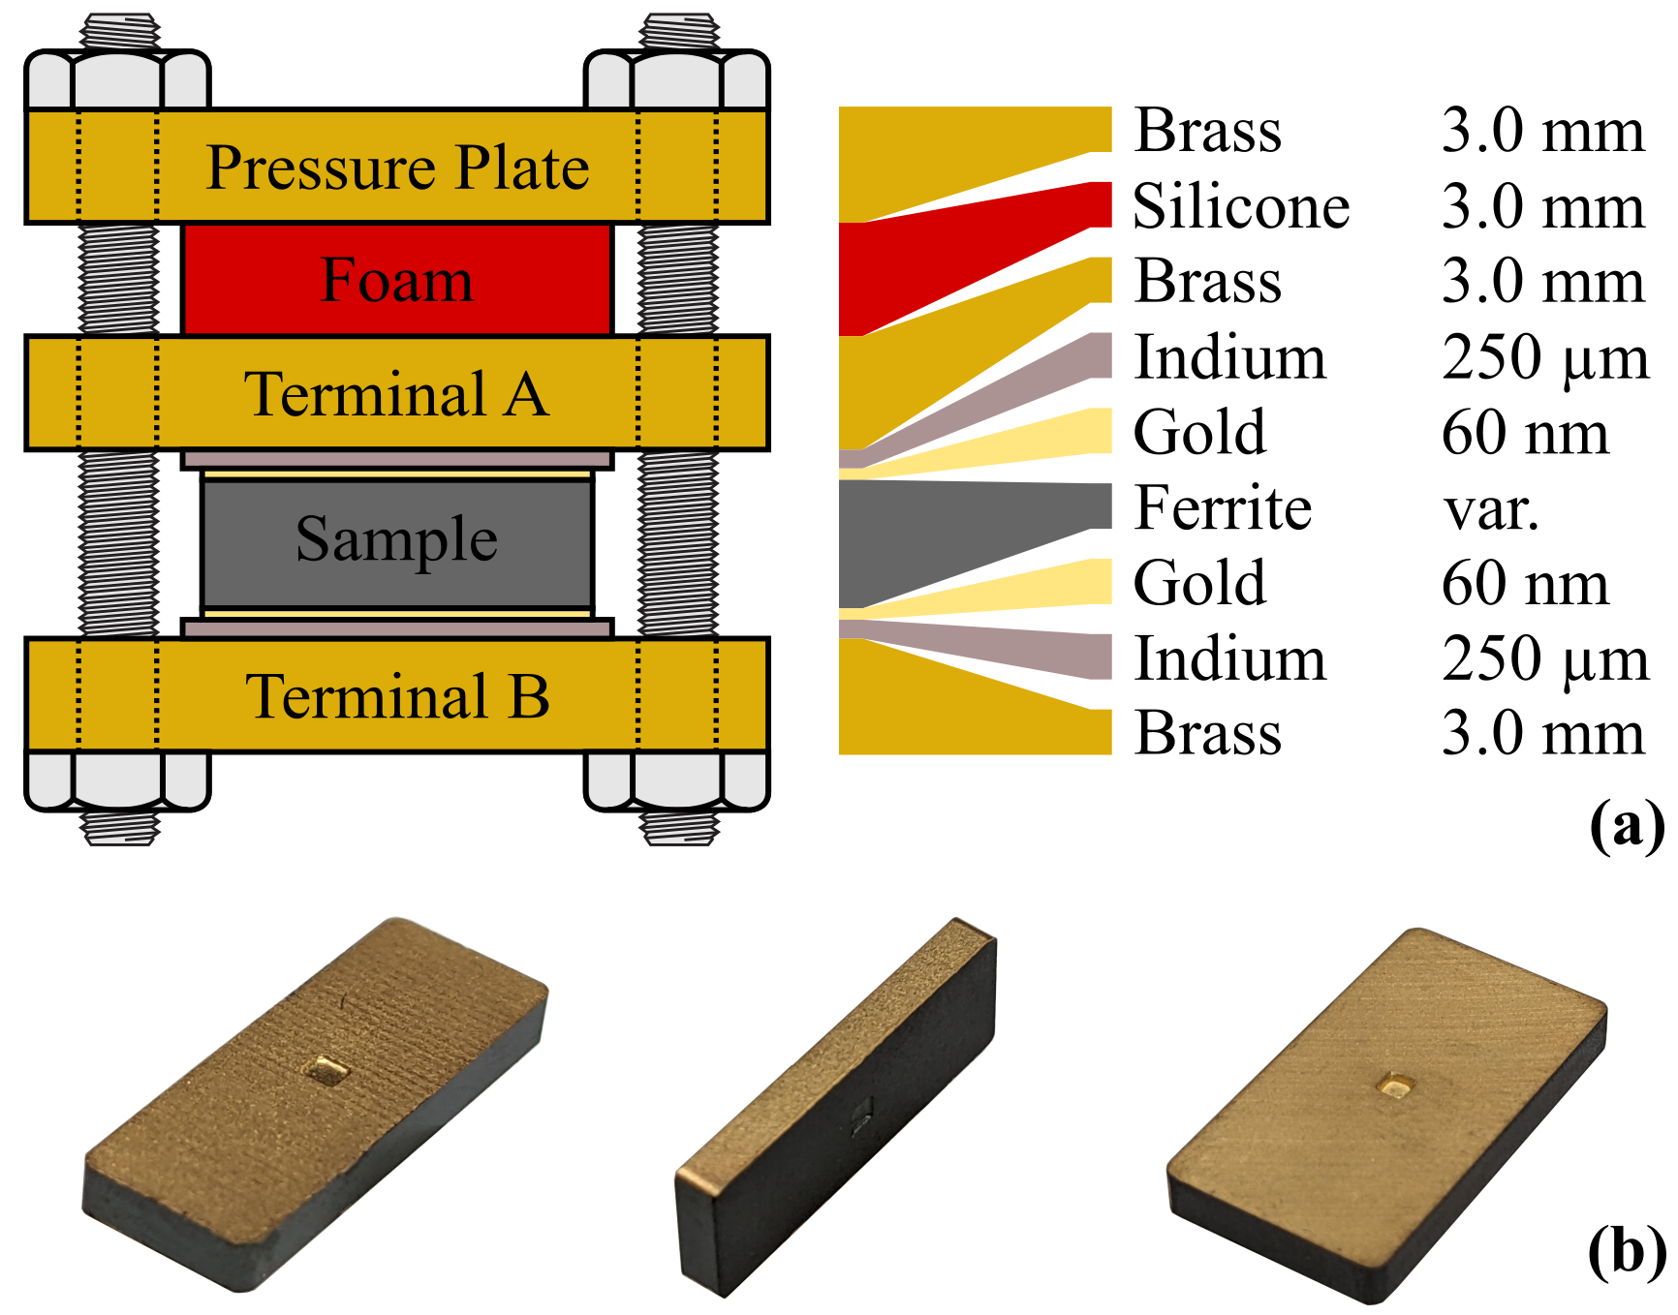
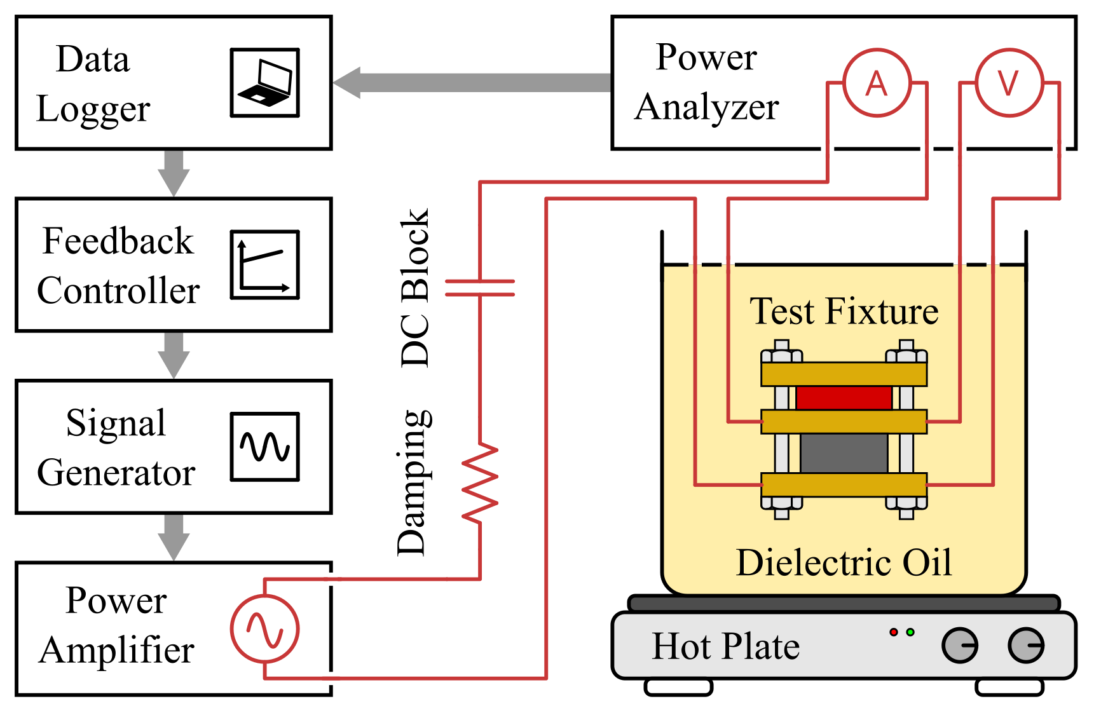
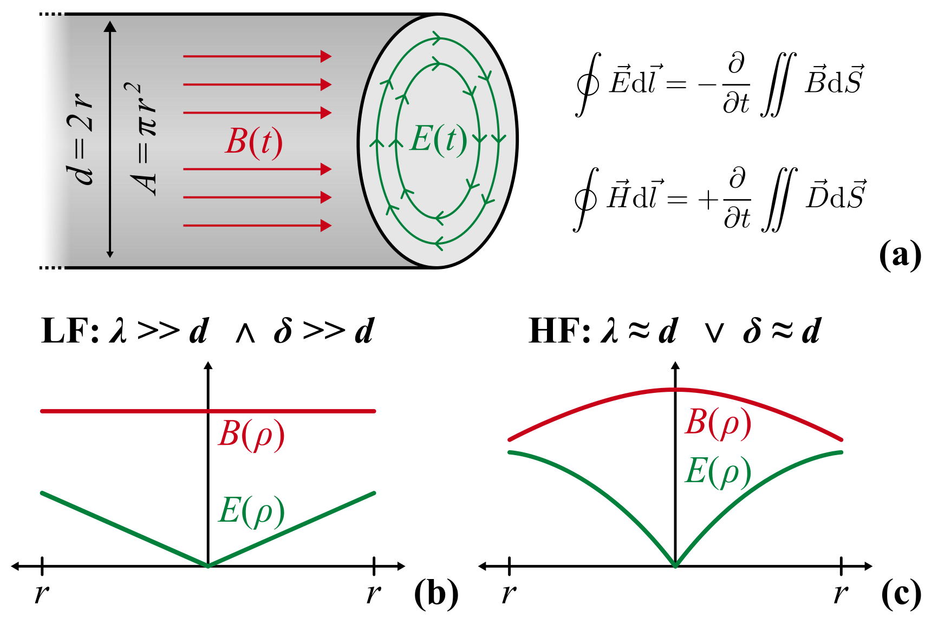
Some Schematics / Diagrams
Inkscape files in the GitHub.

Slide 4
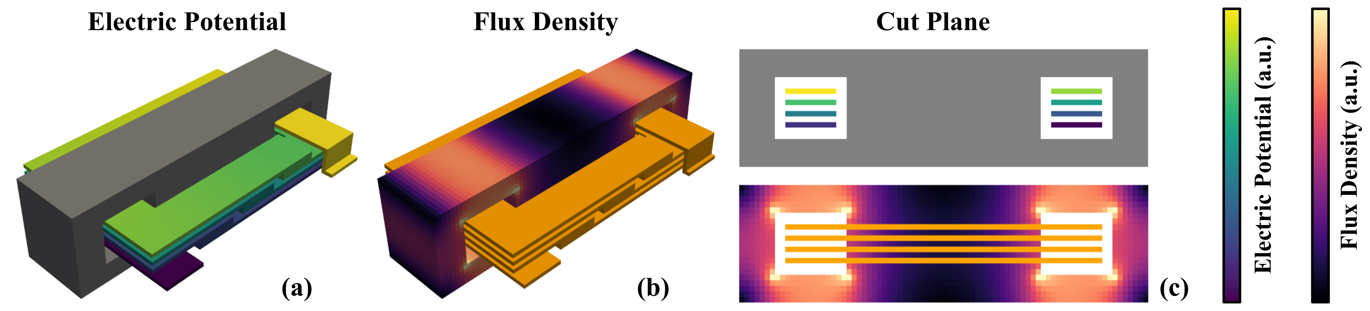
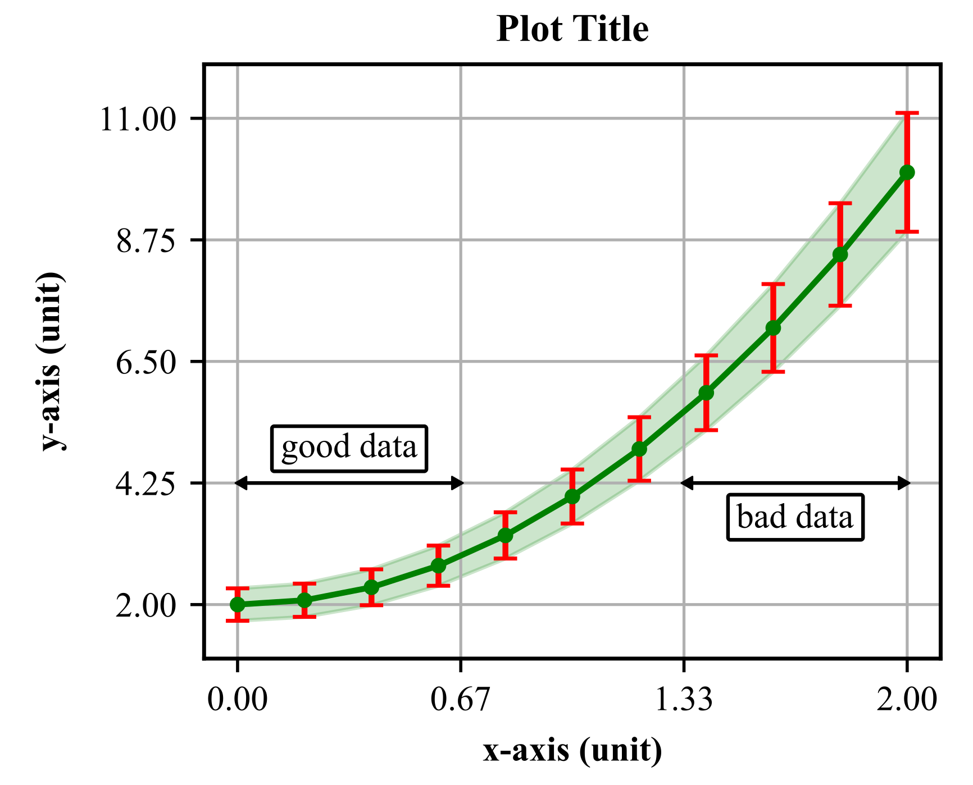
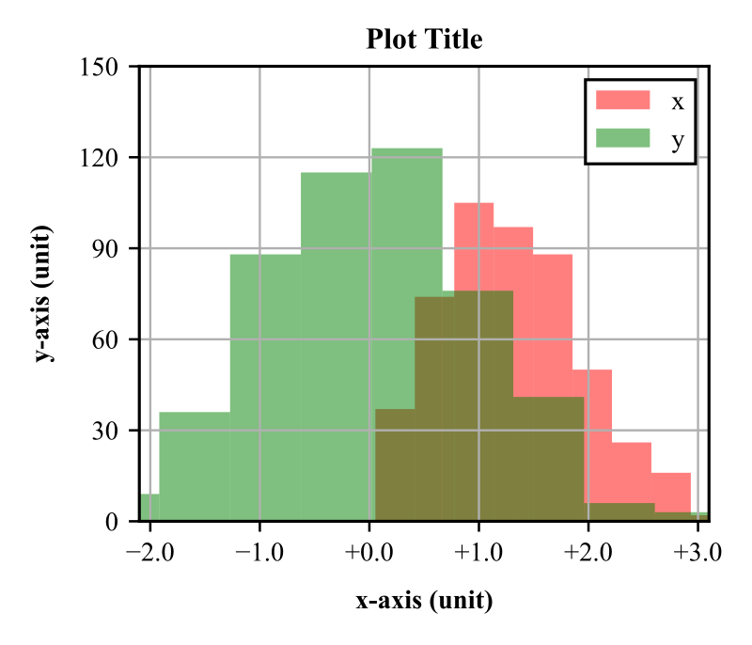
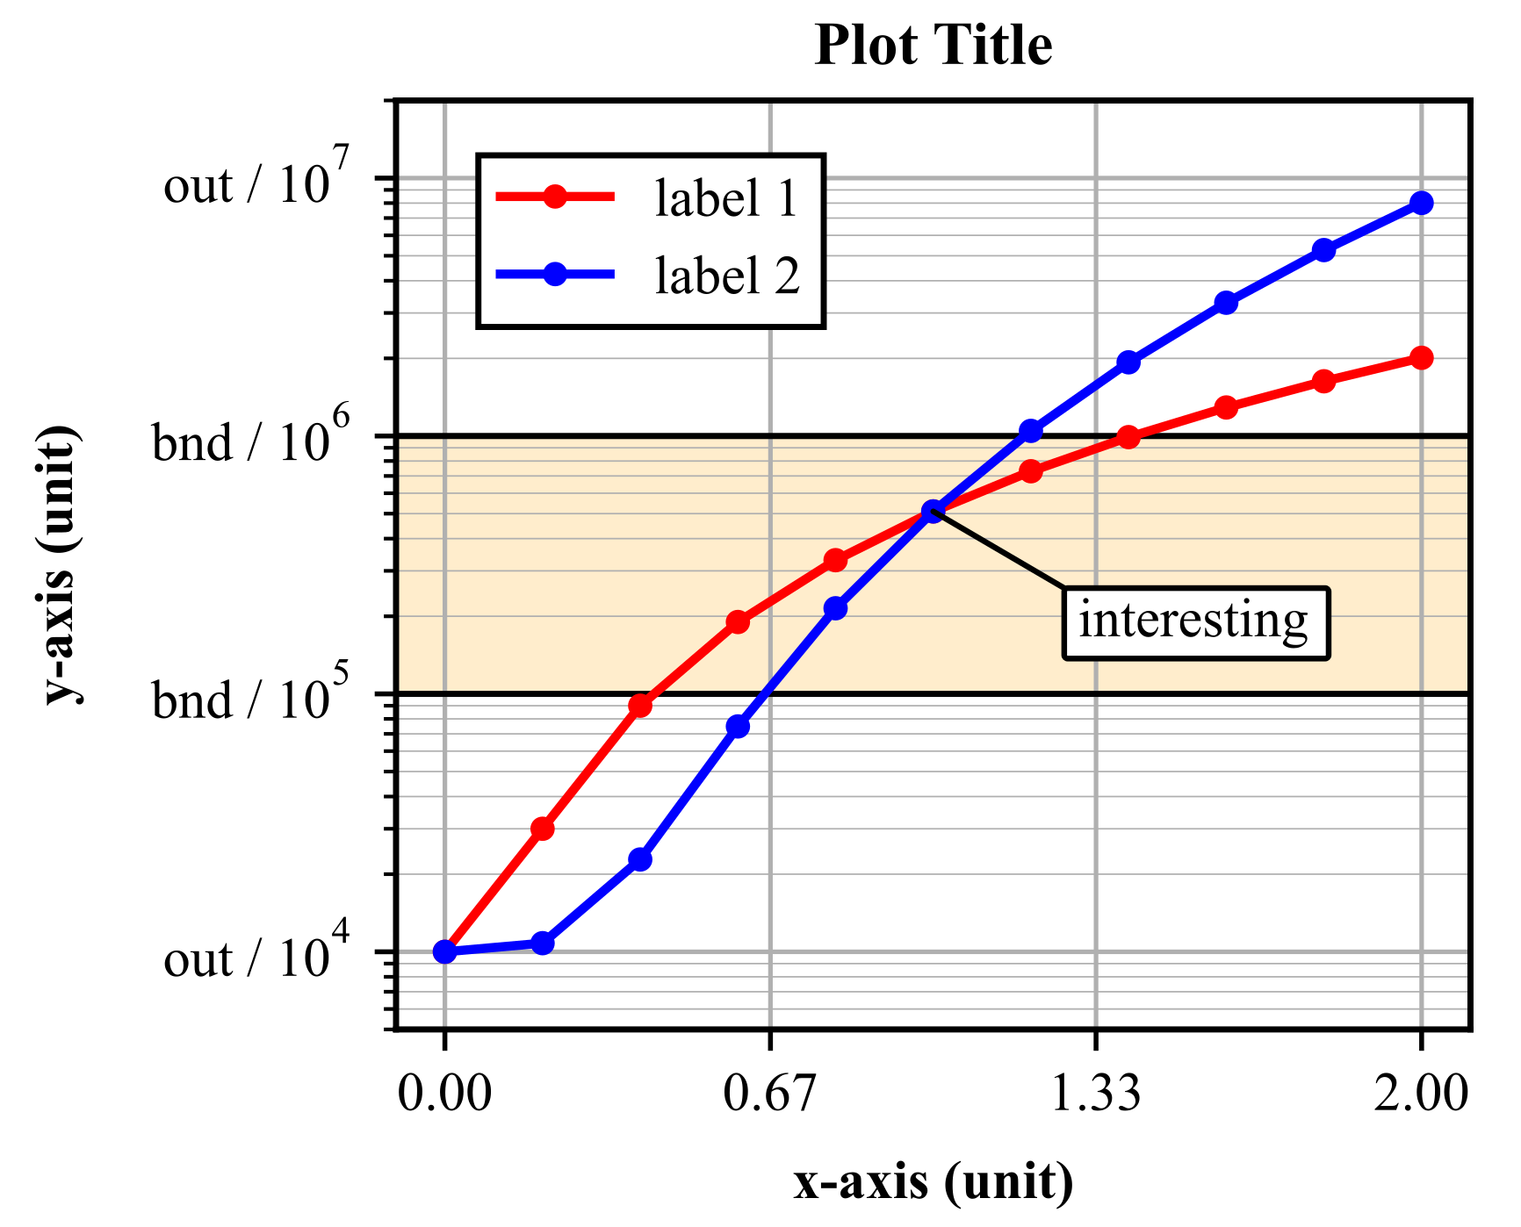
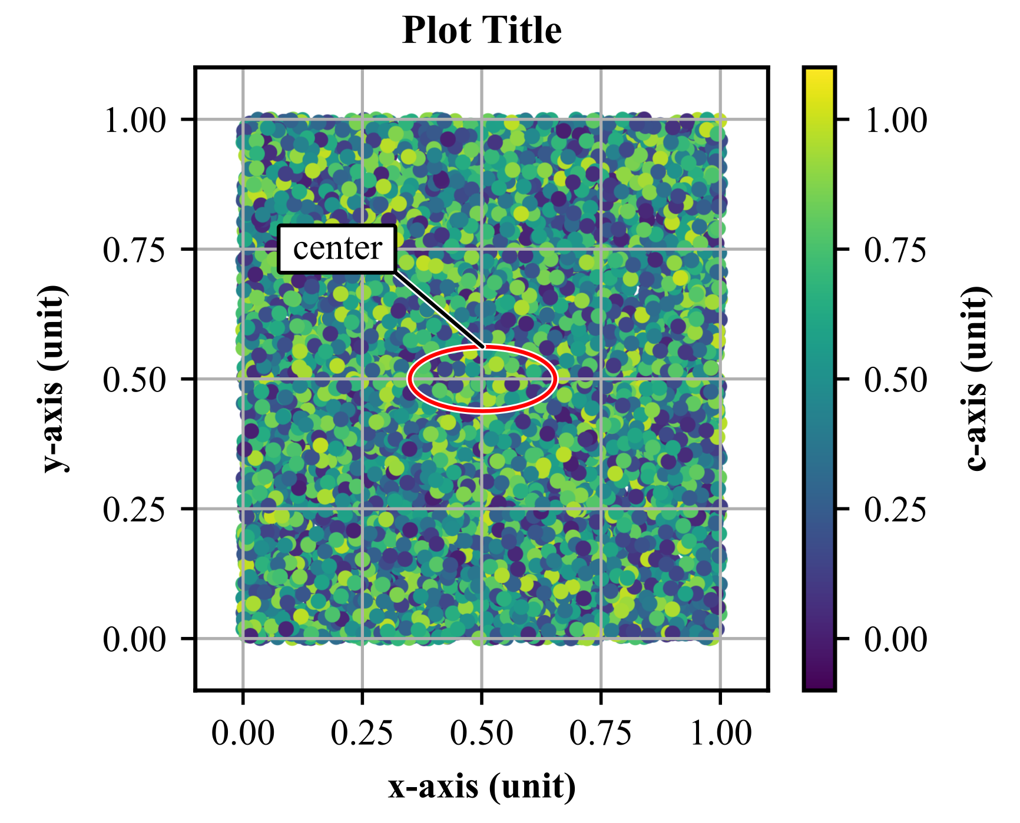
Some Plots
Inkscape files in the GitHub.
Python sources in the GitHub.

Slide 5
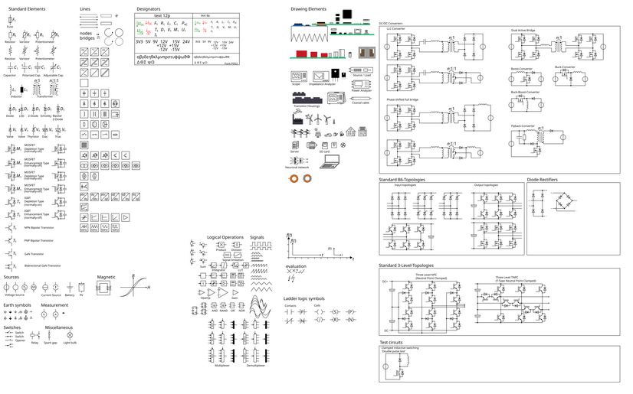
Open-Source Tools
Inkscape for creating / assembling figures
GIMP for handling photos / images
LaTeX for typesetting equations
Python / Matplotlib for plots
Python / PyVista for mesh/FEM
External resources
  Pictures / symbols from “The Internet” (check licenses)
  https://github.com/upb-lea/Inkscape_electric_Symbols
[Paderborn University]

Slide 6
Complete Workflow
GIMP
(photos and images)
jpg / png
Python / Matplotlib
(plots)
pdf / for the paper
svg
Inkscape
editing
drawing
composition
svg
Export
png
Python / PyVista
(mesh/FEM)
png / for the slides
pdf
LaTeX
(equations)
Keep all the files (data, code, figures, etc.) !!!
Reproducibility is important !!!

Slide 7
Before doing “Design”
Goal: highlighting your results in an honest way
Nice plots cannot make up for bad results!
Make a (tentative) figure list before starting
  List of the diagrams, schematics, plots, and tables
  Helpful for doing the figures and writing the paper
Have a clear split between models, data, and plot files
Find the right variables, scaling, and plot type
  1D / 2D plots are greats (simple and clear)
  3D plots are difficult to read (but sometimes required)
  High dimensional plots (e.g. parallel coordinates) can be useful
  https://matplotlib.org/stable/gallery / https://docs.pyvista.org/examples

Slide 8
Standard Sizes
Figure sizes (IEEE format)
  One-column: 88 mm / two-column: 180 mm
  Two-column figures makes LaTeX placement tricky
Fonts sizes
  Times New Roman
  10 pt: title text
  9 pt: normal text
  8 pt: small details
Line thickness: between 0.2 mm and 0.8 mm

Slide 9
Some “Design” Tips
The layout of the figure is important (do quick mockups)
Do not overload the figures (especially for slides / posters)
What makes good figures?
  Consistent size (symbols, fonts, thicknesses, etc.)
  Consistency between plots (axis limits, colors, etc.)
  Use bright / strong colors for the important curves / symbols
  Use pastel / gray colors for less important elements
  Crop / remove background for the photos
  Use annotations to highlight interesting features
  Nice selection of the axis limits and colormaps
  Make the colors printer and projector compatible
  https://matplotlib.org/stable/users/explain/colors

Slide 10
Nice things I am not doing
Drawing figures with a scripting language (e.g. TikZ)
Using LaTeX fonts in the figures (nicer but more complex)
  Import LaTeX equations in the figures as “shapes”
  Times New Roman is fine for the labels, ticks, etc.
Exporting final figures with Python (nicer but time-consuming)
  The Python exports are 90% good (e.g., plot size, font sizes, thicknesses, colors)
  The 10% remaining edits are done in Inkscape (careful not to alter the data)
Making the sub-figures with LaTeX packages (complex and rigid)
  The complete sub-figure composition is done in Inkscape
  Easier and faster to obtain visually pleasing results

Slide 11
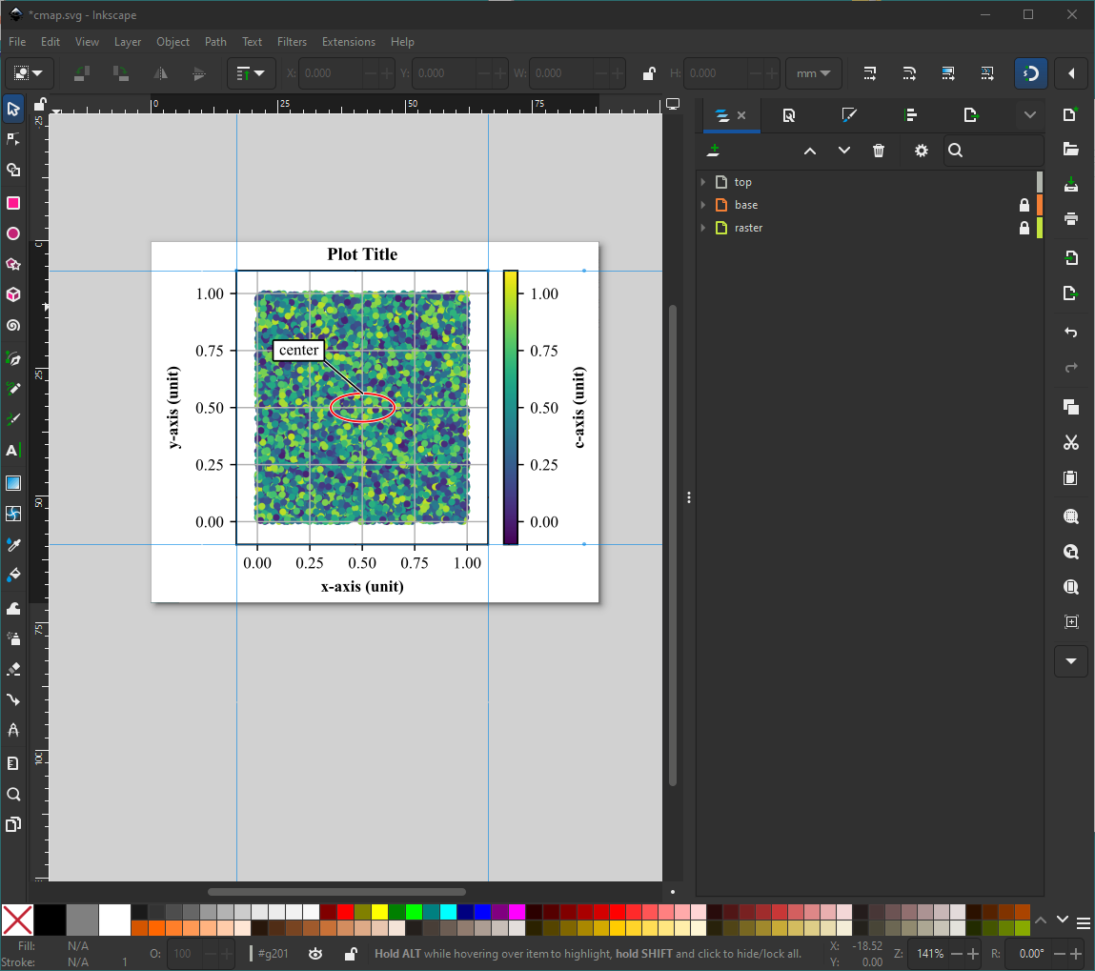
Inkscape Functions I am Using
Inkscape is extremely powerful
  10-20% of the features are often sufficient
  https://inkscape.org/learn
Organizing your figures is important
  Grid / snapping / guides
  Group / layers
Split different content is different layers
  Lock elements / hide elements
  Layer for the images
  Layer for the plots / drawings
  Layer for the annotations

Slide 12
Inkscape Functions I am Using
“Document Properties” – figure and grid sizes
“Layers and Objects” – organize the figure structure
“Transform” – scale, translate, rotate objects
“Fill and Stroke” – color, thickness, arrow, gradient, etc.
“Align and Distribute” – complex alignment options
“Object Properties” – edit complex object properties

Slide 13
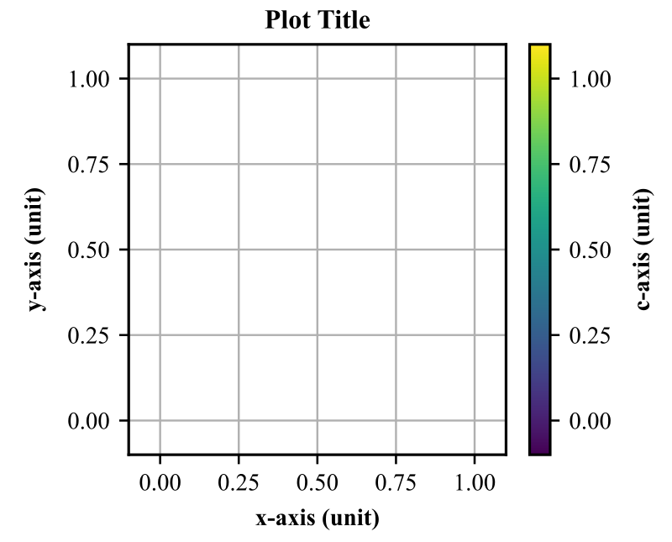
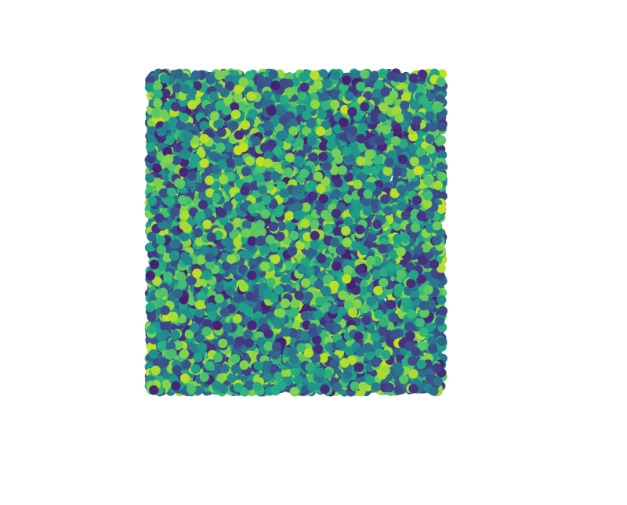
Using Vector Graphics for Everything?
Ideally yes, but there are some exceptions for large plots:
  Scatter / contour plots
  Massive oscilloscope data
  Mesh plots (FEM, FDTD, etc.)
Figures should (ideally) not exceed 1MB
Solution 1: down sample / simplify the data
  Can be easy (oscilloscope data or contour plots)
  Can be extremely unpracticable (large 3D meshes)
Solution 2: split the plot into two parts
  A vector plot with the axes, labels, ticks, legend, etc.
  A raster plot with the scatter plot dots (payload).

Slide 14
2D Plots with Python / Matplotlib
“utils_mpl.py” – Matplotlib utils
  Set up nice default parameters (fonts, sizes, etc.)
  Create and save figures as PDFs and PNGs
  Set the grid, axis limits, and axis ticks
Some examples
  “plot_line.py” – Example with logarithmic axis and custom axis ticks
  “plot_error.py” – Example with error bars and error fill area
  “plot_cmap.py” – Example with scatter plot and colormap
  “plot_notebook.ipynb” – Plot with Jupyter notebook.

Slide 15
2D/3D Meshes with Python / PyVista
Goal: plot variables on 2D/3D meshes (e.g., FEM, FDTD)
Solution 1: direct export from the EM software
  Simple but sometimes the plots are low-quality
  Fix the axis, colorbar, labels in Inkscape
Solution 2: export the mesh and the solution
  Generate the plot with a specialized tool (e.g., ParaView, PyVista)
  Much more powerful but also more complex
  Most EM simulation tools support VTK export
“utils_pv.py” – PyVista utils
“plot_mesh.py” – 2D/3D plots of EM simulation results from VTK data

Slide 16
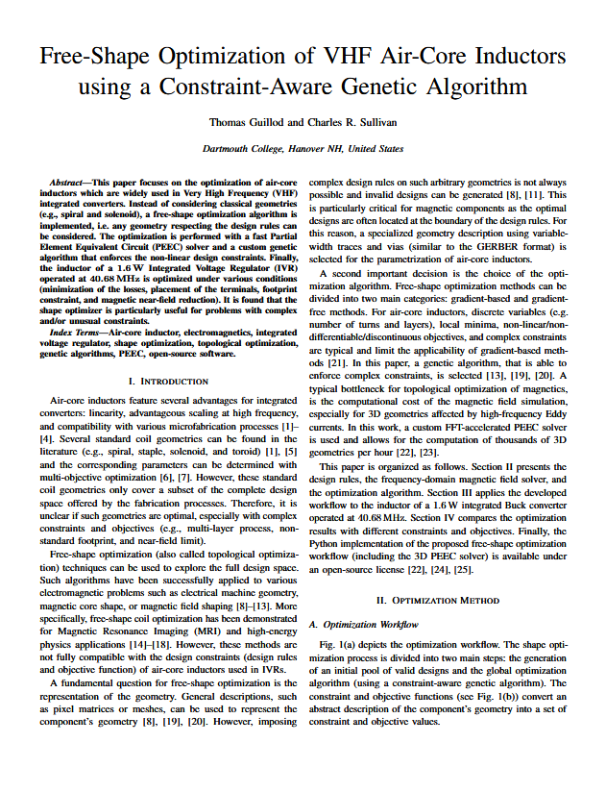
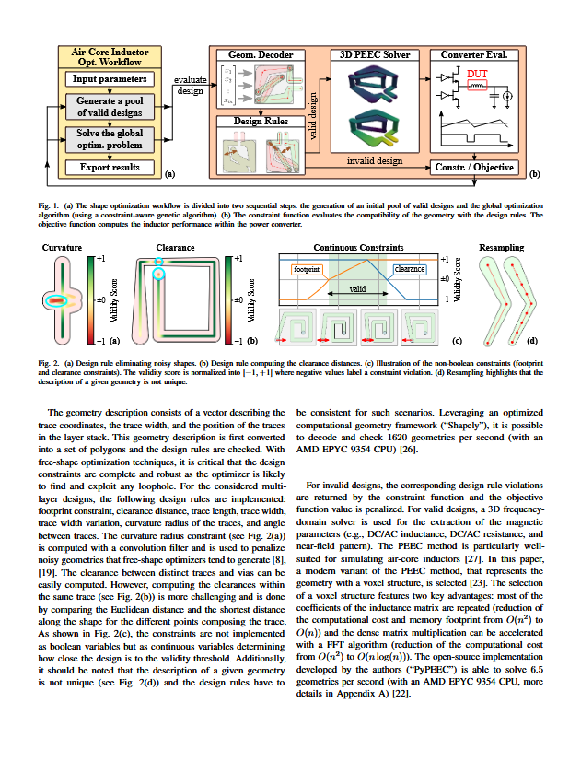
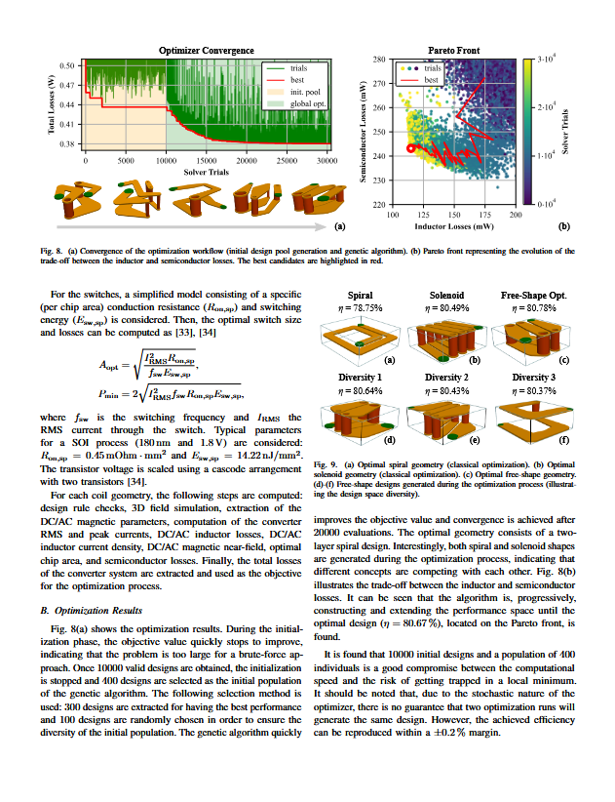

Export the Figures
“export_inkscape.sh” – Inkscape export script
  Export all the Inkscape plots in given folders
  Export as PDF for the paper (with fonts embedding)
  Export as high-resolution PNG for the slides / poster
Vector graphics in slides / poster are possible but prone to bugs
Using high-resolution PNG is a simple solution (300 – 500 dpi)

Slide 17
Python and Inkscape Examples
github.com/otvam/inkscape_python_figures
Slides - CC BY-ND 4.0 License
Code - MPL 2.0 License

