Slide 1

Summer Internship ETSI100
Responsive Portfolio Website using HTML, CSS, and JavaScript
Submitted To
Amity University, Sector- 125, NOIDA, Uttar Pradesh
In partial fulfillment of the requirements for the award of the degree of
BACHELOR OF COMPUTER APPLICATIONS
By Ankit Dhingra (A1004822257)
Under the guidance of Dr. Seema Rani
AMITY INSTITUTE OF INFORMATION TECHNOLOGY AMITY UNIVERSITY, SECTOR- 125,
NOIDA, UTTAR PRADESH

Slide 2
DECLARATION
I Ankit Dhingra, student of BCA (2022-25), hereby declare that the Summer Internship titled “Responsive Portfolio Website using HTML, CSS, and JavaScript” submitted to Amity Institute of Information Technology, AMITY UNIVERSITY, NOIDA, UP, is my original work and has been written under the guidance and supervision of Dr. Seema Rani. All the information, ideas, and concepts presented in this term paper are based on my own research, analysis and understanding of the topic. I further declare that all sources used for gathering information and references have been duly cited and acknowledged in the appropriate format. Any external sources including books, articles. Websites, and other publications have been appropriately referenced in the reference list.
I affirm that this Summer Internship represents my original work and meets the requirements set forth by Amity University for the successful completion of the course.
DATE:
(Signature)
Ankit Dhingra (A1004822257)

Slide 3
ACKNOWLEDGEMENT
The satisfaction that accompanies that the successful completion of any taskwould be incomplete without the mention of people whose ceaseless cooperation made it possible, whose constant guidance and encouragement crown all efforts with success. I would like to thank Amity University, Sector- 125, NOIDA, UP, for giving me the opportunity to undertake this project. I would like to thank my faculty guide Dr. Seema Rani, AIIT, NOIDA, UP, who is the biggest driving force behind my successful completion of the project. She has been always there to solve any query of mine and also guided me in the right direction regarding the project. Without her help and inspiration, I would not have been able to complete the project. Also, I would like to thank my batch mates who guided me, helped me and gave ideas and motivation at each step.
(Signature)
Ankit Dhingra
(A1004822257) BCA (2022-25)
AIIT, Amity University, NOIDA, UP

Slide 4
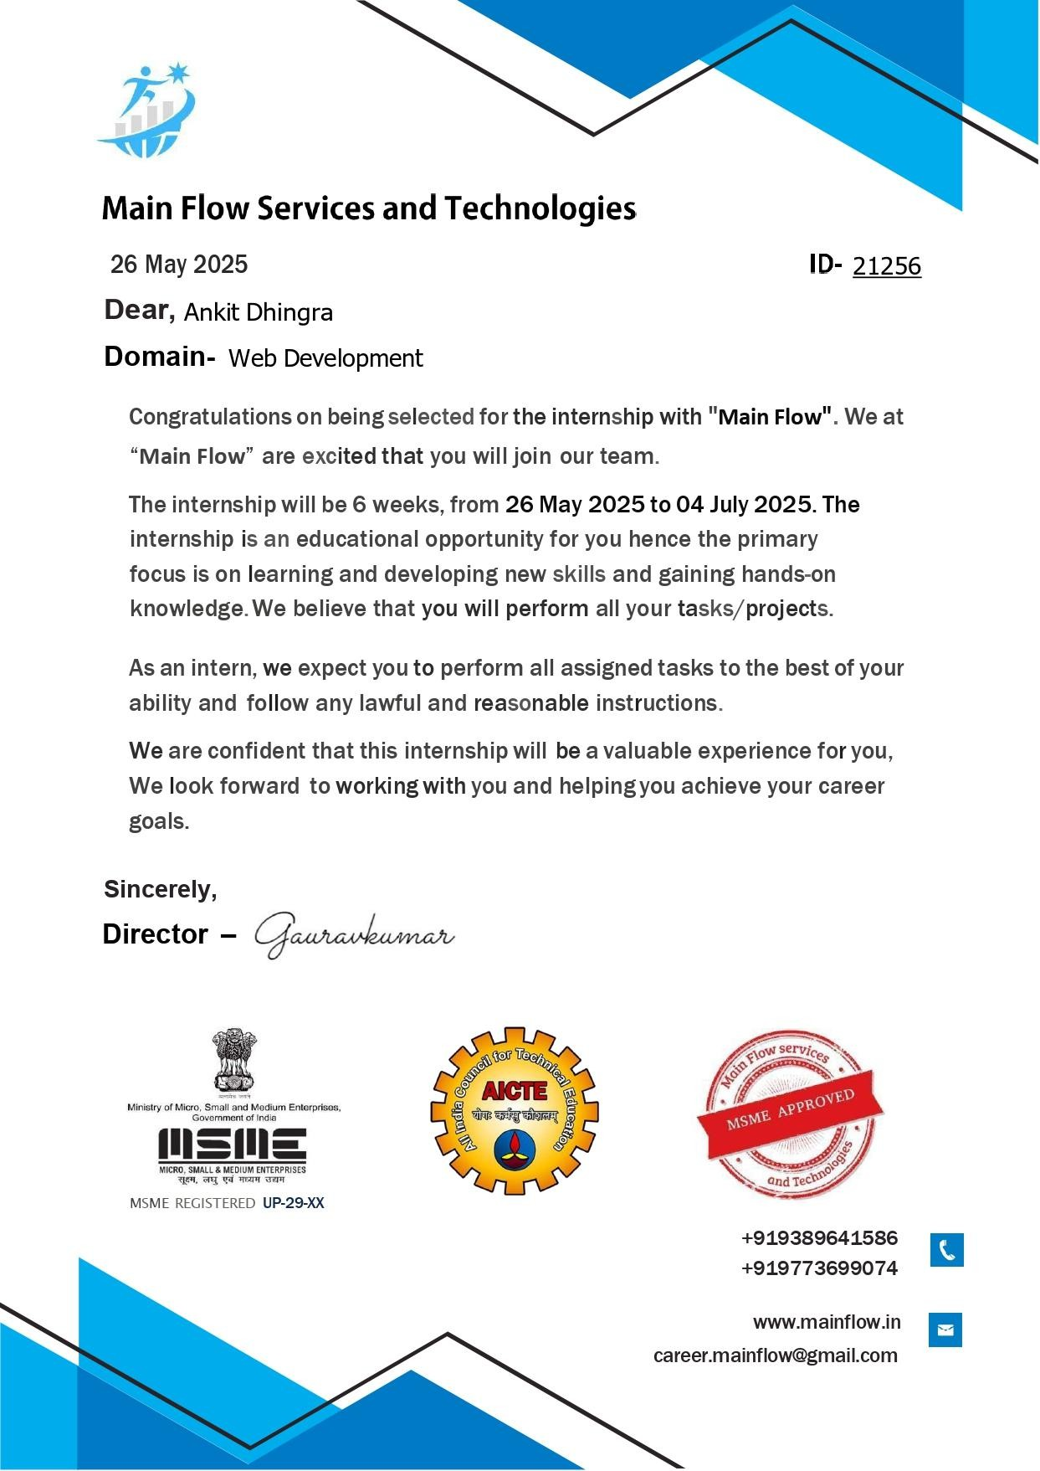
OFFER LETTER

Slide 5
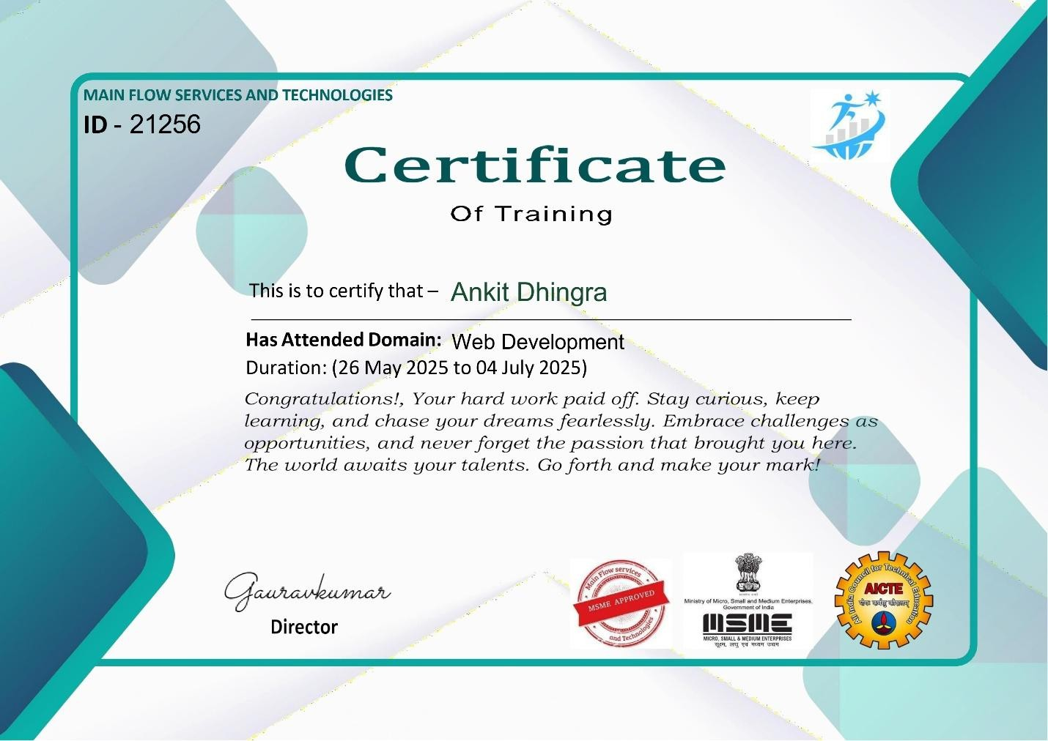
COMPLETION CERTIFICATE

Slide 6
GUIDE CERTIFICATE
I hereby certify that the Summer Internship Report by Mr. Ankit Dhingra, student of BCA, Vth semester, batch of 2022-25 and Enrollment no. A1004822126 with the title “Responsive Portfolio Website using HTML, CSS, and JavaScript” which is submitted to Amity Institute of Information Technology, Amity University, Noida, Uttar Pradesh in partial fulfilment of the requirements for the award of the degree of Bachelor of Computer Applications is an original contribution with existing knowledge and faithful record of work carried out by him under my guidance and supervision and to the best of my knowledge this work has not been submitted in part or full for any Degree or Diploma to this University or elsewhere.
(Signature)
Dr. Seema Rani
Amity Institute of Information Technology, AUUP, Noida, Uttar Pradesh
Place: Noida

Slide 7
AMITY UNIVERSITY
-----UTTAR PRADESH-----
Amity Institute of Information Technology Summer Internship
Student Name: Ankit Dhingra
Enrollment No: A1004822257
Programme: Bachelor of Computer Applications
Company's Name: Main Flow Services and Technologies
Address:
Industry Guide Name:
Designation:
Contact Number Ph.(O) :
Mobile :
Fax :
E-mail :
-------------------------------------------------------------------------------------------------------------------------------
Project Information
Project Duration : (6 Weeks)
Date of Summer Internship commencement (26/05/2025) Date of Summer Internship Completion (04/07/2025)
Topic
Responsive Portfolio Website using HTML, CSS, and JavaScript
Project Objective
To design and develop a responsive, single-page portfolio website using HTML, CSS, and JavaScript that effectively showcases personal skills and projects.
Methodology to be adopted
The project follows an iterative development process involving design, coding, testing, and refinement to ensure a responsive and user-friendly final website.

Slide 8
TABLE OF CONTENTS
S No. | TOPIC | Page No.
1. | Abstract | 1
2. | Objective | 2
3. | Tools & Technologies Used | 3
4. | Implementation Details | 4-5
5. | Screenshots & Images | 6-8
6. | Challenges Faced | 9
7. | Conclusion | 10
8. | References | 11
9. | Plagiarism Report | 12-14
10. | Weekly Progress Reports (WPRs) | 15-20
11. | Daily Diary | 21-26

Slide 9
ABSTRACT
This project focuses on the design and development of a responsive, single-page portfolio website titled “Responsive Portfolio Website using HTML, CSS, and JavaScript.” The primary aim of the project is to create an interactive, visually appealing, and professional web presence that effectively showcases personal or professional details in a minimal and modern format.
The website utilizes core web technologies: HTML for structuring content, CSS for styling and layout, and JavaScript for smooth navigation and interactivity. Key features include a scroll- snapping effect for a seamless presentation-like experience, responsive design to ensure compatibility across a wide range of devices from desktops to smartphones, and customized navigation for intuitive access to different website sections.
Throughout the project, emphasis was placed on clean design principles, ensuring readability, simplicity, and usability. Custom fonts and subtle animations were incorporated to enhance visual appeal without compromising performance or load times. The result is a modern portfolio site that demonstrates foundational web development skills, attention to design aesthetics, and an understanding of responsive layouts and user-centered interfaces.
This project fulfills the objectives of the NTCC (Non-Teaching Credit Course) by combining technical knowledge with creative design, delivering a functional, engaging, and optimized website suitable for real-world professional use.

Slide 10
OBJECTIVE
The primary objectives of this NTCC project are:
To design and implement a modern, responsive single-page portfolio website
Develop a website with a clean and bold aesthetic that adapts seamlessly across devices of varying screen sizes, including desktops, laptops, tablets, and smartphones.
To integrate HTML, CSS, and JavaScript effectively
Demonstrate practical knowledge of core web technologies by using HTML for structure, CSS for styling and layout, and JavaScript for interactive functionality, including smooth scrolling navigation.
To create a professional web presence for personal or academic use
Build a website that can showcase an individual’s skills, projects, and contact information
in a visually appealing and user-friendly format.
To ensure user-centered design principles
Prioritize readability, intuitive navigation, and accessibility to enhance the user experience.
To gain hands-on experience in responsive web design
Apply concepts of modern web design trends, including custom fonts, minimalistic layout, and smooth transitions.

Slide 11
TOOLS & TECHNOLOGIES USED
HTML5
Used for structuring the content of the website, creating semantic elements for each section, and organizing information in a clean, logical way.
CSS3
Applied for styling the website, including custom fonts, responsive layouts, colors, text shadows, scroll-snapping, and visual transitions to enhance aesthetic appeal.
JavaScript (Vanilla)
Implemented to add interactivity and dynamic behaviors, such as smooth scroll navigation to different sections and resetting the page view to the homepage on reload.
Visual Studio Code (VS Code)
The primary code editor used for writing, editing, and managing project files with features like live preview, syntax highlighting, and version control integration.
Web Browsers (Chrome)
Used for testing and debugging the website’s compatibility and responsiveness across
different platforms.
Fonts
Custom fonts such as Anton were utilized for headings and Impact Bold supporting text to achieve a modern, bold look.

Slide 12
Implementation Details
Website Structure
The website was developed as a single-page application with scroll-snapping, allowing users to navigate seamlessly between distinct sections. The main sections include:
Portfolio/Home — Features the website title and navigation menu.
About Me — Contains a brief self-introduction highlighting personal and professional details.
Projects — Presents notable projects with clear headings.
Contact Me — Provides a contact form for visitors to send messages directly.
All sections were implemented within a single HTML document, using IDs for each section and a fixed navigation bar with anchor links enabling smooth scrolling.
Navigation
A fixed navigation bar was created at the top of the page with links to each section. JavaScript was used to enable smooth scrolling to the relevant section upon clicking a navigation item. An additional script ensures the page resets to the top section when refreshed, maintaining consistent user experience.
Styling and Layout
CSS Flexbox was used extensively to center content both vertically and horizontally within each section, ensuring each segment fills the viewport completely. Scroll-snapping was implemented
using CSS scroll-snap-type and scroll-snap-align properties for a presentation-like experience when navigating through sections.
The headings were styled with a bold, modern font, and subtle text shadows were added to improve readability against the background. A minimalist divider was included in the navigation to separate links clearly.
Responsive Design
Media queries were added to ensure the layout adjusts gracefully on various screen sizes, from large desktop monitors to tablets and smartphones. The flexible design prevents content
overflow and maintains alignment, providing a consistent look and feel across devices.

Slide 13
Interactivity
JavaScript was used for:
Smooth scrolling to sections upon clicking navigation links.
Returning to the top section when the page reloads, enhancing user navigation flow. These dynamic features enrich the user experience without relying on external libraries.
Final Touches
A modern color scheme was chosen with a black background, white text, and orange accents for
borders and highlights. The visual design aims to balance minimalism with boldness, creating an impactful and professional look. Font choices and spacing were carefully adjusted for readability and aesthetics.

Slide 14
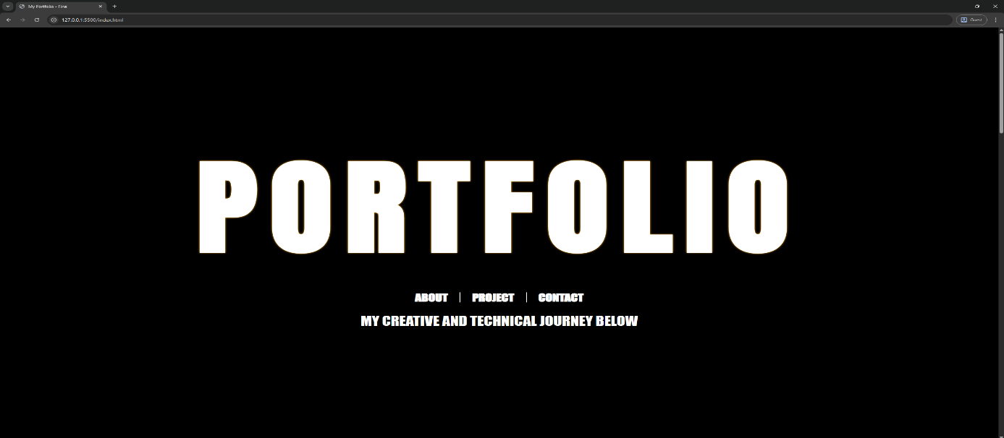
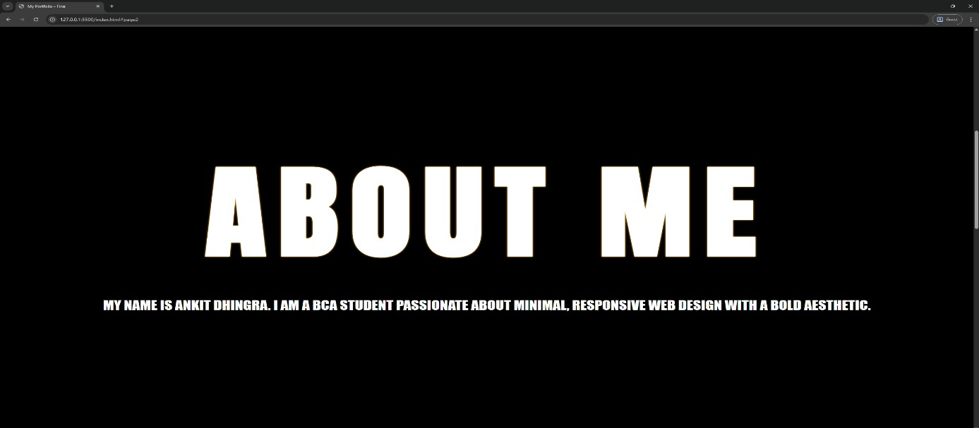
Screenshots & Images
To demonstrate the progress and final look of the project, screenshots of each section of the website will be included below. These images will showcase the layout, design elements, and responsiveness across different devices.
•。.çˆ'· Homepage (Portfolio Section)
ˆ'ç.。•·. About Me Section

Slide 15
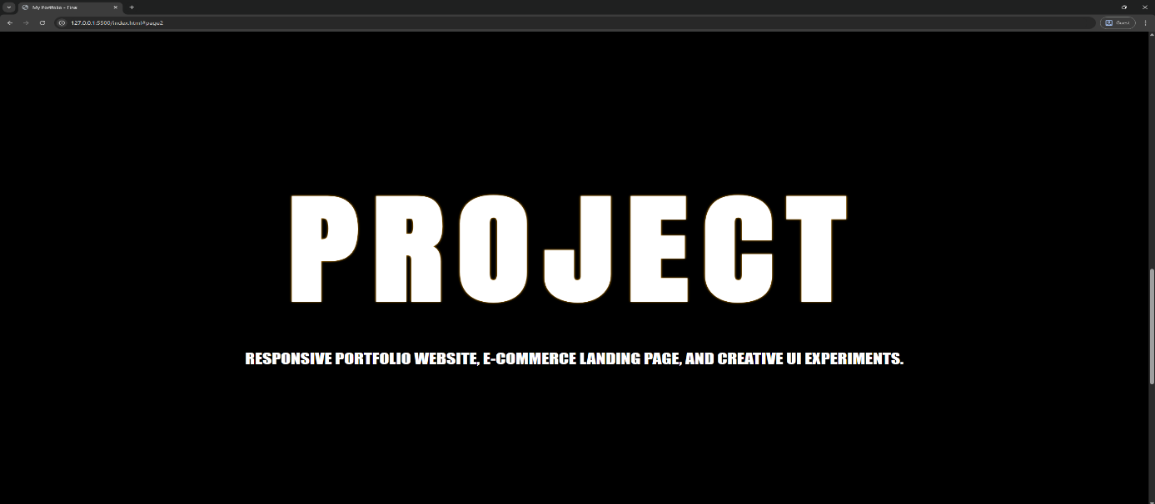
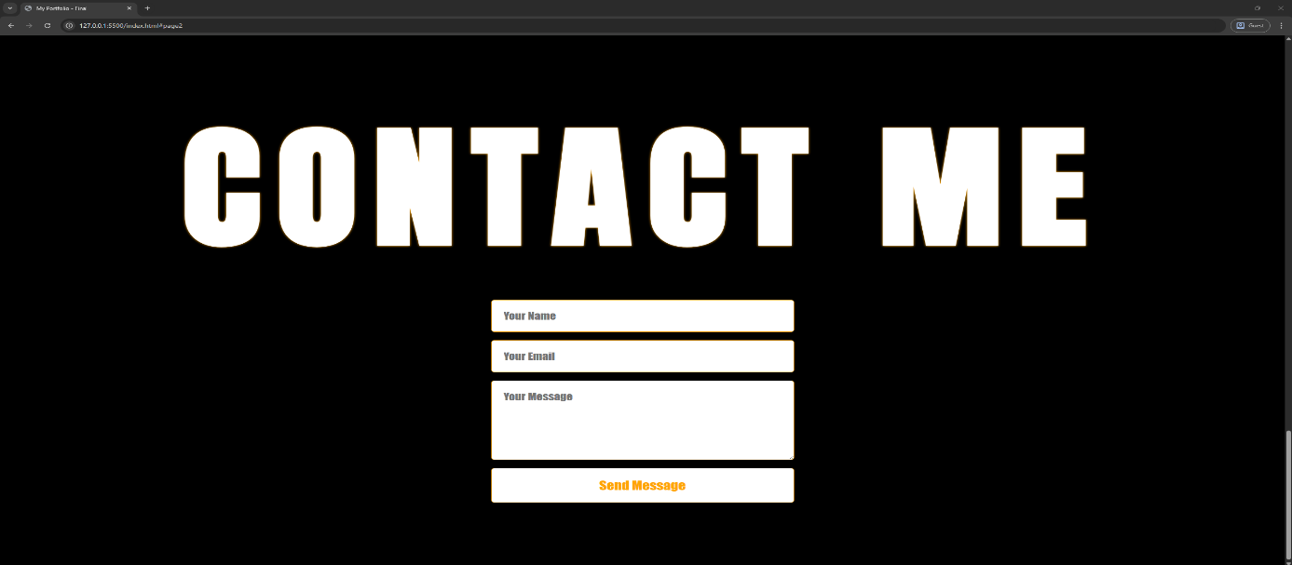
ˆç.。•·' Projects Section
'·•。.çˆ Contact Me Section

Slide 16
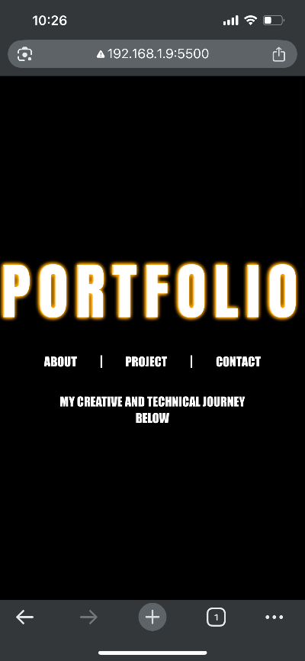
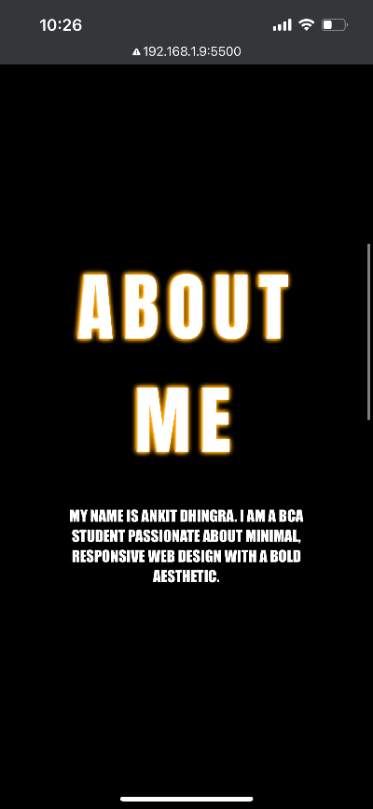
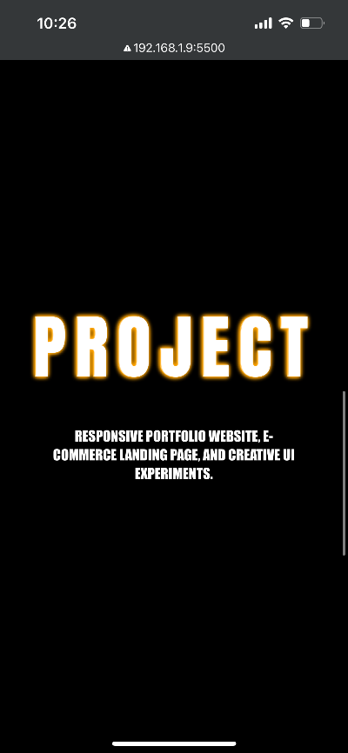
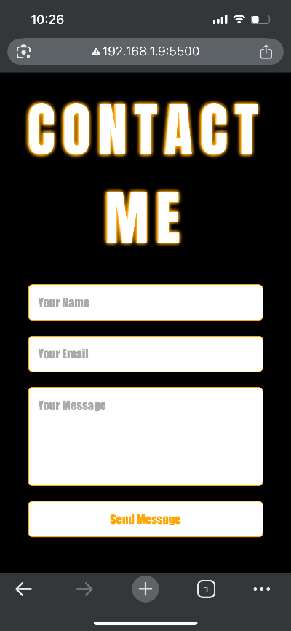
ˆç.。•·' Responsive View

Slide 17
Challenges Faced
During the development of the responsive portfolio website, several challenges were encountered:
Responsive Design Adjustments
Ensuring that the website displayed consistently across a wide range of screen sizes was challenging. Aligning elements perfectly in both desktop and mobile views required multiple iterations of CSS adjustments and testing on different devices.
Scroll Snapping Behavior
Implementing smooth scroll-snapping across all sections without causing content
overflow or misalignment took significant fine-tuning of CSS scroll-snap properties and section heights.
Font and Visual Styling
Selecting a bold, modern font that rendered correctly on all devices and browsers proved to be tricky. Some fonts displayed differently on certain devices, requiring fallback options
and testing.
Navigation Divider Alignment
Maintaining perfect alignment of the divider symbols (“|”) between navigation links was
unexpectedly difficult, as it varied based on font size, spacing, and browser rendering. Several adjustments were made to achieve a consistent and clean appearance.
Consistent Spacing
Balancing the space occupied by headings and text in each section to make the pages feel neither empty nor cluttered required careful tuning of font sizes, line spacing, and padding.
Maintaining Smooth Transitions
Creating a seamless, presentation-like experience when scrolling between sections involved tweaking both JavaScript and CSS to avoid jarring transitions and ensure a natural flow.
Despite these challenges, iterative refinement helped achieve a polished, functional, and visually appealing final product.

Slide 18
Conclusion
The development of the Responsive Portfolio Website using HTML, CSS, and JavaScript successfully met the objectives of the NTCC project. The website combines a bold, modern aesthetic with functional, responsive design, resulting in a professional online presence suitable for showcasing skills and projects.
Through this project, practical experience was gained in:
Structuring content with semantic HTML,
Styling layouts and implementing responsiveness with CSS,
Adding interactivity and enhancing user experience with JavaScript.
The final website delivers a smooth, scroll-snapping presentation-like experience, demonstrating an understanding of user-centered design and compatibility across various devices and screen sizes. Challenges encountered during development strengthened problem-solving skills, especially in areas such as cross-device compatibility, layout alignment, and typography.
Overall, this project not only deepened technical knowledge in front-end web development but also emphasized the importance of design aesthetics and usability in creating engaging, modern websites.

Slide 19
References
MDN Web Docs — HTML, CSS, JavaScript Documentation
https://developer.mozilla.org/
W3Schools Tutorials — HTML, CSS, JavaScript Basics
https://www.w3schools.com/
Google Fonts Documentation
https://fonts.google.com/
Stack Overflow Discussions
Used to troubleshoot specific layout and responsiveness issues.
Visual Studio Code — Official Website
https://code.visualstudio.com/
Personal Experimentation & Practice Code
Iterative code writing and debugging during the NTCC project.

