Slide 1
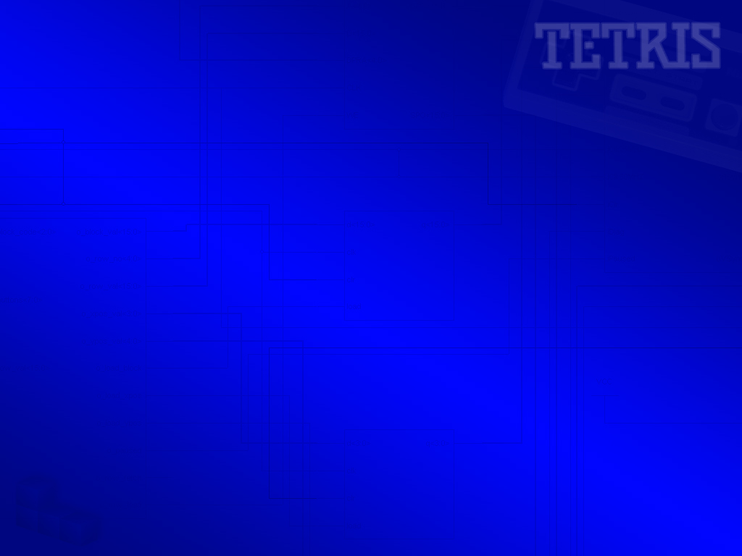
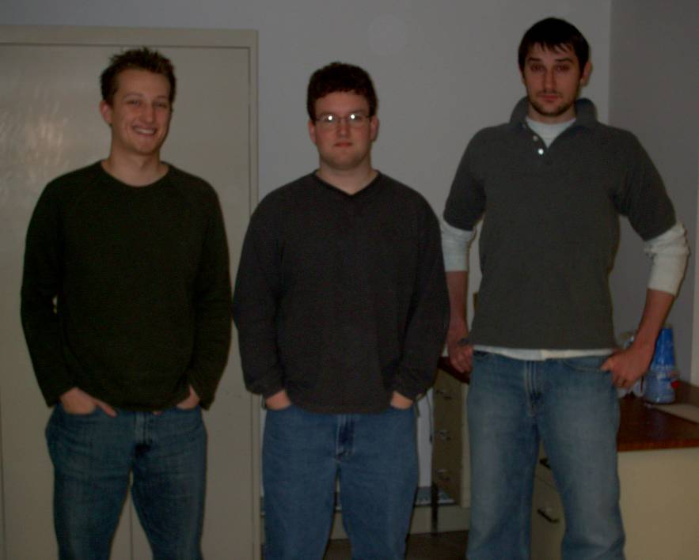
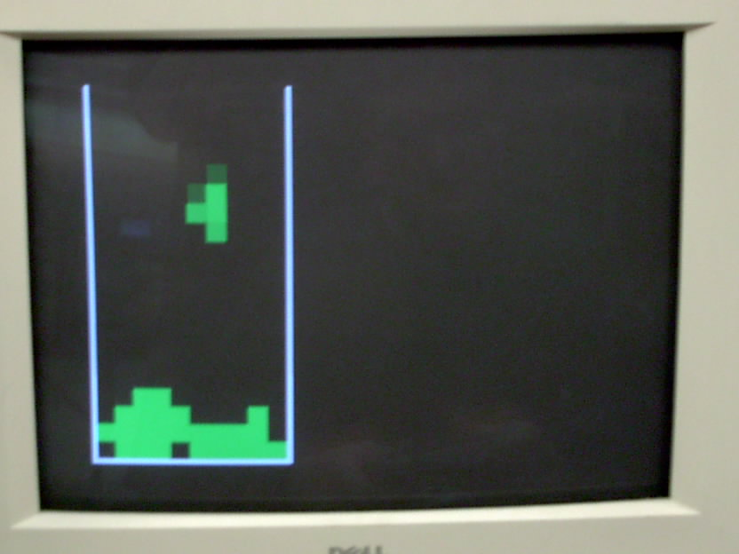






TETRIS
A VHDL approach using the WC16
James Batcheler
Bryan Mason
Brad McMahon
CSE 378, Fall 2004

Slide 2

Implementation & Features
Random pieces fall down from the top of the game area.
A NES controller is used to move pieces on the screen. Pieces can be translated or rotated.
Pieces may not overlap or go outside of the 10x20 game area. A collision detection engine was built to this specification.
The game is over when the pieces reach the top of the game area.
Points are awarded for completing a full row, which clears the row. The score is maintained by WHYP code running on the WC16.
The highest score wins!

Slide 3
Tetris Facts
1600+ lines of custom VHDL for logic / VGA / NES Controller.
Simple and efficient WHYP score-keeper.
Input-buffering implemented on an original NES controller provides a true “retro” feel.
Original design was for a two-player versus Tetris, however two control modules would not fit on a single Spartan 2E processor.
200+ man hours accumulated from conception to completion of entire project.
Fun to play!

Slide 4
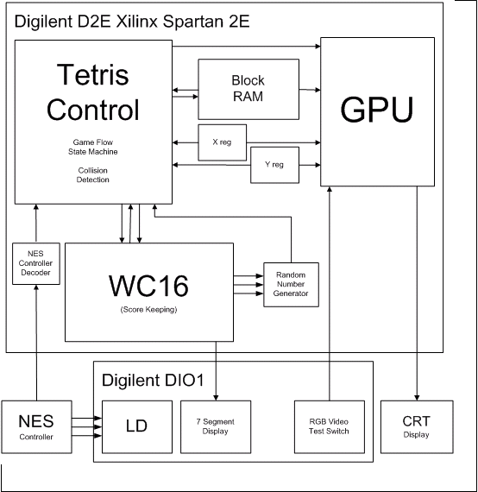
Top Level Design
WC16
Tetris Control
Block RAM
X, Y Registers
GPU
Random Number Generator
NES Controller Decoder

Slide 5
Blocks and Bits
A 16-bit value represents the a given piece. ‘1’ represents a filled block in a 4x4 grid. Every four bits designates a new row.
A dual port RAM stores 16-bit values for each row in the Tetris data. Values are updated and read as necessary for logic and VGA display.
Offset x and y positions for the current piece are stored encoded in 4-bit registers.
0 0 0 1
0 0 0 1
0 0 0 1
0 0 0 1
15 14 13 12
11 10 09 08
07 06 05 04
03 02 01 00
0 1 0 0
0 1 1 0
0 0 1 0
0 0 0 0

Slide 6

Collision Engine
Logical OR
Logical NAND
0 0 0 0 0 0 0 0 0 0
0 0 0 0 0 0 0 0 0 0
0 0 0 0 0 0 0 0 0 0
1 1 1 1 1 1 1 1 1 1
0 0 0 0 0 0 0 0 0 0
0 0 0 0 0 0 0 0 0 0
0 0 0 0 0 0 0 0 0 0
1 1 1 1 1 1 1 1 1 1
0 0 0 0 1 0 0 0 0 0
0 0 0 0 1 1 0 0 0 0
0 0 0 0 0 1 0 0 0 0
0 0 0 0 0 0 0 0 0 0
0 0 0 0 1 0 0 0 0 0
0 0 0 0 1 0 0 0 0 0
0 0 0 0 1 0 0 0 0 0
0 0 0 0 1 0 0 0 0 0
or
nand
0 0 0 0 1 0 0 0 0 0
0 0 0 0 1 1 0 0 0 0
0 0 0 0 0 1 0 0 0 0
1 1 1 1 1 1 1 1 1 1
0 0 0 0 0 0 0 0 0 0
0 0 0 0 0 0 0 0 0 0
0 0 0 0 0 0 0 0 0 0
0 0 0 0 1 0 0 0 0 0
=
=
OR logic is used to combine a falling piece into the rows.
NAND logic is used to check the movement of a piece into the next possible position. If any bit is ‘1’ the movement is not allowed.

Slide 7
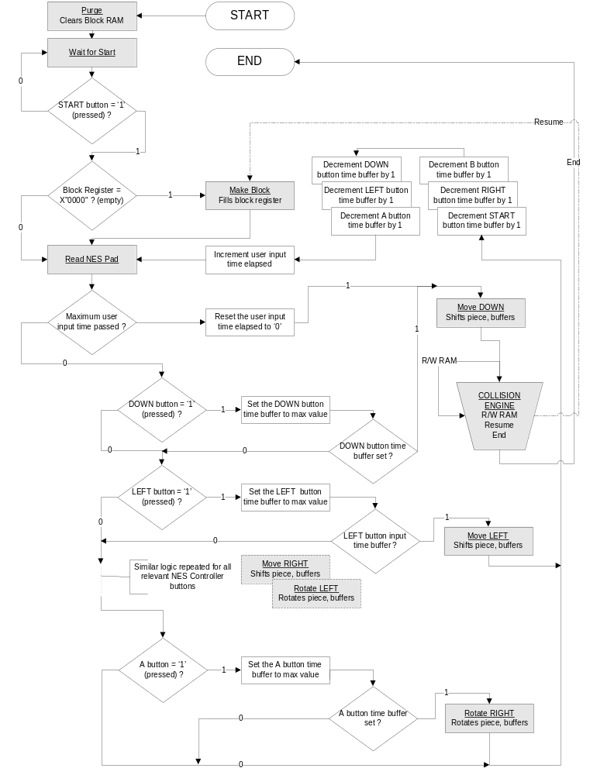

Block Diagram
Purge
Wait for Start
Make Block
Read NES Pad
Collision Engine
Read / Write DPRAM

Slide 8
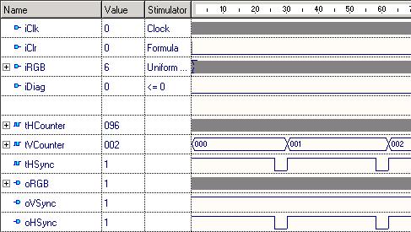
GPU Controller
GPU contains two parts; RGB Controller and VGA Core.
The RGB Controller provides a bit stream to the VGA Core.
The VGA Core routes bit stream to a VGA monitor, adding HSync and VSync signals as necessary.
HSync and VSync properly synchronize VGA horizontally and vertically respectively.

Slide 9
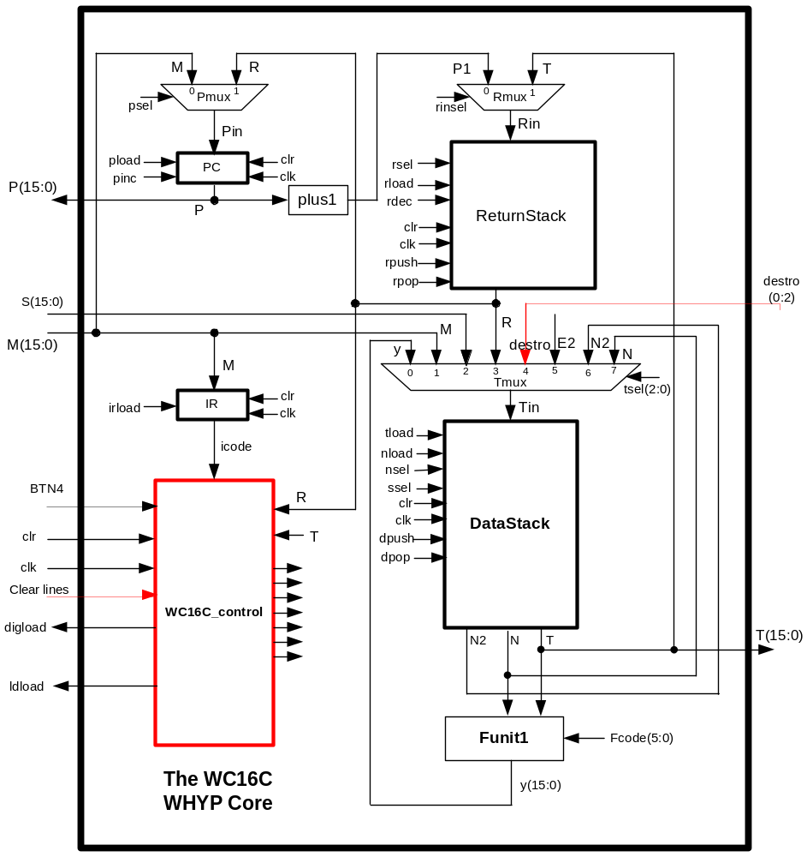
WC16… Improved and WHYP’d
\ tetris.whp
HEX
: MAIN ( -- )
BEGIN
D@ \ fetch in lines
D* \ clear lines
+ \ plus
DUP LD! \ display
AGAIN ; \ ad infinitum
The Tetris Control Module sends out “destro”, the number of lines destroyed. WHYP adds the “destro” lines to the current score and displays it in hexadecimal on the 7 segment displays.

Slide 10
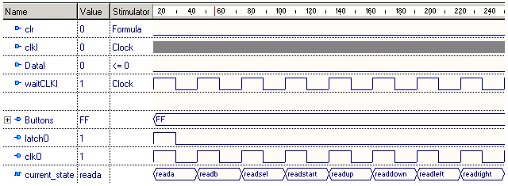
NES Controller
Uses a 4021N analog IC to produce a synchronous serial signal.
Using the 4021N datasheet, the waveform was determined. The NES controller VHDL was modelled using the waveform.

Slide 11
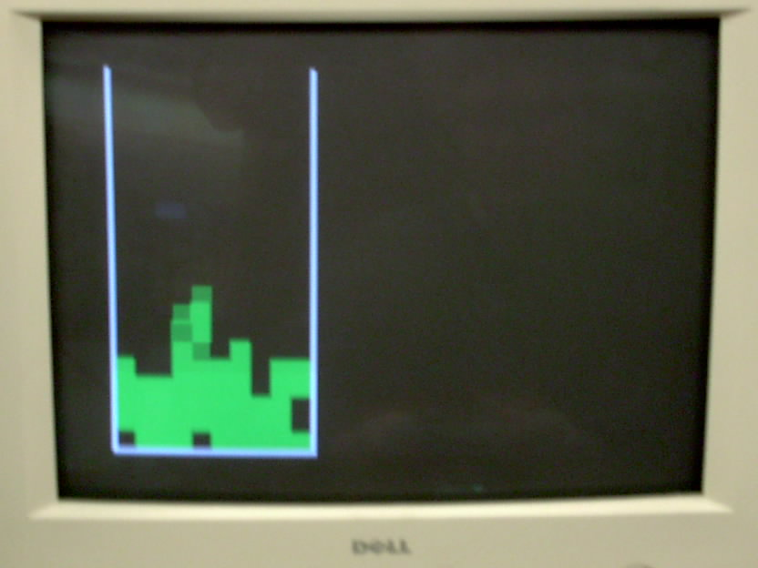
Holy Tetris Action WHYPman!

Slide 12
~ FIN ~

