Slide 1
Why Are There Waves in the Time-Mean Flow?
TELLY ATMOSPHERIC TELECONNECTION MODEL
From ERA5 observations, to simple equations, to the Telly model
[Presenter name] · [Course] · [Date]

Slide 2
Roadmap
OVERVIEW
1
2
3
4
5
Observe
Understand
Telly
Experiments
Results
What does the time-mean atmosphere look like?
Why? Simple equations from class
From the class equations to a model
Three forcings switched on one at a time
What each forcing does to the pattern
Telly · stationary Rossby waves
‹#›

Slide 3
Observations
PART 1
What does the time-mean atmosphere look like?

Slide 4
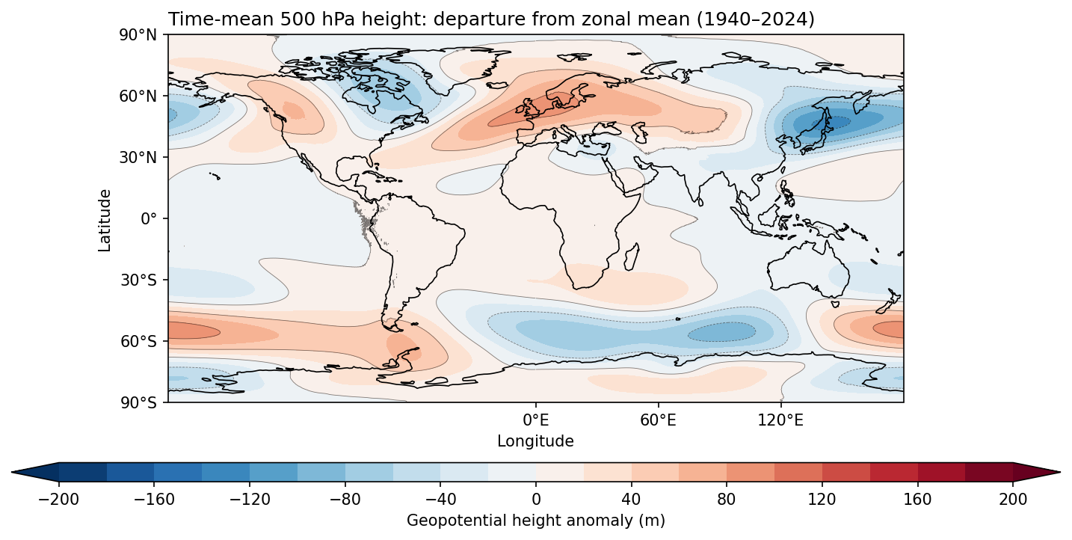
ERA5: Time-Mean 500 hPa Height
PART 1 · OBSERVATIONS
What do you see?
The zonal mean has been removed: a zonally symmetric atmosphere would give a blank map
Highs and lows of 100 m or more remain
They stay at the same places in the time mean
ERA5 daily 500 hPa height, 1940–2024: the time mean minus its zonal mean (class notebook)
Telly · stationary Rossby waves
‹#›

Slide 5
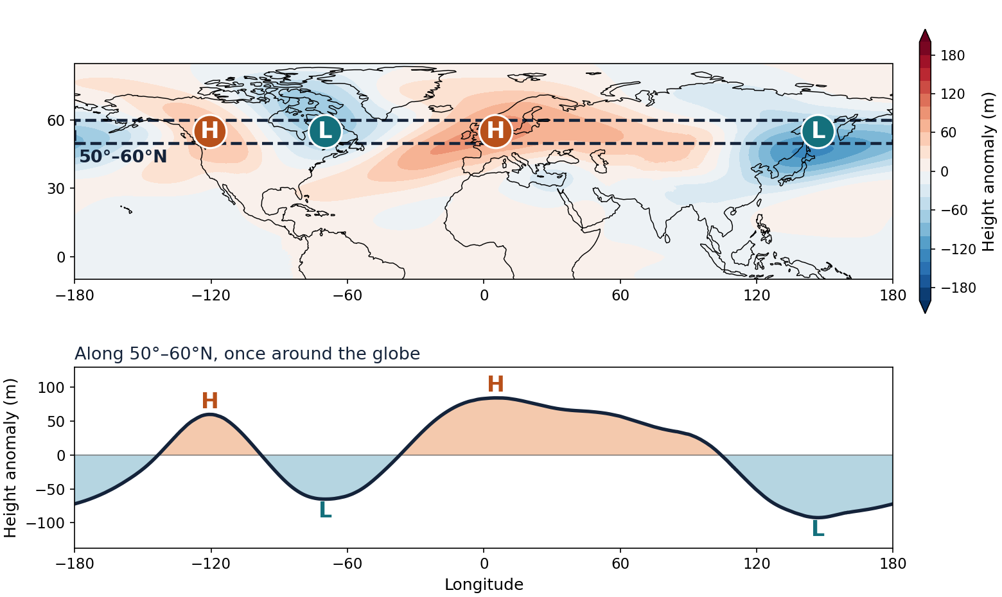
How Many Waves Fit Around the Globe?
PART 1 · OBSERVATIONS
Count the highs and lows
Follow the dashed band once around the globe: 2 highs (H) and 2 lows (L).
So about 2 waves
Their sizes and spacing are uneven, so waves 1 and 3 are present too.
IN WAVENUMBERS
2 waves around 55°N is a wavelength of about 11,500 km: k ≈ 5 × 10⁻⁷ per metre.
ERA5 daily 500 hPa height, 1940–2024: time mean minus zonal mean
Telly · stationary Rossby waves
‹#›

Slide 6
Why is the time-mean atmosphere not the same at every longitude?
A QUESTION FOR THE CLASS
We will look for the answer with a hierarchy of models: simple equations first, then Telly.
Telly · stationary Rossby waves

Slide 7
Simple Equations
PART 2
Understanding it with the equations from class

Slide 8
Splitting the Flow
PART 2 · SIMPLE EQUATIONS
u = ū + u* + u′
v = v̄ + v* + v′
ū
u*
u′
Zonal mean
Stationary wave
Transient eddies
The average around a latitude circle: the same at every longitude.
The part that stays put: the waves in the ERA5 map.
Day-to-day weather that comes and goes.
η = ζ + f is the absolute vorticity; on the β-plane, f = f₀ + βy.
Telly · stationary Rossby waves
‹#›

Slide 9
Vorticity of the Stationary Wave
PART 2 · SIMPLE EQUATIONS
∂ζ*/∂t + ū ∂ζ*/∂x + β v* = 0
Reading the terms
What we assumed
∂ζ*/∂t: how the wave’s vorticity changes
ū ∂ζ*/∂x: carried eastward by the mean wind
β v*: changes as air moves north or south, where the planet’s own vorticity is different
The waves are small, so products of wave terms are dropped
Day-to-day weather is ignored
The flow is nearly non-divergent
Telly · stationary Rossby waves
‹#›

Slide 10
Streamfunction and the Wave Equation
PART 2 · SIMPLE EQUATIONS
1 · Define a streamfunction
STATIONARY DOES NOT MEAN NO MOTION
u* = −∂ψ*/∂y, v* = ∂ψ*/∂x, ζ* = ∇²ψ*
2 · Substitute into the vorticity equation
Air still flows through the pattern at speed ū. The pattern stays put because westward wave propagation, β/K², cancels the eastward flow.
(∂/∂t + ū ∂/∂x) ∇²ψ* + β ∂ψ*/∂x = 0
3 · Try a wave, and find its frequency and phase speed
ψ* = A e^{i(kx + ly − ωt)}
ω = ūk − βk/K², c = ω/k = ū − β/K²
4 · Which waves can stand still? Set c = 0
EXAMPLE
k² + l² = Ks² = β/ū
ū = 20 m/s at 45°N gives Ks ≈ 9 × 10⁻⁷ per metre. Two waves around the globe use k ≈ 4 × 10⁻⁷, which leaves l ≈ 8 × 10⁻⁷.
Only east–west (k) and north–south (l) wavenumbers that satisfy this stay put. Ks (s for stationary) is the total wavenumber of a stationary wave.
Here ω is the wave frequency, K² = k² + l², and β = 2Ω cos φ / a
Telly · stationary Rossby waves
‹#›

Slide 11
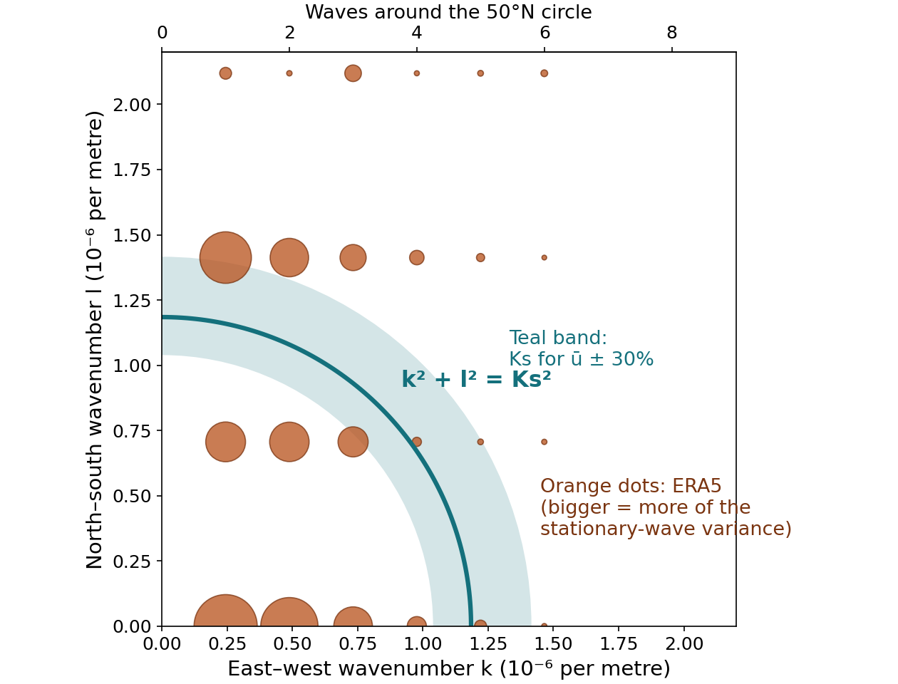
Do the ERA5 Waves Fit?
PART 2 · SIMPLE EQUATIONS
1 · Measure k and l in ERA5
Split the 500 hPa pattern between 30°N and 70°N into waves around the globe (k) and waves from south to north (l).
2 · Draw the stationary circle
With the observed ū ≈ 10 m/s, k² + l² = β/ū is a circle with Ks ≈ 1.2 × 10⁻⁶ per metre.
WHAT WE FIND
Almost all of the pattern is 1 to 3 waves around the globe, with one or two half-waves from south to north. About 60% of it lies within 50% of the circle. The rest is larger scale.
ERA5 1991–2020 time mean; 30°N–70°N; ū is the 500 hPa zonal-mean wind
Telly · stationary Rossby waves
‹#›

Slide 12
Adding a Source
PART 2 · SIMPLE EQUATIONS
∂ζ*/∂t + ū ∂ζ*/∂x + β v* = S
S is a push on the wave: anything that squeezes or stretches columns of air, and so changes their spin.
Air forced over a slope
Heating that lifts air
Land–sea contrast
A column pushed up a mountain is squeezed, which changes its spin.
Columns are stretched below the heating and squeezed above it.
Land and ocean warm differently: like heating over one and cooling over the other.
ψ* = S / [ik(β − ūK²)]
The steady response is strongest when the size of the push matches Ks, the stationary wavenumber from the last slide: Ks = √(β/ū), where c = 0.
Telly · stationary Rossby waves
‹#›

Slide 13
Heat, Pressure and Air Motion
PART 2 · SIMPLE EQUATIONS
Temperature
∂T/∂t + u ∂T/∂x + v ∂T/∂y + ω ∂T/∂p = Q/cp
The wind carries temperature; heating Q warms the air. There is no compression term yet.
Hydrostatic
∂Φ/∂p = −RT/p
Temperature sets how far apart the pressure surfaces are.
Continuity
∂u/∂x + ∂v/∂y + ∂ω/∂p = 0
Air that converges sideways must move vertically.
Telly · stationary Rossby waves
‹#›

Slide 14
What Is in Q?
PART 2 · SIMPLE EQUATIONS
Q = Qrad + Qlatent + Qsurface
Process | What it is | In Telly
Radiation | Sunlight absorbed, infrared emitted: warms the tropics, cools the poles | Not computed; the pull toward the background temperature stands in for it
Latent heating | Heat released when water vapor condenses into rain | Prescribed from observed rainfall: the Q/cp term
Surface heating | Warm land or ocean heats the air above it by mixing | Not computed; carried by the background temperature (the land–sea contrast)
So far we have thought of Q as radiative heating. In Telly, Q is the latent heating only.
Telly has no solar heating or outgoing longwave radiation, so no energy balance: the equator-to-pole temperature contrast is imposed by the background state, not produced.
Telly · stationary Rossby waves
‹#›

Slide 15
Telly
PART 3
From the class equations to a model

Slide 16
Where Telly Fits
PART 3 · TELLY
OBSERVATIONS
CLASS
TODAY
Real atmosphere
Simple equations
Telly
Everything acts at once, so the causes are hard to separate.
Easy to understand, but many things are dropped.
Keeps the main physics, and each forcing can be switched on or off.
Each step answers a different question: what do we see, why does it happen, and how much does each cause matter?
Telly · stationary Rossby waves
‹#›

Slide 17
What Telly Is
PART 3 · TELLY
Property | Description
The physics | The class equations for motion, heat and mass, without the simplifications
The grid | Boxes about 2° wide (about 200 km), in 26 layers up to about 2 hPa
What it tracks | Vorticity, divergence, temperature and surface pressure
Simple stand-ins | Friction, smoothing, a pull toward a background state, and heating from prescribed rainfall patterns
Left out | Detailed treatment of radiation, clouds, the boundary layer and the land surface
Telly · Kirtman et al. (2025), Bull. Amer. Meteor. Soc., 106, E2073–E2086
Telly · stationary Rossby waves
‹#›

Slide 18
Model Anatomy
PART 3 · TELLY
Heating, Q
What the model tracks
Daily output
Rainfall with a prescribed pattern warms the air
ζ, D, T, ln ps
Winds, temperature, height, heating and surface pressure, every day, in 30-day files
Topography, Φs
Ground height sets the bottom of the atmosphere
Background state
Friction and smoothing keep it stable
Average winds and temperatures the model is gently pulled toward
Telly · stationary Rossby waves
‹#›

Slide 19
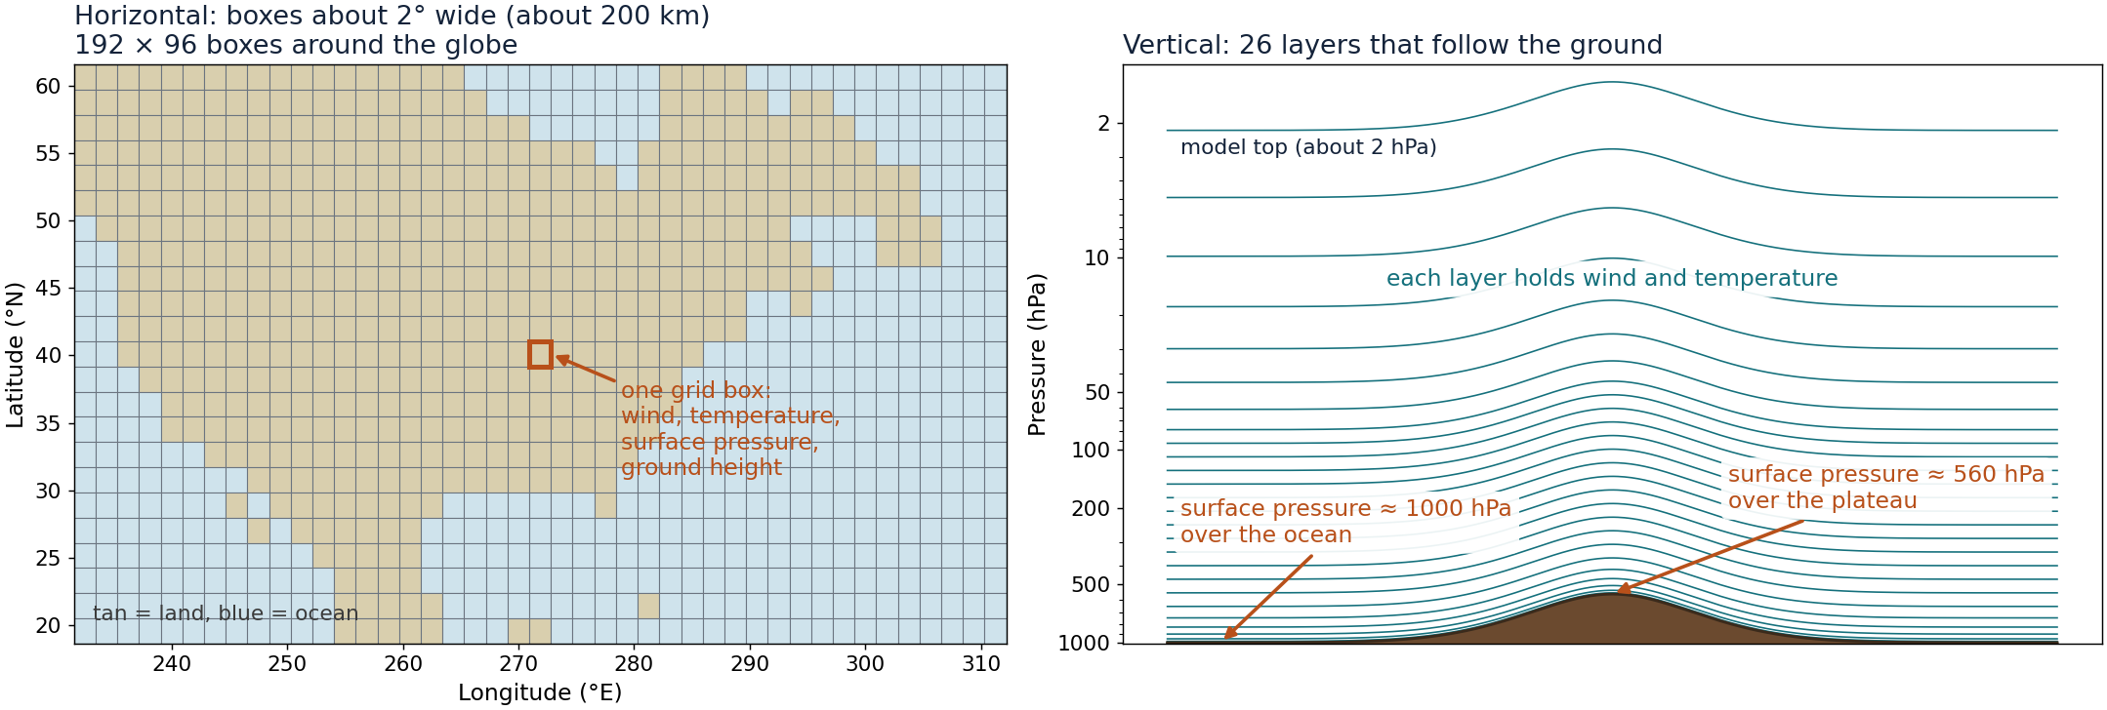
The Model Grid
PART 3 · TELLY
About 480,000 boxes in all: 192 × 96 around the globe, in 26 layers.
Telly · stationary Rossby waves
‹#›

Slide 20
Step 1: Keep the Whole Flow
PART 3 · FROM CLASS TO TELLY
CLASS
TELLY
∂ζ*/∂t + ū ∂ζ*/∂x + β v* = 0
∂ζ/∂t + u ∂ζ/∂x + v ∂ζ/∂y + β v = …
No split into ū, u*, u′: the model follows the total wind, so waves and weather act on each other
No small-wave assumption: every advection term is kept
The Earth is a sphere: f = 2Ω sin φ replaces f₀ + βy
The stationary wave is found afterwards: the time mean minus the zonal mean
Telly · stationary Rossby waves
‹#›

Slide 21
Step 2: Let Columns Stretch
PART 3 · FROM CLASS TO TELLY
∂ζ/∂t + V·∇ζ + β v = −(ζ + f) D
D = ∂u/∂x + ∂v/∂y is the divergence of the wind.
Class: the flow is nearly non-divergent, so this term is dropped
Telly keeps it: converging air stretches a column and spins it up; diverging air squeezes it
Mountains and heating act through D, so this is where the source S of the class equation appears in Telly
−∇·(ηV) = −V·∇ζ − β v − (ζ + f) D
Telly computes all three terms at once, as one quantity: −∇·(ηV).
Telly · stationary Rossby waves
‹#›

Slide 22
Step 3: Add Compression
PART 3 · FROM CLASS TO TELLY
Why: air that moves up or down changes pressure, and that changes its temperature even with no heating.
1 · First law for a moving air parcel
WHAT IT MEANS
cp DT/Dt − αω = Q
Rising air (ω < 0) expands and cools. Sinking air (ω > 0) is compressed and warms.
The class term ω ∂T/∂p only carries temperature up or down. It has no expansion or compression in it.
At 500 hPa, ∂T/∂p ≈ 0.095 K/hPa but κT/p ≈ 0.14 K/hPa: leaving compression out gets the vertical response wrong by a factor of 2.
2 · Use the ideal gas law, α = RT/p
DT/Dt = κTω/p + Q/cp, κ = R/cp
3 · Write out DT/Dt
∂T/∂t + u ∂T/∂x + v ∂T/∂y + ω ∂T/∂p − κTω/p = Q/cp
Typical values: T = 250 K, lapse rate 6.5 K/km
Telly · stationary Rossby waves
‹#›

Slide 23
Step 4: Stack Layers
PART 3 · FROM CLASS TO TELLY
Φ = Φs + R ∫ T d(ln p)
∂u/∂x + ∂v/∂y + ∂ω/∂p = 0
Hydrostatic
Continuity
All layers at once
The temperatures of all 26 layers give the height of every pressure surface. The ground height Φs is the bottom of the sum: this is where mountains enter.
Convergence in each layer gives the vertical motion ω between layers.
Each layer has its own wind, temperature and ω. The terms ω ∂T/∂p and compression link neighboring layers.
Telly · stationary Rossby waves
‹#›

Slide 24
Step 5: Simple Damping
PART 3 · FROM CLASS TO TELLY
Friction, smoothing and a gentle pull toward a background state keep the model realistic and stable.
What it does | Written as | How fast
Pulls temperature and surface pressure toward the background state | −(T − Tref)/τ | 40 days
Friction: pulls vorticity and divergence toward the background state | −(ζ − ζref)/τ | 150 days
Smooths the smallest scales | diffusion | 21 to 28 hours
The pull is faster for the zonal mean (7 days) and for the lowest two layers (2 to 3 days).
The background state is a choice, and our experiments change it.
Telly · stationary Rossby waves
‹#›

Slide 25
Telly: Vorticity and Divergence
PART 3 · TELLY
∂ζ/∂t = −∇·(ηV) − R k·(∇T × ∇ln ps) − (ζ − ζref)/τ + smoothing
∂D/∂t = k·∇×(ηV) − ∇²(Φ + ½V·V) − R ∇·(T ∇ln ps) − (D − Dref)/τ + smoothing
■ from class ■ added in Telly ■ forcing
The first term is steps 1 and 2 together. Divergence D now has its own equation: it is how Telly follows columns stretching and squeezing.
The height Φ includes the ground height Φs, so terrain pushes on D.
Some vertical terms are left out of this view
Telly · stationary Rossby waves
‹#›

Slide 26
Telly: Temperature and Pressure
PART 3 · TELLY
∂T/∂t = −V·∇T − ω ∂T/∂p + κTω/p + Q/cp − (T − Tref)/τ + smoothing
∂(ln ps)/∂t = −V·∇(ln ps) − (sum of D over all layers) − (ln ps − ln psref)/τ
Φ = Φs + R ∫ T d(ln p)
■ from class ■ added in Telly ■ forcing
The temperature equation is the class equation plus compression, a pull toward the background state and smoothing.
Surface pressure is new: it changes where columns converge or diverge.
Telly writes the advection terms in an equivalent form
Telly · stationary Rossby waves
‹#›

Slide 27
Where the Forcings Enter
PART 3 · TELLY
Mountains
Land–sea contrast
Diabatic heating
Φs
−(T − Tref)/τ
Q/cp
Ground height is the bottom of the height sum, so it pushes on the divergence
Land and ocean are pulled toward different background temperatures, like heating and cooling
Rainfall heating in the temperature equation
Each one is a kind of source S from the class equation.
Telly · stationary Rossby waves
‹#›

Slide 28
Heating from Observed Rainfall Patterns
PART 3 · TELLY
P ~ Gamma(k, θ)
Q/cp = β · exp(−φ²/1000) · P · s
Vertical profile s, top of the model to the ground
The pattern is prescribed: k and θ are fitted to daily satellite rainfall at every location and day of the year, so the average rain, kθ, follows the observed pattern
Only the day-to-day amount varies: each day’s rain is drawn around that average, with a spread set by k and θ
The rain does not respond to the model’s own weather
The factor exp(−φ²/1000), with latitude φ in degrees, confines heating to the tropics; β turns rain into heating and s spreads it in the vertical
Peaks in the middle of the troposphere; scaled so it adds up to 1.
Telly · stationary Rossby waves
‹#›

Slide 29
How the Model Runs
PART 3 · TELLY
2°
26
4 min
1 day
Grid boxes about 200 km wide
Layers in the vertical
Time step: the equations are advanced every 4 minutes
of computer time for a 5-year run
At each step the model works out how the wind, temperature and pressure change, using the equations from the last few slides
A 5-year run is about 600,000 steps
Rainfall varies from day to day, so we average over years to see the stationary waves
Telly · stationary Rossby waves
‹#›

Slide 30
What Goes In
PART 3 · TELLY
Input | What it describes | Where it comes from
Ground height | The height of the terrain at each point | A gridded topography data set
Surface pressure | Average surface pressure for each day of the year | NCEP reanalysis, 1994–2024
Winds and temperature | Average through the year in every layer: the background state | NCEP reanalysis, 1994–2024
Starting temperature | Where the model begins | NCEP plus a typical decrease with height
Rainfall statistics | How much it rains each day, and how variable it is | Fit to daily satellite rainfall
Land–sea map | The fraction of land in each grid box | ERA5 land–sea mask
Monthly averages are interpolated to every day of the year. These inputs are prepared once and reused by every run.
Telly · stationary Rossby waves
‹#›

Slide 31
The average state the model is pulled toward already contains the observed stationary waves.
WHY THE BACKGROUND STATE MATTERS
A run that keeps the observed background state is pulled toward the answer. These experiments use a background state that is the same at every longitude, and add each forcing separately.
Telly · stationary Rossby waves

Slide 32
Running an Experiment
PART 3 · TELLY
1
2
3
4
Prepare inputs
Run the model
Convert
Make maps
Put the data on the model grid
Step the equations forward in time
Interpolate to standard pressure levels
Time means and differences
ONE SETTINGS FILE PER EXPERIMENT
Inputs are prepared once and reused by every run
Output is saved in 30-day files, so a run can be extended
Each step can be run on its own
Mountains: real
Land–sea contrast: on
Heating: observed
Length: 5 years
Telly · stationary Rossby waves
‹#›

Slide 33
What Comes Out
PART 3 · TELLY
Output | Contents | Step
Daily model fields | Winds, temperature, height, heating and surface pressure in every layer, one file per 30 days | 2
Saved state | Lets a run be continued where it stopped | 2
Pressure-level fields | Winds, temperature and height at 850, 500, 300 and 200 hPa | 3
Figures | Time-mean maps and differences from a control run | 4
61
≈ 0.5 GB
30-day files make up a 5-year run
per file, about 33 GB for 5 years
Telly · stationary Rossby waves
‹#›

Slide 34
Experiments
PART 4
Three forcings switched on one at a time

Slide 35
Three Forcings, Each On or Off
PART 4 · EXPERIMENTS
Forcing | Off | On | What it changes
Mountains | Flat: ground height set to zero | Real topography | The ground under the air
Land–sea contrast | Background temperature the same at every longitude | Observed land–ocean temperature differences added | The background temperature
Diabatic heating | Rainfall the same at every longitude | Observed rainfall | The latent heating, Q/cp
Each switch changes only its own part of the model. The next three slides show what each one looks like.
Telly · stationary Rossby waves
‹#›

Slide 36
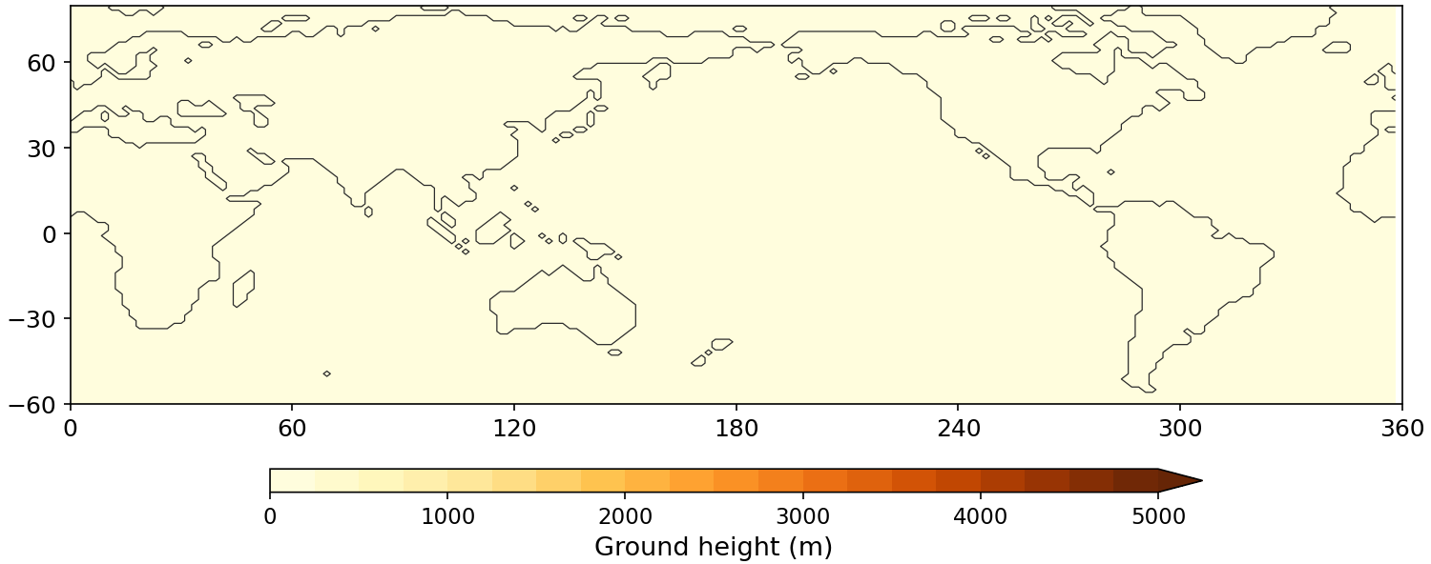
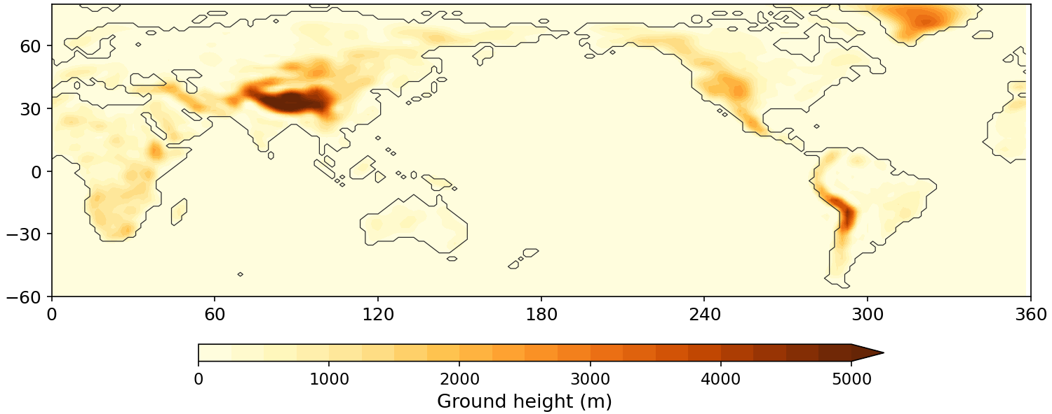
Mountains: Off and On
PART 4 · EXPERIMENTS · FORCING 1 OF 3
Off: flat ground
On: real ground height
Ground height is zero at every point: no Himalayas, Rockies or Andes. The wind meets no slopes.
Real terrain, with surface pressure lowered to match (about 560 hPa over Tibet, not 1010).
What it changes: The ground under the air. Air forced over a slope stretches and squeezes columns of air: a source S for waves.
Telly · stationary Rossby waves
‹#›

Slide 37
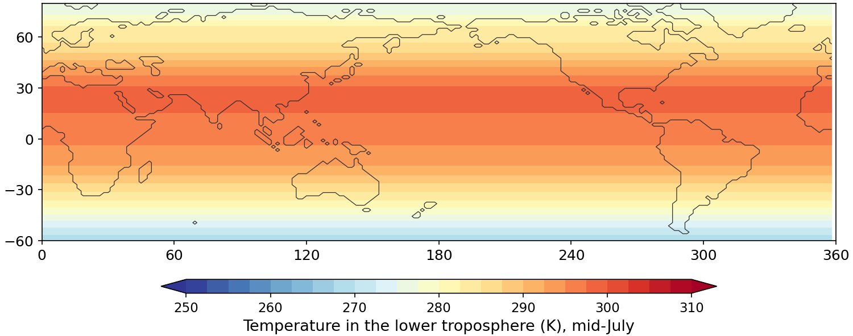
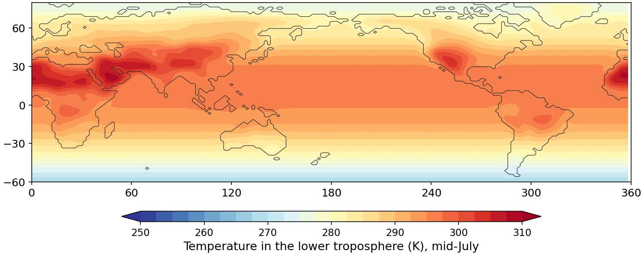
Land–Sea Contrast: Off and On
PART 4 · EXPERIMENTS · FORCING 2 OF 3
Off: same at every longitude
On: land differs from ocean
The background temperature depends on latitude only: warm tropics, cold poles.
Observed land departures added over land only. The zonal average is unchanged.
What it changes: The background temperature the model is pulled toward. Warm or cool land acts like a heating or cooling pattern.
Telly · stationary Rossby waves
‹#›

Slide 38
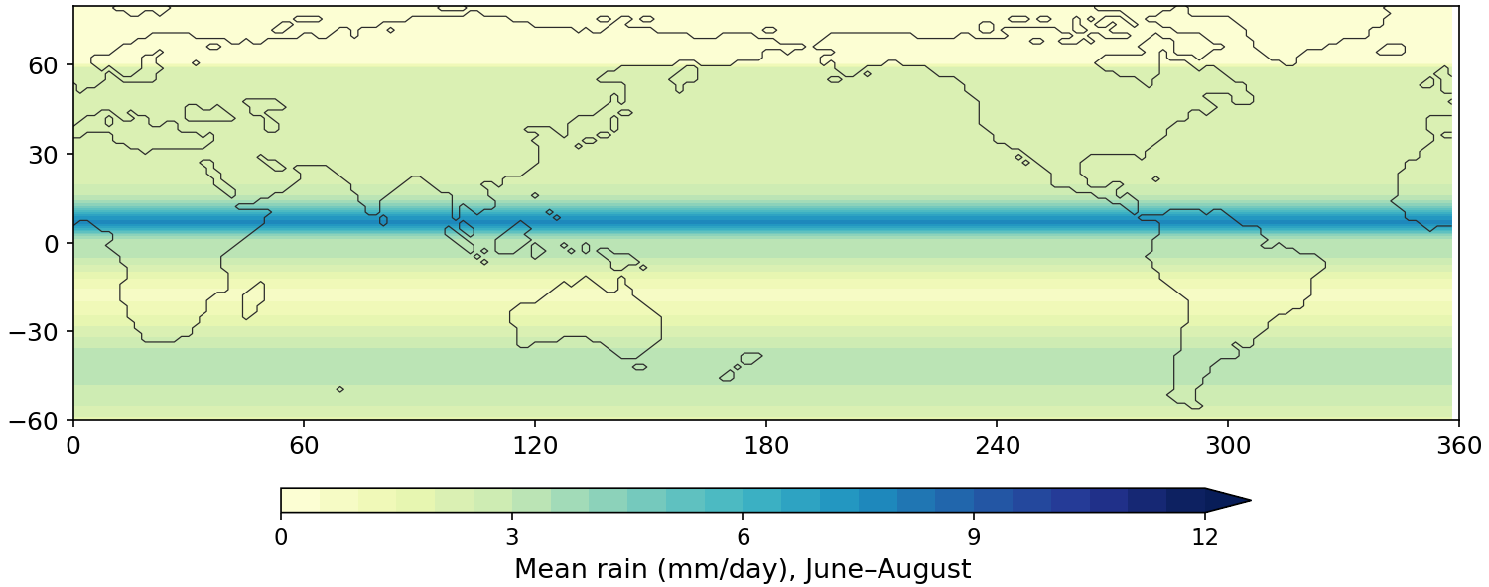
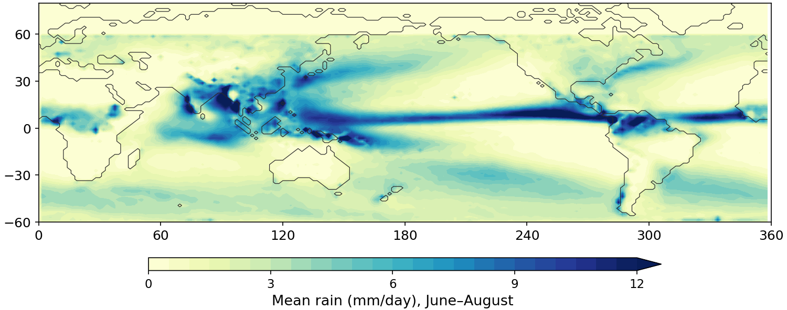
Diabatic Heating: Off and On
PART 4 · EXPERIMENTS · FORCING 3 OF 3
Off: rain the same at every longitude
On: observed rainfall
The same average rain all the way around each latitude circle: one tropical band.
Rain falls where it really does: the Indian Ocean, western Pacific, and the Americas.
What it changes: Where latent heat is released. Heating in some places and not others pushes on the waves.
Telly · stationary Rossby waves
‹#›

Slide 39
The Five Experiments
PART 4 · EXPERIMENTS
Run | Mountains | Land–sea | Heating | What it shows
Baseline | off | off | off | No longitude-dependent forcing at all
Mountains only | ON | off | off | The effect of mountains
Land–sea only | off | ON | off | The effect of land–sea contrast
Heating only | off | off | ON | The effect of diabatic heating
All three | ON | ON | ON | The full idealized model: the reference
Run names: AC_SW_base, _mtn, _landsea, _heat and _all. For comparison, AC_Test is the same model run with the observed background state.
Telly · stationary Rossby waves
‹#›

Slide 40
Reading the Results
PART 4 · EXPERIMENTS
Stationary eddy
z* = z − [z]
Response to a forcing
z*(run) − z*(base)
Nonlinearity
all − mtn − landsea − heat + 2·base
[z] is the zonal mean; the maps show 500 hPa height, averaged over a season, like the ERA5 map
The first months of each run are discarded while the model settles
Each difference map shows what one forcing does on its own
Telly · stationary Rossby waves
‹#›

Slide 41
Results
PART 5
What each forcing does to the wave pattern
Preliminary: about four model years of the five-year runs, winter and summer

Slide 42
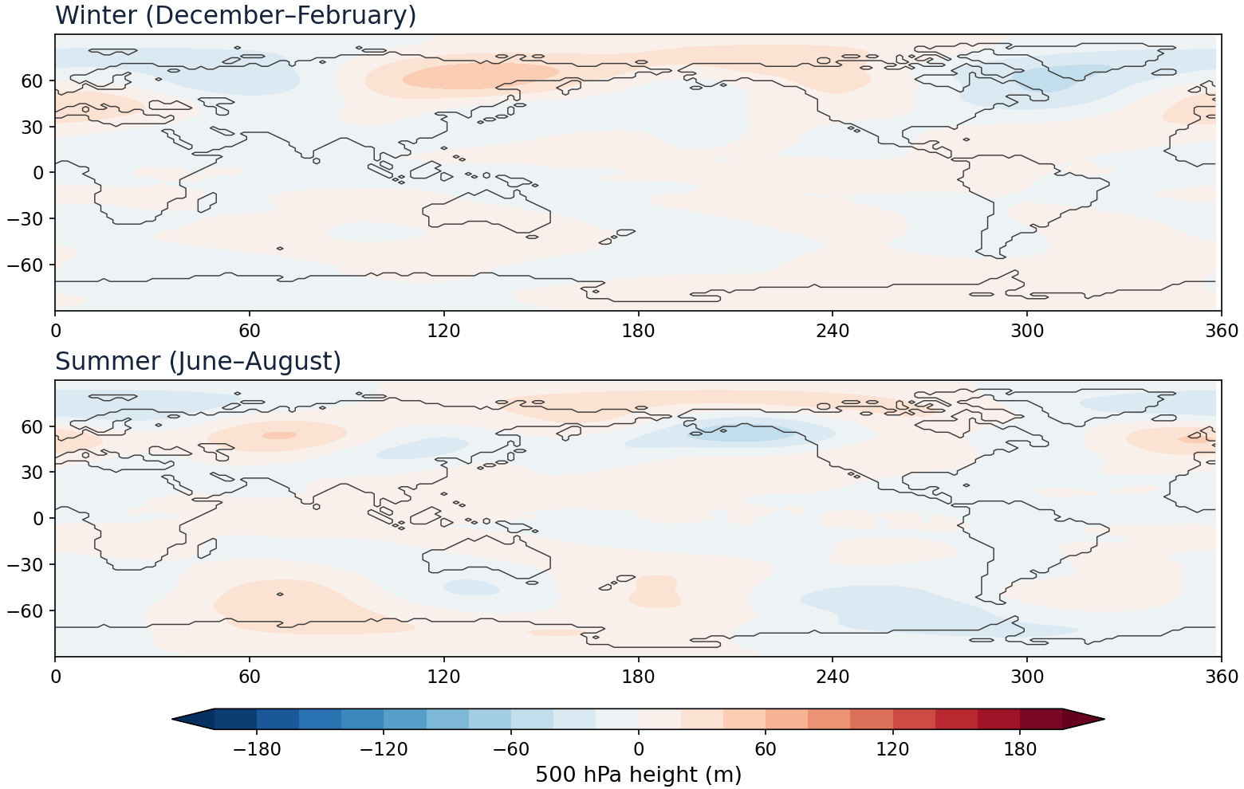
Baseline: No Zonal Asymmetry
PART 5 · RESULTS · PRELIMINARY
What to look for
Is z* close to zero?
How big is the leftover pattern?
What we see so far
Very weak leftover patterns in both seasons
Day-to-day rainfall leaves small random wiggles
This is the starting point for every other panel
Preliminary: about 3.75 years after spin-up; winter and summer; 500 hPa height; runs still in progress
Telly · stationary Rossby waves
‹#›

Slide 43
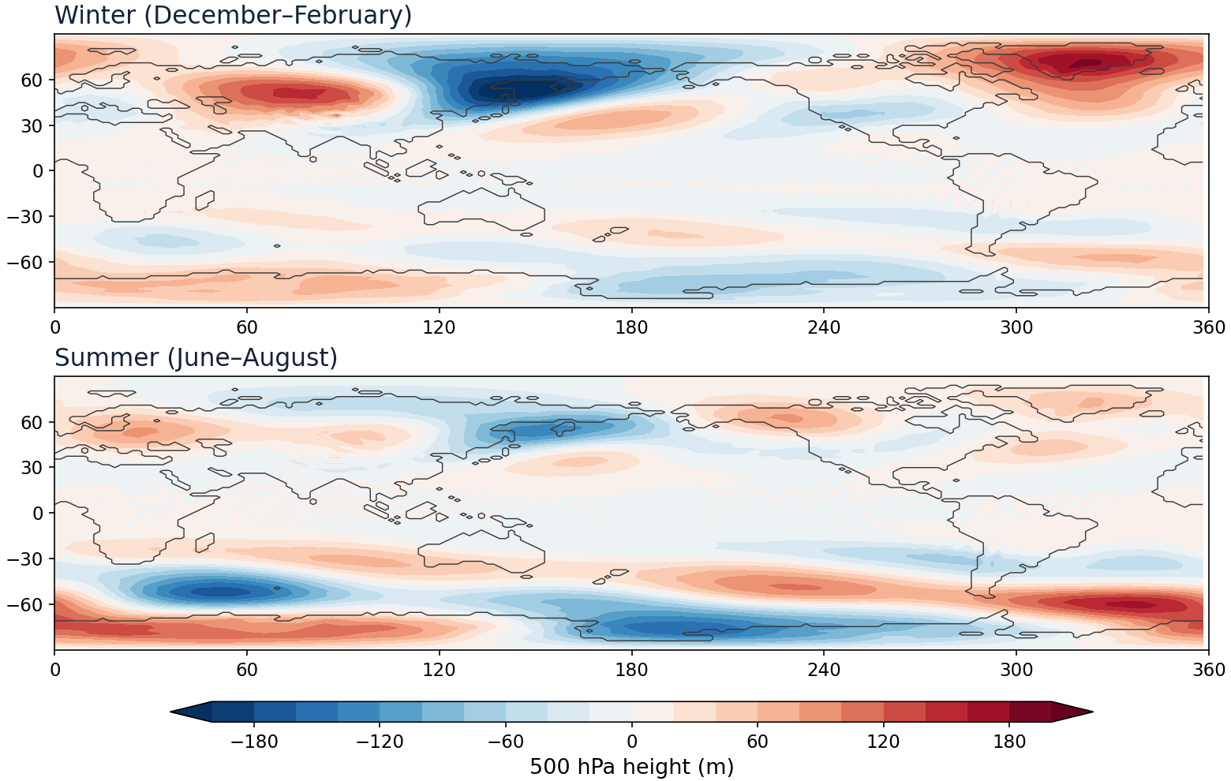
Mountains Alone
PART 5 · RESULTS · PRELIMINARY
What to look for
A wave train downstream of the Rockies and the Tibetan Plateau?
Is the response stronger in winter than in summer?
What we see so far
Winter: a deep low over northeast Asia, with highs over central Asia and Greenland
Summer: weaker in the north; the largest features are around Antarctica
The strongest of the three forcings in both seasons
Preliminary: about 3.75 years after spin-up; winter and summer; 500 hPa height; runs still in progress
Telly · stationary Rossby waves
‹#›

Slide 44
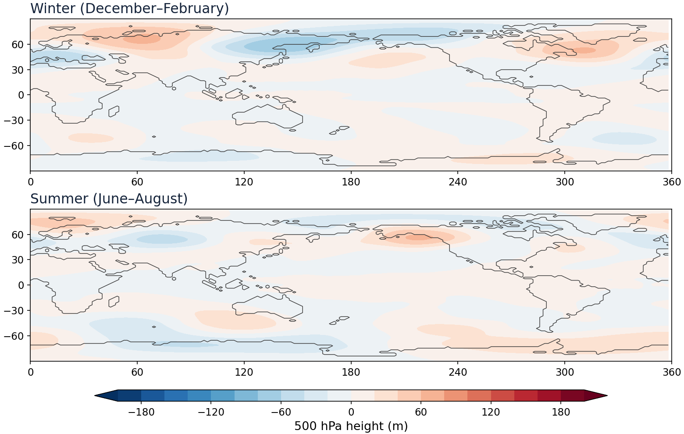
Land–Sea Contrast Alone
PART 5 · RESULTS · PRELIMINARY
What to look for
Is it larger or smaller than the mountain response?
Are its centres over the continents or the oceans?
What we see so far
Winter: weak highs and lows over the North Pacific and Asia
Summer: very weak
Much weaker than the mountain response
Preliminary: about 3.75 years after spin-up; winter and summer; 500 hPa height; runs still in progress
Telly · stationary Rossby waves
‹#›

Slide 45
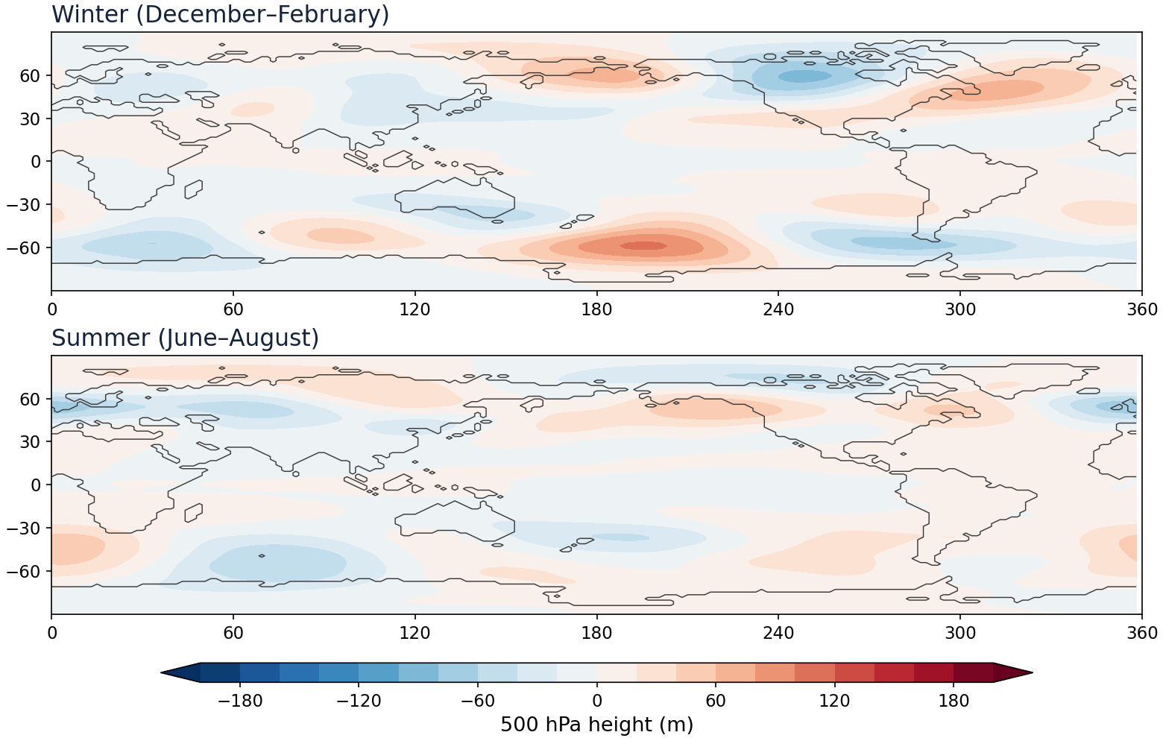
Diabatic Heating Alone
PART 5 · RESULTS · PRELIMINARY
What to look for
A response near the tropical rain regions?
Do wave trains extend into the extratropics?
What we see so far
Winter: a weak wave train from the North Pacific to North America
Summer: very weak
Much weaker than the mountain response
Preliminary: about 3.75 years after spin-up; winter and summer; 500 hPa height; runs still in progress
Telly · stationary Rossby waves
‹#›

Slide 46
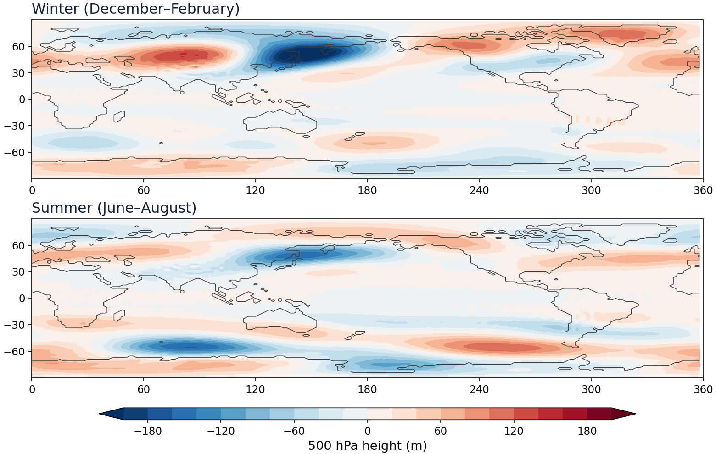
All Three Together
PART 5 · RESULTS · PRELIMINARY
What to look for
Does it look like the ERA5 map?
Which features are missing, and why?
What we see so far
Winter: a deep low over northeast Asia and a high over central Asia, as in ERA5
Summer: weaker in the north, strong around Antarctica
Almost the same as the observed-background run (correlation 0.96 in each season)
Preliminary: about 3.75 years after spin-up; winter and summer; 500 hPa height; runs still in progress
Telly · stationary Rossby waves
‹#›

Slide 47
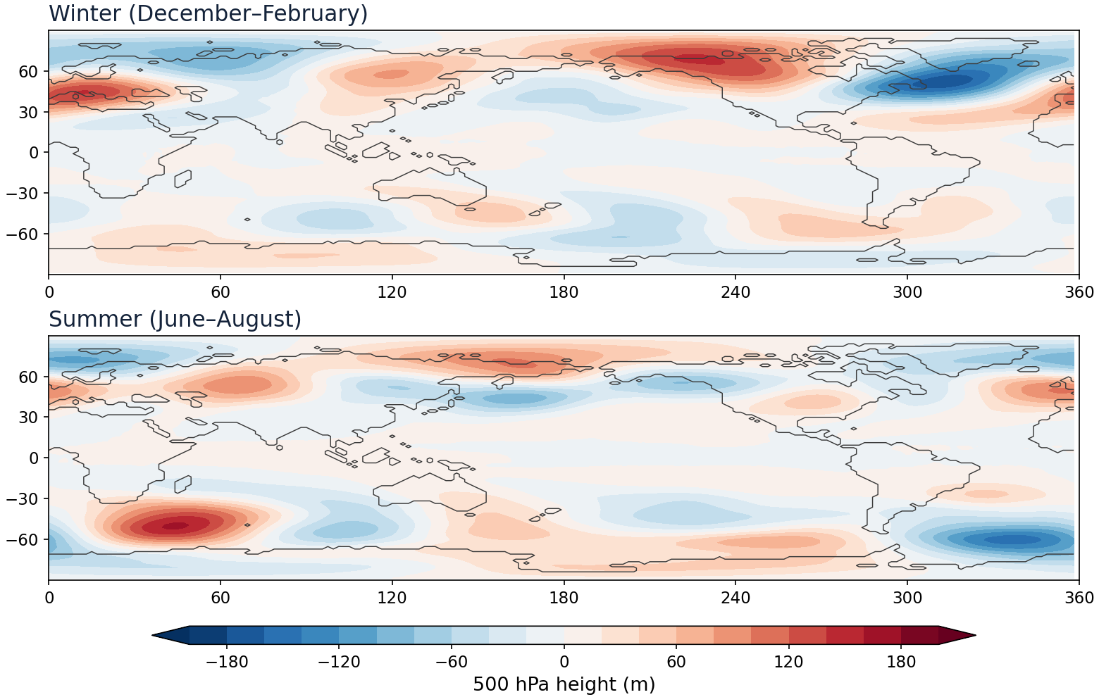
Is the Whole the Sum of the Parts?
PART 5 · RESULTS · PRELIMINARY
What to look for
Where does the combined response differ from the sum of the three?
Is that difference small compared with each single response?
What we see so far
The combined response differs from the sum of the three
Large in northern winter over the North Atlantic, Arctic and North Pacific
Mountains plus heating and land–sea do not simply add
Preliminary: about 3.75 years after spin-up; winter and summer; 500 hPa height; runs still in progress
Telly · stationary Rossby waves
‹#›

Slide 48
Discussion
WRAP-UP
1
Which forcing dominates the pattern at 500 hPa in winter, and which in summer?
2
Why must the surface pressure be placed on the terrain before mountains can be added?
3
How would you change the experiments to isolate ocean-only asymmetries such as the warm pool?
Telly · stationary Rossby waves
‹#›

Slide 49
References and Code
APPENDIX
Model paper
Run it yourself
Kirtman, B. P., and coauthors, 2025: A simplified-physics atmosphere general circulation model for idealized climate dynamics studies. Bull. Amer. Meteor. Soc., 106, E2073–E2086.
github.com/ou-esplab/Telly
config/experiments/AC_SW_*.yaml
scripts/stationary_waves.py
EXPERIMENTS.md
Original model: github.com/jsb288/Atmospheric-Teleconnection-Model
doi.org/10.1175/BAMS-D-24-0196.1
Telly · stationary Rossby waves
‹#›

