Slide 1
Time Series Forecasting with Generative AI
2025-01

Slide 2
Agenda
Resources used
Introduction and intuition
Popular time series transformers
TimeGPT in Nixtla
Introduction
Model architecture
Training of the model
Benefits of using the pre-trained model
Examples of comparison with traditional models
No fine tuning (zero-shot)
With fine tuning
Code snippet
Additional info: default model vs. long horizon forecast model

Slide 3
Resources
https://www.databricks.com/blog/introduction-time-series-forecasting-generative-ai
Some general introduction to generative time series models on Databricks
https://medium.com/@andrepedrinho/from-arima-to-timegpt-a-new-era-in-time-series-prediction-part-i-f65602fead04
A medium article on TimeGPT, part 1
https://medium.com/@andrepedrinho/from-arima-to-timegpt-a-new-era-in-time-series-prediction-part-ii-136ff41ca40a
A medium article on TimeGPT, part 2
https://nixtlaverse.nixtla.io/nixtla/docs/getting-started/introduction.html
Nixtla documentation

Slide 4
Introduction and Intuition
Similar to large language models, time series transformers predict the next value in a numerical sequence.
With exposure to large volumes of time series data, these models become experts.
Intuition: the complex model architecture is very good at picking up on the complex relationships between values in long sequences.
After it has had the opportunity to train on millions if not billions of time series values, it learns the complex patterns of relationships found in these datasets.
When it is then exposed to a previously unseen time series, it can use this foundational knowledge to identify where similar patterns of relationships within the time series exist and predict new values in the sequence.

Slide 5
Introduction and Intuition
Internal scaling in the model deals with different time series with different scales in values.
Self-attention in transformer architecture deals with detecting seasonality through the tokenization process.
How tokenization is done may be important to understand whether a model is appropriate for your data.
Time series transformers employ a variety of approaches to provide limited support for external variables.
Some models are trained on both time series data and related external variables.
Others are architected to understand that a single times series may be composed of multiple, parallel, related sequences.

Slide 6
Popular Time Series Transformers
Chronos: a family of open source models from Amazon, free to use
TimesFM: an open source model from Google, free to use
Moirai: a family of open source models from Salesforce, free to use
TimeGPT: a proprietary model from Nixtla, charge by tokens or by subscription
There are more models, and more to come…
Some allow missing data, some don’t.
Some can handle exogenous variables, some don’t.
Many perform best on GPU, due to deep learning neural network nature.

Slide 7
TimeGPT in Nixtla: Introduction
Model is pre-trained through a comprehensive training process to capture patterns across multiple domains.
It can produce reliable forecasts without task-specific fine-tuning
Fine-tuning may be crucial for improving the performance
finetune_steps: refers to the number of iterations used to adjust the model
finetune_depth: determines the amount of modified parameters during fine-tuning. takes values between 1 and 5: 1 small set of model’s parameters are being adjusted, 5 will fine-tune the maximum amount of parameters.
Usage fees are based on usage consumption (token based). Also has a flat fee pricing structure with subscription. Free plan available (50 API calls/month).

Slide 8
TimeGPT architecture
Positional Encoding: TimeGPT uses positional encoding at the start to keep the order of each data point. This helps the model accurately understand the sequence and timing of the data points.
Encoder-Decoder Structure with Self-Attention: Once encoded, TimeGPT applies an encoder-decoder structure built by multiple layers, each equipped with residual connections and layer normalization. The encoder processes the encoded data through self-attention layers to capture short-term fluctuations and long-term trends, while the decoder refines this information to generate predictions. This layered structure is essential for identifying complex patterns and dependencies within time series data.
Linear Projection Layer: Finally, the decoder’s output is mapped to the forecasting window dimensions through a linear projection layer, producing the final forecasted values based on the learned patterns.

Slide 9
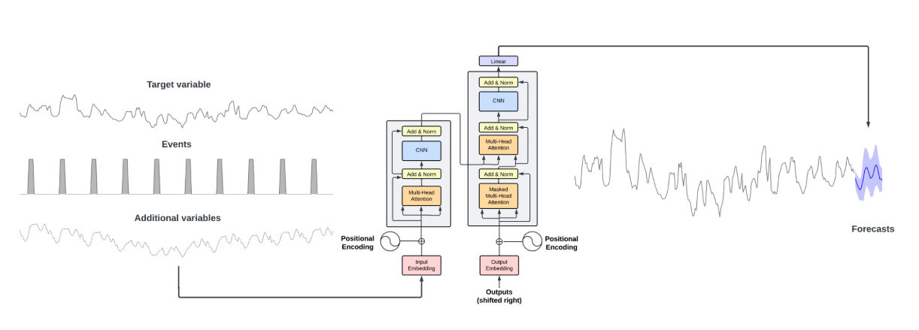
TimeGPT architecture
The architecture consists of an encoder-decoder structure with multiple layers, each with residual connections and layer normalization. Finally, a linear layer maps the decoder’s output to the forecasting window dimension. The general intuition is that attention-based mechanisms are able to capture the diversity of past events and correctly extrapolate potential future distributions.

Slide 10
Training of TimeGPT model
Use carefully curated and diverse dataset strategy.
Trained with 100 billion data points, the model saw data from several sectors, such as finance, healthcare, and industry.
TimeGPT employs conformal prediction, a flexible, non-parametric approach that generates prediction intervals without strict distributional assumptions.

Slide 11
Benefits of TimeGPT model
Without extensive data pre-processing, training, or parameter tuning makes it an efficient and appealing choice, particularly for resource- and time-conscious applications.
Looking ahead, TimeGPT’s capabilities can be significantly expanded through fine-tuning, adding external variables, and applying transfer learning.
Nixtla shows an example of superior performance on M5 Forecasting comparing to ARIAM, Light GBM, and NHITS) with fine tunning.

Slide 12
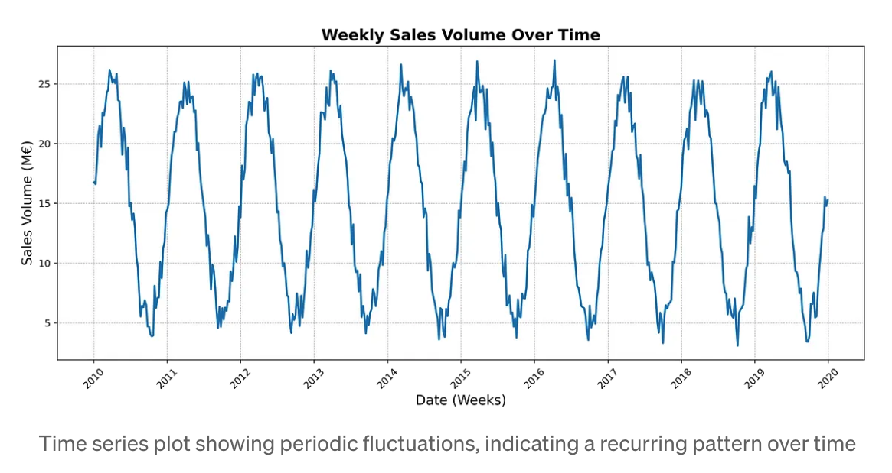
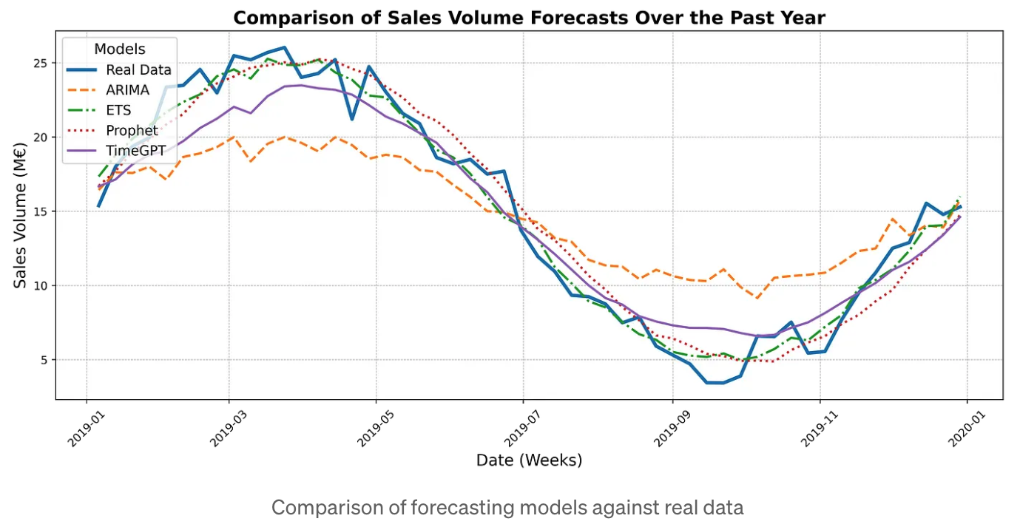
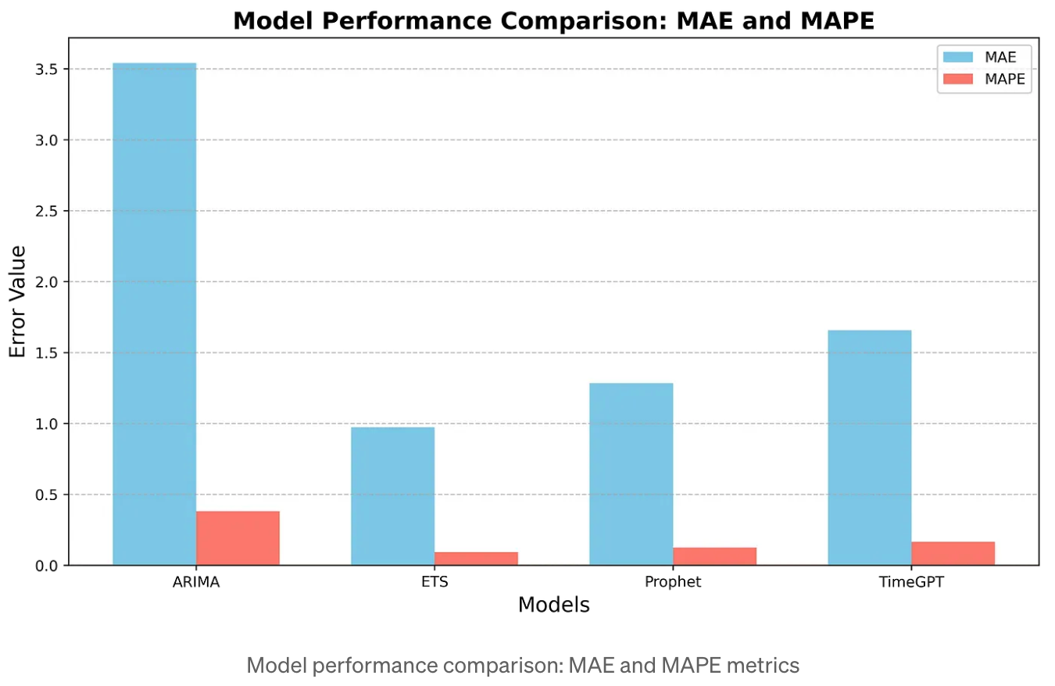
Comparing TimeGPT with Other Models
No fine tuning, or known as zero-shot learning

Slide 13
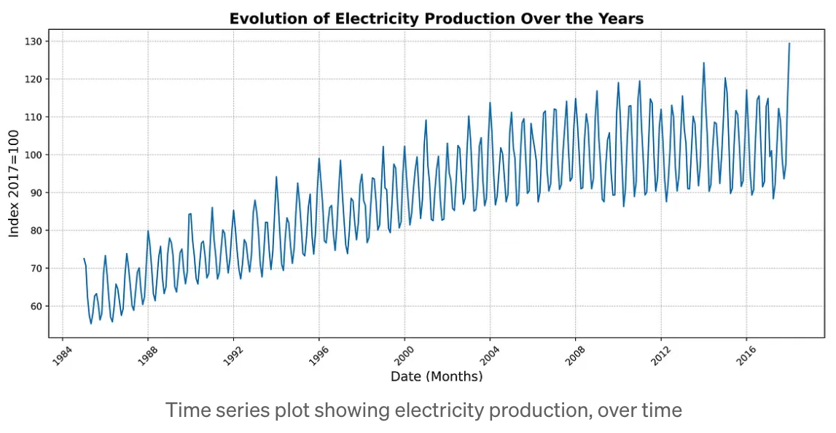
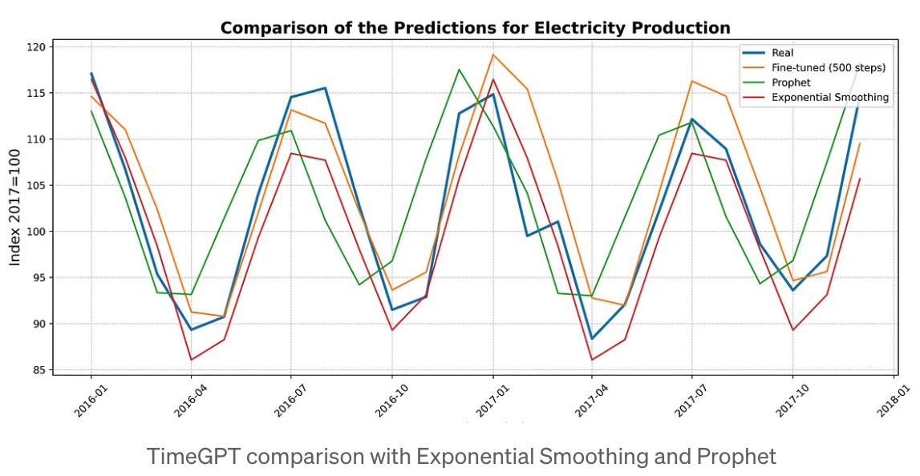
Comparing TimeGPT with fine tuning
MAE
TimeGPT: 3.67
Prophet: 6.18
ETS: 3.69
Currently fine-tuned parameters cannot be saved for later use.

Slide 14
Code snippet for TimeGPT with fine tunning
from nixtla import NixtlaClient
# Initialize the TimeGPT client with your API key nixtla_client = NixtlaClient(api_key='YOUR-API-KEY')
# Generate forecasts with 500 fine-tuning steps preds_ft_500_steps = nixtla_client.forecast( df=df_train, h=24, finetune_steps=500, time_col='date', target_col='power', )
Needs an account and API key.
Target variable cannot have missing or non-numeric values.
Date stamp variable cannot have gaps.
Multiple series can be processed using a unique identifier column.
Can include exogenous variables.

Slide 15
Additional info: default vs. long horizon forecast models
For long horizon forecast (more than one seasonal period), use timegpt-1-long-horizon model.
timegpt_fcst_df = nixtla_client.forecast(df=df, h=36, time_col='timestamp', target_col='value', freq='MS', model='timegpt-1-long-horizon’)
Otherwise, recommend using default model.
timegpt_fcst_df = nixtla_client.forecast(df=df, h=6, time_col='timestamp', target_col='value', freq='MS')

