Slide 1
Opencores: SOCGEN project
Creating Reusable Test Benches
John Eaton
Ouabache Designworks

Slide 2
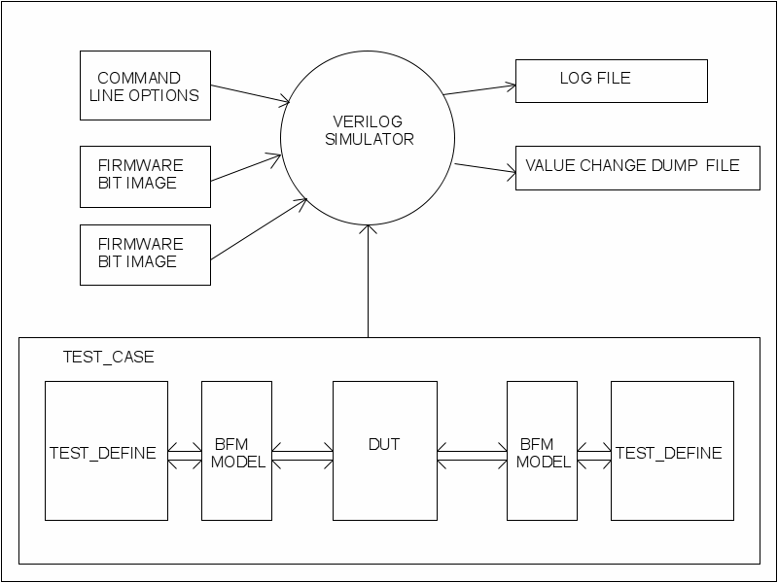

Slide 3
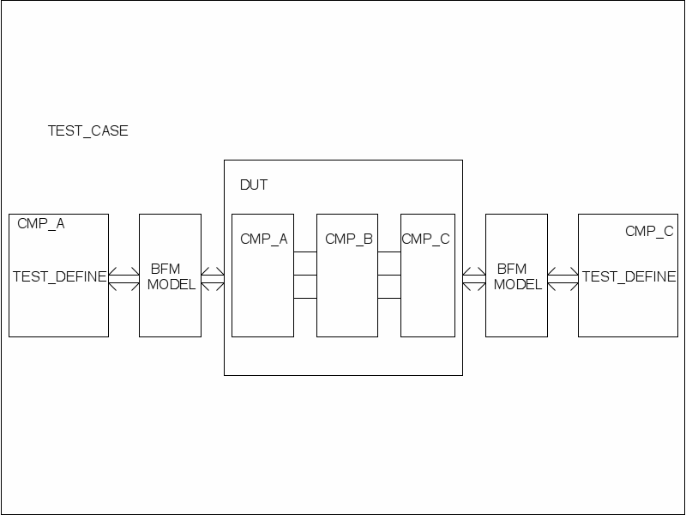

Slide 4
