Slide 1
Opencores: SOCGEN Project
Open Sourced Design for Reuse Toolset
John Eaton
Ouabache Designworks

Slide 2
Socgen
Creates a development environment for building IP from cores and running tool flows
Provides a structure for packaging a component IP and delivering it to a end user.
Uses a ip-xact enabled toolflows.
Open sourced scripts and example rtl

Slide 3
Component Structure
Component_name
bin
doc
ip-xact
designConfig and toolConfig file
rtl
xml
component.xml
component_version.xml
verilog
verilogSource
verilogSourceTop
verilogInclude
verilogFragment
fsm
views
sim
verilogLibrary
syn
verilogLibrary

Slide 4
Project Library Structure
Library_name
bin
doc
ip
component1
component2
sw
program1
program2

Slide 5
Development Environment
Socgen
Makefile
tools
projects
vendor_library1
vendor_library2
vendor_libraryx
work

Slide 6
build_verilogLibrary

Slide 7
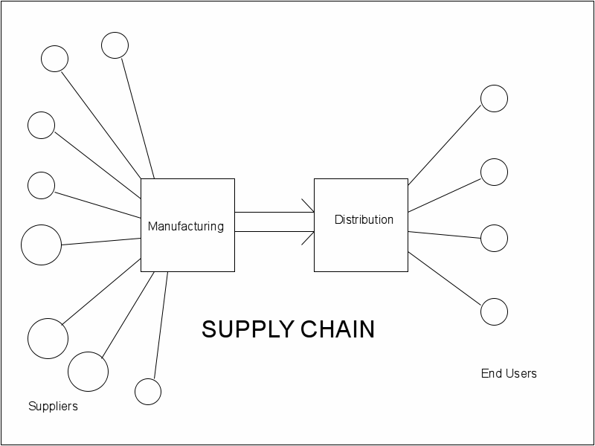
Understand the overall process involving suppliers, producers and customers
d

