Slide 1
Images for Kactus context helps
March 2013
Created by Erno Salminen

Slide 2
Purpose
Images orientate users better than text
They provide simplified overlook what is the main idea in each editor

Slide 3
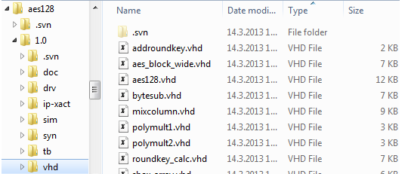
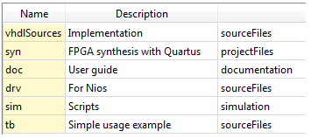
Filesets

Slide 4

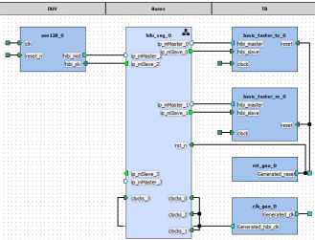
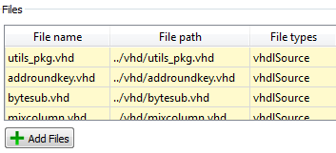
Views
component AccelA
Fileset
Design
View V0
(non-hier)
Fileset ref.
View V1 (hier)
Hier. ref.

Slide 5

SW Views
component GizmoCpu
SW View SV0
SW Design
Hier. ref.

Slide 6
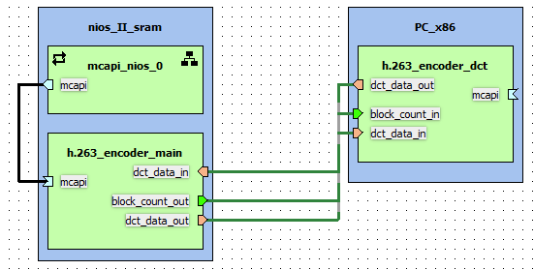
SystemViews
component CoolProduct
System Design
System View SyV0
Hier. ref.

Slide 7
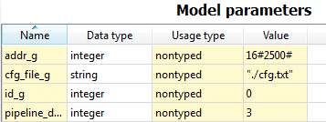
Generic editor
library ieee;
use ieee.std_logic_1164.all;
entity bar is
generic (
id_g : integer;
addr_g : integer;
cfg_file_g : string := "";
pipeline_depth_g : integer;
. . .
);
port ( . . .
sad

Slide 8
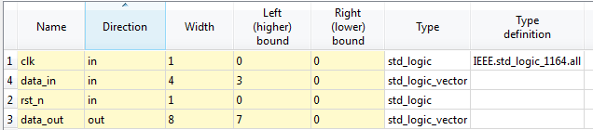
Ports editor
library ieee;
use ieee.std_logic_1164.all;
entity foo is
port (
clk : in std_logic;
rst_n : in std_logic;
data_in : in std_logic_vector (3 downto 0);
data_out : out std_logic_vector (7 downto 0)
);
end foo;
Relation between code and Kactus should be obvious

Slide 9
Memory map
component AccelA
memory map MM0
r0
slave RegsIF
r1
r2
memory map MM1
mem
a

Slide 10
Address space
component CPU0
component NetN
component Acc0
addr space AS0
memmap
seg0
seg1
master MainIF
component Acc1
memmap
a

Slide 11
CPUs
component DualCoreSoC
cpuA
Addr space AS0
…
cpuB
Addr space w/ local mem map AS1
a

Slide 12
Relation between bus interface and ports
component Foo
master bus interface MBIF
port Data_out
port Req_out
port Ack_in
port maps
=

Slide 13
Other clock driver
clockPeriod = 10 ns
component Foo
clockPulseDuration = 5 ns
port ClkIn
clk0
clk_gen.vhd
clockPeriod = 10 ns
clk0
clk1
clockPulseDuration = 4 ns
*.vhd
clk1
clockPulseOffset = 1 ns

Slide 14


COM interfaces

Slide 15


API interfaces

