Slide 1
STATISTICS FOR DATA SCIENCE
UE19CS203
TEAM WATER QUALITY
SEM 3 SEC : A
ABHISHEK ADITYA BS - PES1UG19CS019
ANIKET AAYUSH - PES1UG19CS061
AAKASH G ACHARYA - PES1UG19CS005
A SAI CHAITHANYA - PES1UG19CS002

Slide 2
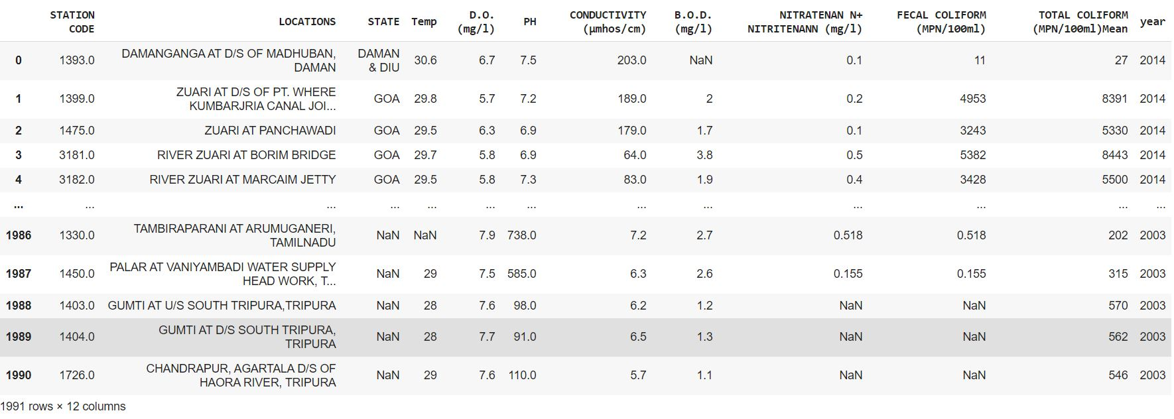
INDIA ‘S WATER QUALITY DATA SET
The data set has 1991 rows and 12 columns or variables

Slide 3
INSPIRATION BEHIND SELECTING THE DATA-SET
ABOUT THIS DATASET
Combined data of historical water quality of certain locations in India. Pollutants measures in each column is the average values measured over a period of time. Source: " Indian government websites''.
WHY WE CHOSE THIS DATASET ?
The data set provides valuable information about important water qualifiers like TOTAL COLIFORM LEVEL , TEMPERATURE , pH , B.O.D , D.O etc. helpful in determining the water quality of various water bodies across India. By these water qualifier data values we can determine which state has the most polluted water , unfit for domestic as well as for industrial purposes , and also toxic to the humans and the environment . We can also determine which state has the least polluted water and then can do an extensive study on that state and try to implement methods to keep the pollution levels less . We can determine the relationship between the water qualifiers and find which qualifier has the most impact on the pollution level. By realizing the extent of pollution levels we all should make an effort in keeping our water bodies clean , and save ourselves and future generations from toxic water pollutants.

Slide 4
DESCRIBING THE COLUMNS ( VARIABLES ) IN THE DATA SET
CATEGORICAL VARIABLES
STATION CODE
LOCATIONS
STATE
YEAR
Geographical Location codes of various water bodies across India.
Physical Geographical Locations of various water bodies across india.
Various States across India
The year in which the observations were made.
NUMERICAL VARIABLES
TEMPERATURE (°C)
D.O. (mg/l)
pH
Temperature levels of the water bodies
Dissolved oxygen level in the water , lesser the D.O value more is the pollution level
If pH < 7 the water is acidic , and is unfit for use
If pH > 7 the water is alkaline and is safe
Typically the water should be neutral with pH 7

Slide 5
CONTINUATION OF NUMERICAL VARIABLES
CONDUCTIVITY (µmhos/cm)
B.O.D. (mg/l)
NITRATENAN N+ NITRITENANN (mg/l)
Nitrates affect aquatic life. Nitrates have the same effect on aquatic plant growth as phosphates and thus the same negative effect on water quality. Thus higher the nitrate levels higher is the water contamination.
A sudden increase or decrease in conductivity in a body of water can indicate pollution.
A low BOD is an indicator of good quality water, while a high BOD indicates polluted water.
FECAL COLIFORM (MPN/100ml)
TOTAL COLIFORM (MPN/100ml)Mean
The presence of fecal coliform bacteria in aquatic environments indicates that the water has been contaminated with the fecal material of man or other animals.Water pollution caused by fecal contamination is a serious problem due to the potential for contracting diseases from pathogens (disease-causing organisms).
Total coliforms are a variety of bacteria, parasites, and viruses, known as pathogens, can potentially cause health problems if humans ingest them. EPA considers total coliforms a useful indicator of pathogens in water.So higher the total coliform levels more is the pathogens in water hence more is the water contamination.

Slide 6
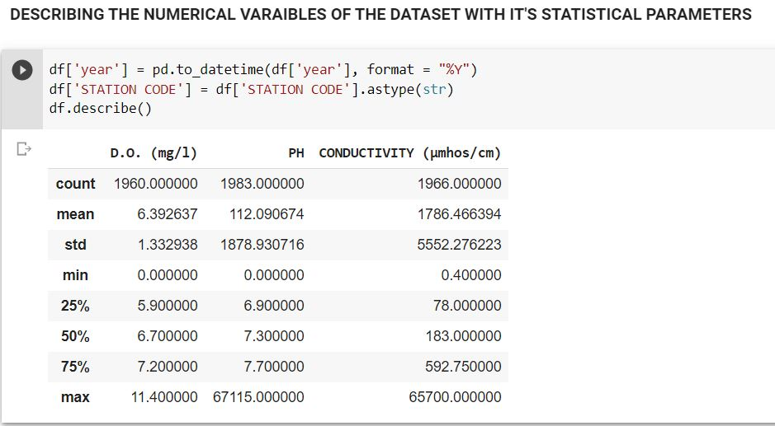
DESCRIBING THE NUMERICAL COLUMNS WITH STATISTICAL PARAMETERS

Slide 7
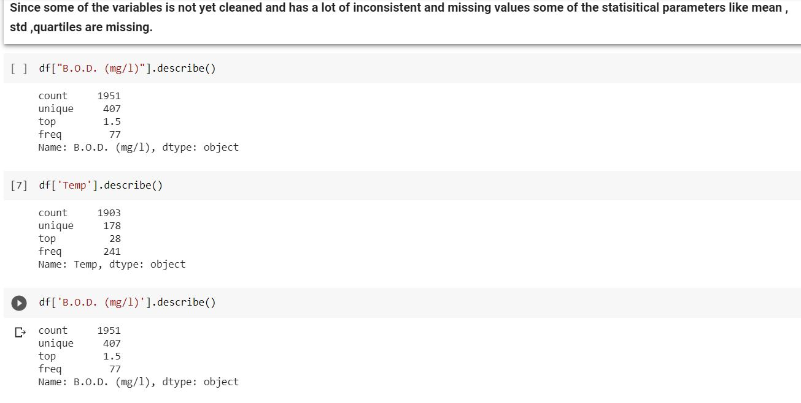

Slide 8
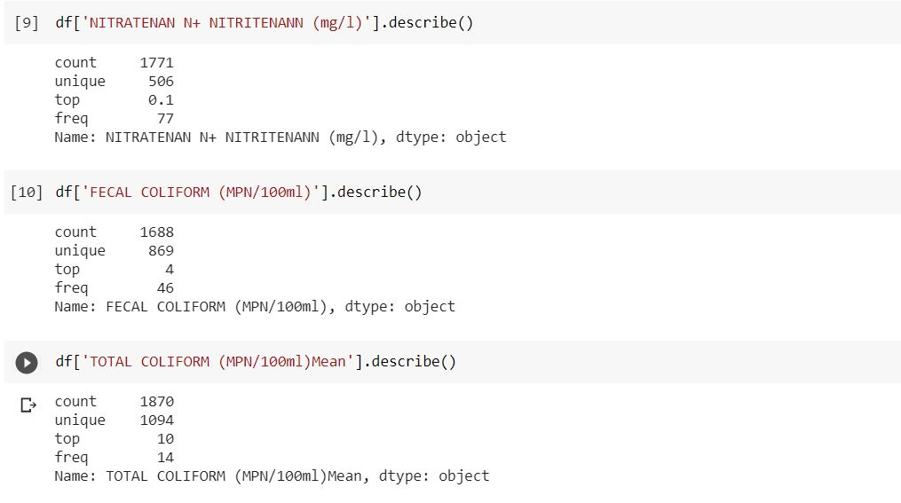

Slide 9
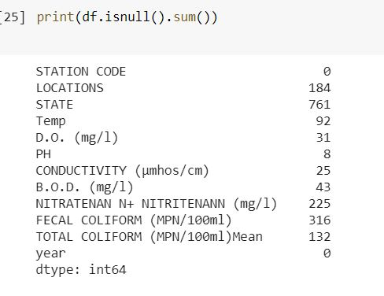

DATA CLEANING
The process of removing , manipulating , modifying inconsistent , repetitive , irregular , missing data values.
Replacing empty values with NAN
Checking for NAN values in each column

Slide 10
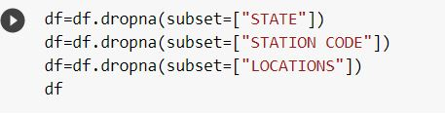
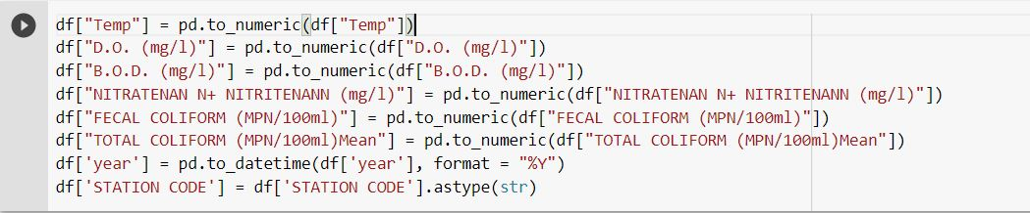
HANDLING NAN VALUES IN CATEGORICAL COLUMNS
DROPPING THE ROWS FOR WHICH STATE ,STATION CODE & LOCATION OF THE WATER BODIES ARE NAN (MISSING) BECAUSE WE CAN'T DESCRIBE , VISUALIZE AND INFER ANY VALUABLE INFORMATION FROM THOSE ROWS
CONVERTING NUMERICAL COLUMNS TO NUMERIC TYPE TO AVOID ANY DATA TYPE AMBIGUITY , YEAR COLUMN TO PANDAS DATE TIME FORMAT AND STATION CODE TO STRING TYPE SINCE ITS CONSIDERED AS NON-NUMERICAL COLUMN

Slide 11
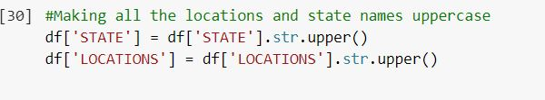
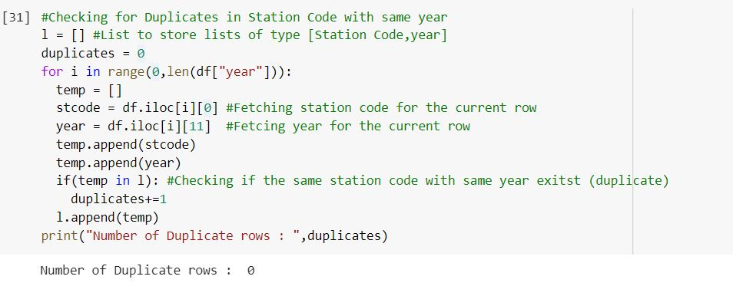
CONVERTING THE CATEGORICAL DATA TO UPPER CASE TO AVOID ERRORS IN CAPITALIZATION
VERIFYING THERE ARE NO DUPLICATE WATER BODY LOCATIONS WITH SAME STATION CODE AND IN SAME YEAR

Slide 12
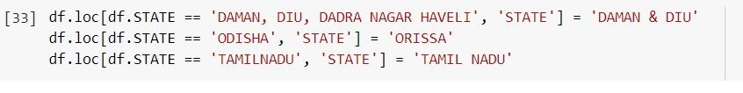
THERE ARE TYPOS IN STATE NAMES LIKE "TAMILNADU AND TAMIL NADU", "ODISHA AND ORISSA" "DAMAN & DIU AND ' DAMAN, DIU, DADRA NAGAR HAVELI ' "
FIXING THE TYPOS BY REPLACING THE TYPOS WITH THEIR CORRECT NAMES
VERIFYING THE TYPOS HAS BEEN FIXED BY CHECKING FOR ALL THE STATES

Slide 13
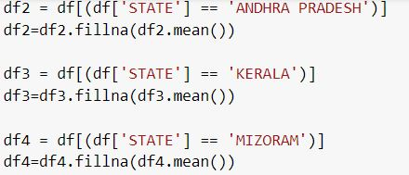
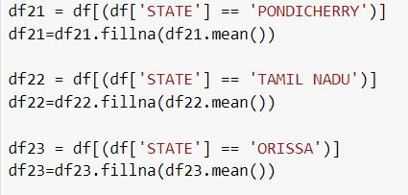
HANDLING NAN IN NUMERICAL COLUMNS
TO REPLACE NAN VALUES IN EACH NUMERICAL COLUMNS , WE REPLACE IT WITH THAT PARTICULAR STATE'S MEAN NUMERICAL COLUMN VALUES FOR THAT WE CREATE A SEPERATE SUB-DATAFRAMES FOR EACH STATE AND REPLACE THE NAN VALUES WITH THAT PARTICULAR STATE'S MEAN NUMERICAL VALUES IN EACH COLUMN
WE THEN MERGE ALL THE SUB DATA FRAMES IN WHICH MOST OF THE NAN ( IN BOTH CATEGORICAL AND NUMERICAL COLUMNS ARE HANDLED)

Slide 14
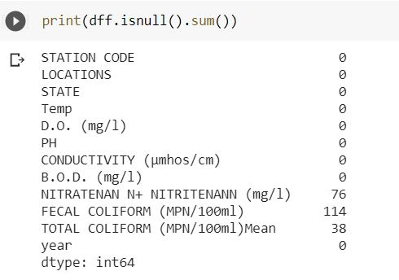

WE STILL SEE THAT THERE ARE SOME NAN VALUES IN THE NEW DATA SET CREATED BECAUSE SOME OF THE STATES DO NOT HAVE REQUIRED NUMERICAL VALUES TO CALCULATE THE MEAN TO BE REPLACED
SO WE DROP THOSE ROWS WHICH STILL HAS NAN VALUES BECAUSE WE CAN'T DESCRIBE OR VISUALIZE AND INFER ANY VALUABLE INFORMATION FROM THOSE ROWS

Slide 15
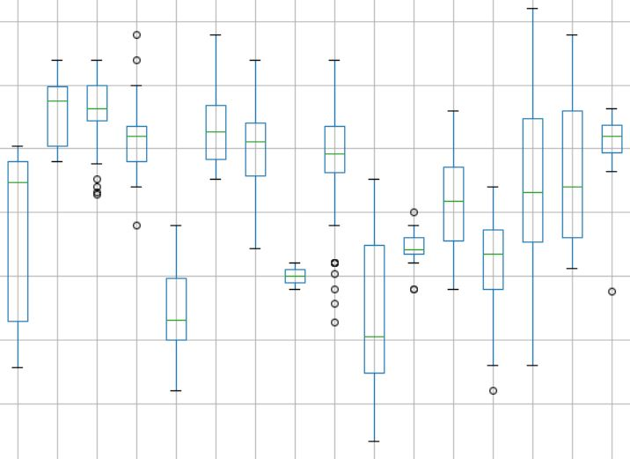
DATA VISUALIZATION
CHECKING FOR OUTLIERS BY BOX PLOT
OUTLIERS
In statistics, an outlier is a data point that differs significantly from other observations. An outlier may be due to variability in the measurement or it may indicate experimental error; the latter are sometimes excluded from the data set. An outlier can cause serious problems in statistical analyses.
Q25 -> 25th PERCENTILE
Q75 -> 75th PERCENTILE
INTER-QUARTILE RANGE [IQR] = Q75-Q25
OUTLIERS are data points :
Data < Q25-1.5*IQR
Data < Q75+1.5*IQR

Slide 16
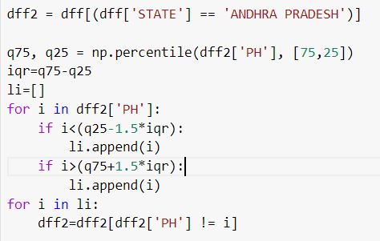
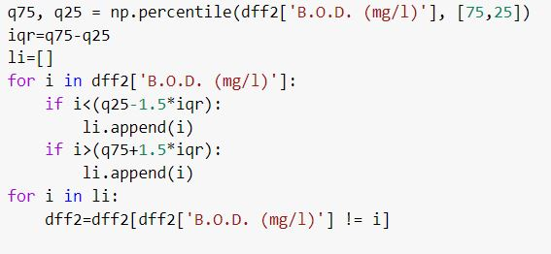
REMOVAL OF OUTLIERS
CALCULATING AND REMOVING OUTLIERS FOR EACH STATE FOR THE COLUMNS 'PH' , 'B.O.D. (mg/l)' AND 'TOTAL COLIFORM (MPN/100ml)Mean' USING THE INTER-QUARTILE RANGE BECAUSE THESE THREE COLUMNS ARE THE MOST IMPORTANT TO OUR INFERENCE AND PROVIDE MORE VALUABLE INFORMATION REGARDING WATER QUALITY THAN OTHER WATER QUALITY QUALIFIER COLUMNS

Slide 17
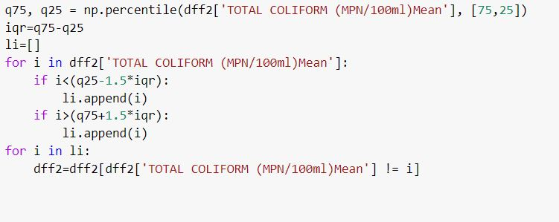
So the same method of removing outliers is applied to every State and for the three variables TOTAL COLIFORM , PH and B.O.D , Since we are making all the visualizations and inferences based on these three columns since they are the most important water qualifiers in determining the water quality set by EPA (Environmental Protection Agency) .

Slide 18
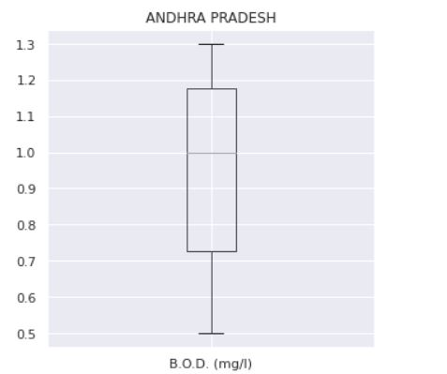
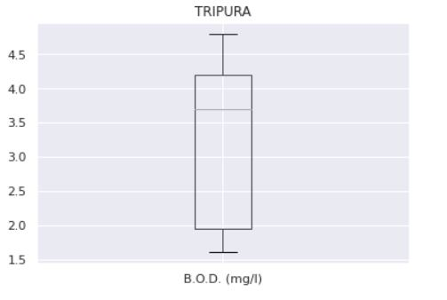
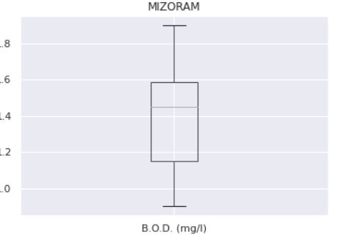
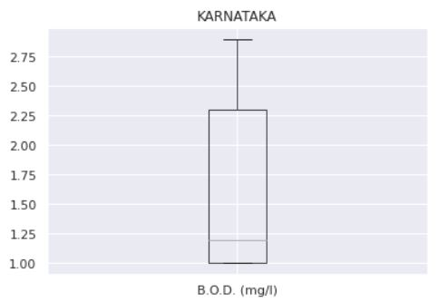
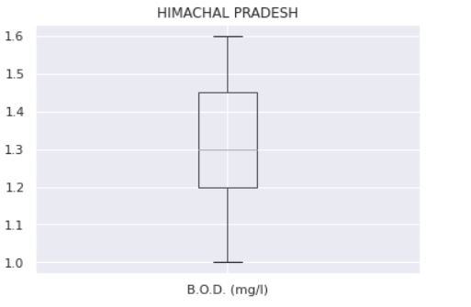
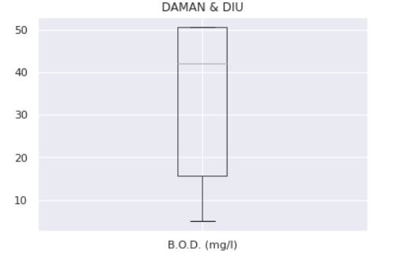
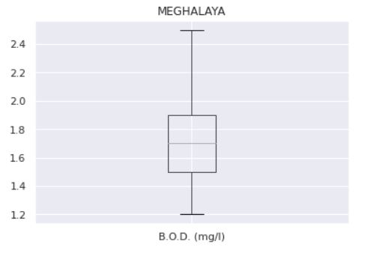
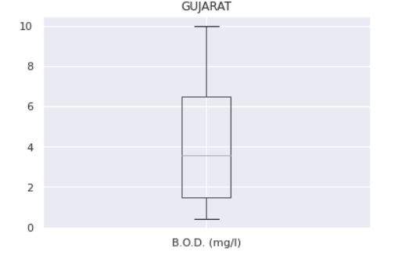
VERIFYING THAT OUTLIERS ARE REMOVED BY BOX PLOT

Slide 19
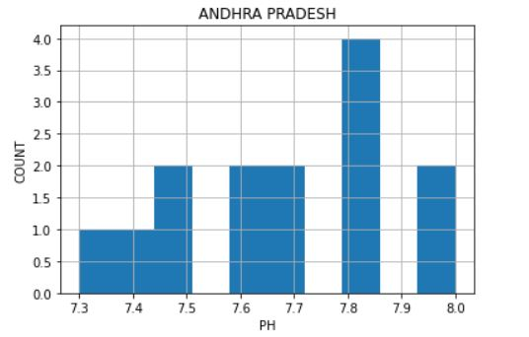
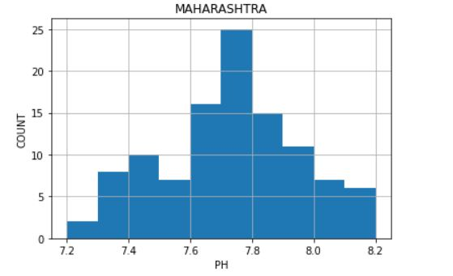
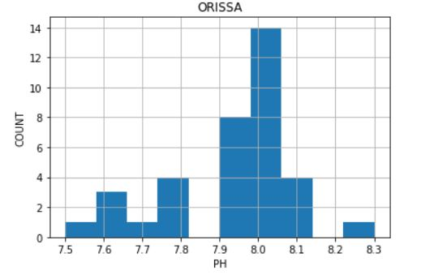
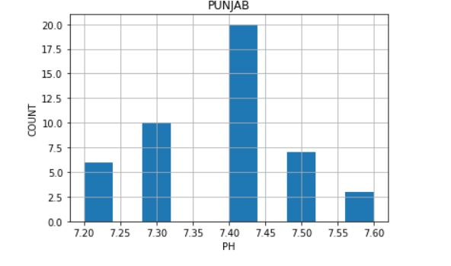
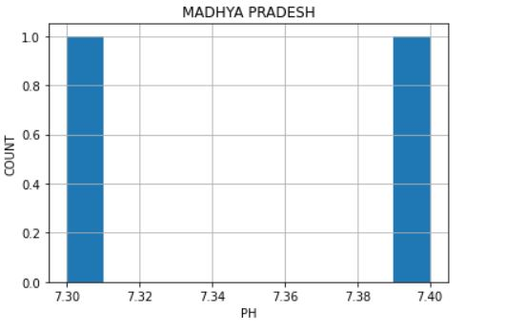
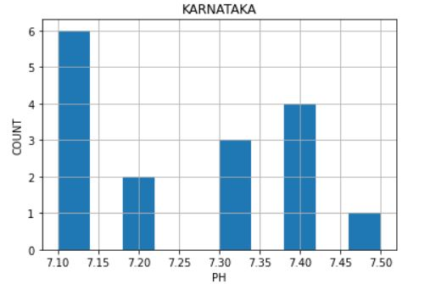
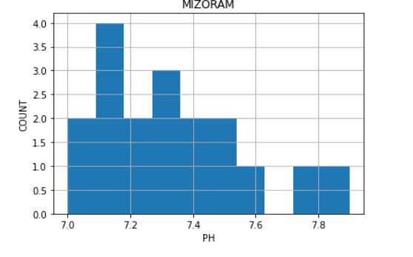
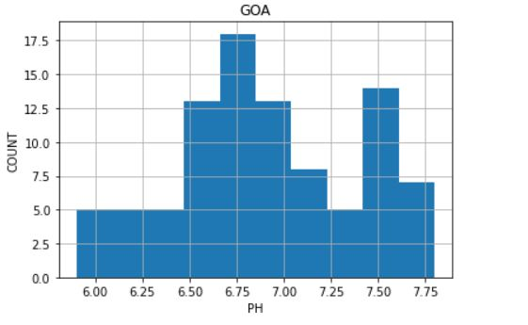
HISTOGRAMS FOR STATE’S pH LEVELS

Slide 20
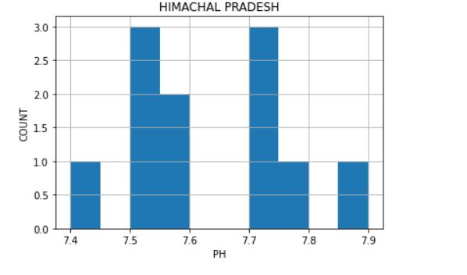
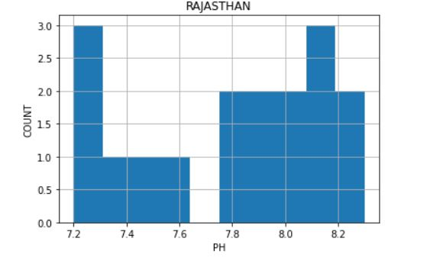
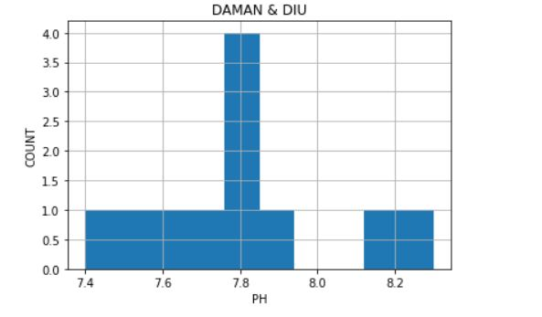
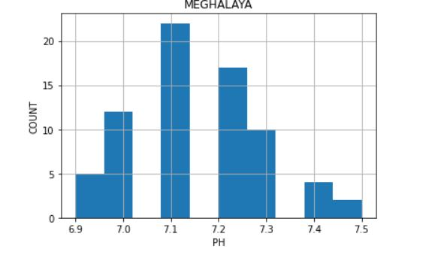
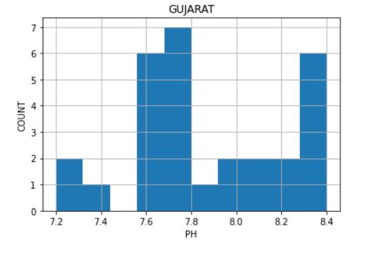
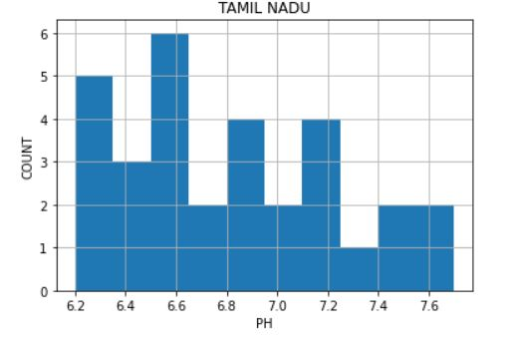

Slide 21
INFERENCES FROM THE HISTOGRAM’S
AVERAGE pH LEVELS OF MOST WATER BODIES IN EACH STATE
ANDHRA PRADESH = 7.8
MAHARASHTRA = 7.7
ORISSA = 8.05
PUNJAB = 7.4
TRIPURA = 7.8
MADHYA PRADESH = 7.35
GOA = 6.75
KARNATAKA = 7.1
MIZORAM = 7.1
RAJASTHAN = 7.8
HIMACHAL PRADESH = 7.75
MEGHALAYA = 7.1
GUJRAT = 7.7
TAMIL NADU = 6.5
DAMAN & DIU = 7.8
pH < 7 means water is acidic and is unfit for use and harmful for the environment as well.
So TAMIL NADU has most water bodies with pH level 6.5
Followed by GOA which has most water bodies with pH level 6.75
Typically India water is neutral between 7 and 8 , so all other states other than Tamil nadu , goa and orissa have pH levels between 7 and 8 , water is neither acidic nor basic and perfect for all uses. Usually neutral water is preferred.
pH>8 means water is alkaline and is not harmful and useful for domestic as well as industrial purposes.
So Orissa has the most water bodies with pH level 8.05

Slide 22
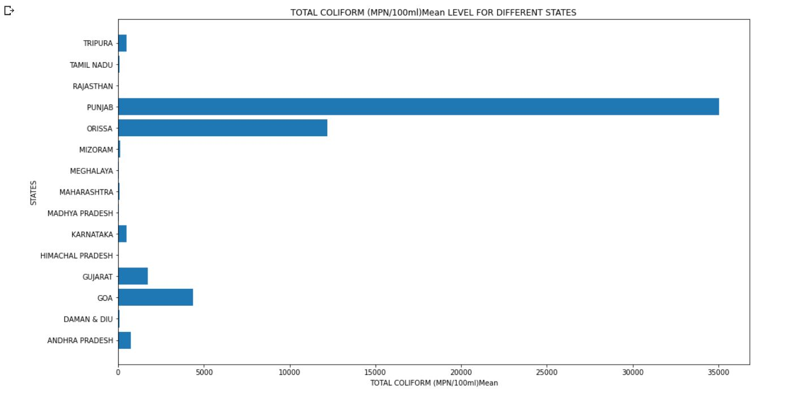
BAR CHART FOR STATE’S VS TOTAL COLIFORM LEVEL’S

Slide 23
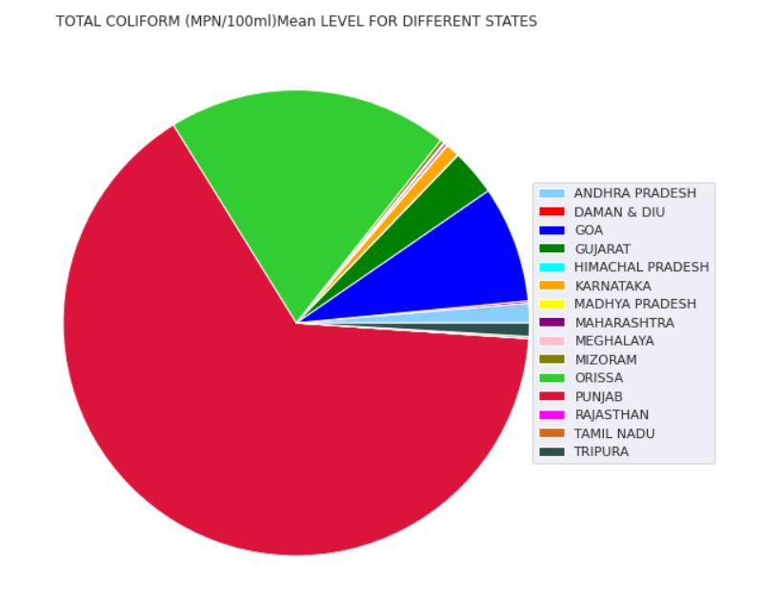
PIE CHART FOR STATE’S VS TOTAL COLIFORM LEVELS

Slide 24
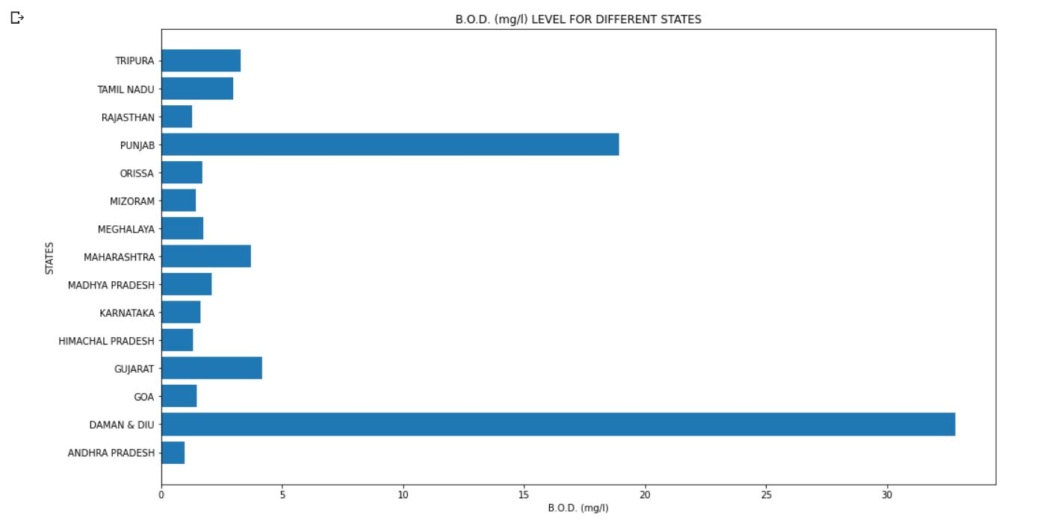
BAR CHART FOR STATE’S VS B.O.D(mg/l)

Slide 25
INFERENCES FROM BAR GRAPH ’S AND PIE CHART
Bar graph for state’s vs Total coliform ( MPN/100ml) mean
We can see that PUNJAB state has the highest Total coliform ( MPN/100ml) mean level at 35000 MPN/100ml followed by ORISSA which has Total coliform ( MPN/100ml) mean level at 125000 MPN/100ml.Rajasthan and Himachal pradesh has lowest Total coliform levels.
To verify the result obtained by bar graph for state’s vs Total Coliform we create a pie chart
The pie chart for state ’s vs vs Total coliform ( MPN/100ml) mean
verifies the same result showing Punjab has the highest highest Total coliform ( MPN/100ml) mean level followed by ORISSA .
The Bar graph for state’s vs B.O.D (mg/l)
We can see that Daman & Diu has the highest B.O.D (mg/l) level at 35 mg/ml followed by Punjab at 20 mg/l , so we can say that Daman & Diu water bodies has very less oxygen saturation in water due to the presence of algae pathogens, toxic substances , proving harmful for the aquatic life.
CONCLUSION : PUNJAB HAS THE HIGHEST TOTAL COLIFORM LEVEL AND SECOND HIGHEST B.O.D LEVELS THEREBY SHOWING THAT IT HAS THE MOST POLLUTED WATER IN INDIA , AND RAJASTHAN AND HIMACHAL PRADESH HAS LOWEST TOTAL COLIFORM LEVELS , THEREBY THEY HAVE THE LEAST POLLUTED WATER IN INDIA.

Slide 26
NORMALIZATION
Normalization is one of the important steps in data preprocessing. Normalization zeros out the mean of the data and makes data have a unit standard deviation .
Why do we need Normalization ?
Similarly, the goal of normalization is to change the values of numeric columns in the dataset to a common scale, without distorting differences in the ranges of values. Every dataset does not require normalization. It is required only when features have different ranges.
When should we use Normalization ?
Normalization is a good technique to use when you do not know the distribution of your data or when you know the distribution is not Gaussian (a bell curve). Normalization is useful when your data has varying scales and the algorithm you are using does not make assumptions about the distribution of your data, such as k-nearest neighbors and artificial neural networks.

Slide 27
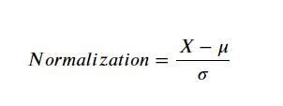
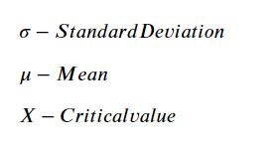
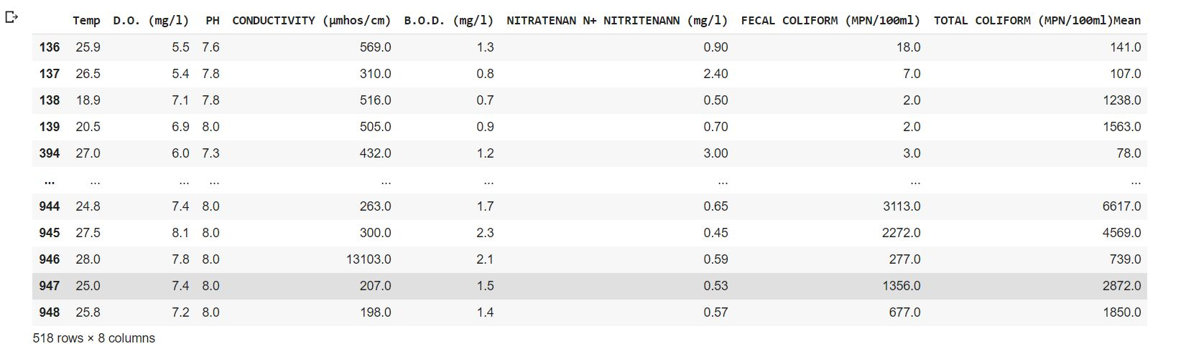
THE NUMERICAL COLUMNS BEFORE NORMALIZATION

Slide 28
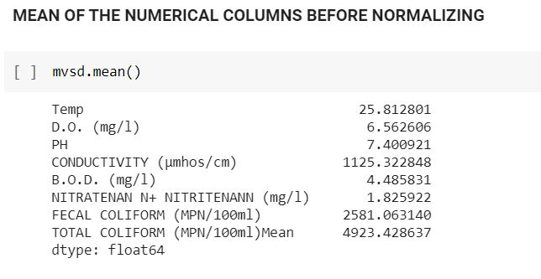
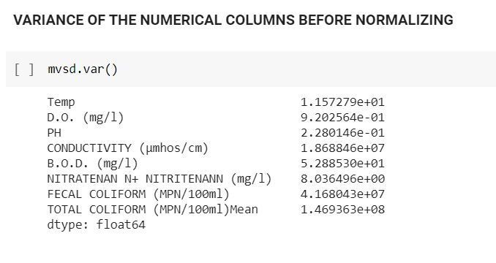
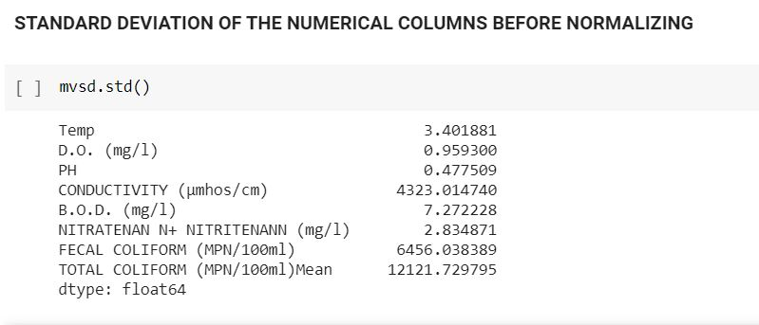

Slide 29
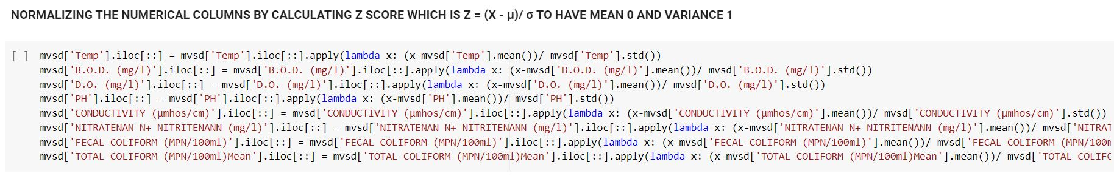
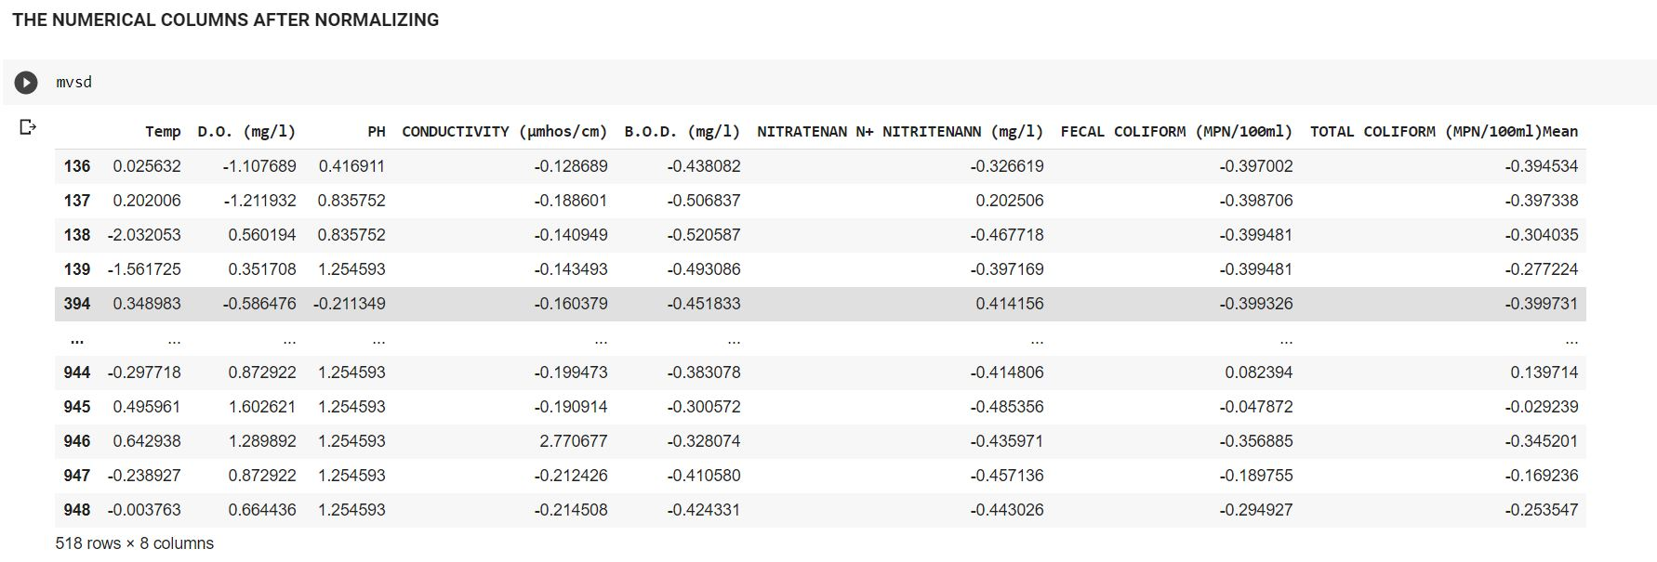

Slide 30




Slide 31



VERIFYING THE NORMALITY OF DATA BY DISTPLOTS

Slide 32



VERIFYING NORMALITY OF DATA BY NORMAL PROBABILITY PLOTS

Slide 33




NORMALLY DISTRIBUTED CURVES
SYMMETRIC DISTRIBUTION
RIGHT SKEWED DISTRIBUTION

Slide 34
HYPOTHESIS TESTING
A statistical hypothesis is an assumption about a population parameter. This assumption may or may not be true. Hypothesis testing refers to the formal procedures used by statisticians to accept or reject statistical hypotheses.
Statistical Hypotheses
The best way to determine whether a statistical hypothesis is true would be to examine the entire population. Since that is often impractical, we examine a random sample from the population. If sample data are not consistent with the statistical hypothesis, the hypothesis is rejected.

Slide 35
Types of Statistical Hypothesis
Null hypothesis. The null hypothesis, denoted by H0, is usually the hypothesis that sample observations result purely from chance.
Alternative hypothesis. The alternative hypothesis, denoted by H1 or H(a), is the hypothesis that sample observations are influenced by some non-random cause.
ERRORS INVOLVED IN HYPOTHESIS TESTING
TYPE 1 ERROR -> Null hypothesis is true [ H0 is true ] but we reject it . (α)
TYPE 2 ERROR -> Null hypothesis is false [H0 is false ] but we fail to reject it . (β)

Slide 36


Slide 37


Slide 38


Slide 39





Correlation
Correlation is a statistical measure of the strength of relation between two variables.
Correlation also refers to the extent to which two variables have a linear relationship with each other (or related to each other).
Correlations are useful because they can indicate a predictive relationship that can be exploited in practice.
The Correlation Co-efficient is a numerical measure of the strength and direction of the linear relationship between two variables.
Let = ordered pairs that represent points on a scatter plot.
= mean of the ‘𝑥’ values
= mean of the ‘𝑦’ values
= standard deviation of ‘𝑥’ values
= standard deviation of ‘𝑦’ values
Correlation Co-efficient is given by

Slide 40

CORRELATION BETWEEN ALL THE VARIABLES WITH THEIR CORRESPONDING CORRELATION COEFFICIENT

Slide 41

PLOTTING HEAT MAP SHOWING THE CORRELATION BETWEEN ALL THE VARIABLES

Slide 42
Linear Regression
In Linear Regression, we try to model a linear relationship between two variables one of which is dependent on the other. It is a predictive analysis in which we can predict the values of the dependent variable based on the general trend it follows in other observations.
In Linear Regression, we choose two variables in which one is independent variable(represented on the x-axis) and the other is dependent variable(represented on the y-axis). Then , we assume a linear relationship between them represented by the formula Y = mX + c where m and c represent the slope and intercept respectively.
Here, we have performed Simple Linear Regression for BOD(independent) vs. Total Coliform(dependent) and Fecal coliform (independent) vs Total coliform (dependent).

Slide 43
Procedure for Linear Regression
We sampled the dataset for better visualization. Then we plotted a scatter plot containing all the values for chosen variables present in the dataset.
Based on the variables chosen, we try to plot the line of best fit which refers to a line through a scatter plot of data points that best expresses the relationship between those points. We assume that our chosen variables follows the same trend.
Based on the slope of the line of best fit, we can predict the relation between those variables.
Also, since we got a line representing the two variables, we can easily predict the value of Y for any value of X which is not present in the dataset. So, Linear Regression helps us to predict the values which are not present in the dataset.

Slide 44


Calculations Involved
The slope(m) of the line of best fit is given by :-
Slope(m) =
And the intercept c is given by :-
Intercept(c) =

Slide 45

Calculations Involved
The equation of the best fit line is given by :-
The value of Y is calculated for each value of X present in the dataset and the pair (X,Y) is plotted and joined to get the best fit line.

Slide 46

We observe that we get a positive correlation between BOD vs. Total Coliform with Slope(m) = 0.882

Slide 47

We observe that we get a positive correlation between Fecal coliform vs. Total Coliform with Slope(m) = 1.0208

Slide 48

CONCLUSIONS
From our data analysis we find that :
PUNJAB has the highest Total coliform level and second highest B.O.D levels thereby showing that it has the most polluted water in India , Rajasthan and Himachal pradesh having the least polluted water bodies.
Daman & Diu has the highest B.O.D (mg/l) level so we can say that Daman & Diu water bodies has very less oxygen saturation in water due to the presence of algae pathogens, toxic substances , proving harmful for the aquatic life.
TAMIL NADU has most water bodies with pH level 6.5 followed by GOA which has most water bodies with pH level 6.75 means water is acidic and is unfit for use and harmful for the environment as well.
B.O.D and Total coliform & Fecal coliform and Total coliform levels are positively correlated qualifiers.

Slide 49
Thank You !!

