Slide 1

PROGRAMMING IN HASKELL
Week 1 - Introduction

Slide 2
Who we are
Ouanis Seddaoui, 3rd year computer science student. ouanixi@gmail.com
Andrew Pond, 4th year computer science student a.r.pond@dundee.ac.uk
Chris Warburton – Phd Student.

Slide 3
Learning Material
Syllabus:
http://www.seas.upenn.edu/~cis194/fall14/spring13/lectures.html
Books:
- Beginner friendly: http://learnyouahaskell.com/
- A tiny bit more formal:
http://book.realworldhaskell.org/

Slide 4
The Software Crisis
How can we cope with the size and complexity of modern computer programs?
How can we reduce the time and cost of program development?
How can we increase our confidence that the finished programs work correctly?

Slide 5
What is Haskell?
Haskell is a lazy, functional programming language created in the late 1980’s by a committee of academics.
A bunch of people got together and took some of the best ideas from existing languages (and a few new ideas of their own) and used them to create Haskell.

Slide 6
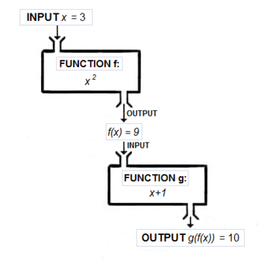
Haskell is Functional
There is no precise, accepted meaning for the term “functional”. But when we say that Haskell is a functional language, we usually have in mind two things:
Functions are first-class
Centered around evaluating expressions rather than executing instructions.
Taken together, these result in an entirely different way of thinking about programming. Much of our time will be spent exploring this way of thinking.

Slide 7
Haskell is pure
No mutation! Everything (variables, data structures…) is immutable.
Expressions never have “side effects” (like updating global variables or printing to the screen).
Calling the same function with the same arguments results in the same output every time.

Slide 8
Haskell is Lazy
In Haskell, expressions are not evaluated until their results are actually needed

Slide 9
Themes
Types:
Helps clarify thinking and express program structure
Serves as a form of documentation
Turns run-time errors into compile-time errors

Slide 10
Themes
Don’t Repeat Yourself
Wholemeal Programming
Example:
  int acc = 0;
  for ( int i = 0; i < lst.length; i++ ) {
  acc = acc + 3 * lst[i];
  }
  sum (map (3*) lst)

