Slide 1
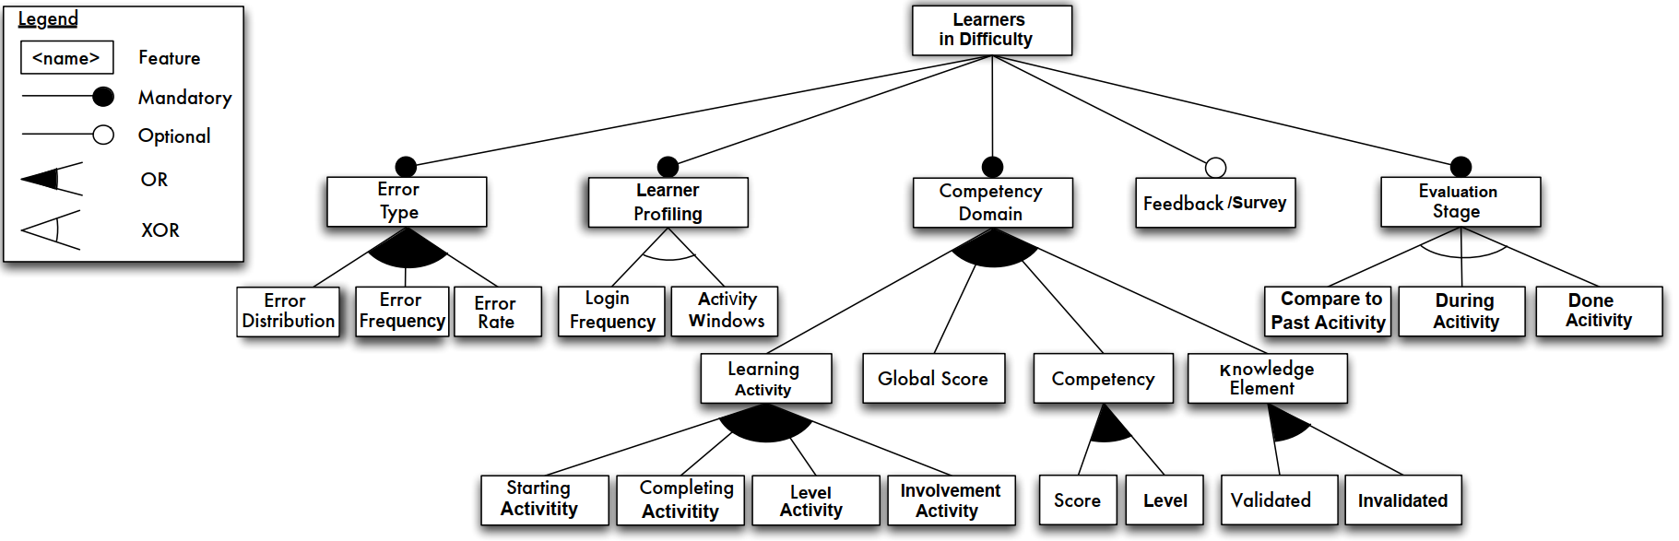
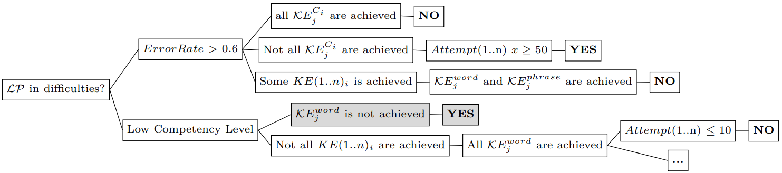
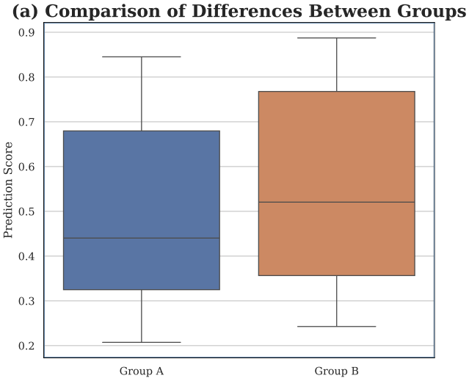
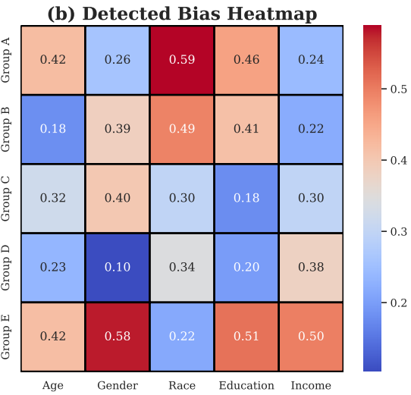
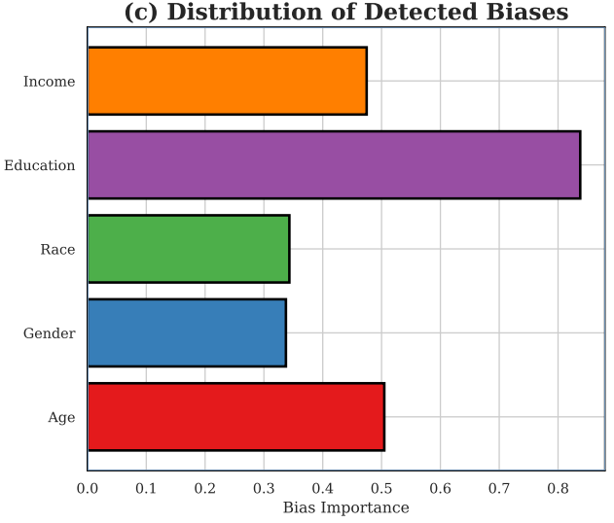
Steps | Example
Educational Requirement | A user wants to identify a set of students in difficulty using écri+ platforms in a specific competency domain, by considering a set of knowledge elements related to this domain, such as P-GRAM (Grammaire) and P-CONS (Construction) knowledge, , along with detailed information about academic data and resource interactions to support them.
Problem/ Goal Validation
Testable Factors
Data Source (entities/attributes)
ML Models Exaplanation
Bias Detection & Fairness
1
2
$H_{1}$: A low learner score may be influenced by whether French is a second or native language
$H_{2}$: A low learner score may be related to unchecked resources
3
KnowledgeElements
Answers
Assessments
User
4
Answer ID
Assessment ID
Skill ID
Earned Pix
User ID
Competence ID
Status
ID
Value
Result
Result Details
Challenge ID
Assessment ID
Created At
Updated At
Time Out
Time Spent
Is Focused Out
IsBeta
Course ID
Created At
Updated At
User ID
Type
State
Competence ID
Is Improving
Campaign Participation ID
Certification Course ID
Last Question Date
Last Challenge ID
Last Question State
Method
User ID
First Name
Last Name
Birthdate
Birthplace
Status
5
Decision Tree
6

Slide 2
Steps | Example
Educational Requirement
Problem/ Goal Validation
Testable Factors
Data Source (entities/attributes)
ML Models Exaplanation
Bias Detection & Fairness
1
Capability
layer
…
2
3
Operating
Envirenement
Layer
Domain
Technology
Layer
4
Implemntation
Technique
Layer
Legend
Composed of
Mandatory
Feature
Optional
Feature
generalization/specialisation
Alternative Feature
KnowledgeElements
Answers
Assessments
User
Answer ID
Assessment ID
Skill ID
Earned Pix
User ID
Competence ID
Status
ID
Value
Result
Result Details
Challenge ID
Assessment ID
Created At
Updated At
Time Out
Time Spent
Is Focused Out
IsBeta
Course ID
Created At
Updated At
User ID
Type
State
Competence ID
Is Improving
Campaign Participation ID
Certification Course ID
Last Question Date
Last Challenge ID
Last Question State
Method
User ID
First Name
Last Name
Birthdate
Birthplace
Status
5
6
Decision Tree

Slide 3
Capability
layer
…
Operating
Envirenement
Layer
Domain
Technology
Layer
Implemntation
Technique
Layer
Legend
Composed of
Mandatory
Feature
Optional
Feature
generalization/specialisation
Alternative Feature

Slide 4
Capability
layer
…
Operating
Envirenement
Layer
Domain
Technology
Layer
Implemntation
Technique
Layer
Legend
Composed of
Mandatory
Feature
Optional
Feature
generalization/specialisation
Alternative Feature

Slide 5
Capability
layer
Operating
Envirenement
Layer
Domain
Technology
Layer
Implemntation
Technique
Layer
Legend
Composed of
Mandatory
Feature
Optional
Feature
generalization/specialisation
Alternative Feature

