Slide 1
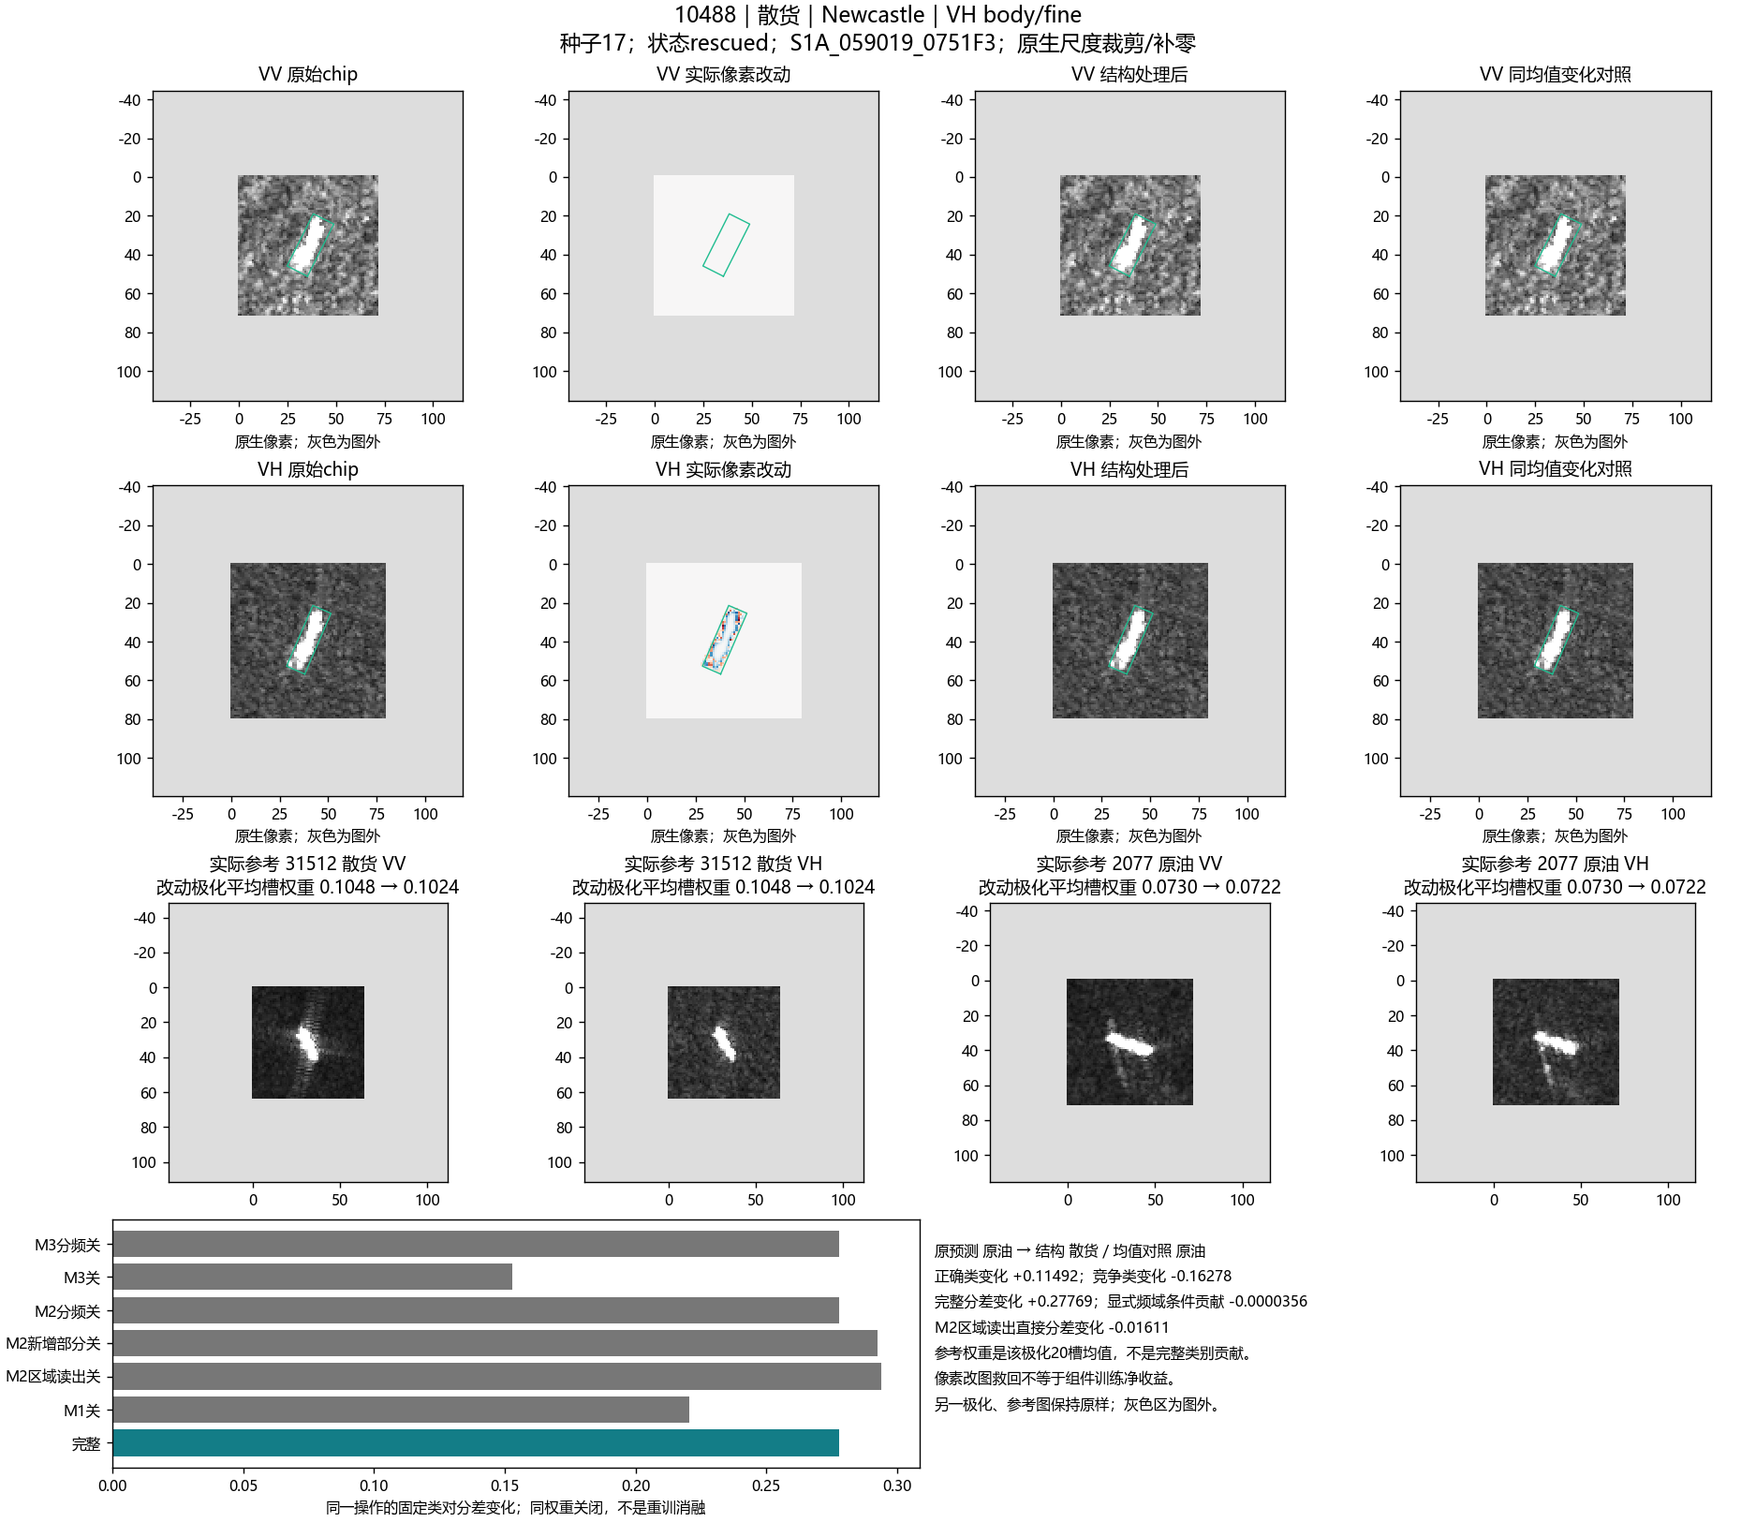
RGRP
Block [3]
Shallow RGRP
Readout
Block [5]
RGRP
Linear
Deep RGRP
Readout
RGRP
Global Description
Region sum
(512 per region)
CLS
Conv
LAYER1
BLOCK1
Conv
CRFB
Pool
Conv
BLOCK 2
BLOCK1
Write
RCEW
Max Pooling
Conv
Conv
BLOCK 2
Conv
Avg Mean Pooling
Conv
LAYER4
× 2
× 4
Concat
CLS
CRFB-guided regional complement
Global (2048)
x_{n}⁰
Addition
Concatenation
RELU
7x7 Conv
Conv
3x3 Conv
Conv
1x1 Conv
Conv
Intervention Screening and Review with Frozen Teacher
Generating Structural Interventions and Paired Mean Controls
z_{n}⁰
Candidate Variation
Preliminary Screening
Teacher
x_{n}⁰
Normalize to the identical L2 magnitude
Selected Intervention Map
Review
Structural Intervention
stopgrad
0.1 L_{KL,correct,w}
b_{nc}
Total Grayscale Variation Induced by Intervention
Teacher
correct
Paired Mean
Control
Selection flag
u_{n} = 0 or 1
z_{n}^{S}
L_{CE,w}
λ L_{guide,w}
u_{n} = 1
Student
L_{adapt}

Slide 2
CRFB: Class-Response Feedback Block
L₀
tanh
W₀
W_Mean
V̄₁
Content Response
s₁(u)
Conv
......
...
Lₖ
tanh
W_Mean
s_{K}(u)
Relation Branch
Mean Branch
...
...
V₁(u)^{32×20×20}
C_{k} (32D)
G_{CRFB}(u) = o(u) tanh(...)
...
Class Response
A₁(u)
A₂(u)
v_{i}
A_{K}(u)
s_{k}(u)
Conv
...
...
...
...
d_{k}(u)
R₁(u)
...
v_{j}
Class contrast
W_Z-score
tanh
Mean_{k}(⊙)
tanh
=
...
d_{k}(u) = A_{k}(u) - mean_{j≠k} A_{j}(u)
W₁
×0.3
X₁(u)^{128×20×20}
A(u)^{K×20×20}
X₁(u)
X'₁(u)^{128×20×20}
Subtract
Hadamard
W_Mean
Weighted Mean
W_Z-score
=
Weighted Z-score Standardization

Slide 3
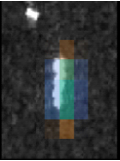
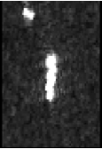
RGRP: Response-Guided Regional Pooling
Normalize
W_Mean
π_{r}(u)
Linear 160 to 512
tanh
0.1 stopgrad RMS
tanh
=
Concat (160D)
W_Mean
W_Mean
δ⁽²⁾_{p,r} (512D)
LayerNorm
...
...
...
CRFB
Conv
d₁(u)
d₂(u)
v_{i}
d_{K}(u)
1
0
0
...
...
...
...
π_{r}(u)
...
v_{j}
Class Response
0
0
0
α_{r,k}
·
...
q_{k}(u)
·
·
0
0
2
d(u)^{K×20×20}
A(u)
2tanh
W_Z-score
W_Mean

Slide 4
RCEW: Reference-Class Evidence Writeback
W_Mean
Softmax
k^{q}_{i}, k^{ref}_{sj} (32D)
Matching
Key
T_{sij}
S_{sij}
W_Mean
SB
T_{sij}
T_{sij}
β_{si}
F₁(u)
Key similarity S_{sij}
T_{sij}
T_{sij}
Row
Marginals
ρ_{si}
B_{ic} = max S_{sij} (class c)
T_{sij}
T^{agg}_{sij}
v̄_{s}
b_{ic} = B_{ic} - mean_{c'≠c} B_{ic'}
Sinkhorn
T_{sij}
T_{sij}
T_{sij}
L_{sij} = S_{sij} + b_{ic}
T_{sij}
T_{sij}
T_{sij}
Column
Marginals
Outer / M_{s}
W_Mean
W_Mean
W_sd
Center(-D/0.1)
c = y_{s}
T_{sij}
T_{sij}
E_{c}(u)
SB
T_{sij}
T_{sij}
κ_{sj}
W_Mean
Evidence
Feature
T_{sij}
v^{q}_{i}, v^{ref}_{sj} (32D)
T_{sij}
T_{sij}
T_{sij}
SB
Spatial Branch
E_{c}(u) = Σ_{i} η_{i}(u) ẽ_{ic}
T_{sij}
CB
Channel Branch
F₃⁺ = F₃ + 0.1 W_{p}^{out} E
W_sd
weighted squared distance

Slide 5

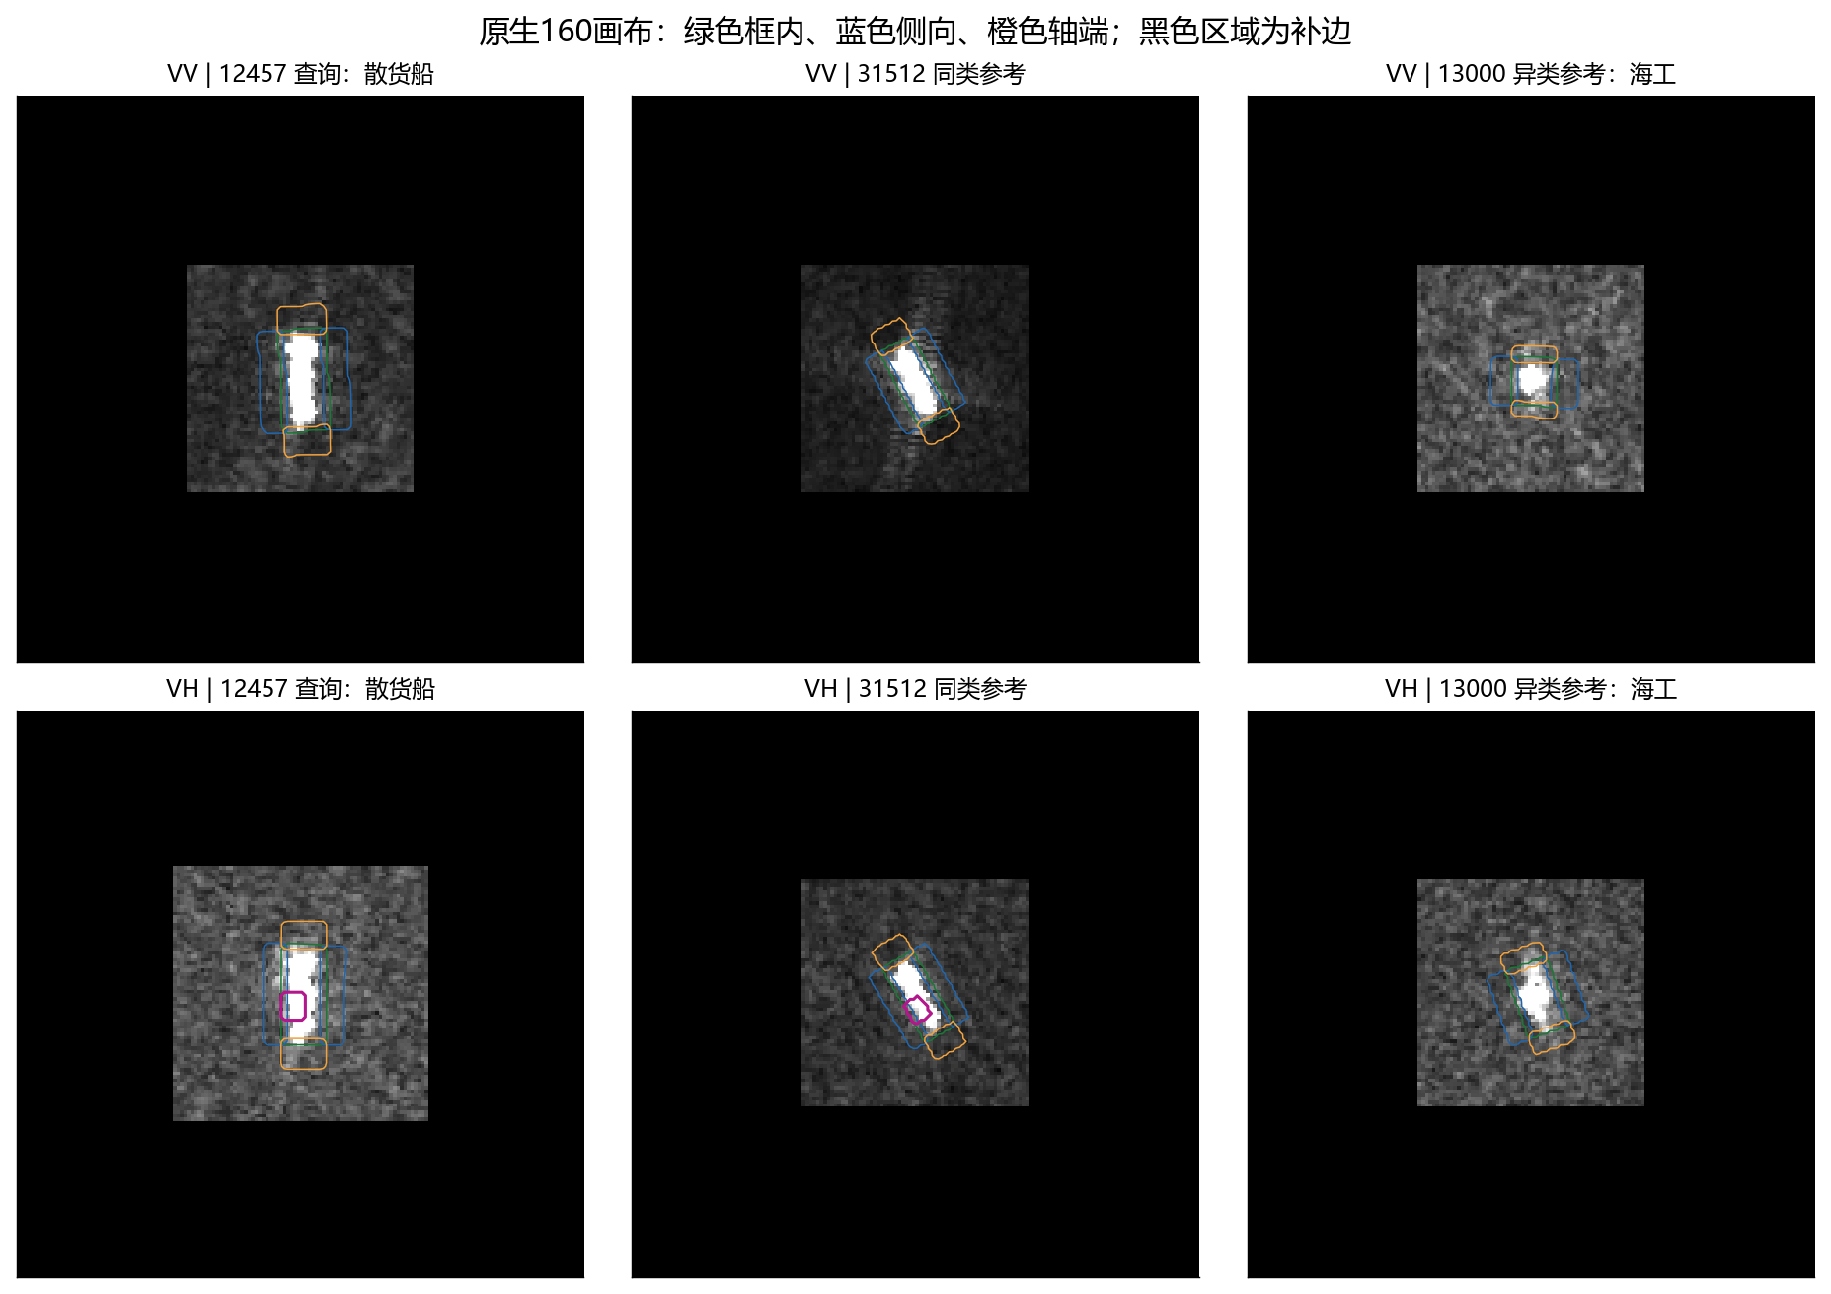
RCEW: Channel and Spatial Comparison
Channel Branch
μ_{c}
μ_{¬c}
MLP
0.5 tanh
1
ChannelWeight
w_{c}
Spatial Branch
S_{sij}
S_{sij}
w_{c}
S_{sij}
S_{sij}
S_{sij}
S_{sij}
S_{sij}
S_{sij}
S_{sij}
S_{sij}
S_{sij}
Weighted
Cosine
Similarity
S_{sij}
S_{sij}
S_{sij}
Single-pair
Slot Similarity
S_{sij}
S_{sij}
S_{sij}
S_{sij}
S_{sij}
S_{sij}
S_{sij}

