Slide 1
Lockdown Strategies

Slide 2
Contact Network
Epidemic model
Control strategies
Outcome measures

Slide 3
Contact network

Slide 4
Situation | Household | School/Work | Other
Normal | *** | ** | *
Lockdown | ↑ | ↓ | ↓
Isolate | 0 | 0 | 0
Quarantine | 0 | 0 | 0
Home quarantine | * | 0 | 0
Type | 0 (no contact) | 1 (weak) | 2 (moderate) | 3 (strong)
Household | 0.1 | 0.2 | 0.4 | 0.3
School/Work | 0.2 | 0.4 | 0.3 | 0.1
Other | 0.65 | 0.2 | 0.1 | 0.05

Slide 5
Epidemic model

Slide 6
Infected
Onset
Isolated
Recovery
Released
I
Onset time
Isolated time
Recovery time
Released time
Incubation period
Isolated delay
Recovery period (14 days)
Isolated period (14 days)
I
S

Slide 7
Initial: n_initial = 1
Outside: p_outside = 0.001
IAS
p_asym=40%
14 days
S
I
R
IS
p_sym=1-p_asym
14 days
Isolation
p_isolation=1
p_infection
14 days
Release
Contact network
p_quarantine = 1
C
p_trace = 1
Traced
Quarantine
14 days

Slide 8

Transmission rate
$$λ\left(t,s_{i},p_{i}\right)=A_{s_{i}}I_{ei}\int_{t−1}^{t}{f\left(u;μ_{i},α_{p_{i}},ω_{p_{i}}\right)du}$$
Generation time
number of days since the infector i was exposed
Weighting of the edge of the network
infector’s asymptomatic status
infector’s presymptomatic status
Scaling factor for the infector’s symptomatic status

Slide 9
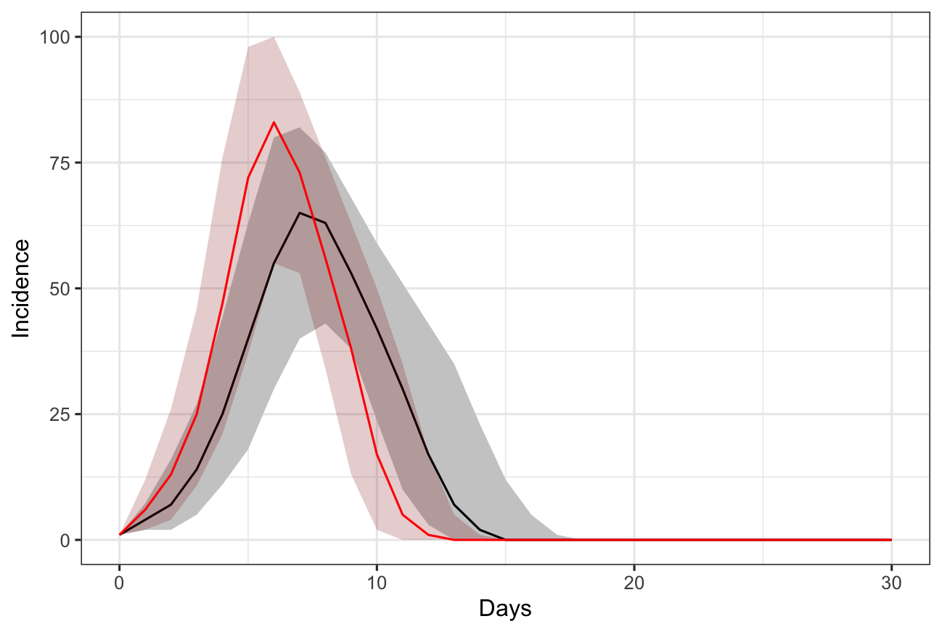
No control
n_initial = 1
p_asym = 0.4
d_recovery = 14
p_presym = 0.4
p_asymtrans = 0.5
R = 2 (black), 4 (red)
p_outside = 0.001
p_contact = 0.9
cap_max_days = 180
hh = 0.1, 0.2, 0.4, 0.3
ws = 0.69, 0.2, 0.1, 0.01
ot = 0.889, 0.1, 0.01, 0.001

Slide 10
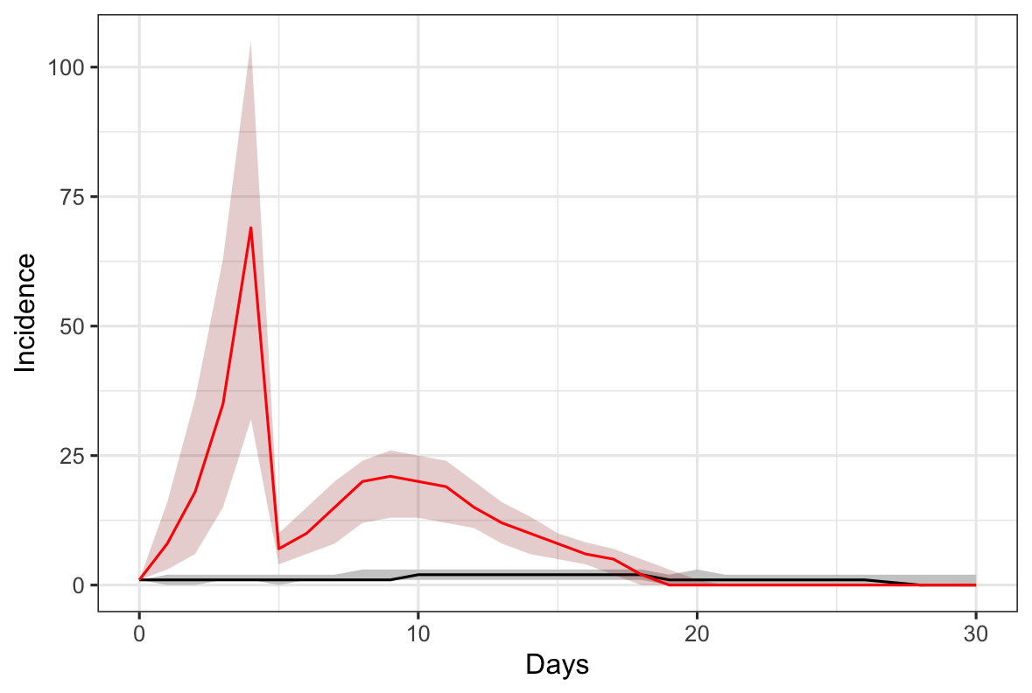
Full lockdown
n_initial = 1
p_asym = 0.4
d_recovery = 14
p_presym = 0.4
p_asymtrans = 0.5
R = 6.5
p_outside = 0.001
p_contact = 0.9
cap_max_days = 180
hh = 0.01, 0.02, 0.5, 0.47
ws = 0.9889, 0.01, 0.001, 0.0001
ot = 0.9989, 0.001, 0.0001, 0.00001

