Slide 1

APIs
What They Are and How to Use Them

Slide 2
Who We Are
Jordan Emmendorfer, Software Developer
2+ years at the Credit Union
Maintains API for Authentication of 3rd party chat system
Austin Drouare, Senior Software Developer
9 years at the Credit Union
Experience consuming APIs of 3rd party vendors
Maintaining and consuming internal APIs for Computerline and Mobile banking applications.
Thanks to Ryan Ballard, Jenny Schiebner, Aaron Parks for contributing content to this presentation

Slide 3
Agenda
API definition
Common API formats
API consumption demo
Considerations around using APIs
Overview of API documentation

Slide 4
What is an API?
An Application Programming Interface (API) is a set of protocols used by programmers to create applications for a specific operating system or to interface between the different modules of an application. (dictionary.com)
Operating system
Web-based system
Database system
Computer hardware
Software library

Slide 5
What is an API? (cont.)
Simplified: An API is how our code can leverage code written by other developers.
Software library The library’s API is how your IDE (e.g. Eclipse, NetBeans, IntelliJ) is able to provide autocomplete suggestions.
Web-based system Availability: open (public), partner (licensed), or internal (private) We will focus on open APIs today. Not built in like a library – so how do we communicate?

Slide 6
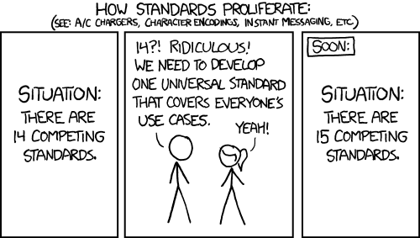
It depends!

Slide 7
API Standards and Protocols
Define how we communicate with APIs
Remote Procedure Call (RPC) and Remote Method Invocation (RMI)
Simple Object Access Protocol (SOAP)
Representational State Transfer (REST) (kind of)
REST is an architectural style, not a protocol, but REST implementations typically use a common set of protocols

Slide 8
RPC and RMI
RPC was first, and RMI is the object-oriented analog
Usually includes tooling to generate stubs and data structures as well as libraries to serialize requests and de-serialize responses.
First popular implementation was Sun’s RPC, best known for its use in Network File System (NFS).
Java RMI, DCOM, CORBA, and WCF have also enjoyed popularity in their niches.

Slide 9
Simple Object Access Protocol (SOAP)
Descended from XML-RPC
Formalized by the World Wide Web Consortium (W3C)
Currently (somewhat) popular, though it is rapidly being replaced by REST and REST-like services.
Requests and responses are serialized as XML and typically sent by HTTP, though other communication protocols may also be used.
Contract typically defined in machine-readable format (WSDL and XSD) to support tooling.

Slide 10
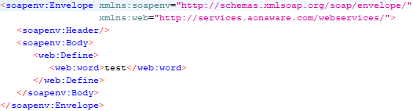
SOAP Request Example
When dealing with SOAP, language aside, SoapUI is your friend

Slide 11
Representational State Transfer (REST)
More general than RPC
Can be used to implement RPC or RMI
More often presents as a CRUD interface
Good APIs are typically a blend
Works with HTTP rather than against it – makes semantic use of HTTP operations (GET, POST, PUT, DELETE, etc.) and response codes, caching, and so on.
JSON is the most common serialization. XML was popular too.
Hypermedia: good APIs include links to other resources in their responses rather than assuming the client knows where to find them.

Slide 12
HTTP Overview (for REST purposes)
Headers
Status Codes
Content-Type
Accepts
Authentication
Explicit Caching
1xx – Informational
2xx – All good!
3xx – Redirect
4xx – You messed up
5xx – I messed up

Slide 13
SOAP vs REST
SOAP
REST
XML
Typically HTTP
More explicitly defined
More common in internal/private web services
Typically JSON
Exclusively HTTP
More implicitly understandable
More common in external/public web services

Slide 14
Live Demo
https://github.com/oucreditunion/grizzhacks2019
Consuming a REST API
If you’re still not sure where to start, check out this tutorial: https://www.restapitutorial.com/

Slide 15
Should I use an external API?
Pros
Cons
Leverage work that’s already done
Maintenance is outsourced
Focus on the core functionality of your project
Additional overhead/latency
Usage limits
Risk of API going away or changing without notice
Potential mismatch in SLAs

Slide 16
Should I use an internal API?
Pros
Cons
Allow sharing of resources across systems/languages
Can prevent isolated failures from bringing the entire system down
Only works if API consumers are fault tolerant
e.g. Netflix
Can use to limit other systems’ access to network elements (e.g. data sources)
Additional overhead
Additional maintenance
More points of failure
System coupling
Less obvious discrepancy issues
Compile vs. runtime

Slide 17
Decision factors for using an API
External API
Internal API
Can the same functionality be reasonably recreated and maintained?
Is there a code library that performs a similar function?
Is the API functionality vital to the success of the project?
Would multiple systems benefit from access to the resource?
Still could use a library if they’re the same language
Do the consuming systems have value without the resource?
At larger organizations, these questions are typically not answered (exclusively) by software developers.

Slide 18
Either way, exercise caution
Fault tolerance/graceful failure
Caching/backup plan

Slide 19
Examples from OU Credit Union
Google Maps API
Correio
NeverBounce
We also have in-house solutions for integrating e-mail bounce detection with proprietary vendor software
Visa
Some vendors have SOAP APIs
We expose some APIs internally to share implementations of defined processes and communicate between languages

Slide 20
Examples of Cool (Free-ish!) APIs
REST
Weather: darksky.net (aka forecast.io)
first 1,000 requests/day are free
Contact: twilio.com
Free trial with credit, some limitations on call length, etc.
Others can be found in this article: https://blog.rapidapi.com/most-popular-apis/
SOAP
Dictionary: http://services.aonaware.com/DictService/DictService.asmx
E-mail Verification: http://ws.cdyne.com/emailverify/Emailvernotestemail.asmx

Slide 21
What makes good documentation?
Clear communication layer requirements (request/response objects).
Detailed descriptions (types and purpose) of properties.
Easy to find and search, separated from other documentation.
Language-agnostic
Examples:
https://darksky.net/dev/docs (simple)
https://developers.google.com/maps/documentation/ (complex well organized)

Slide 22
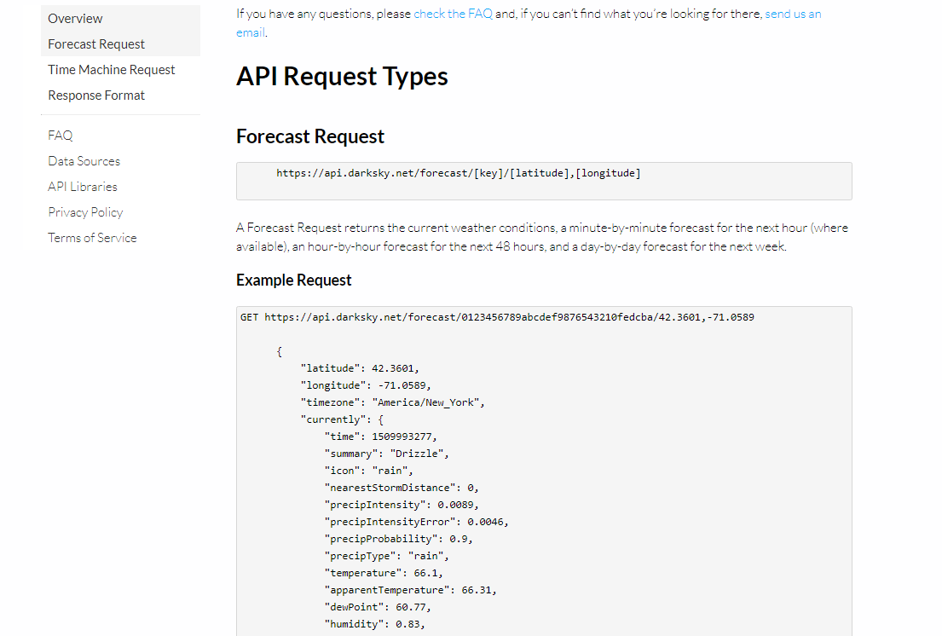

Slide 23
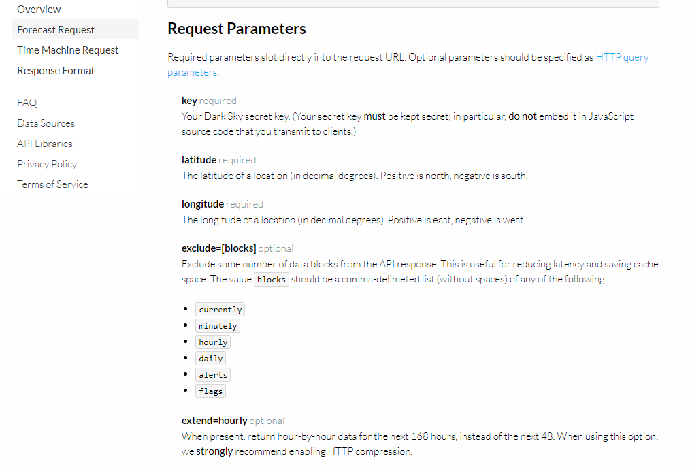

Slide 24
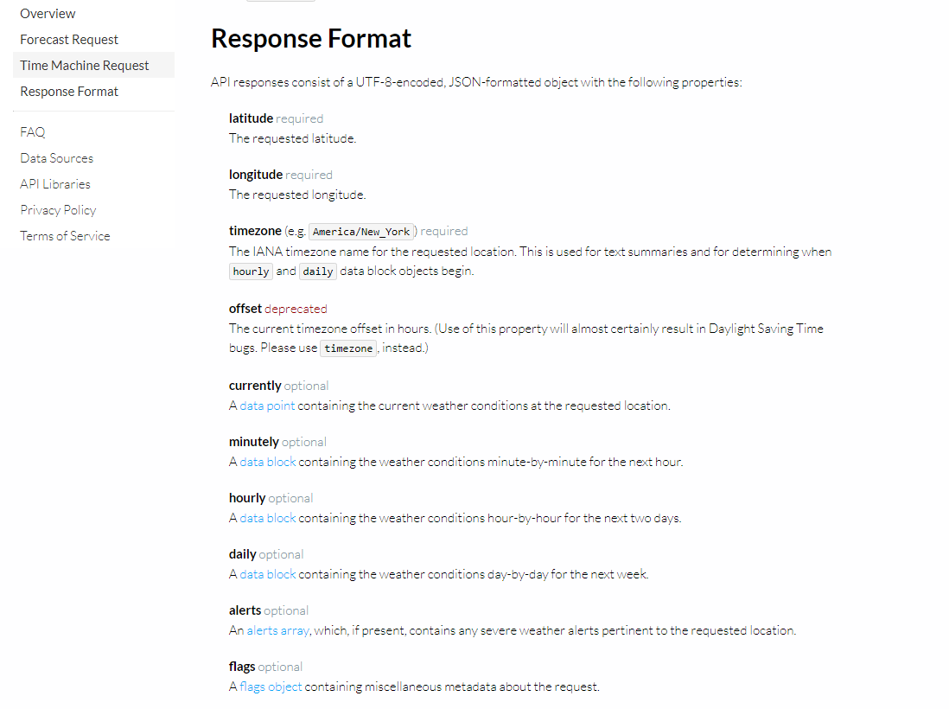

Slide 25
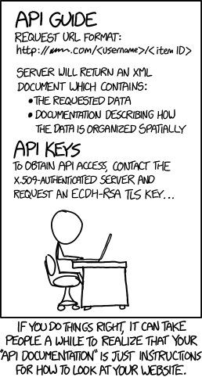
This documentation is bad. What now?
Commiserate.
When documentation for a public API is poor, odds are high that someone else has struggled with it and has advice to share. Check Stack Overflow and search for blog posts if you’re having a hard time using an API.
Eliminate variables.
Work in test environments and do trial and error testing.

Slide 26
What We Covered
API Definition
Different types of API
Different communication standards and protocols for Web APIs
How to consume a REST API
Considerations around using an API
How to deal with poorly documented APIs

Slide 27
Questions?

Slide 28
References
Article by Glenn Johnson - https://it.toolbox.com/blogs/glennjohnson/application-programming-interface-api-definition-and-classification-by-types-040214
Comics from xkcd.com
The developer hive mind
And, of course… Wikipedia

Slide 29
Thank you!

