Slide 1
Deconvolution Results Summary Report

Slide 2
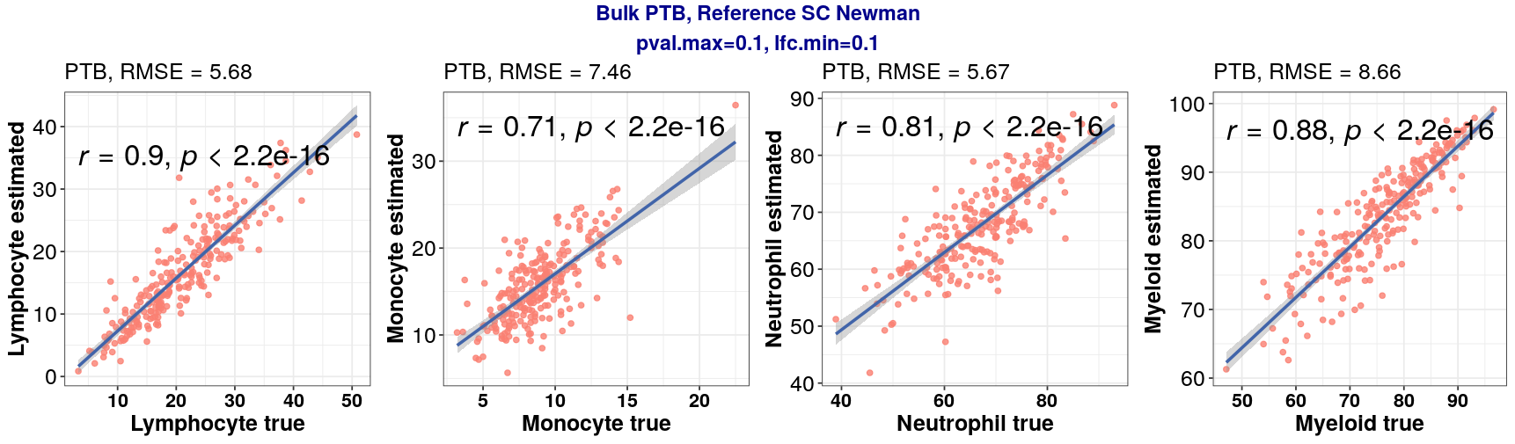
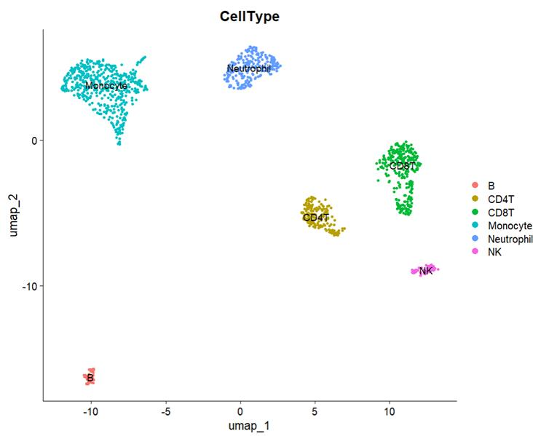
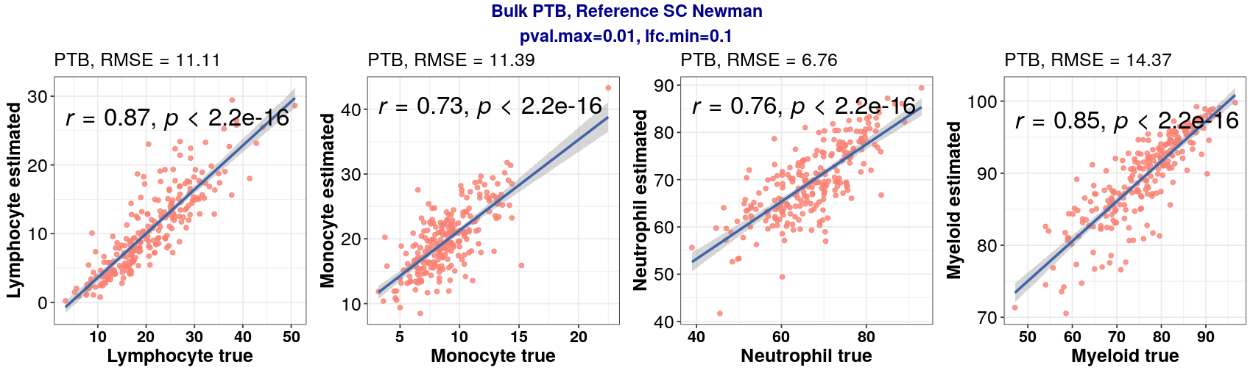
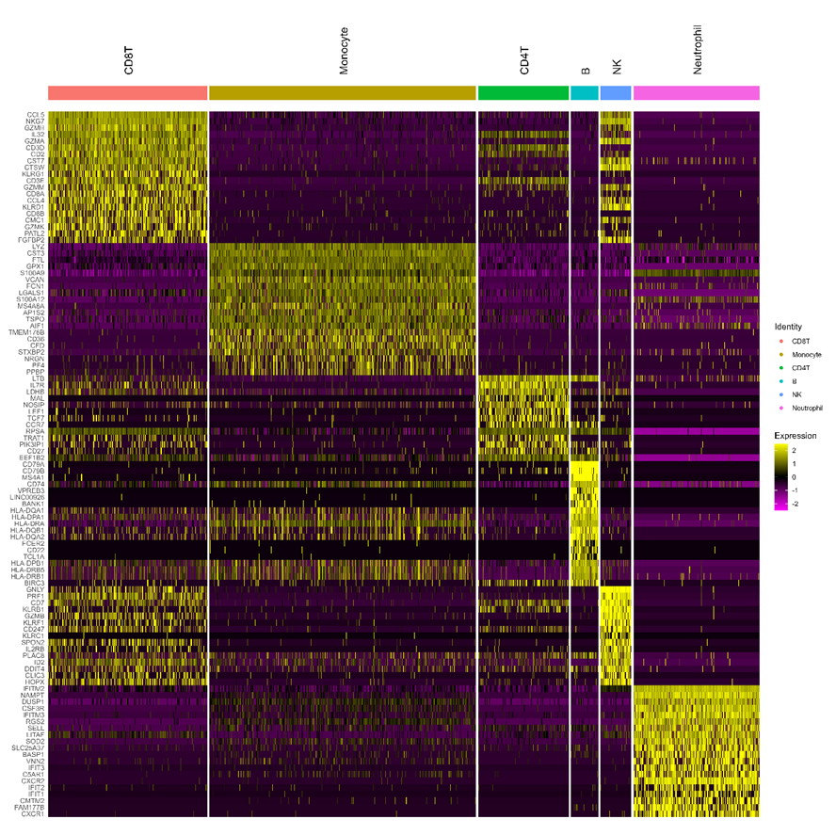
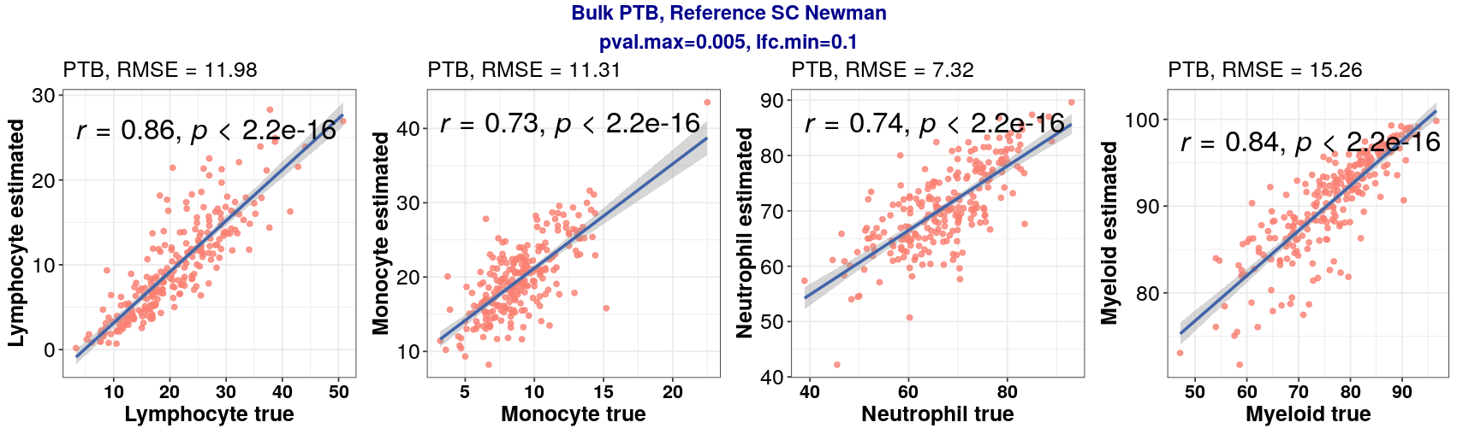
Bulk PTB, Ref Newman
Single-cell data: (1303, 11585)
Bulk RNA-seq data: (296, 60642)
# genes after filtering: 2399 (0.1, 0.1)

Slide 3
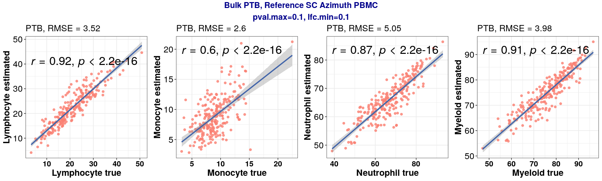
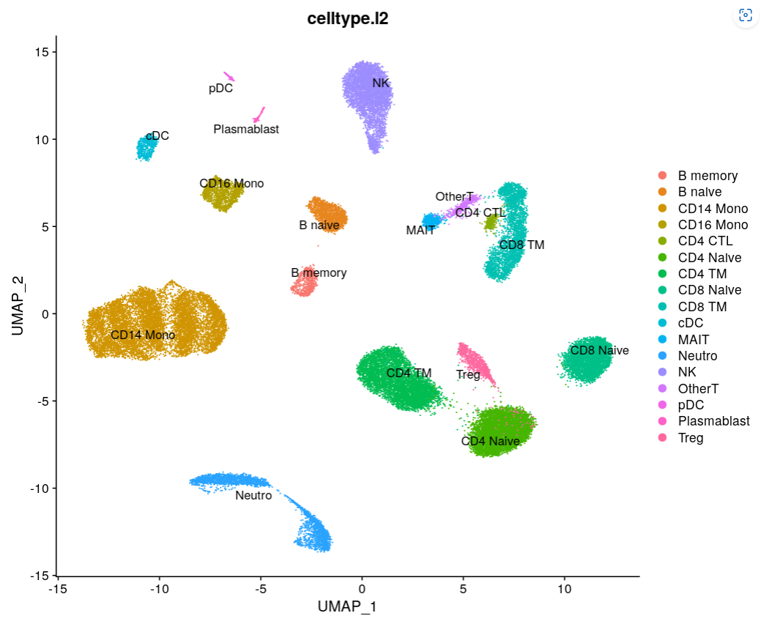

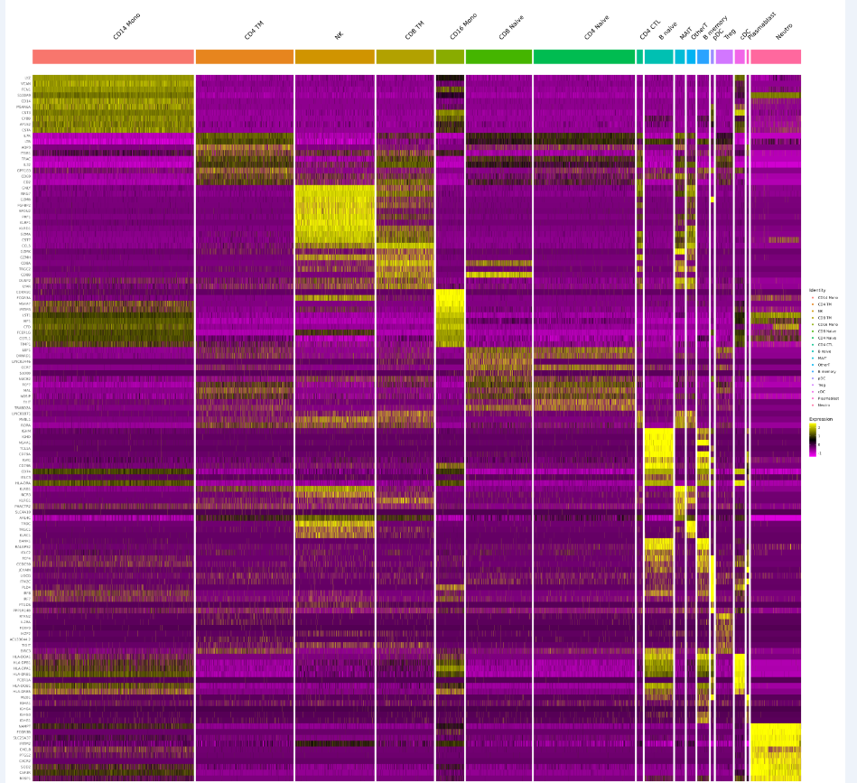
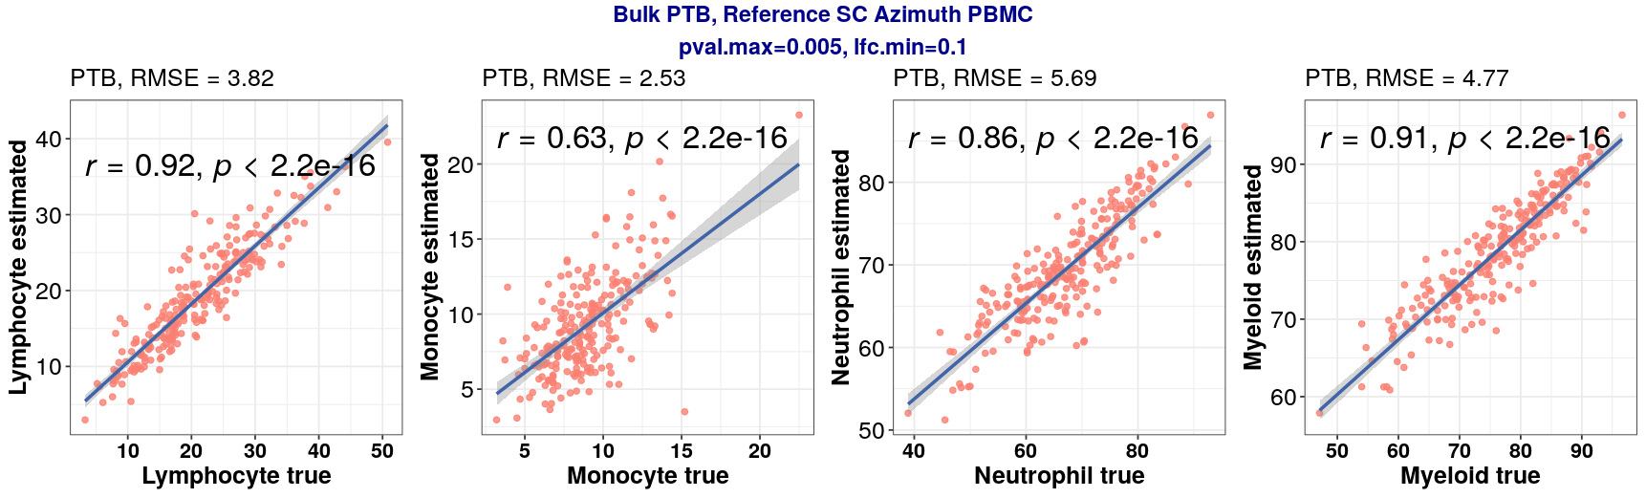
Bulk PTB, Ref PBMC
Single-cell data: (43380, 10017)
Bulk RNA-seq data: (296, 60642)
# genes after filtering : 4867 (0.1, 0.1)

Slide 4
Ref Newman vs PBMC
Newman
PBMC

Slide 5
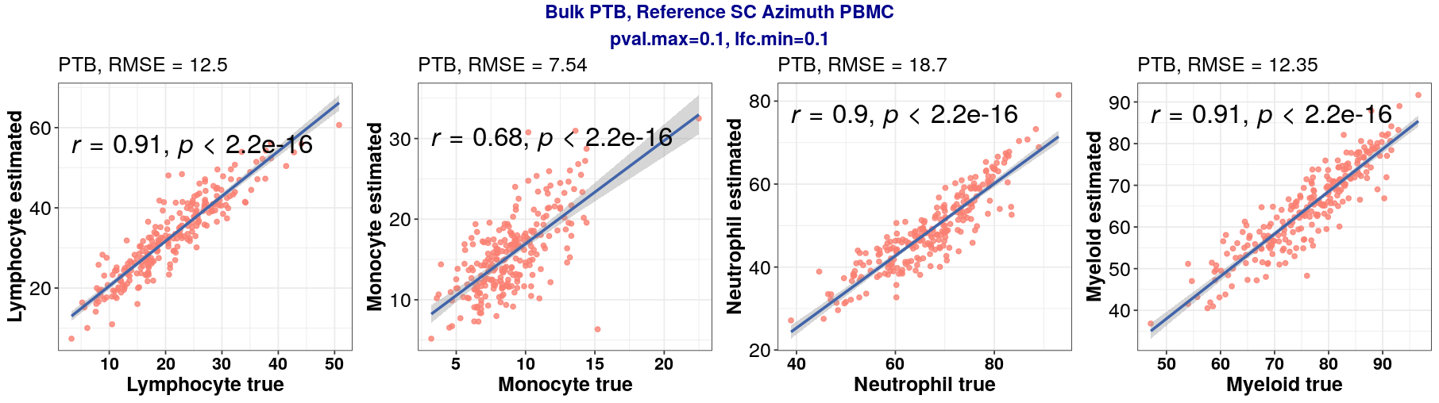
Ref PBMC – BayesPrism update estimation
Update all cell types
Update Neutrophil only

Slide 6
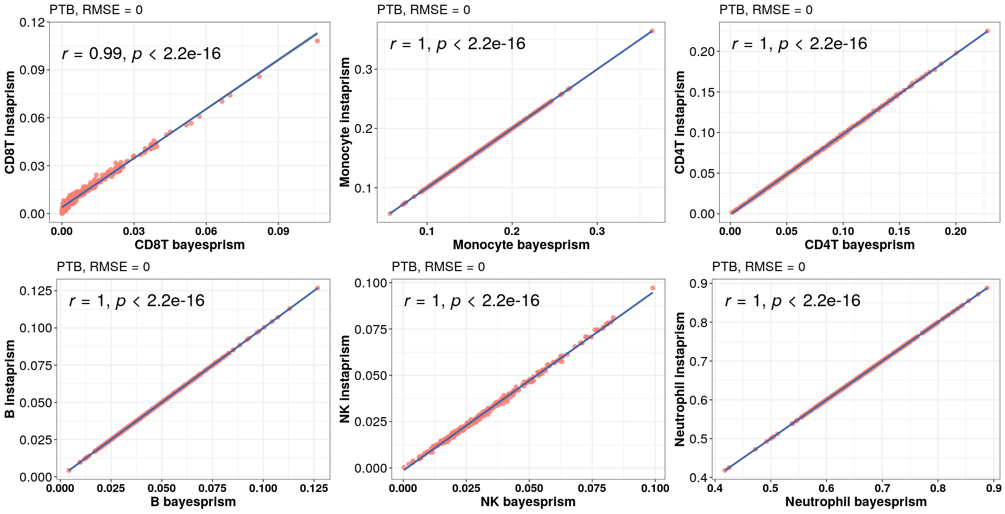
BayesPrism vs InstaPrism on Newman
pval.max=0.1, lfc.min=0.1

