Slide 1
CS Demand Forecasting & Shift Scheduling
AI-Powered Staffing Optimization for April 2026
Technical Assessment | AI & Full-Stack Engineer
(Presented by Ougrid D. – Candidate)
Presented to ARWN

Slide 2
The Challenge
What we're solving
50 Agents
4 Shifts/Day
30 Days
2 KPI Targets
10 Senior + 40 Junior 8 English-capable
Morning · Afternoon Evening · Night
April 2026 6 leave days each
CSAT ≥ 4.0 Wait ≤ 60 seconds
Business Constraints
6 hard constraints: leave allowance, pre-selected leave, night rest, minimum staffing, daily leave cap, valid assignments
2 soft objectives: night shift fairness across agents, minimize overstaffing
Goal: Find an optimal schedule respecting ALL constraints while maximizing service quality
ARWN | CS Demand Forecasting & Shift Scheduling

Slide 3
Solution Architecture
Two-stage pipeline: Predict → Optimize → Validate
Stage 1
Stage 2
Stage 3
Stage 4
FORECAST
STAFFING
SCHEDULE
EVALUATE
Predict ticket volume per shift per day
→
Determine minimum Sr/Jr/Eng per shift
→
Assign 50 agents to shifts × 30 days
→
Validate constraints & project quality
GradientBoosting Regressor
Quality Models + Grid Search
Google OR-Tools CP-SAT Solver
Fairness + CSAT + Remediation
Tech Stack: Python 3.11 · scikit-learn · Google OR-Tools · Streamlit · Plotly · pandas · pytest
ARWN | CS Demand Forecasting & Shift Scheduling

Slide 4
Task A: Demand Forecasting
Two-stage approach — Volume Prediction → Staffing Optimization
STAGE 1: VOLUME
STAGE 2: STAFFING
GradientBoostingRegressor
Quality Models + Grid Search
Trained on 6 months of historical shift data (728 records)
Features: day_of_week, is_weekend, cyclical month, shift ID, day_of_month
Time-based validation split (last month held out)
Predicts ticket volume per shift per day for April 2026
CSAT Regression: volume + senior + junior + english → CSAT score
Wait Time Regression: same features → avg wait seconds
Vectorized grid search: find minimum staff meeting both targets
Historical floors (p10) prevent model extrapolation errors
Feasibility caps for scarce pools (8 English agents, ~6.4 avail/day)
0.927
19.7 tickets
0.818
0.963
Validation R²
Validation MAE
CSAT Model R²
Wait Model R²
Why GradientBoosting over LSTM/Prophet? → Tabular data with few features (not sequential), small dataset (728 rows), interpretable feature importance, fast training, strong out-of-box performance on structured data. LSTM would need 10-100x more data and offer no interpretability benefit.
ARWN | CS Demand Forecasting & Shift Scheduling

Slide 5
Task B: Shift Scheduling Engine
Constraint Programming with Google OR-Tools CP-SAT
Hard Constraints (must satisfy)
Soft Constraints (optimize)
1. Exactly one assignment per agent per day (shift or leave)
2. Each agent gets exactly 6 leave days per month
3. All 3 pre-selected leave dates honored
4. Night shift → mandatory rest day (counts as leave)
5. Minimum staffing per shift: Senior, Junior, English
6. Daily leave cap: max 19 agents on leave
1. Night shift fairness — minimize variance across agents (w=5)
2. Overstaffing penalty — minimize excess beyond minimums (w=1)
3. Agent preferences — honor shift likes/dislikes (w=1)
Model Complexity
Decision variables: 50 agents × 30 days × 5 options = 7,500
Solver: CP-SAT (Constraint Programming – SAT)
Solution time: ~60s → FEASIBLE (119/120 targets met)
Why CP-SAT over heuristics/genetic algorithms? → Guaranteed constraint satisfaction, provable optimality bounds, declarative modeling (add constraints without rewriting logic), scales well to 7,500 variables, industry-standard for shift scheduling.
ARWN | CS Demand Forecasting & Shift Scheduling

Slide 6
Results
Full pipeline performance
4.27
21.6s
119/120
0
~71s
Avg CSAT
Avg Wait
Targets Met
Hard Errors
Pipeline Time
Target ≥ 4.0
Target ≤ 60s
99.2% of shifts
All satisfied
End-to-end
Average Daily Staffing by Shift
Shift
Senior
Junior
English
Total
CSAT
Wait (s)
Morning (06-14)
5.0
10.3
4.6
15.3
4.29
18.1
Afternoon (14-20)
3.5
8.2
3.8
11.7
4.25
23.4
Evening (20-00)
1.7
3.8
1.3
5.5
4.30
19.8
Night (00-06)
0.5
2.0
0.7
2.5
4.22
25.2
ARWN | CS Demand Forecasting & Shift Scheduling

Slide 7
Design Decisions & Trade-offs
Why we chose what we chose
FORECASTING
SCHEDULING
GradientBoosting over LSTM/Prophet
CP-SAT over Heuristics/GA
Tabular data (not sequential), only 728 rows, strong OOB performance, interpretable features, <1s training. LSTM needs 10-100x more data for marginal improvement.
Guaranteed constraint satisfaction, provable bounds, declarative modeling (easy to add/modify constraints), scales well for 7,500 decision variables. Greedy/GA cannot guarantee feasibility.
ARCHITECTURE
PRODUCTION
Two-Stage Forecasting
Config-Driven Design
Volume → Staffing decoupling: isolates forecasting error from optimization. Quality models bridge the gap (CSAT/wait as function of staffing). Historical floors prevent model extrapolation into unrealistic territory.
All business rules in SchedulingConfig dataclass — weights, thresholds, solver params. Zero magic numbers in logic. Managers can tune via dashboard sliders without code changes.
ARWN | CS Demand Forecasting & Shift Scheduling

Slide 8
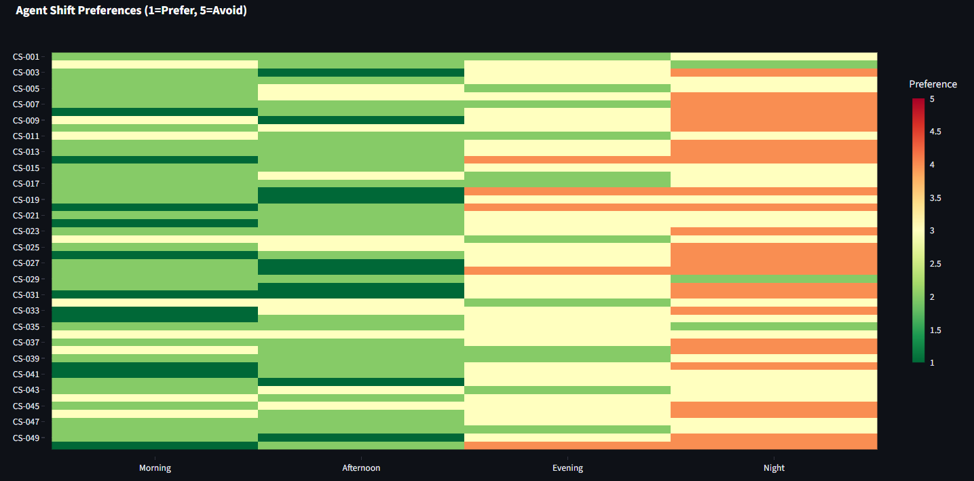
Bonus: Agent Shift Preferences
Soft constraint integration for employee satisfaction
How It Works
Results
Each agent has preferences for each shift (1=love → 5=avoid)
Generated based on role (seniors prefer day), language, + individual variation
Integrated as soft objective: solver minimizes assigning agents to disliked shifts
Preference cost = (preference score - 1) × weight in CP-SAT objective
Balanced against fairness and staffing: satisfaction is a goal, not a guarantee
82%
1,083/1,200
Satisfaction
Preferred Shifts
Production Value
Reduces burnout by respecting individual scheduling preferences
Improves agent retention — a key metric for CS operations
Tunable weight: managers can trade preference vs. fairness
Dashboard tab shows per-agent satisfaction with heatmap visualization
[Screenshot: Preference Heatmap from Dashboard]
ARWN | CS Demand Forecasting & Shift Scheduling

Slide 9
Bonus: Agent Shift Preferences
ARWN | CS Demand Forecasting & Shift Scheduling

Slide 10
Bonus: Fairness Metrics & Remediation
Quantitative equity measurement + actionable suggestions
Fairness Scoring
Constraint Remediation
Gini coefficient: 0 = everyone equal, 1 = one person gets all
Night shift Gini: measures equity in unpopular shift distribution
Workload Gini: measures equity in total working days
Shift entropy (Shannon): diversity of shift assignments per agent
Composite score (0-100): 40% night + 30% workload + 30% variety
Letter grade: A (≥90) → F (<60); sparsity-adjusted for realism
Each violation type → specific, actionable suggestion
Grouped by category with affected days listed
e.g. "Move a senior from lower-demand shift" for staffing gaps
e.g. "Swap with agent having complementary pattern" for continuity
Dashboard shows expandable remediation per violation group
Enables managers to make informed manual adjustments
Why This Matters for Production → Fairness metrics give managers visibility into equity issues before agent complaints. Remediation transforms a 'failed constraint' alert into a concrete action plan. Together, they close the feedback loop between automated scheduling and human oversight.
ARWN | CS Demand Forecasting & Shift Scheduling

Slide 11
Production Readiness
Built for maintainability, not just to pass the test
📦
Modular Architecture
⚙️
Config-Driven
Clean separation: forecasting / scheduling / evaluation. Each module testable independently. New constraints = new function, not rewrite.
SchedulingConfig dataclass: all business rules, weights, thresholds in one place. Dashboard sliders map directly to config. Zero magic numbers in logic.
✅
Comprehensive Testing
🚀
CI/CD Ready
55+ pytest tests: data integrity (8), forecasting (11), scheduling (13), bonus features (26). Module + integration coverage.
pyproject.toml with dependencies. Conventional commits (13 total). Tests run in <5s (unit) + ~71s (integration pipeline). Git-clean repo.
🛡️
Defensive Engineering
📊
Interactive Dashboard
Historical floors prevent model extrapolation. Feasibility caps for scarce agents. Windows encoding fix for cross-platform. Graceful degradation on solver timeout.
7-tab Streamlit app: managers adjust parameters, see results, download CSV. Cached pipeline results for responsive interaction. No code changes needed.
ARWN | CS Demand Forecasting & Shift Scheduling

Slide 12
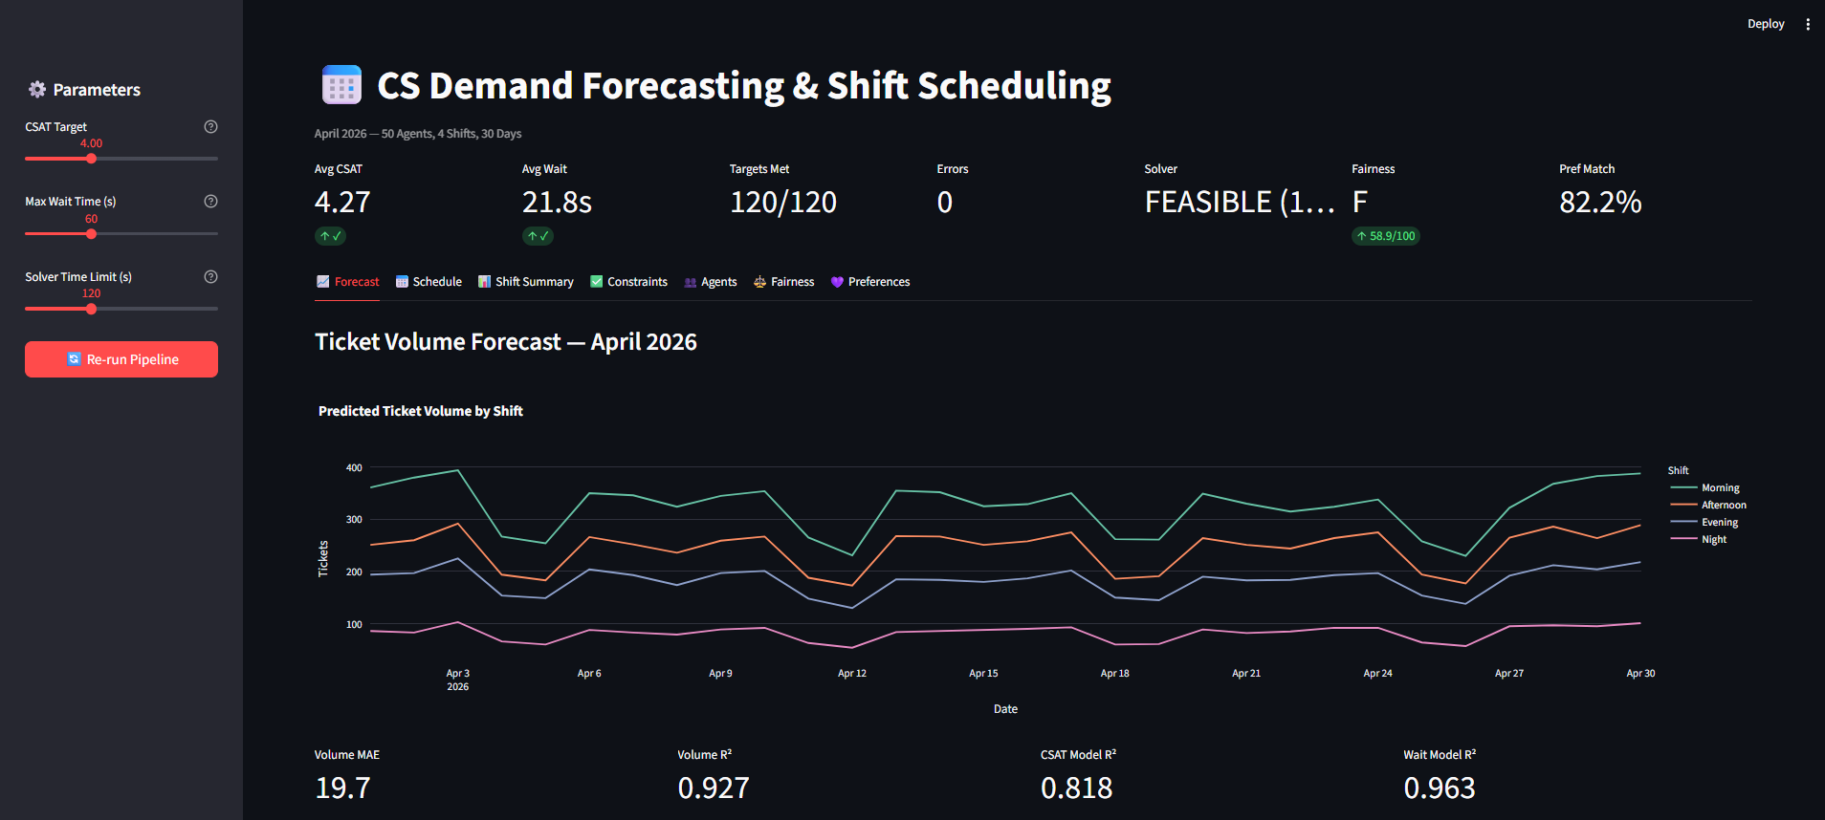
Interactive Dashboard
7 tabs: Forecast · Schedule · Summary · Constraints · Agents · Fairness · Preferences
[Insert Dashboard Screenshots Here] Run: streamlit run app.py
Adjustable CSAT/wait targets
Calendar schedule view
Download CSV export
Real-time constraint validation
Preference heatmap
Fairness grade & Gini
Remediation suggestions
ARWN | CS Demand Forecasting & Shift Scheduling

Slide 13
Interactive Dashboard
[Insert Dashboard Screenshots Here] Run: streamlit run app.py
ARWN | CS Demand Forecasting & Shift Scheduling

Slide 14
Challenges Solved
Real engineering problems encountered and resolved
Unrealistic Staffing Predictions
English Agent Scarcity
Problem: Model extrapolated: predicted 4-5 agents when historical data showed 14+
Problem: 8 English agents total, optimizer demanded 8/day — impossible with 6 leave days
Solution: Added historical staffing floors (10th percentile of quality-meeting shifts) as lower bounds. Prevents model from predicting below observed reality.
Solution: Added feasibility caps: available_english = max(1, int(8 × 0.8) - 1) = 5. Prevents infeasible staffing requirements that would block the scheduler.
Preference vs. Fairness Tension
Windows Encoding
Problem: Adding preference soft constraint → solver trade-offs night shift equity
Problem: Emoji in CLI output crashed on Windows cp1252 console encoding
Solution: Sparsity-adjusted Gini scoring (only ~80 night slots for 50 agents), tunable weight balance. Accept mathematical limits of sparse distributions.
Solution: Wrapped stdout with io.TextIOWrapper(encoding='utf-8', errors='replace'). Cross-platform compatible.
ARWN | CS Demand Forecasting & Shift Scheduling

Slide 15
What's Next
Production roadmap if this goes to production
Short Term
Medium Term
Long Term
Add real agent preference survey integration
Auto-tune solver time based on solution gap
A/B test scheduling configs
Add shift swap request workflow
Online learning: retrain models monthly on actual data
Multi-month scheduling (rollover constraints)
Agent skill-based routing (beyond Sr/Jr/Eng)
Real-time re-scheduling on sick days
Reinforcement learning for adaptive scheduling
Integration with HR/payroll systems
Multi-site scheduling optimization
Automated anomaly detection in CSAT trends
ARWN | CS Demand Forecasting & Shift Scheduling

Slide 16
Thank You
Questions & Discussion
github.com/ougrid/arwn-aifse
Python 3.11 · scikit-learn · OR-Tools · Streamlit · 55+ Tests · 13 Commits
ARWN

