Slide 1

SPARKS
Sequential Pilot-point Assisted
Random-path Kriging and Simulation
A Fortran command-line engine for reproducible spatial estimation, block kriging, co-kriging, external-drift workflows, and sequential Gaussian simulation.
Fortran core
OpenMP
CLI + namelist
SGSIM
Source basis: pyKriging README and SPARKS source, accessed May 2026.
01

Slide 2
Why SPARKS?
A compact executable for large, repeatable geostatistical runs.
Typical workflow pain points
Large grids make interactive tools slow or hard to automate.
obs
vgm
grid
Simulation needs reproducible random paths and samples.
Block / pilot-point workflows need clear file I/O.
solve
Debugging kriging matrices and weights should be transparent.
est
sim
SPARKS wraps the full run as a deterministic, scriptable command.
SPARKS source documents: parse files → set_vgm/set_obs/set_grid/set_sim/set_search → solve → write output.
02

Slide 3
Core functionality
What the executable exposes from the kriging engine.
OK / SK
Co-kriging
KED / UK
Ordinary and simple kriging; point or block targets.
Primary, secondary, and cross-variograms for two-variable workflows.
External drift fields through observation and block drift columns.
SGSIM
Anisotropy
Diagnostics
Sequential Gaussian simulation with seed, path, and sample controls.
Angles, anisotropy ratios, and anisotropic neighbor search.
LOOCV, matrix writing, verbose run summary, failure continuation.
Features summarized from pyKriging README and SPARKS CLI options.
03

Slide 4
File-based interface
Simple text files in; estimates, simulations, and weights out.
obsfile1
obsfile2
variograms
angles / search
blocks + grid
weights / drift
solve
kriging or SGSIM
outfile
facfile
CLI mode
Namelist mode
One executable call can specify dimensions, observations, variograms, anisotropy, simulation, and output format.
A single .nml file stores a reproducible project configuration for batch runs and version control.
SPARKS options include obsfile1/2, gridfile, blockfile, facfile, randpath, samfile, rangescale, localnugget, and namelist.
04

Slide 5
Architecture for speed and repeatability
Object-oriented Fortran core, search acceleration, and controlled stochastic runs.
SPARKS executable
CLI / namelist parser; reads files and writes results
OpenMP
parallel block loop
t_kriging engine
set_vgm, set_obs, set_grid, set_sim, set_search, solve
KD-tree
fast neighborhood search
Search + solver workspace
k-d trees, matrices, RHS, weights, thread-private contexts
Factor files
reuse kriging weights
Fortran numerics
variogram, rotation, Gaussian quadrature, LAPACK-style solver
kriging.F90 notes: OpenMP block loop, thread-private contexts, k-d tree search, and factor-file weight reuse.
05

Slide 6
Kriging and SGSIM in one execution model
Same spatial model, two outputs: best estimate or conditional realizations.
Kriging
Build covariance matrix → solve weights → estimate and variance.
data
C
λ
z*
SGSIM
Visit grid in random path; condition on observations plus prior simulated cells.
path
cond
N
sim
SGSIM uses block%order for random path and sample(s,ib) to draw z_sim = z_est + sqrt(var) * sample.
06

Slide 7
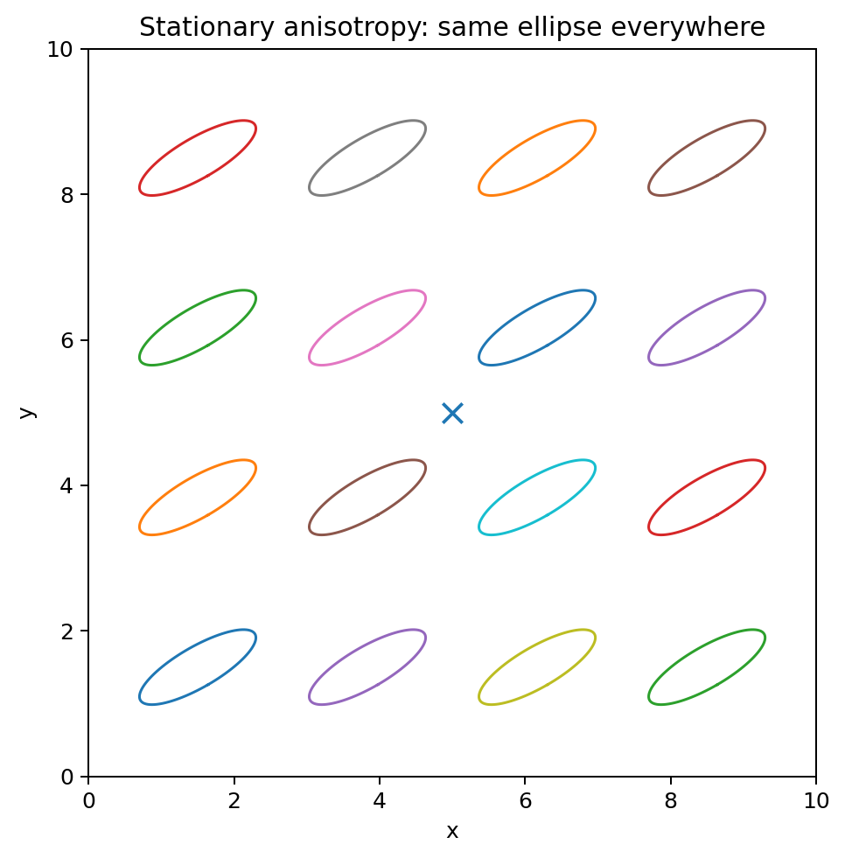
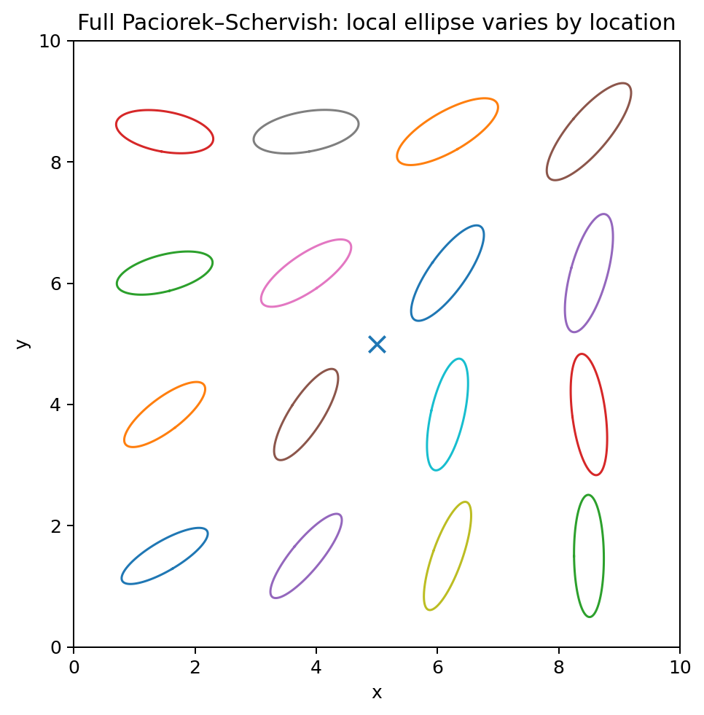
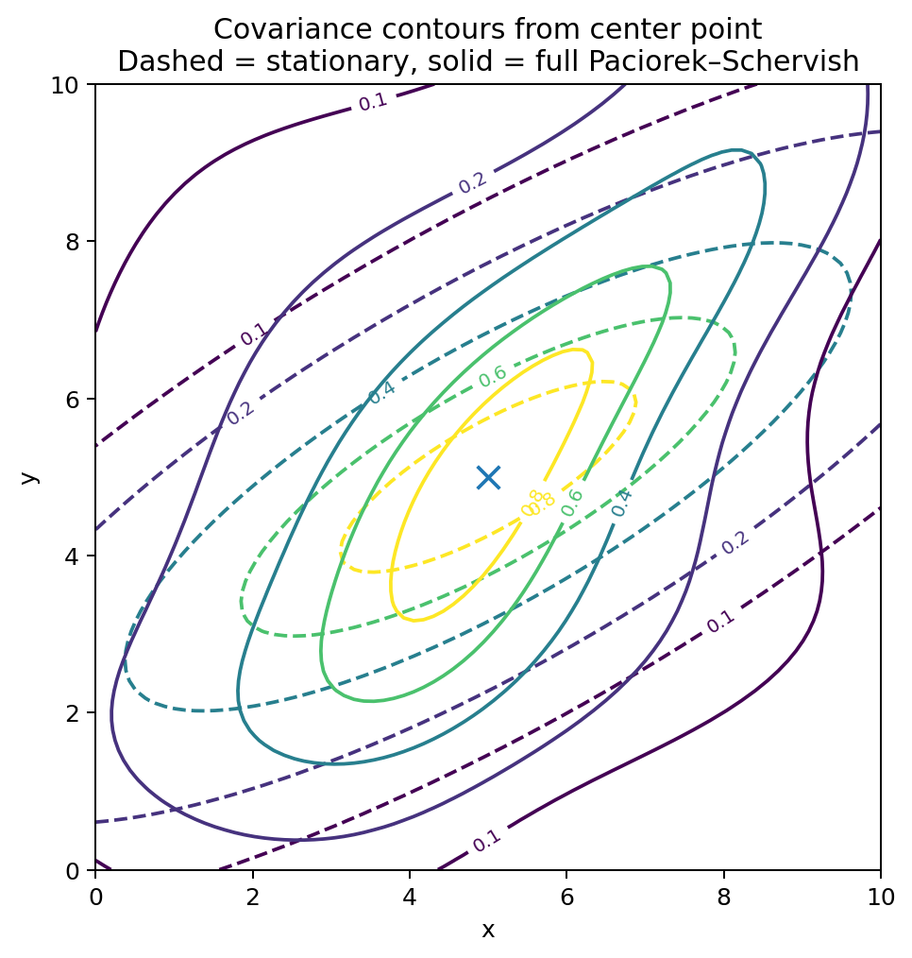
Anisotropy and local controls
Designed for geostatistical workflows where the covariance model changes with context.
Global anisotropy
Local anisotropy field
Covariance behavior
Current SPARKS supports angle/ratio anisotropy, anisotropic search, per-block range scale, and local nugget; these create a strong base for future local-anisotropy modes.
Figures are illustrative; feature basis from README + SPARKS options: ang1/2/3, anis1/2, anisosearch, rangescale, localnugget.
07

Slide 8
Where SPARKS is strong
Not a GUI replacement; a production-oriented executable for scripted geostatistics.
Python-only prototypes
SPARKS advantage
Compiled Fortran engine for heavier grids and batch execution.
Desktop GUI workflows
SPARKS advantage
Project runs can be fully scripted, versioned, and repeated.
General-purpose GP libraries
SPARKS advantage
Geostatistical concepts are first-class: block kriging, variograms, anisotropic search, SGSIM.
One-off simulation scripts
SPARKS advantage
Path/sample control and factor-file reuse support reproducible ensembles.
Best fit: hydrogeology, mining, environmental mapping, uncertainty ensembles, pilot-point studies, and repeatable model preprocessing.
Comparison is based on design orientation, not benchmark claims.
08

Slide 9
A typical run
Compact command-line execution with transparent inputs and outputs.
sparks -d 2 1500 25000 0 0 \
-of obs.csv -bf blocks.csv \
-v1 sph 1200 1.0 0.05 \
-a1 35 -s1 0.45 -as \
-n1 48 -u -xy estimates.csv
Outputs can include estimated values, kriging variance, coordinates, debugging matrices, or reusable factor files depending on flags.
Script → map / ensemble
Command shown is illustrative; option names come from SPARKS source.
09

Slide 10

Development roadmap
A focused path from robust estimator to richer research platform.
1
Stable CLI
tests, examples, CI binaries
2
Local anisotropy
target-local rotmat; then optional Paciorek–Schervish
3
Space-time
ST variograms, time scaling, reproducible ST simulations
4
Packaging
release artifacts, docs, example datasets
SPARKS aims to make advanced kriging workflows portable, testable, and repeatable — without hiding the geostatistics.
Suggested roadmap derived from current SPARKS capabilities and your planned extensions.
10

