Slide 1
Integrated Physiology – an overview
Systems in PHSI2005/2905
Nervous (CNS and PNS)
Musculoskeletal (but largely skeletal muscle)
Cardiovascular
Combined Systems
Cellular Neurophysiology – Nervous & Skeletal Muscle
CV & Nervous system & Endocrine system
Exercise Physiology – CV, Skeletal Muscle & Nervous
Systems in PHSI2005/2905
Respiratory
Endocrine
Gastrointestinal
Renal
Reproductive

Slide 2
Concepts in Physiology
PHSI2005
Michael Morris

Slide 3
5 lectures
Physiology & Homeostasis
Membranes, gradients & transporters
Cell communication and signalling
Oxygen transport and use
Pathophysiology – what goes wrong

Slide 4
Definition of homeostasis
Homeo – like or similar
Stasis – condition of state
I.e., similar conditions
Effectively a steady state or set of steady states
Requires energy to be maintained

Slide 5
Homeostasis: Life in the comfort zone - mostly
Death
Morbidity
Human at rest
Morbidity
Death
Heavy Exercise
Mild disease/
injury
Light Exercise
Serious disease/
injury

Slide 6
Video: Athletes pushed to the red zone
Video: Parkinson’s Disease

Slide 7
Pathophysiology – precarious or no comfort zone
Death
Morbidity
Human at rest
Morbidity
Death
Heavy
Exercise
Light Exercise
Mild disease/
injury
Serious disease/
injury

Slide 8
Normal Physiology – a comfortable life vs Pathophysiology – life on the edge

Slide 9
What might this line represent?
Energy & Exercise
Blood pressure
Level of hydration
Sweating
Core temperature
Energy consumption
ATP production/use
O₂ consumption
CO₂ production
[Plasma glucose]
Other molecular events
Nerve stimulation & kidney filtering
Transport of ions/molecules
Metabolism
Cell signalling
Gene expression
Protein production
Diurnal cycles
Sleep/wake
Brain activity
Cortisol production
Bile production
Cell production
Blood cells
Red cells
White cells
Epithelial linings
Gut
Lung
Skin
Psychological
Mood
Happiness
Anger
Anxiety
Memory
Short-term
Long term
Recall

Slide 10
Homeostasis: Steady states require intakes and losses
Energy
Ingestion (food)
Breathing in (O₂)
Light & heat
INTAKE
Water
Ingestion
Ions
Ingestion
Metabolism
Chemical gradients
Energy production
Energy storage
Energy use!!
Metabolic byproducts
(inc. H₂O & CO₂)
Storage
Movement
(e.g., between ICF & ECF)
Use (chem. reactions)
Electrochemical gradients
Use (chem. reactions)
Electrical signals
Nerve firing
Muscle cell contraction
ORGANISM
Urine
Faeces
CO₂ (breathing out)
Heat
Urine
Faeces
Breathing out
Sweat
Tears
Urine
Faeces
Sweat
Tears
LOSS

Slide 11
Other types of loss
Diarrhoea
Vomiting
Feeding your gut flora
Diuresis (e.g., diuretics, cholera)
Blood/tissue loss
Menstruation, ejaculation
Donation
Injury, amputation
Disease
Muscle wasting (DMD, ALS)
Cachexia (cancer)
Nerve loss (Parkinson’s, Alzheimer’s, stroke)
Cardiomyopathy

Slide 12
Physiology & Homeostasis: The interconnectedness of all things

Slide 13
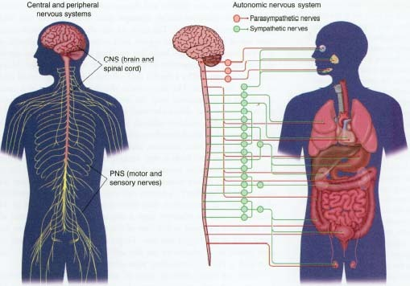
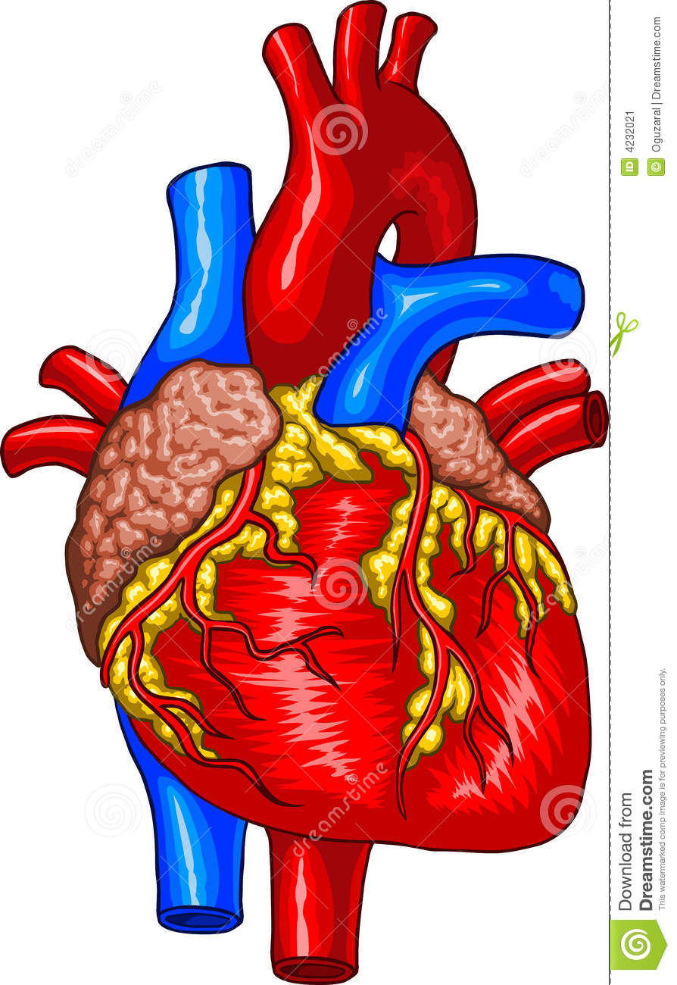
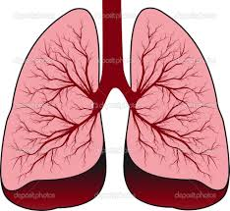
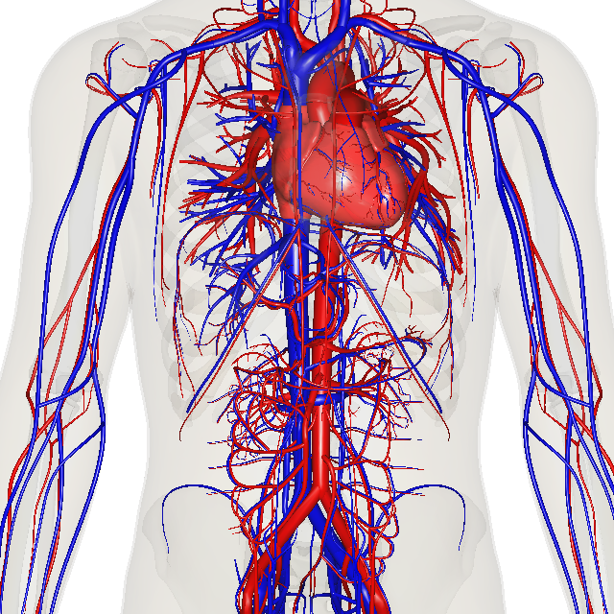
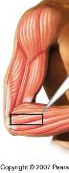
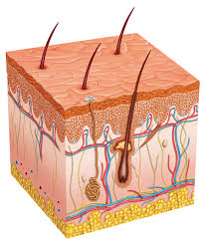
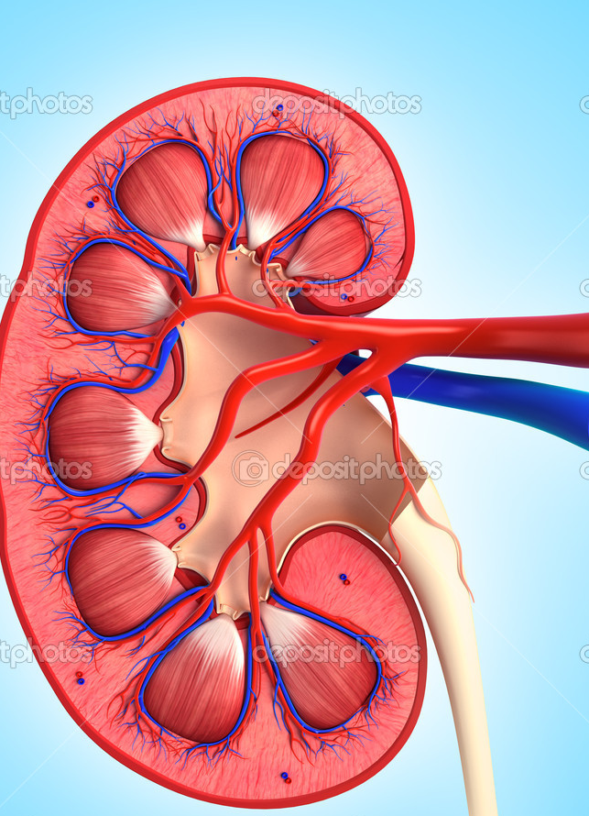
An example – Dynamic Exercise
Electrical/hormonal
signals
⬆Cardiac output
⬆O₂ uptake
⬆CO₂ loss
⬆Work
Vasodilation:
working muscle, skin
Vasconstriction:
elsewhere
Hormone secretion
H₂O/Ion conservation
Sweating
Molecular → cellular → tissues → organs → systems (e.g. cardiovascular) → whole systems (organism)
Notes:
Think of it: Everything in beautiful balance from moment to moment. Everybody shouting at each other at the same time and yet being very well understood.

Slide 14
An example – Dynamic Exercise
CNS - Central command
Signals In/Out:
Electrical/Chemical/Hormonal
Thermoregulation
Pain & pressure monitor
PNS - Interlocutor
Signals In/Out:
Electrical/Chemical/Hormonal
Proprioception
Pain & pressure sensor
Heart
Heart rate
Cardiac output
Energy consumption
Kidneys
Vasoconstriction/dilation
- Hormones
Reabsorption
- Ions, water
Lungs
Breathing rate
Inflation
O₂ intake
CO₂ expiration
Skeletal Muscle
Contraction/relaxation
Energy consumption –
Glucose/ATP/O₂
Waste products –
CO₂, metabolites
Muscle pump
Circulation
Transport - O₂/CO₂,
metabolites
Baroreceptor reflex
Vasodilation (skin,
working muscle)
Vasoconstriction
Skin
Cooling
Water loss
Ion loss

