Slide 1
PEARLS Fondaparinux vs. Enoxaparin for VTE prophylaxis
Weber Liu

Slide 2
The patient
Mr. WM, a 58 year old male recently diagnosed with B-ALL admitted to hospital following unstoppable gum bleeding after flossing and pancytopenia on FBC.
PMx:
Previous DVT and PE within the past year
2 NSTEMIs in the last 10 years
Currently has repeat bouts of angina
WM was started on LMWH (enoxaparin) for VTE prophylaxis
I was curious to find whether fondaparinux or enoxaparin (LMWH) was more efficacious in the prevention of VTEs

Slide 3
The question
Does fondaparinux reduce VTE rates for adult hospital inpatients compared to enoxaparin?
Type: intervention

Slide 4
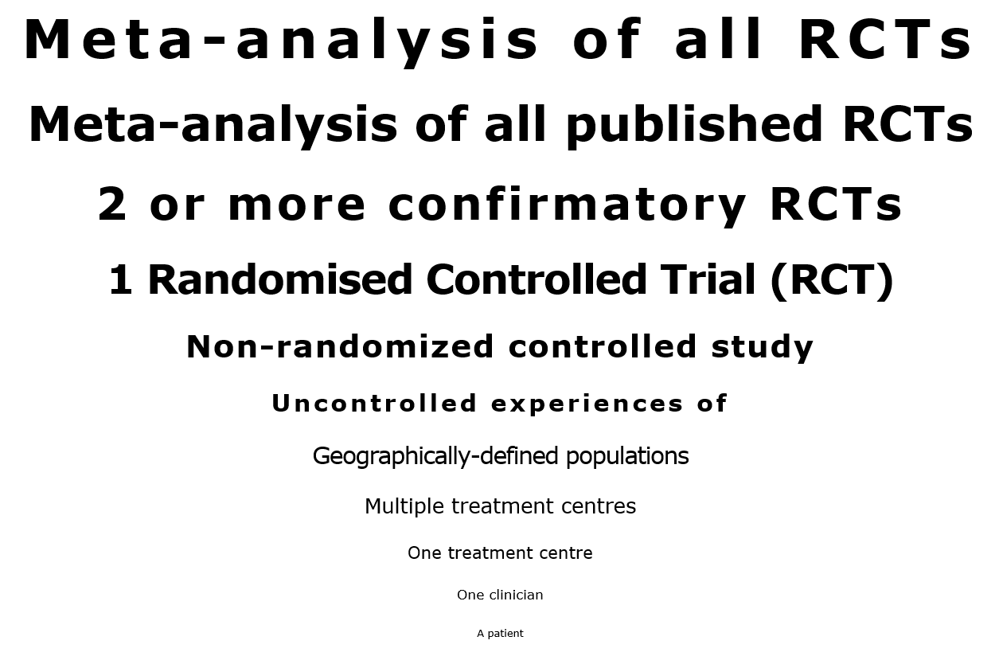
Search strategy
P: Patients in hospital I: Pentasaccharides (e.g. fondaparinux) C: LMWH (i.e. enoxaparin, clexane) O: Prevention of venous thromboembolism
(Limited to humans)
Preferred study:
Meta-analysis of all RCTs
Databases searched:
Cochrane
Medline
Embase

Slide 5
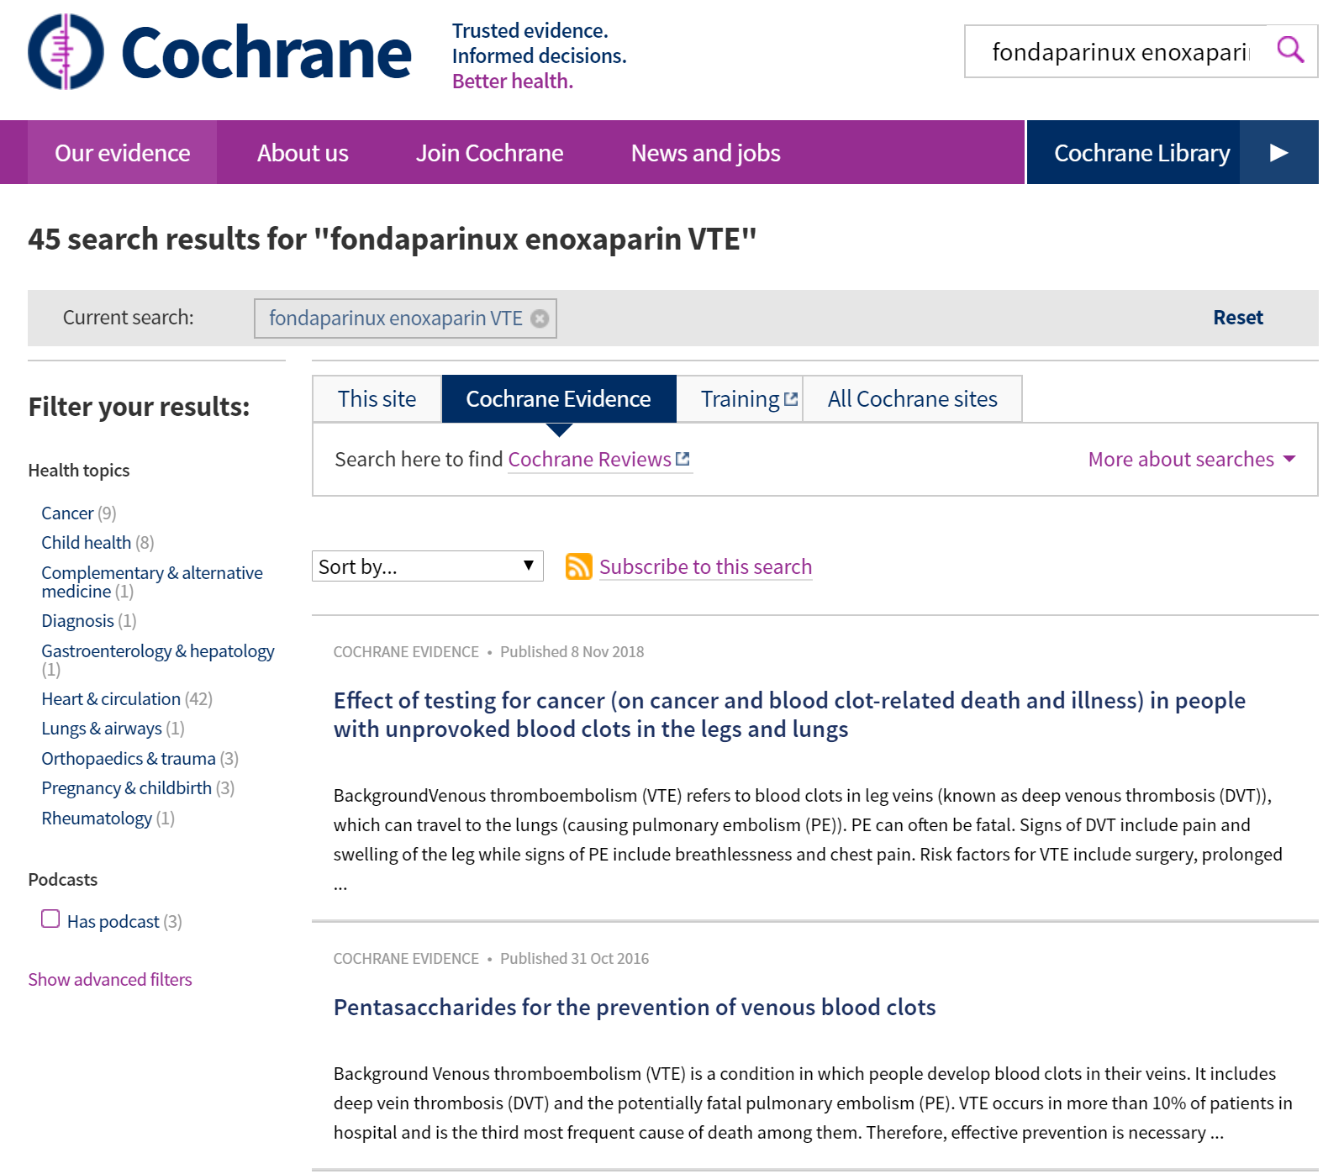
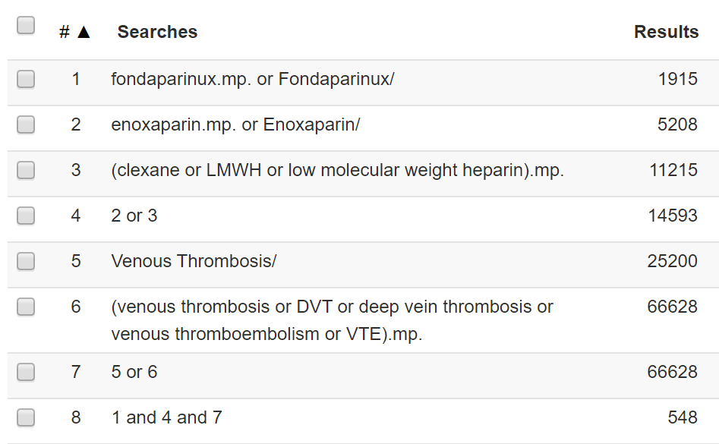
Search results
Cochrane:
Search term: “Fondaparinux enoxaparin VTE”
Medline:

Slide 6
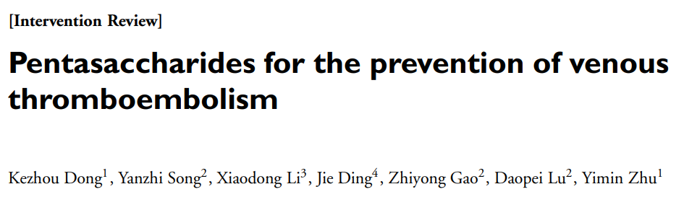
Objective: To assess effects of pentasaccharides versus other methods of thromboembolic prevention (thromboprophylaxis) in people who require anticoagulant treatment to prevent venous thromboembolism.
Design: Systematic review of Randomised controlled trials
Primary outcomes:
Rate of VTE
Rate of major bleeding
Secondary outcomes
Symptomatic VTE
Total DVT
Proximal DVT
Total PE
Fatal PE
Non-fatal PE
Symptomatic PE
Fatal bleeding
MI (fatal and non-fatal)
All cause mortality
Other serious adverse effects

Slide 7
Critical appraisal tools for systematic reviews
Oxford CEBM – Centre of evidence based medicine
AMSTAR2 – Assessing the Methodological Quality of Systematic Reviews
Adequate reporting determined by comparing against PRISMA 2009

Slide 8
Study method
Cochrane Vascular Information Specialist searched
Cochrane vascular specialised register
MEDLINE Ovid
Embase Ovid
CINAHL
AMED
Hand-searching relevant journals
Cochrane central register of controlled trials (CENTRAL)
Clinicaltrials.gov
WHO International Clinical Trials Registry Platform (ICTRP)
PubMed, Embase
Trial registries
Clinicaltrials.gov
WHO clinical trials registry platform
International Standard RCT Number Register (ISRCTN)
Review authors searched:
LILACS (Latin american and Caribbean health sciences)
Backwards-chain of relevant studies and reviews

Slide 9
Assessment of search method
CEBM: Is it unlikely that important, relevant studies were missed?
Extensive search conducted with the Cochrane Vascular Information Specialist
Backwards-chaining of relevant studies/reviews conducted by authors
No limitations based on language
No search conducted for unpublished data, conference proceedings, and gray literature
Authors did not consult with expert in field

Slide 10
Applicability to our patient
Study criteria | Our patient
Inclusion
Adults (>18) in study | Our patient is aged 58
Exclusion
People contraindicated to anticoagulant therapy or pregnant, haemodialysis, or those receiving other anticoagulant/fibrinolytic therapy in past 2 days | Patient is not pregnant, and has not had anticoagulant therapy within the week prior to admission. Patient is also not on haemodialysis
Study clearly applies to our patient

Slide 11
Assessment of inclusion/exclusion criteria
CEBM: Were the criteria used to select articles for inclusion appropriate?
The article notes a protocol exists (however doesn’t adequately report it within the methods – as per PRISMA guidelines and AMSTAR2 ‘explicit statement’)
The article did not note deviation for protocol for study selection
The study used appropriate inclusion and exclusion criteria
However I believe the question is too broad to be answered adequately with the number of papers found
The study does not explain WHY only RCTs are to be included (as per AMSTAR2)

Slide 12
Additional assessments of study method
AMSTAR2: Did the review authors perform study selection in duplicate? - YES
AMSTAR2: Did the review authors perform data extraction in duplicate? - YES
AMSTAR2: Did the review authors provide a list of excluded studies and justify the exclusions? - YES
AMSTAR2: Did the review authors describe the included studies in adequate detail? - YES
AMSTAR2: Did the review authors use a satisfactory technique for assessing the risk of bias (RoB) in individual studies that were included in the review? – YES
AMSTAR2: Did the review authors report on the sources of funding for the studies included in the review? – NOT EXPLICITLY – this was combined into ‘other bias’ in the ROB assessment
AMSTAR2: If meta-analysis was performed, did the review authors use appropriate methods for statistical combination of results? – YES
AMSTAR2: Did the review authors account for RoB in primary studies when interpreting/discussing the results of the review? – YES
AMSTAR2: Did the review authors provide a satisfactory explanation for, and discussion of, any heterogeneity observed in the results of the review? – YES, however this was not done per-protocol
AMSTAR2: If they performed quantitative synthesis did the review authors carry out an adequate investigation of publication bias (small study bias) and discuss its likely impact on the results of the review? - YES
AMSTAR2: Did the review authors report any potential sources of conflict of interest, including any funding they received for conducting the review? - YES

Slide 13
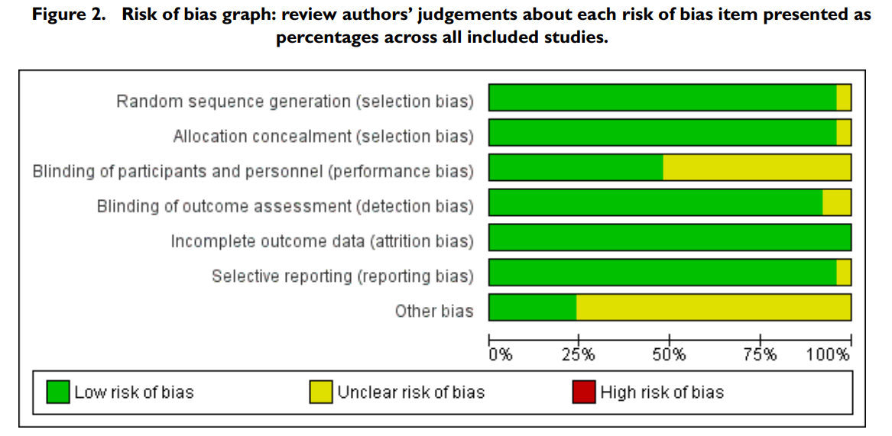
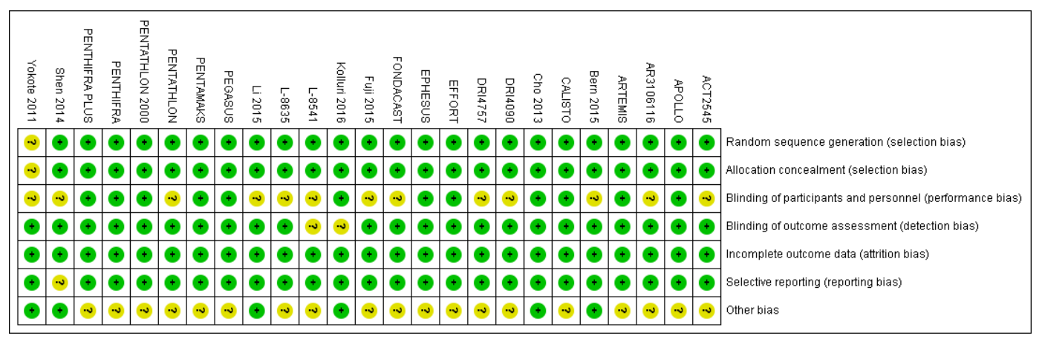
Risk of bias assessment
No studies demonstrated high risk of bias
Performance bias
Appears to be due to wording issues – ‘open label’ or ‘single blind’, or lacking blinding of healthcare staff
Other bias
All ‘other bias’ due to company sponsorship

Slide 14
Assessment of study validity
CEBM: Were the included studies sufficiently valid for the type of question asked?
Risk of bias assessed using the Cochrane ROB tool
Conducted independently by both authors and resolved by discussion followed by involvement of a third party
All study data extracted and presented within the review

Slide 15
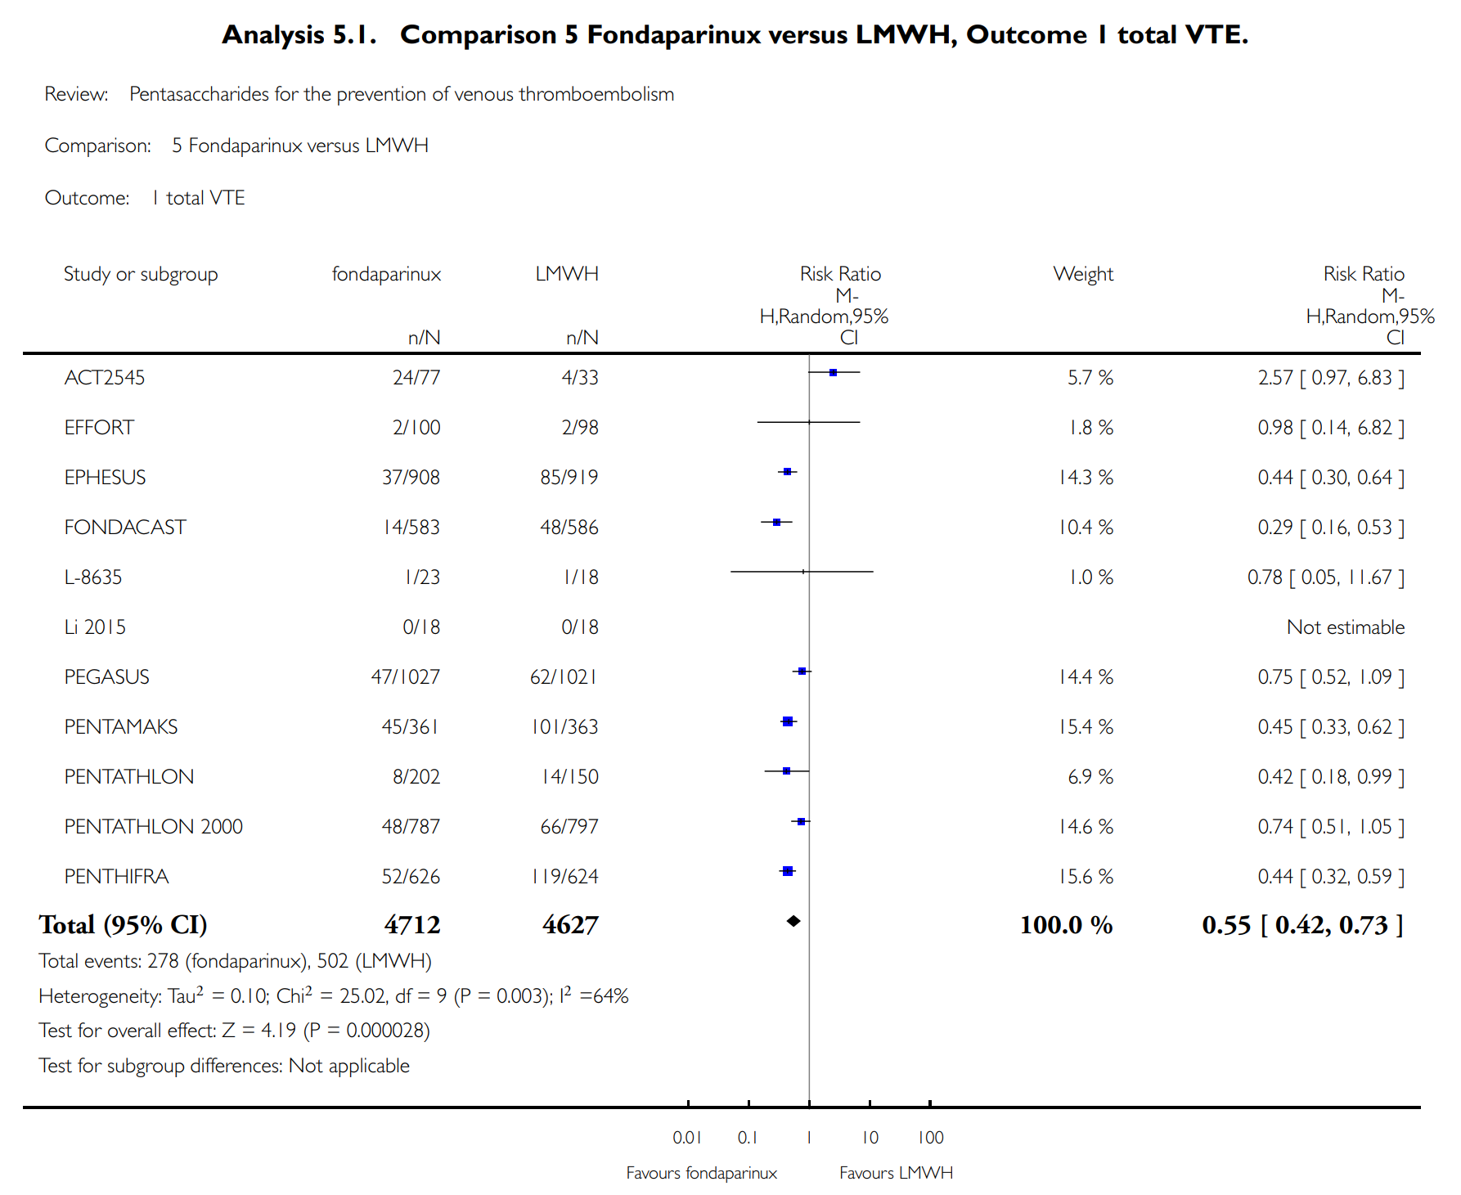
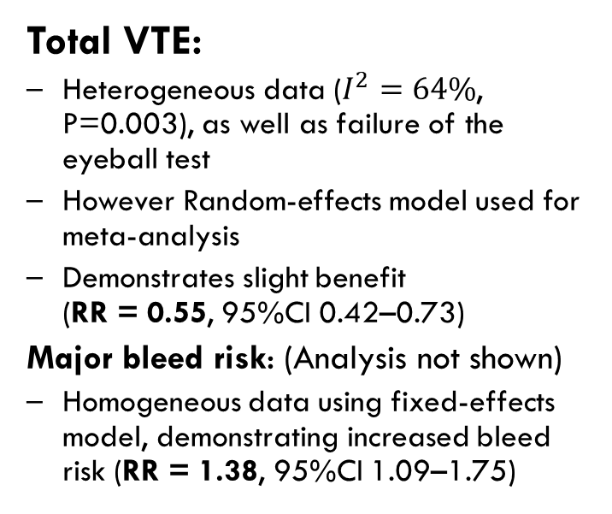
Results
Total VTE:
Heterogeneous data ($I^{2}=64\%$, P=0.003), as well as failure of the eyeball test
However Random-effects model used for meta-analysis
Demonstrates slight benefit (RR = 0.55, 95%CI 0.42–0.73)
Major bleed risk: (Analysis not shown)
Homogeneous data using fixed-effects model, demonstrating increased bleed risk (RR = 1.38, 95%CI 1.09–1.75)

Slide 16
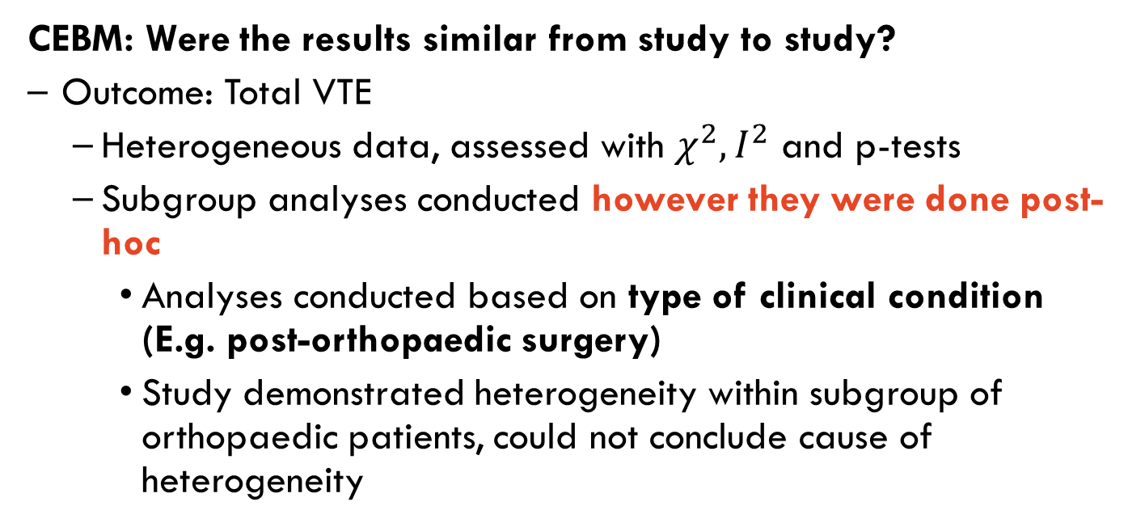
Assessment of results
CEBM: Were the results similar from study to study?
Outcome: Total VTE
Heterogeneous data, assessed with $χ^{2}, I^{2}$ and p-tests
Subgroup analyses conducted however they were done post-hoc
Analyses conducted based on type of clinical condition (E.g. post-orthopaedic surgery)
Study demonstrated heterogeneity within subgroup of orthopaedic patients, could not conclude cause of heterogeneity

Slide 17
Biases present
Post-hoc analysis
Publication bias

Slide 18
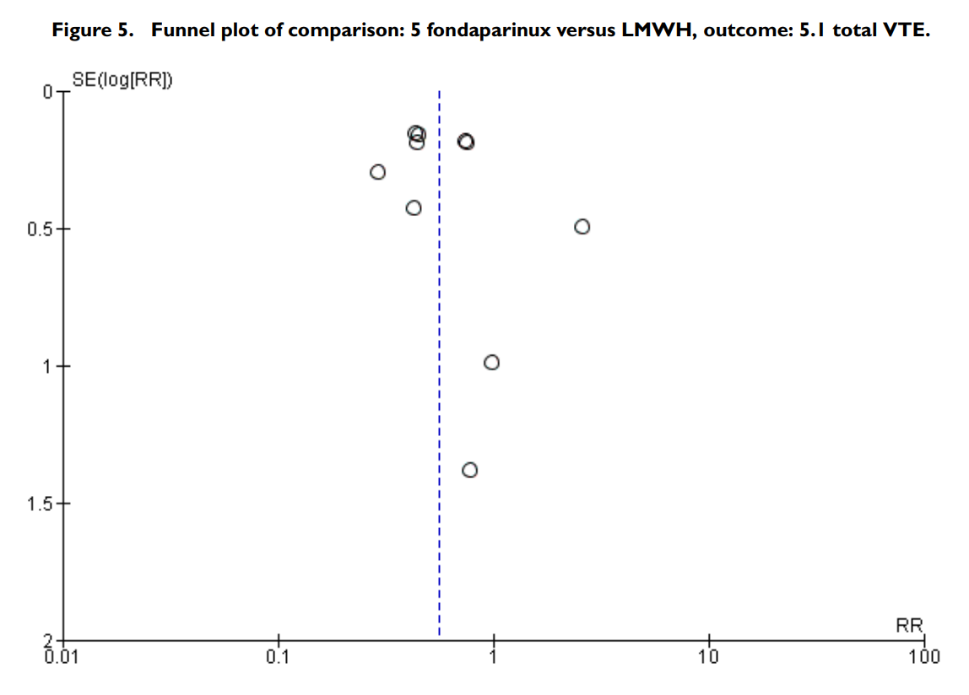
Publication bias: Funnel plot assessment
Note 95% CI not drawn
Appears to be studies missing from the low RR region
Would indicate tendency for RR to be increased, indicating more VTE with fondaparinux – underestimating its effect
Authors did not downgrade level of evidence in light of this

Slide 19
Strengths
Thorough search of all relevant papers
Exploration of heterogeneity conducted

Slide 20
Weaknesses
Broad research question with limited papers to adequately answer the question
Unable to generalise findings to all patients
Possible publication bias, with incomplete finding of gray literature
Subgroup analyses were conducted post-hoc

Slide 21
Level of evidence and conclusions
AMSTAR rating of confidence: MODERATE
Moderate - More than one non-critical weakness*: The systematic review has more than one weakness, but no critical flaws. It may provide an accurate summary of the results of the available studies that were included in the review.
CEBM Level of evidence
Level 1 evidence for Interventions (Systematic review of randomized trials)

Slide 22
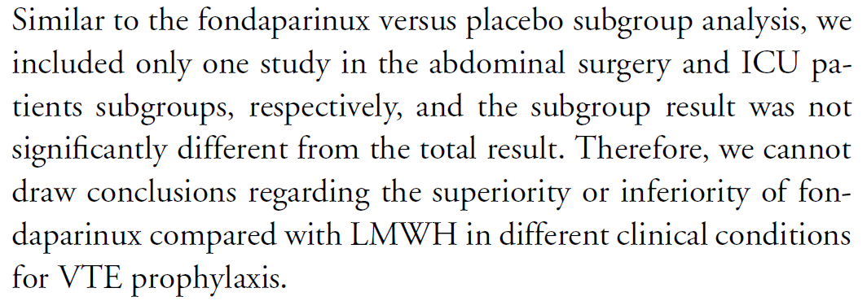



Applicability of fondaparinux to WM
Insufficient evidence for patients outside the orthopaedic surgery group
Given increased bleeding risk with fondaparinux w/ recent B-ALL diagnosis (with pancytopenia)
Would NOT give fondaparinux to our patient

Slide 23
Unanswered questions
Is fondaparinux beneficial compared to enoxaparin for VTE prevention in hospital inpatients who aren’t post-surgical (needs further research)

Slide 24
Questions?

